Slide 1
PeeringDB Update
Paul Hoogsteder
paulh@peeringdb.com

Slide 2
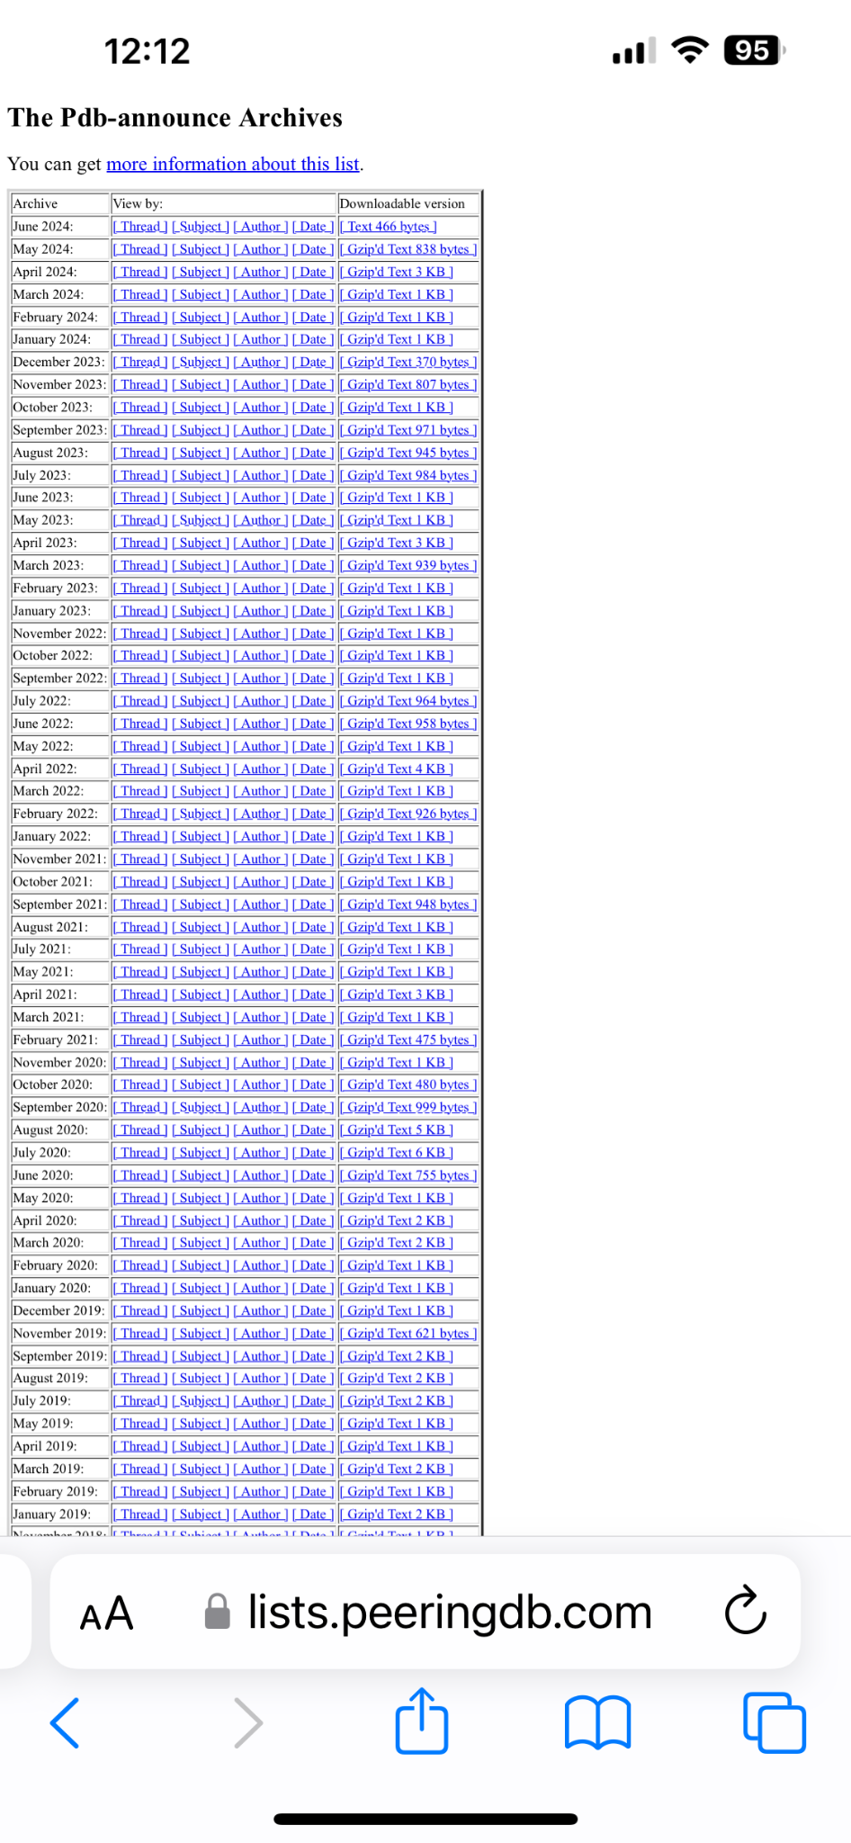
2024 Strategic Review
Stewards reviewed the strategy and proposed updates
Announcement of proposed changes to follow, so subscribe to the pdb-announce list if you care and aren’t there yet

Slide 3
High Priority Strategic Tasks for 2024/2025
Write Operational Service Level Policy for services provided to the community and regularly report compliance
Regular third-party security audit
Conduct redundancy and restoration test every two years

Slide 4
Product Roadmap Periodic Review
The Product Committee votes on product features
This means a long term roadmap is a poor choice
So instead of looking a year into the future, we’ll be reporting on the last six months of changes each April and October
Image by freepik

Slide 5
Product & Operations Focus
Continuing with web UI improvements. Check preview.beta.peeringdb.com and provide feedback
Normalizing the presentation of place names, e.g. Always show Göteborg as Gothenburg to help people doing analytical work
Looking at significant security improvements
Mandatory 2FA (#1634)
Require dormant accounts to revalidate before being used again (#1636)
Create a “read only” mode to provide availability when defending against an attack (#1635)

Slide 6
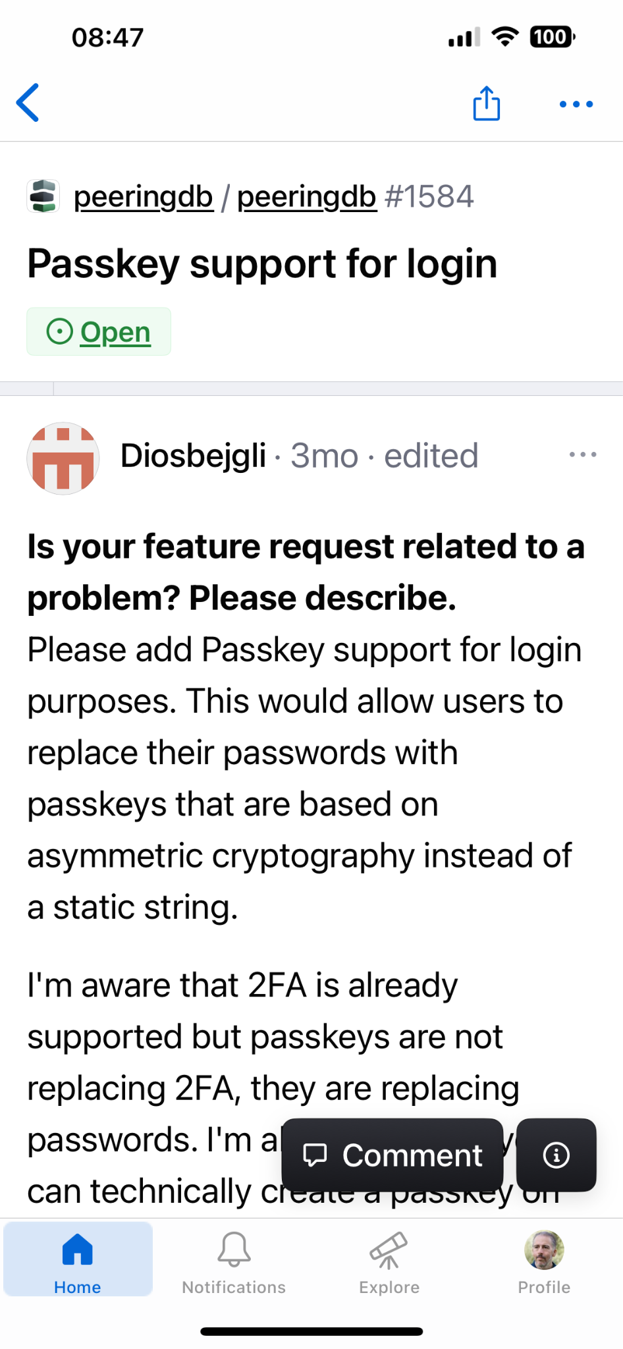
Engage with us!
If you want a feature or found a bug you can:
Discuss it with anyone on the Product Committee
Discuss it with us and other users on the user-discuss list
Ask for help at support@peeringdb.com
Create an issue on Github in
peeringdb/peeringdb
peeringdb/peeringd-py
peeringdb/django-peeringdb

Slide 7
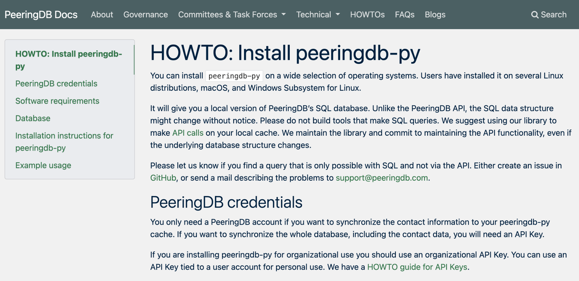
peeringdb-py
Get a local cache of Peeringdb data
Sync every hour
Keep queries local for faster access
Integrate with other datasets
No query limits

Slide 8
Thank you to our sponsors!
Diamond Sponsor
Platinum Sponsors
Gold Sponsors
Silver Sponsors
Notes:
Logo height proportions: 100%, 85%, 65%, 40%

