Slide 1

^{Kriten}
API driven automation

Slide 2


10 years of Network Automation
Many platforms, modules and products now available
No single solution, even within an organisation.
Custom code necessary to automate networks.

Slide 3

Common Problems
Where to run automation code?
How to make it available?
How to implement authentication/authorisation.
How to protect system/priviledged accounts?

Slide 4

Kriten – The API-driven runtime environment
Kriten is a cloud-native code execution platform.
Build and test your automation code.
Build a container with your packages installed.
Configure runner and task in Kriten.
You can now send consumers the Kriten task URL, which is all they need to run your automation code.
https://kriten.io/

Slide 5
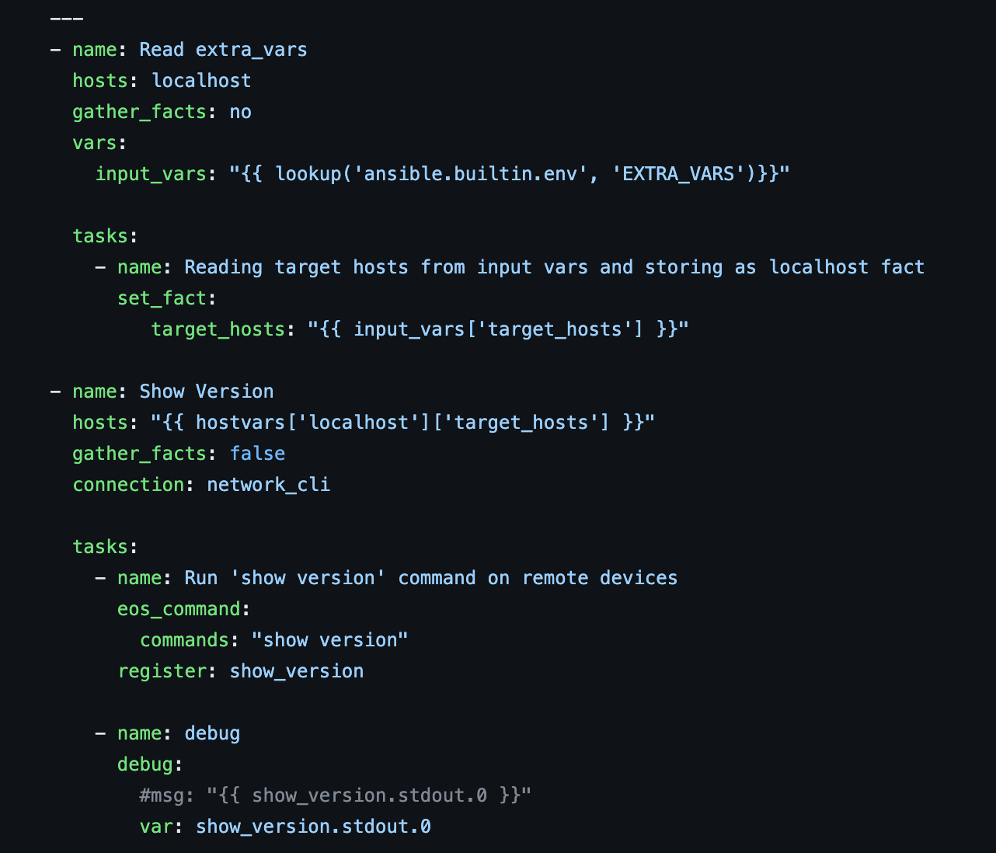
The show version example
You have proudly written an Ansible playbook to issue the “show version” command to a set of devices.
https://github.com/kriten-io/kriten-examples/tree/main/netbox-ansible

Slide 6
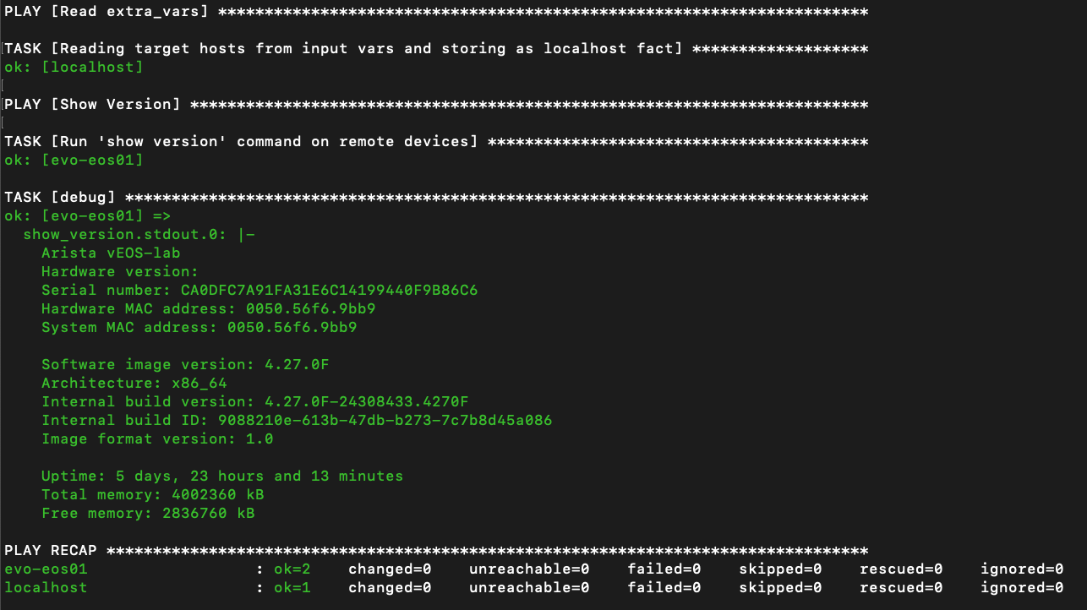
Run the playbook locally
python3 –m venv venv
source venv/bin/activate
pip install –r requirements.txt
source venv/bin/activate
export NETBOX_TOKEN=a08684c4649c091e201f1eeb4eb5c18123123123
export NETBOX_API=http://192.168.10.55:8000/
export EXTRA_VARS='{"target_hosts": "all"}’
ansible-playbook -i netbox_inv.yml show_version.yml -e EXTRA_VARS

Slide 7
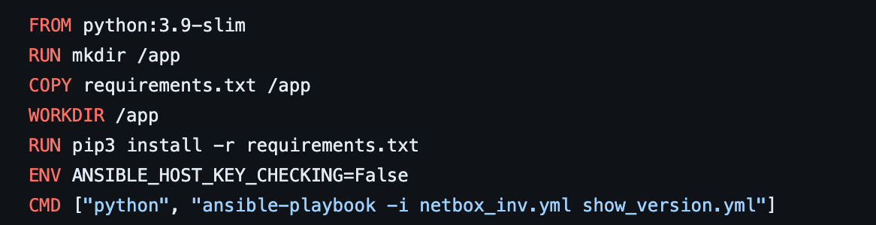
Build a container image
docker build –t evolvere/netbox-ansible-webinar:0.2 .
docker push evolvere/netbox-ansible-webinar:0.2

Slide 8
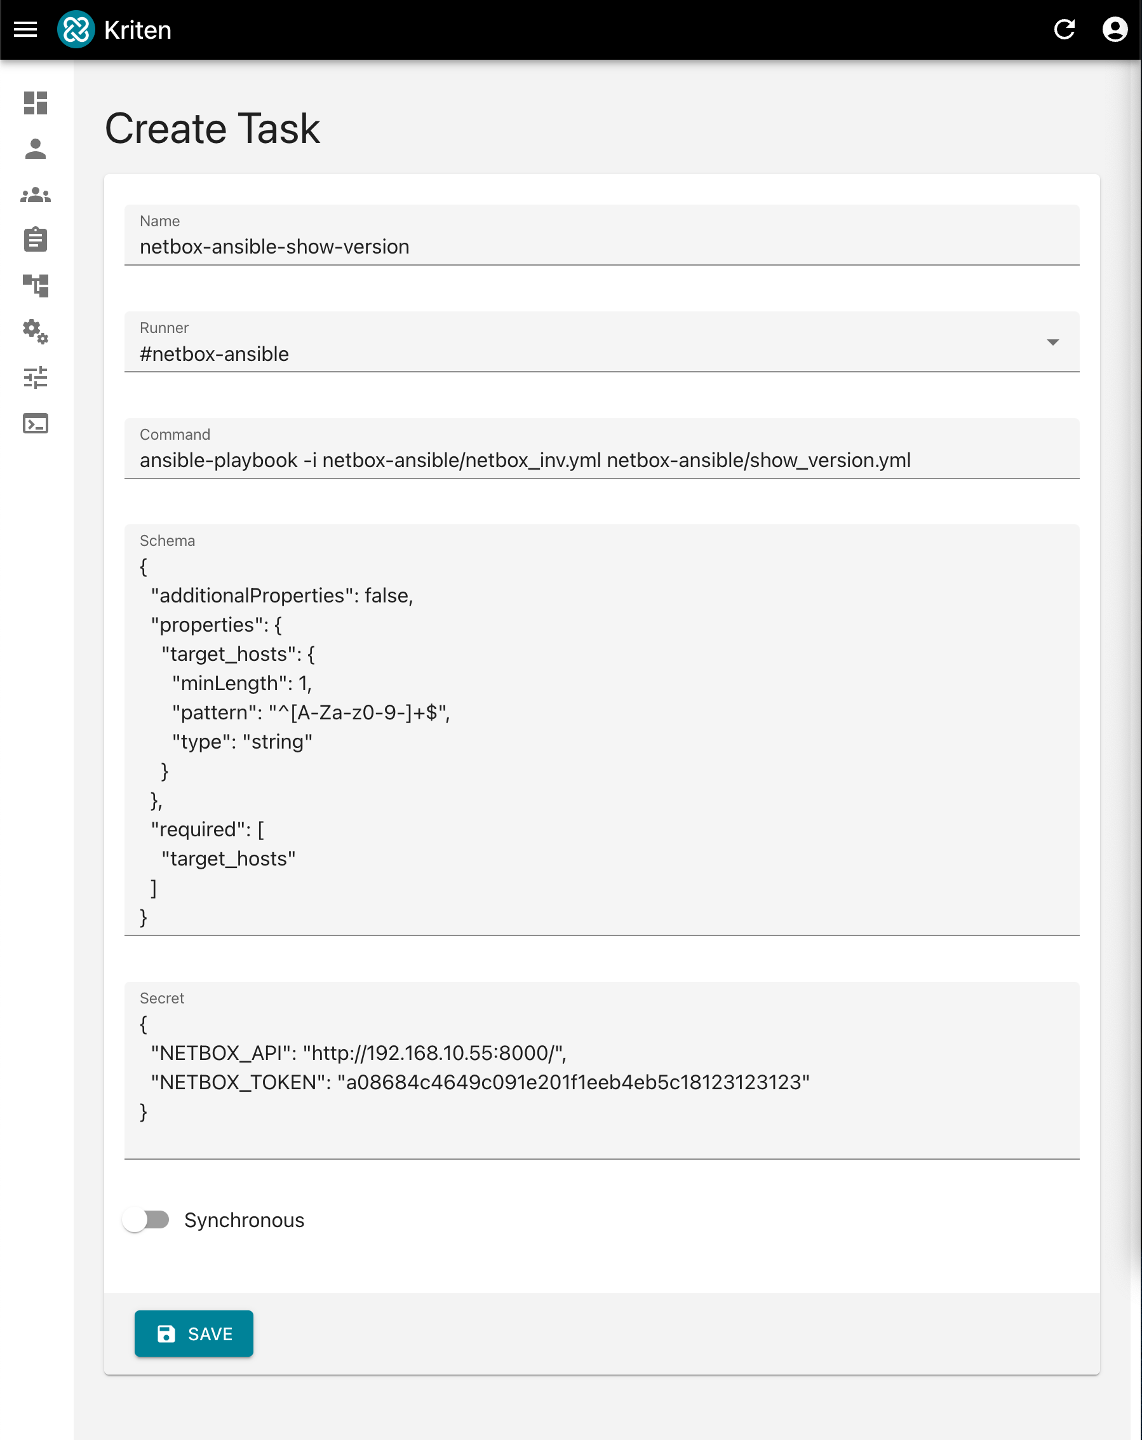
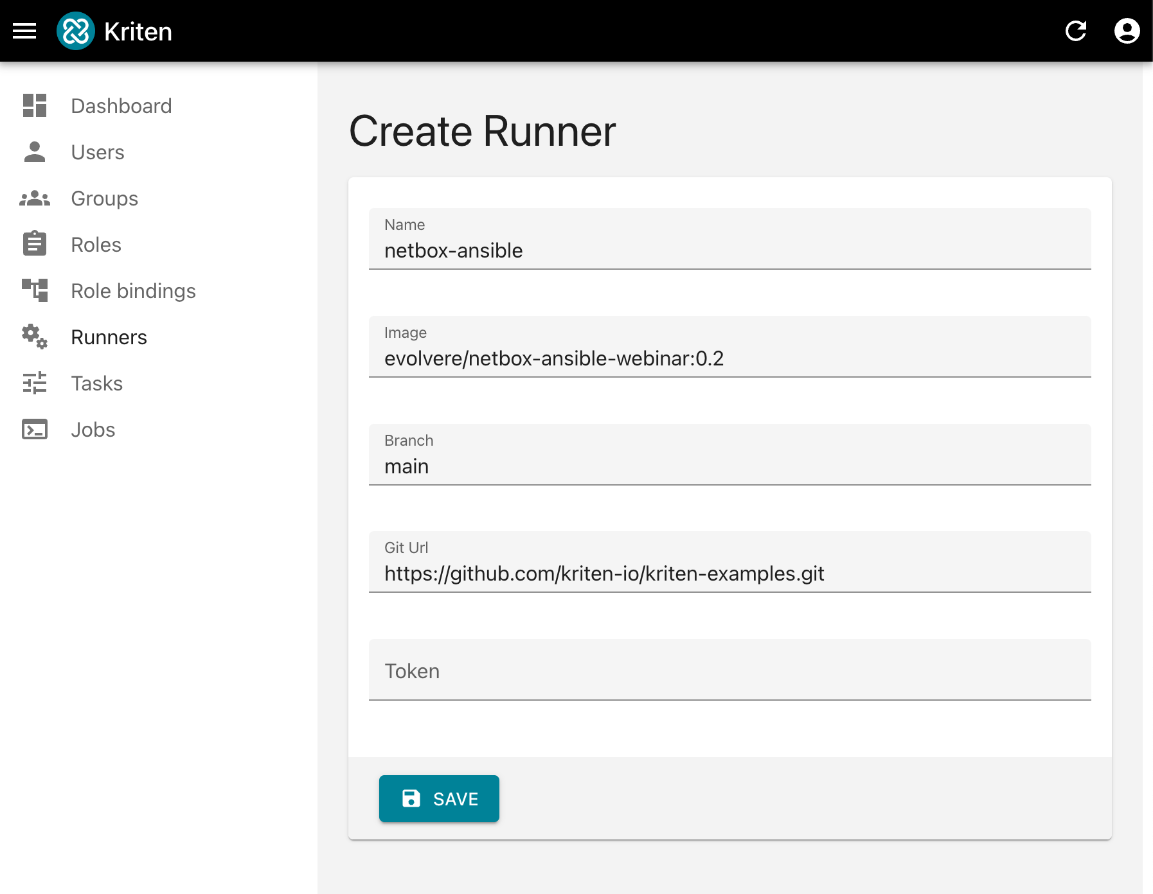
Create runner and task

Slide 9
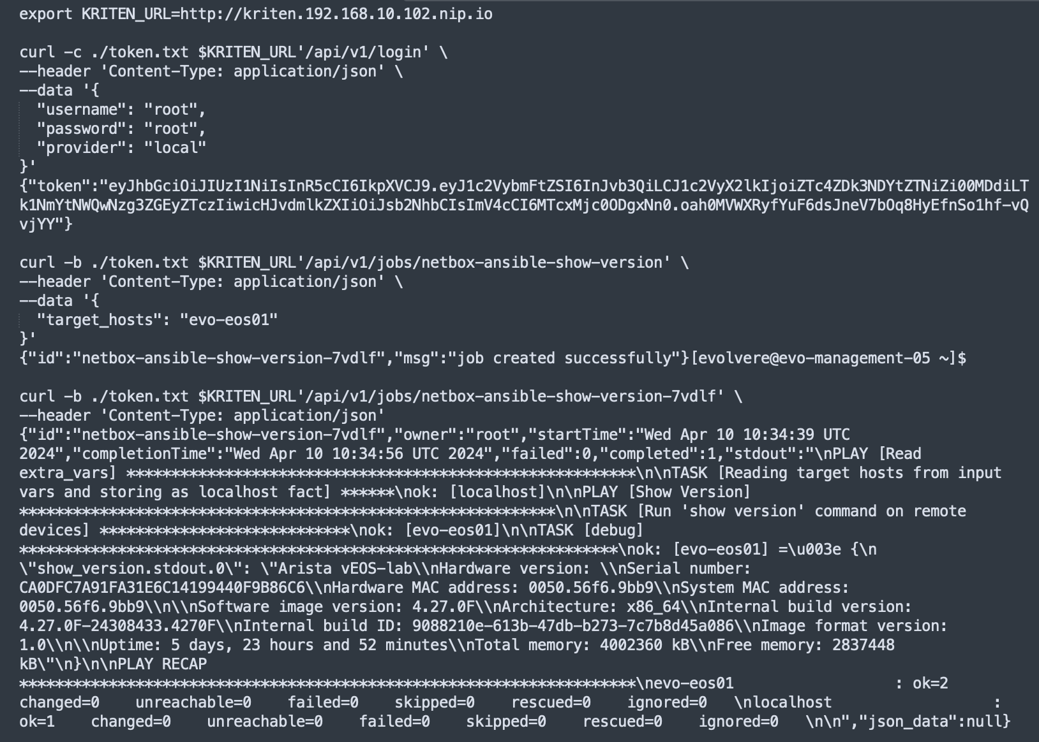
Run the playbook via Kriten API call

Slide 10
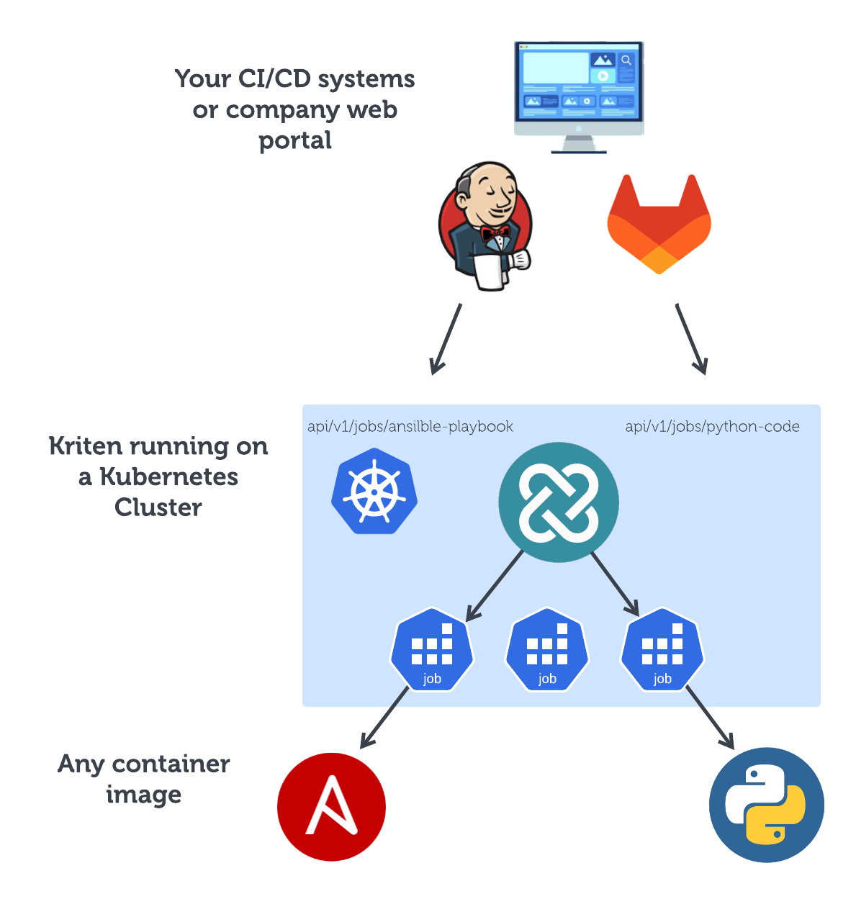
Typical deployment scheme

Slide 11
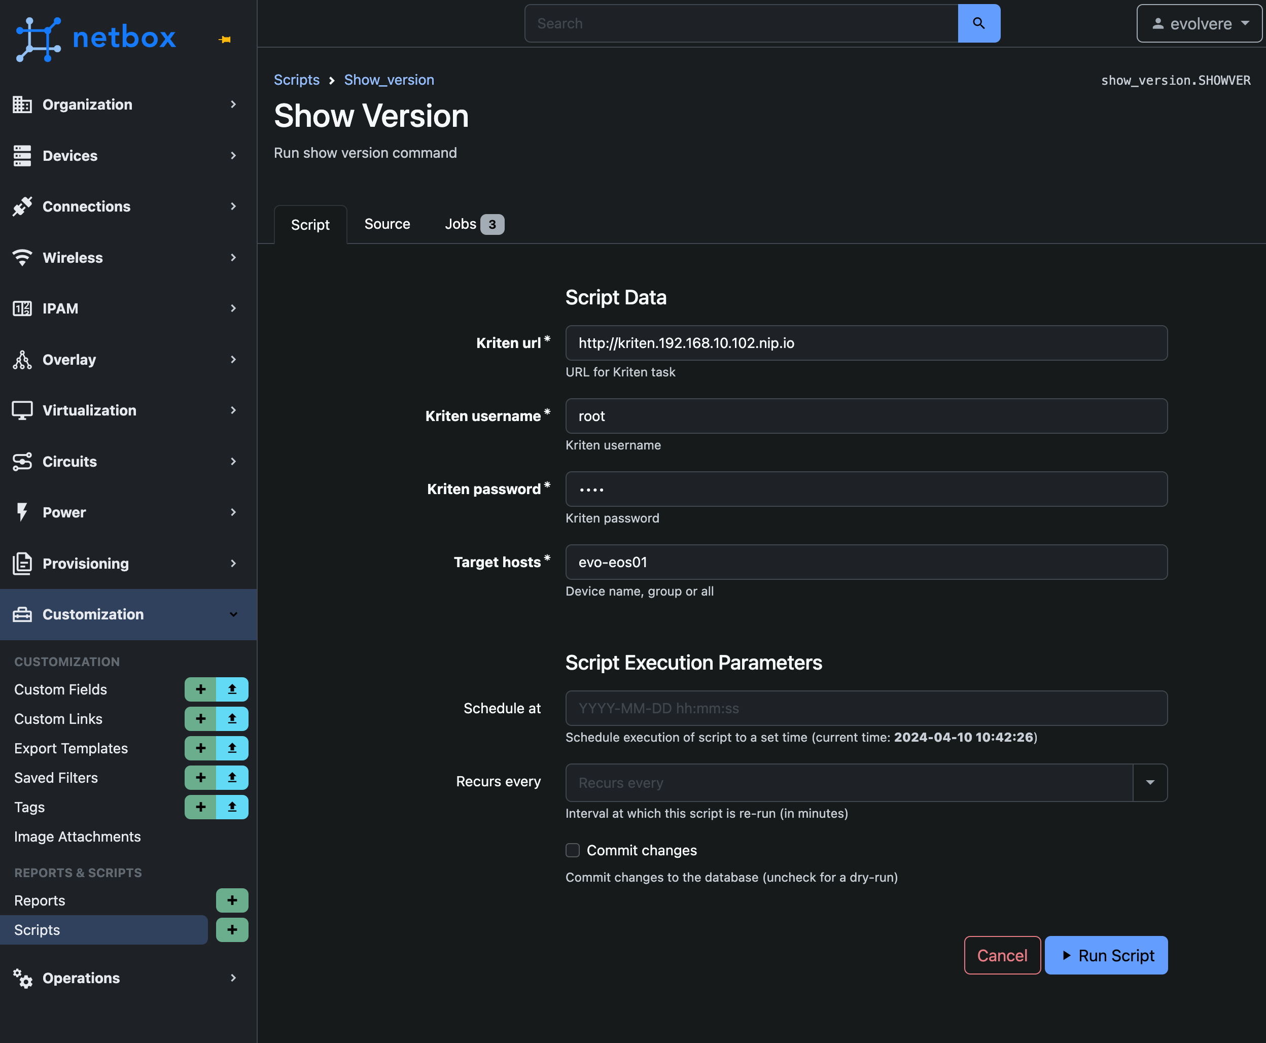
Run from NetBox

Slide 12
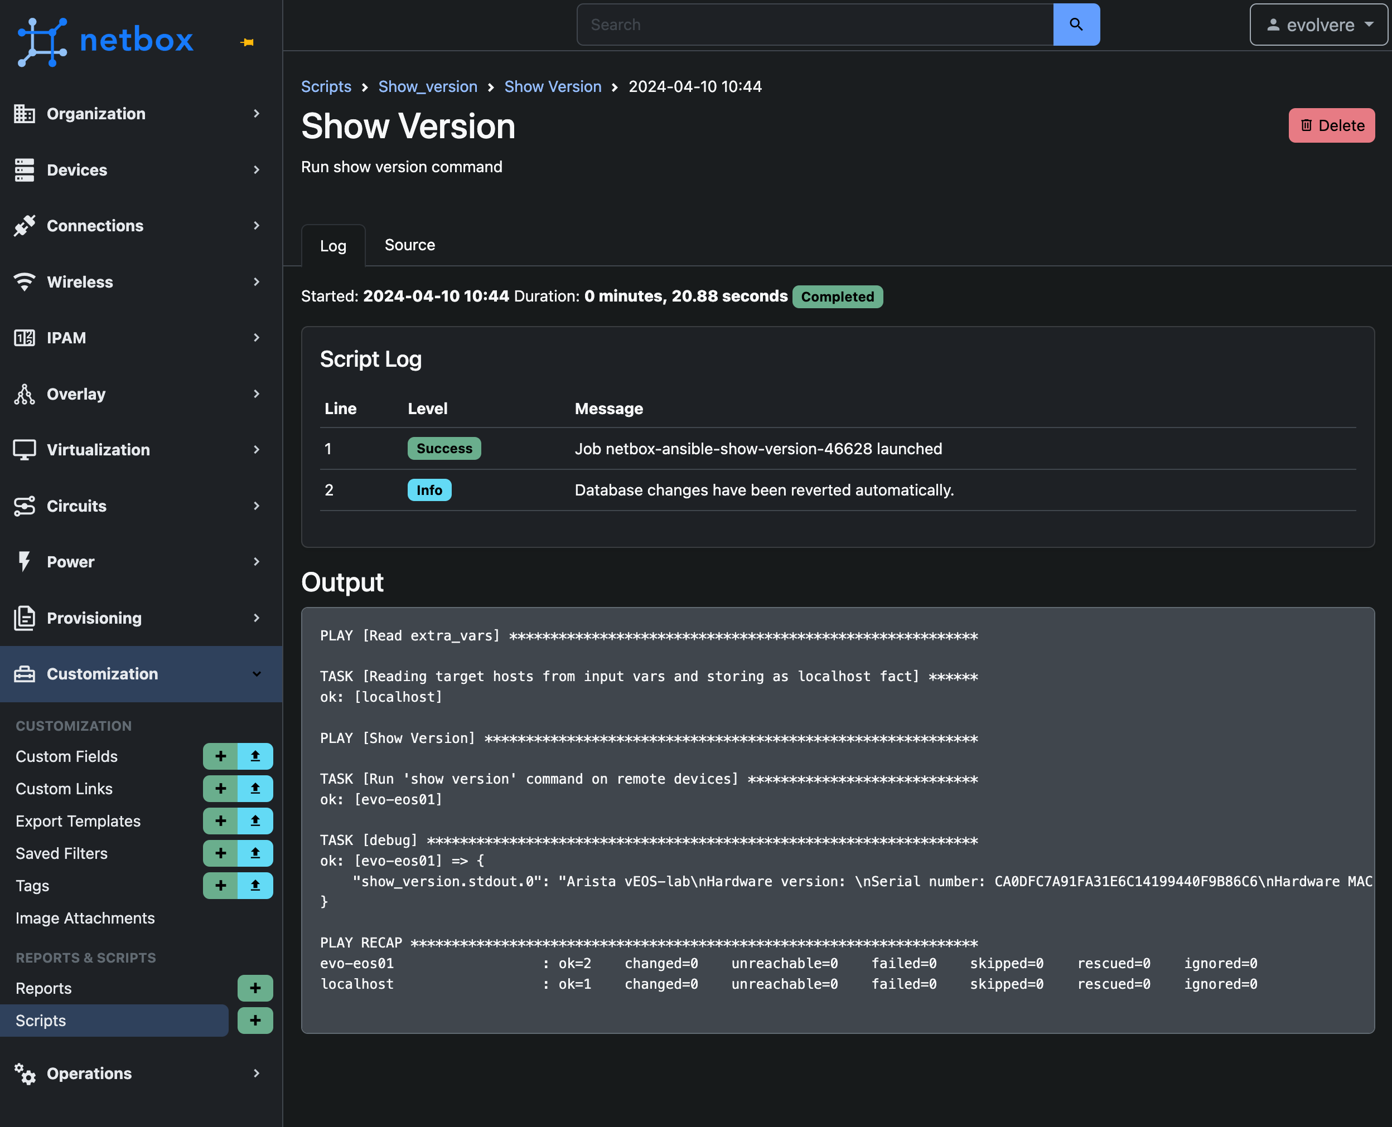
Results from NetBox

Slide 13
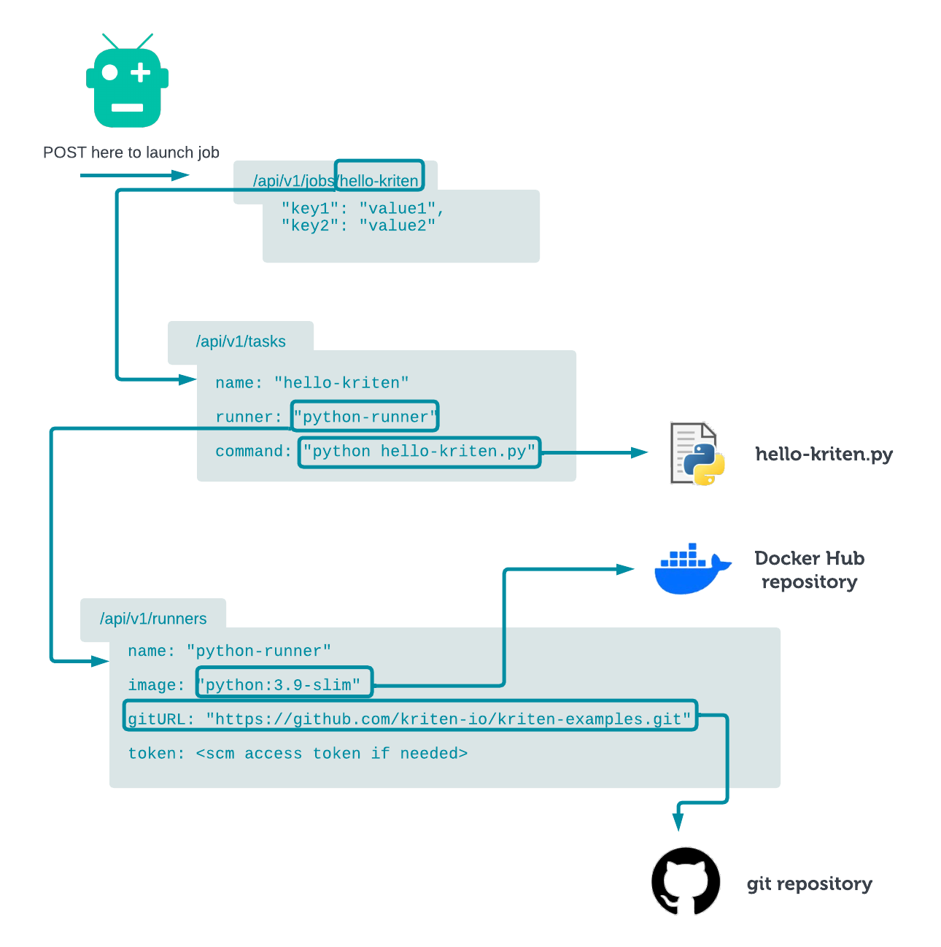
Kriten runners and tasks

Slide 14
Kriten Backlog
We have several features in the backlog for future release.
Scheduling
Deployments
Administrstion UI
Kritctl
New feature and enhancement suggestions welcome.
Contact us at support@kriten.io

Slide 15
Need some help?
We have Network Automation and DevOps capabilities and a flexible approach to help wherever you are in the automation maturity model.
Contact us at info@evolvere-tech.co.uk.

