Slide 1
Design-Driven
Automation

Slide 2
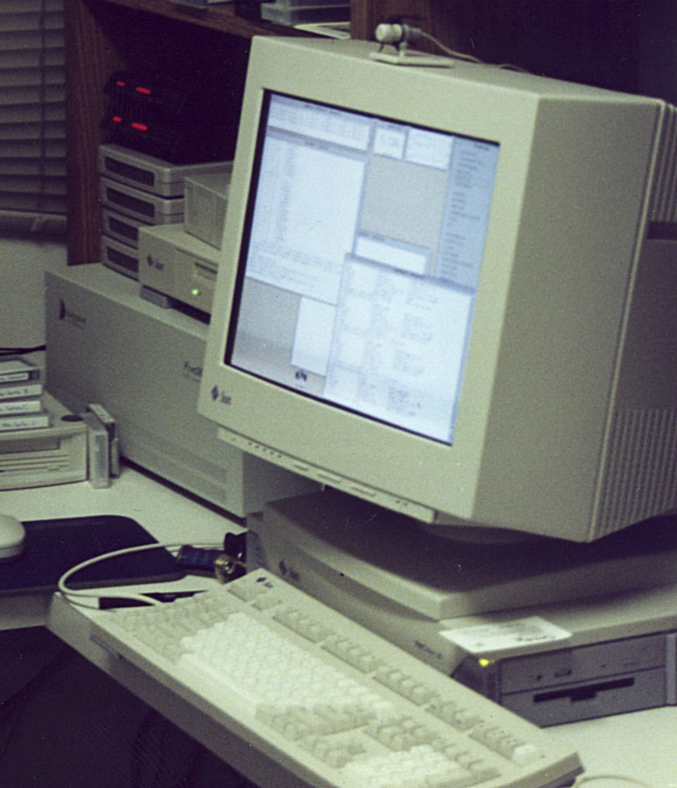
Obligatory Backstory
Pete Crocker
Currently @ OpsMill
Network engineer @ large SP in the mid-90s
Decommissioned AGS+ Serial No #3
2014 - DevOps sink or swim

Slide 3
Source of Truth?
Intended State
Deployment
Actual State
Notes:
First, let’s discuss SoT
Everyone hates this term, yet it’s still constantly being used.
I’ll be talking about intended state

Slide 4
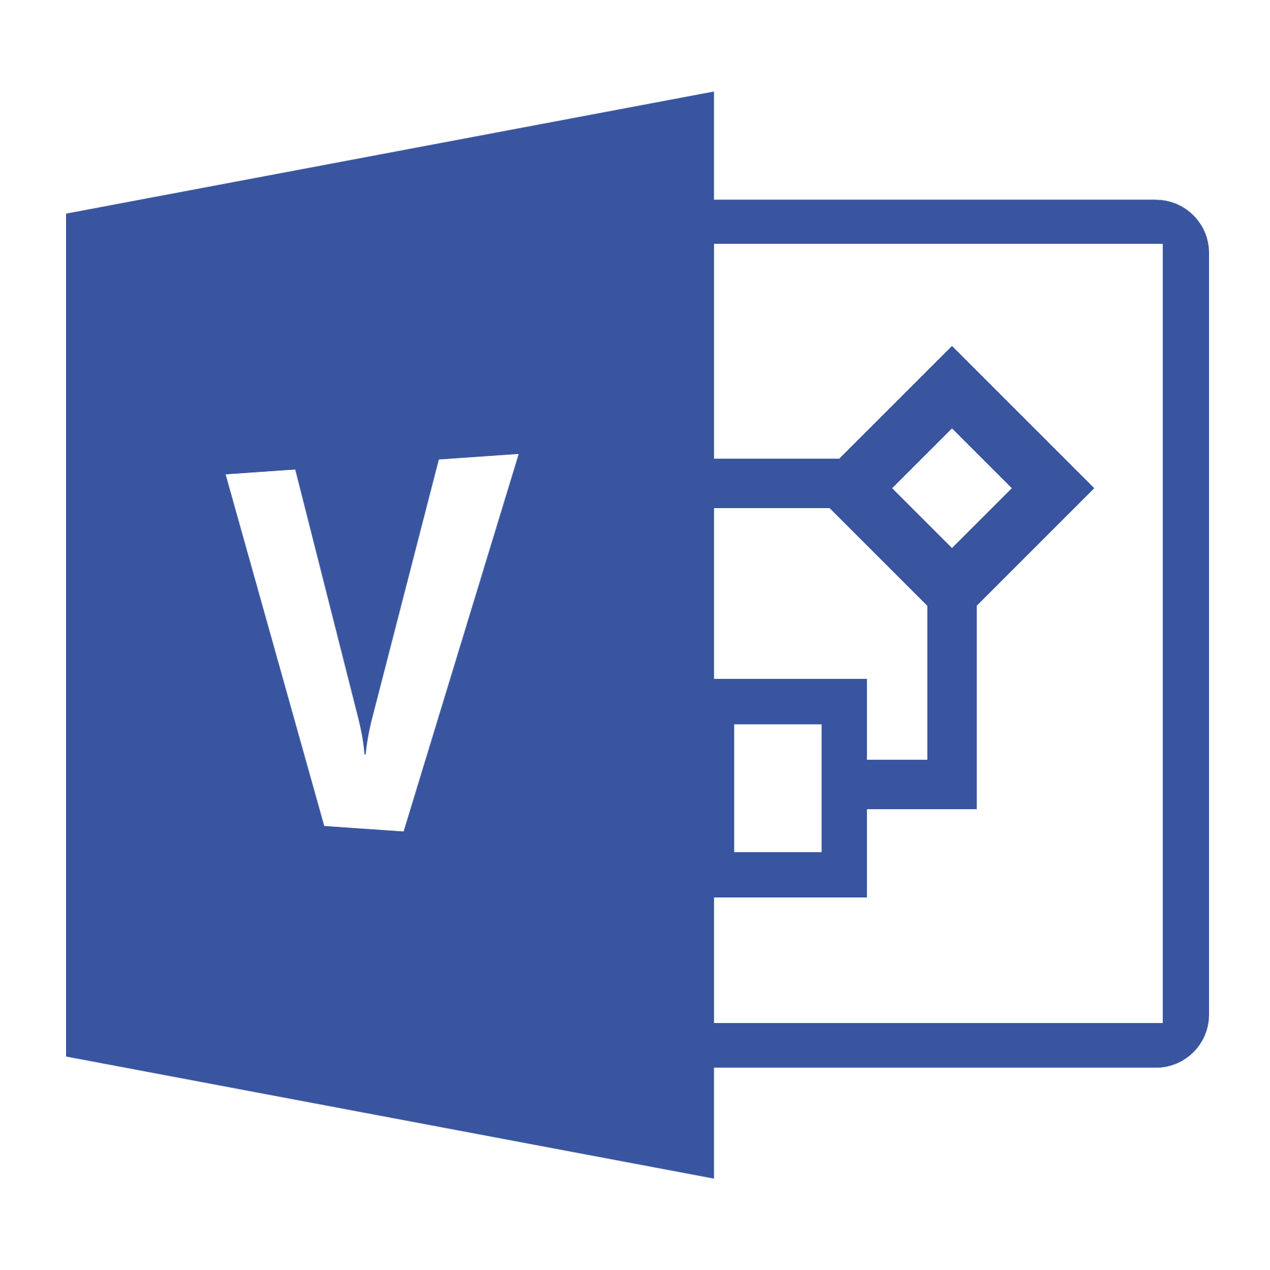
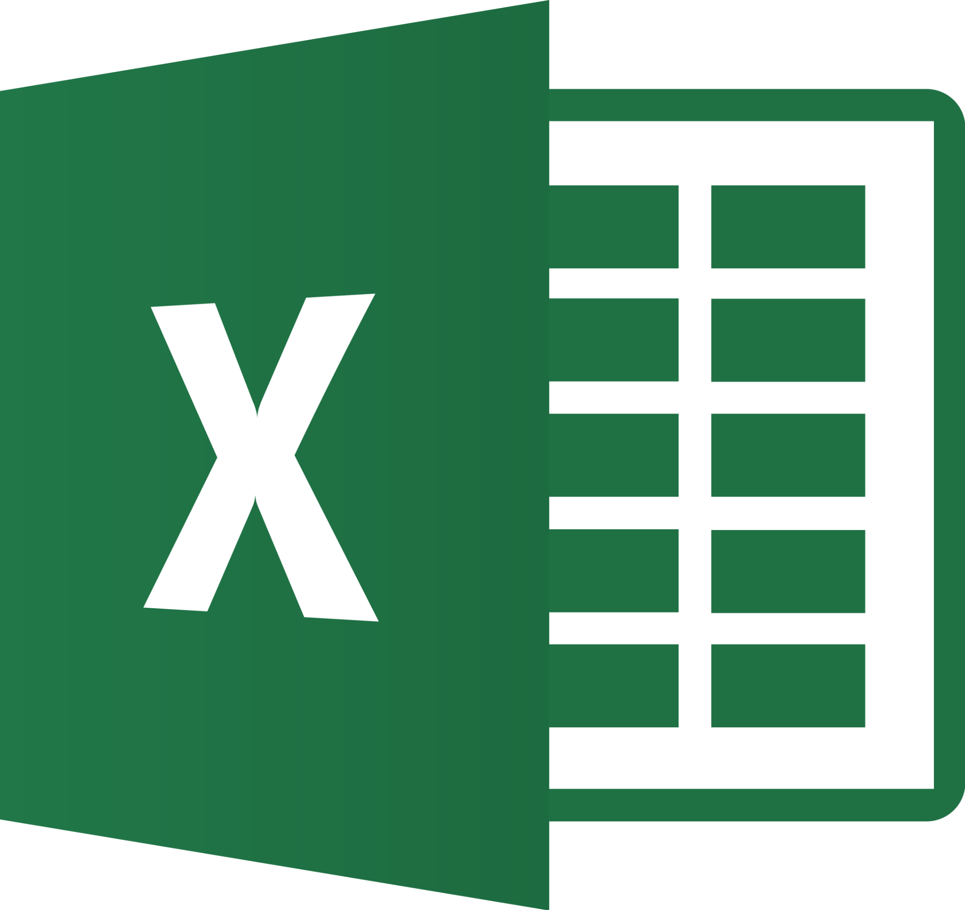
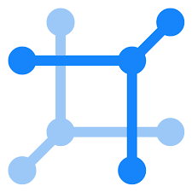
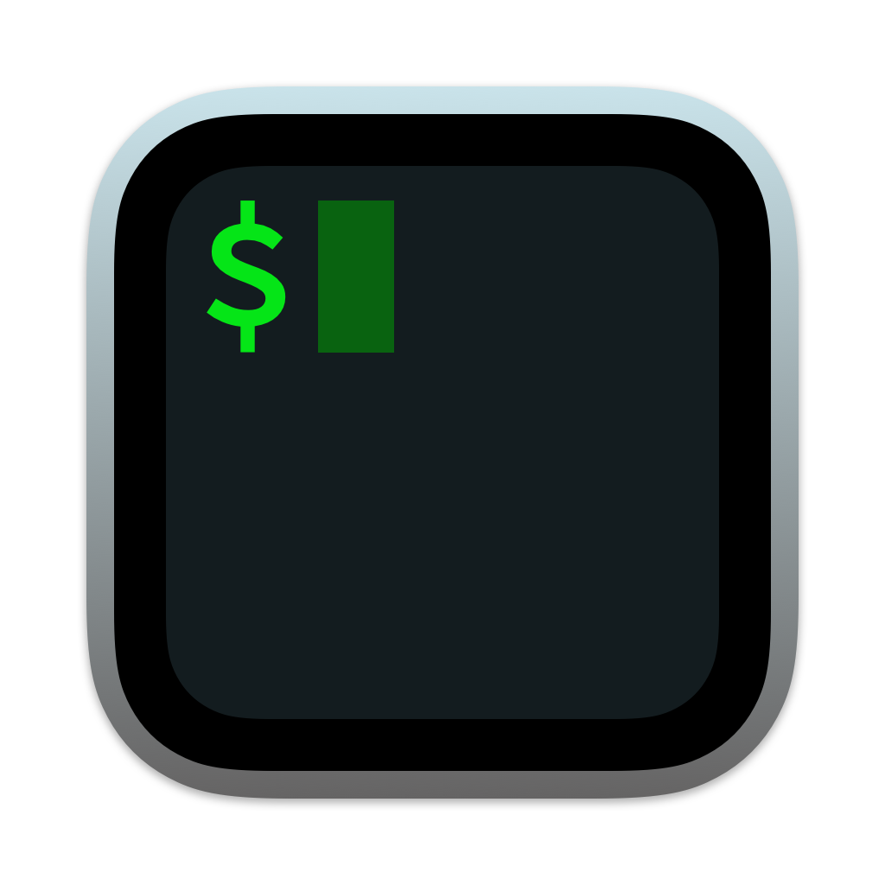
Infrastructure Building Lifecycle
Design
Build
Operate
Mermaid.js
Design Documents Diagrams & Wording HLD
Convert Design to Implementation Configure, Allocate LLD
Operate, keep the lights on Troubleshoot
Notes:
Before we get to automation, let’s talk about how we build infrastructure.
First we need to do a design, write an HLD
Move to build phase, write the LLD
Decide how things will be connected
Low level allocation of resources
Then we move to operate.
That’s typically how we’ve all been running infrastructure.
If we talk about the tools we’ve used at each of these stages,
For Design we’ve typically used Visio and done lots of writing
For the build phase, we still use excel spreadsheets, sometimes something like NetBox, and could be one-time automations in python or Ansible to do the first build of a design.
The part you don’t see in this process is what we’re losing a lot of context and very important data

Slide 5
Critical Design Context is lost in the process
Design
Build
Operate
Design Documents
Convert Design to Implementation
Operate, keep the lights on
Notes:
In design phase
Automations start at the build phase
Design part is not included in any automation.
The opportunity here is how we can bring information in the design phase in to the automations. Why?
Brings in context - “why?” is something this way?
Allows iterating on the design, implementing those “version 1.1” designs, and keeping track of design drift

Slide 6
Design Driven Automation
Design
Implementation
Instance of a Design
Configure Configs
Validate Tests
Document LLD
Configure Configs
Validate Tests
Document LLD
Configure Configs
Validate Tests
Document LLD
Physical
Notes:
Let’s talk about an example to make this more tangible.
Let’s say you’re running a backbone. There’s two common services you offer on that backbone:
Site-to-site connectivity.
Another example is Peering
In these cases, you’ve got some options:
For site-to-site, it could be MPLS. L2 VPNs, L3 VPNs, or IPsec. Or SD-WAN
For peering, it could be direct peering, could be at an IXP
And every time to want to turn up these services, you need to enter some service info. For peering, it could be:
What company
What AS
What peering location
Direct or across IXP
But all of these come back to the same general designs. There’s variations on inputs, but based on these inputs, you’d be able to generate the needed configs
But also generate the validations - how do you ensure the way things have been implemented are in line with the design. And you could generate the documentation.

Slide 7
From Design to Implementation
Instance #1
Instance #2
Input #1
Input #2
The design is usually implemented in code or with a DSL (Design Builder)
Each instance is defined by specific inputs
Design Builder
Implementations
Notes:
Another way to look at this:
You have your design, every time you’ll need to feed in some inputs.
For a site-to-site service, you’d need to define
customer name
Type of service: L2 VPN vs. SD-WAN
Which sites
Etc.
Here I’m trying to really over-simplify this. I’ve put shapes and colors.
If I input a square and triangle and blue and orange, I’ll get the bottom-left implementation.
If I do the same shapes, and different colors, I’ll get something different.
How this part works in the middle, there’s lots of options. Some people do this 100% with code, there’s also frameworks that have a DSL (domain-specific language) that allow you to express how your design is going to look like.
That’s not the part I’m focusing on. Let’s assume that you have a way to capture how you convert your inputs in to your implementations.

Slide 8
Resources & Examples of
Design Driven Automation
Jeremy Schulman
Design Driven Network Assurance Implemented at MLB Presentations
Autocon0
NANOG88
AVD : Arista Validated Design
Infrastructure as Code
MALT : Multi Abstraction Layer Topology
Paper & Presentations
NSDI 2020
NANOG80
https://avd.sh/
Physical
Notes:
Jeremy Schulman @ Major League Baseball.
Arista AVD
For Data centre IP fabrics, it’ll generate configs, validations and documentation
Google
MALT - Tool that sits on top of OpenConfig

Slide 9
Common Challenges
How to update the implementations when a design evolve ?
How to identify Drift from the Design ?
How to store the information about each implementation ?
Physical

Slide 10
Only the implementation is stored
Input #1
Input #2
Lost, not Stored
Design Builder
Stored in Git
Source Of Truth
Stored in the Source of Truth

Slide 11
Infrahub’s approach
Infrahub
All aspects of the design are stored in Infrahub
Input #1
Input #2
CI Pipeline
Design Builder
Design builds are idempotent
Implementations are continuous validated based on the Input and the Design

Slide 12
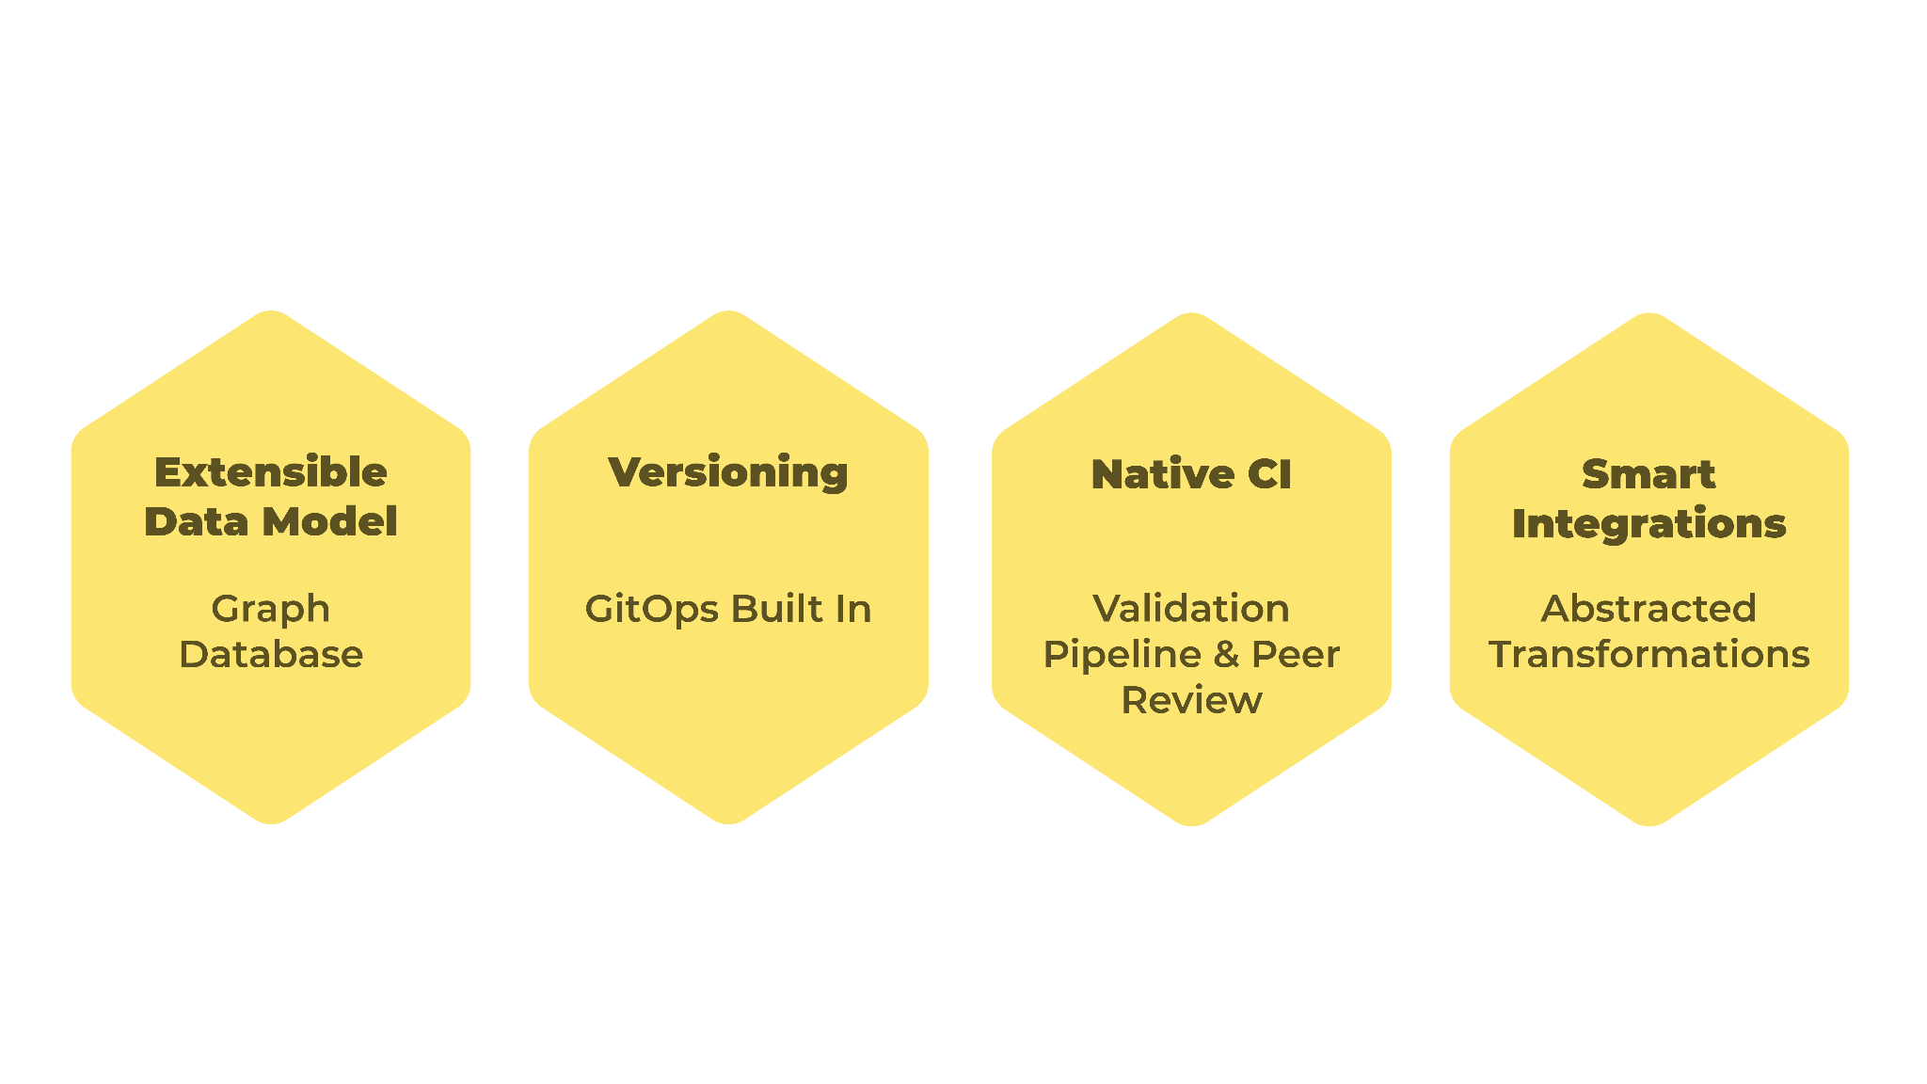
Introducing Infrahub
A centralized hub for infrastructure automation
Notes:
These problems are exactly what Infrahub was designed to solve.
Infrahub goes beyond being a source of truth, because it includes some key elements that allow you to build a sound, sustainable automation process without all the stitching together and tech debt of home-grown integrations.
We’re bringing the world of infrastructure data and GitOps together in a single platform with an extensible data model, versioning, artifact rendering, and CI validation so network and infrastructure teams can build reliable and sustainable automation for the long haul.
Imagine if you needed to recreate your infrastructure from scratch overnight. What would be needed? It’s not just data such as devices, it’s the model, the data, the code and templates, plus a reliable method to generate and deploy changes.
This is Infrahub.

Slide 13
Use Case - VPN Service
Objects:
VPN Service
Protocols
Interfaces
Vendor-Specific Configs
Validations
Documentation
Service Catalog
Design
Build
Operate
Design
Implementation

Slide 14
Demo

Slide 15
Thank You
Notes:
Thanks for your time and attention. We’d welcome questions at this point from our participants.

Slide 16
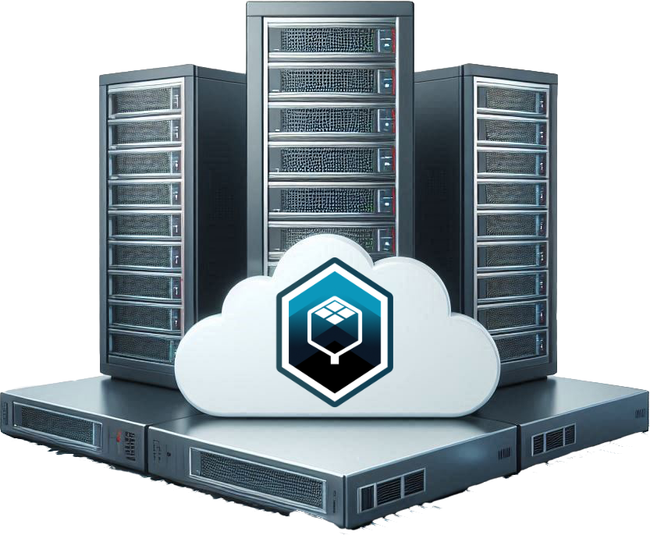
How to spark joy with Infrahub
Coming in 2024
Open Source
on GitHub
Cloud SaaS
Enterprise
Notes:
OpsMill believes in the value of the open-source automation community. Much of the work we’ve done in our past lives were built on open-source tools.
We’ve already released the open-source offering of Infrahub on GitHub, and we’re actively building a community around it to help share knowledge and examples.
Later this year, we’ll have a production-ready and scalable product, a commercial model, plus systems and support necessary to have a solid enterprise offering.
We’re also currently building a cloud SaaS offering and deployment of Infrahub in cloud marketplaces for both the customers who prefer a fully managed offering, and to make it easier for prospective users to try Infrahub with rapid time-to-value.

Slide 17
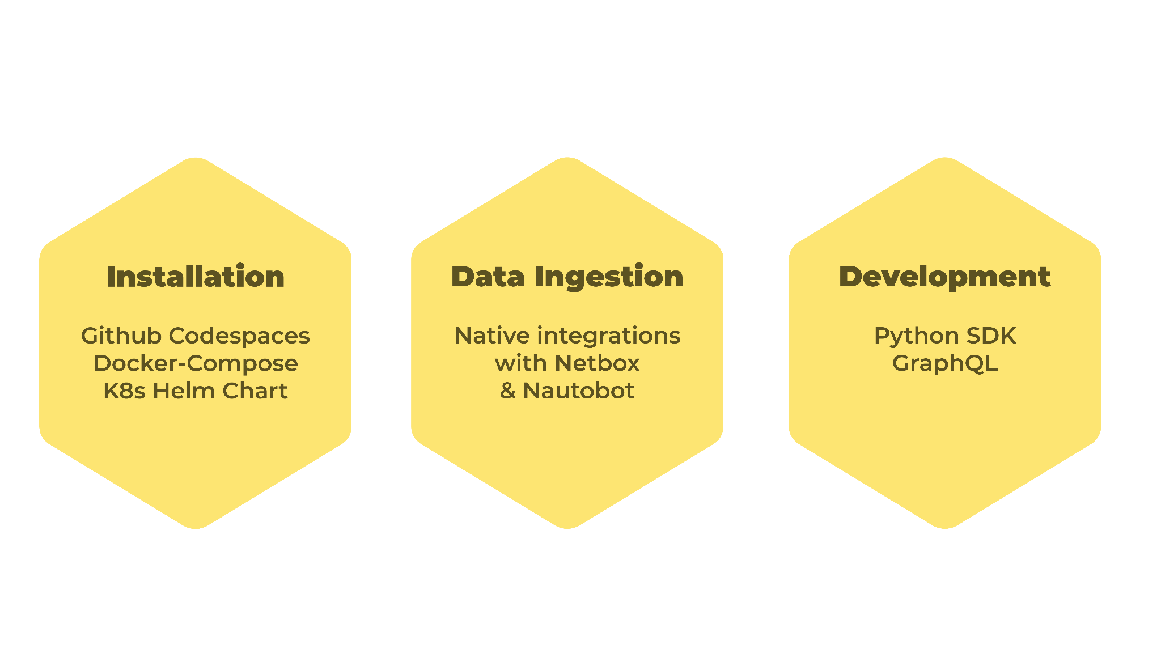
Getting Started
Notes:
So how can you get started?
You can spin up Infrahub in a few minutes now via GitHub Codespaces. Our documentation has a getting started tutorial to walk you through the basics.
Or spin up an instance locally on your laptop or a server via Docker or Kubernetes.
No system stands on its own, so we developed infrahub-sync to bring in data from other sources of truth.
Infrahub is built as a platform that’s made to be integrated with, so we’ve published a python SDK and APIs with extensive documentation from day one.
In addition, we’ve got experimental tools for quickly building and extending schemas, and we’d be happy to partner with you on deploying Infrahub in your environment. Please reach out!

Slide 18
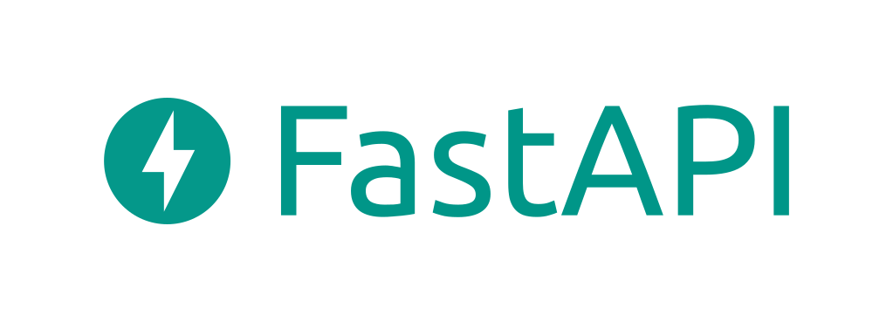
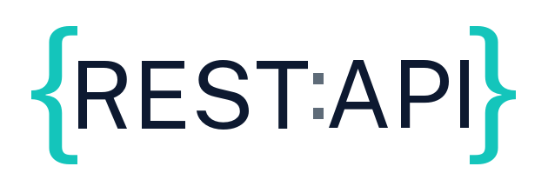
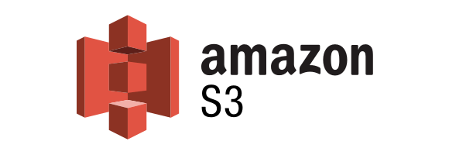
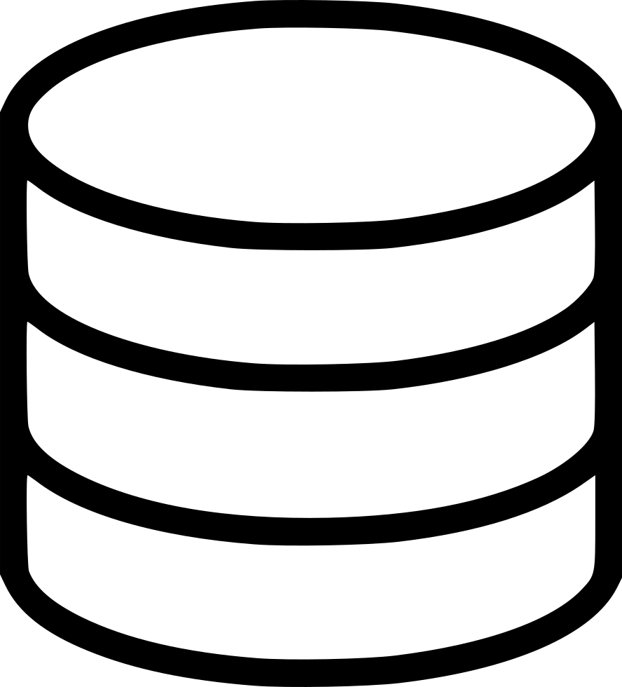
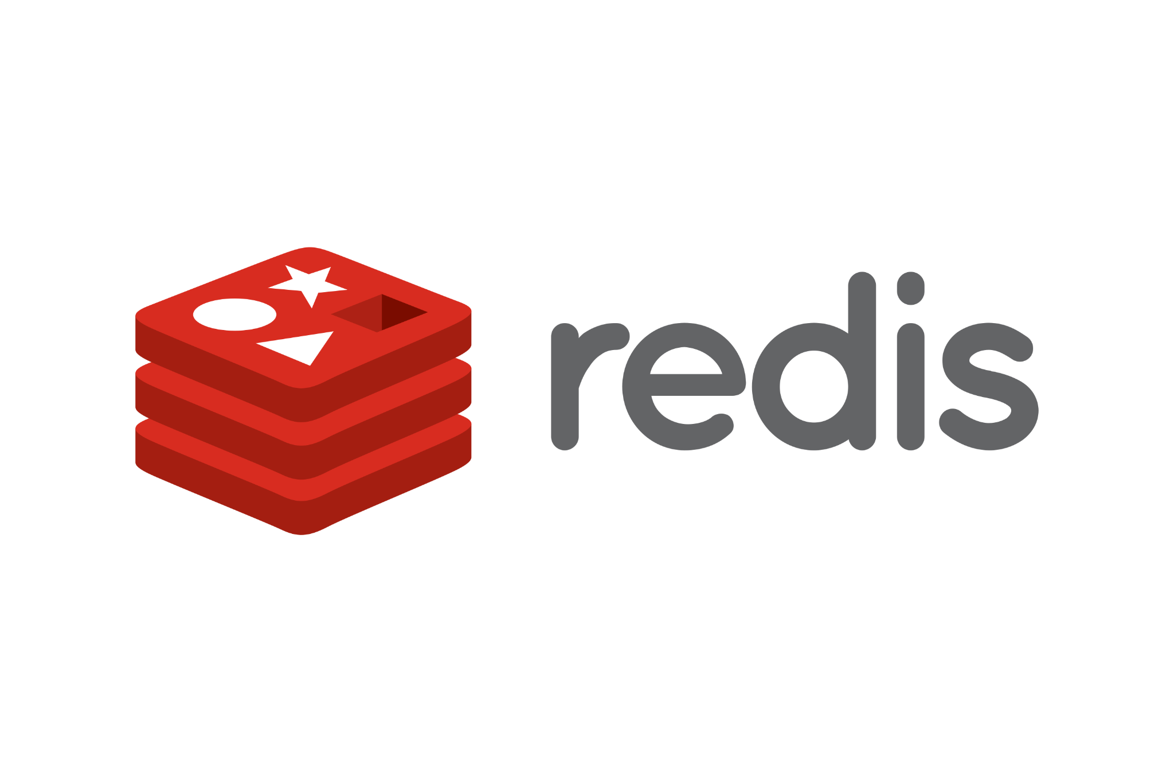
Core Architecture
infrahub-sync
infrahub-ansible
WebUI
API via SDK
infrahubctl
Git client
nornir-infrahub
Message Bus
Unified Storage
Object Store
Graph DB
Repository
Cache
Notes:
Infrahub is built on a container-based, linearly scalable and resilient architecture.
Let’s briefly walk through a few key components.
First, there’s multiple ways to interact with Infrahub:
A WebUI for the humans amongst us.
An API, primarily via GraphQL, with REST for some specific use cases. Our frontend WebUI is 100% API calls to the backend.
Infrahubctl is a command-line tool providing a convenient alternative for some common actions.
And Git for checking in code such as scripts and templates.
Underneath the hood, Infrahub’s Unified Storage allows for storing data in a graph database, and files in a repository.
Backing those up are well-proven and scalable systems for object storage, caching and a message bus.

