Slide 1
Black Hole detection in packet networks
Julian Lucek
Sr Distinguished Systems Engineer

Slide 2
Background
Traditionally, identifying the location and the cause of packet drops (“black-holes”) in a network is quite time-consuming: “Needle in a haystack”.
Transient drops are particularly difficult to detect.
Two main approaches to detection:
Indirect Detection
Direct Detection

Slide 3
Indirect Detection
✓
✓
X
✓
Probe 4
X
Probe 5
✓
Probe 6
Probe 1
Probe 2
Probe 3

Slide 4
Indirect Detection
✓
✓
X
✓
Probe 4
R1
X
Probe 5
✓
Probe 6
Probe 3 is not arriving
Probe 5 is not arriving
They have R1 in common, so probably R1 is black-holing
Probe 1
Probe 2
Probe 3

Slide 5
Issues with Indirect Detection
A black-hole may only affect packets with particular characteristics, and the probes might not have those characteristics.
Triangulation becomes increasing difficult in a large network
For example, if there is more than one blackhole present…

Slide 6
Indirect Detection
✓
X
X
X
Probe 4
Router A
X
Probe 5
✓
Probe 6
Probe 1
Probe 2
Probe 3

Slide 7
Indirect Detection
✓
X
X
X
Probe 4
R3
R2
X
Probe 5
R4
R1
✓
Probe 6
Are R3 and R1 black-holing?
Or are R2 and R4 black-holing?
Or more than 2 out of R1, R2, R3, R4?
Probe 1
Probe 2
Probe 3

Slide 8
Direct detection
Key principle:
A router knows why it is dropping a packet.
So it can proactively send a report about it! (an exception report)
Works with any kind of packet e.g. IPv4, IPv6, MPLS, Layer 2 etc

Slide 9
Exception reporting
SQLite Database
or logfiles
DB
Optimize
Plan
RE
Local
Collector
Assure
Orchestrate
External Collector
e.g. Paragon Automation
IPFIX
exception
report
PFE
Ingress interface
Egress interface
Dropped packet
Router
Available in Junos since 2021: “Juniper Resiliency Interface (JRI)”
Deployed in multiple production networks

Slide 10
Examples of forwarding exception categories
Unknown address family
No matching IP prefix in FIB
No matching MPLS label in FIB
TTL expired
Unknown VLAN tag
MAC learn limit exceeded
GRE mismatch
MTU exceeded
Various packet errors e.g. header errors, checksum errors, length not matching declared length…

Slide 11
Easy to setup test
ping 192.0.2.1 ttl 1
R1
R2 (DUT)
R3 (192.0.2.1)

Slide 12
Example exception report (local collector)
***** IPFIX ****
Version: 10
Length: 106
Export time: 1695116517
Seq no: 3397
ObservationDomainID: 65536
setID: 1024
setLength: 90
field_type: exceptionCode, field_length: 2
value: TTL Expired
field_type: nhIndex, field_length: 4
value: 707
field_type: oifIndex, field_length: 4
value: 0
field_type: underlyingiifIndex, field_length: 4
value: 0
field_type: iifIndex, field_length: 4
value: 362
field_type: flowDirection, field_length: 1
value: 00
field_type: dataLinkFrameSize, field_length: 2
value: 1446
field_type: dataLinkFrameSection, field_length: 64
value: 2c6bf561 482a2c6b f5e6d72a 88470002
31014500 05948050 00000101 b4480b65
69010b00 006b0800 d64b023a 00006509
6ce50007 b6370809 0a0b0c0d 0e0f1011
First N bytes of the packet (64 in this example)

Slide 13
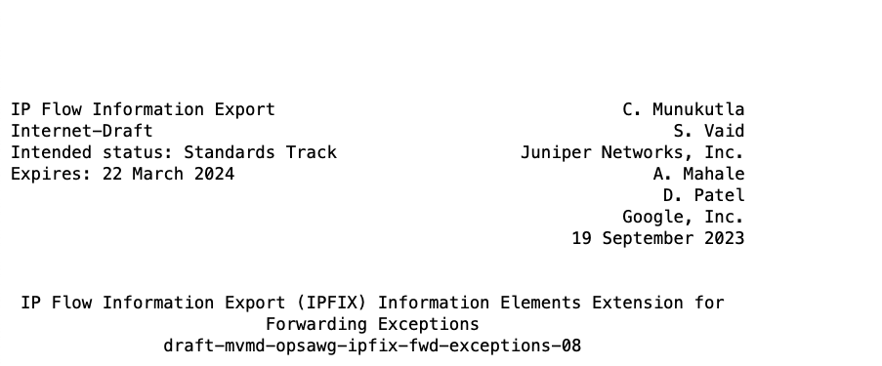
IETF work: IPFIX extensions
IP Flow Information Export (IPFIX) Information Elements Extension for Forwarding Exceptions
https://datatracker.ietf.org/doc/draft-mvmd-opsawg-ipfix-fwd-exceptions/
Proposes new IPFIX Information Elements for reporting exceptions
Propose putting Forwarding Exception reason codes in the IANA registry (e.g. 2 = TTL_EXPIRY)

Slide 14
New IPFIX Information Elements defined in the IETF draft (highlighted in green)
***** Netflow/IPFIX ****
Version: 10
Length: 106
Export time: 1695116517
Seq no: 3397
ObservationDomainID: 65536
setID: 1024
setLength: 90
field_type: exceptionCode, field_length: 2
value: TTL Expired
field_type: nhIndex, field_length: 4
value: 707
field_type: oifIndex, field_length: 4
value: 0
field_type: underlyingiifIndex, field_length: 4
value: 0
field_type: iifIndex, field_length: 4
value: 362
field_type: flowDirection, field_length: 1
value: 00
field_type: dataLinkFrameSize, field_length: 2
value: 1446
field_type: dataLinkFrameSection, field_length: 64
value: 2c6bf561 482a2c6b f5e6d72a 88470002
31014500 05948050 00000101 b4480b65
69010b00 006b0800 d64b023a 00006509
6ce50007 b6370809 0a0b0c0d 0e0f1011

Slide 15
The role of the external collector
Optimize
Plan
Ingest IPFIX exception reports, plus streaming telemetry, BGP-LS, BMP etc.
Assure
Orchestrate
Paragon Automation
Correlation with other events
Root-cause analysis with the aid of AI/ML
Alarms and alerts
Remediation

Slide 16
Further information
Juniper Techpubs link:
https://www.juniper.net/documentation/us/en/software/junos/flow-monitoring/topics/topic-map/resiliency-exception-reporting.html
Blog:
https://community.juniper.net/blogs/julian-lucek/2024/01/02/detection-of-blackholes-in-networks-using-jri

