Slide 1
Secure by Design
Lessons from the Nuclear Industry
Rob Barnes MEng AUS MIET MSyI GICSP
8/9th July 2024

Slide 2




Rolls-Royce SMR Ltd Shareholders
Rolls-Royce Group
60 years designing, manufacturing, supporting and operating nuclear technology
Rolls-Royce SMR Ltd is a technology vendor offering a complete SMR power plant on a turnkey basis
Constellation Energy (previously Exelon Generation Ltd)
Operates the largest U.S. fleet of zero-carbon nuclear plants with over 18.7GW from 21 reactors at 12 facilities
BNF Resources UK Ltd
Extensive investments in the energy space and represented and advised by BNF Capital Limited, an FCA regulated UK-based investment advisory
Our development programme is fully funded with £495m through commercial equity and UK Government grant funding
Qatar Investment Authority
Invests in the energy transition and funds technologies that enable low carbon electricity generation
UK Government Grant Funding
Rolls-Royce SMR has received UK Government funding of £210m as part of Phase 2 of the Low-Cost Nuclear Challenge Project, administered by UKRI,
Notes:
Rolls-Royce SMR Ltd is a special purpose vehicle, majority owned by Rolls-Royce Plc. We’re well into a design development programme and generic design assessment for a small modular reactor power station. Our work is funded through investment by Rolls-Royce, Constellation Energy, who operate the largest fleet of nuclear power plants in the USA, BNF Resources UK Ltd, the Qatar Investment Authority, and £210M of grant funding from the UK Government.

Slide 3
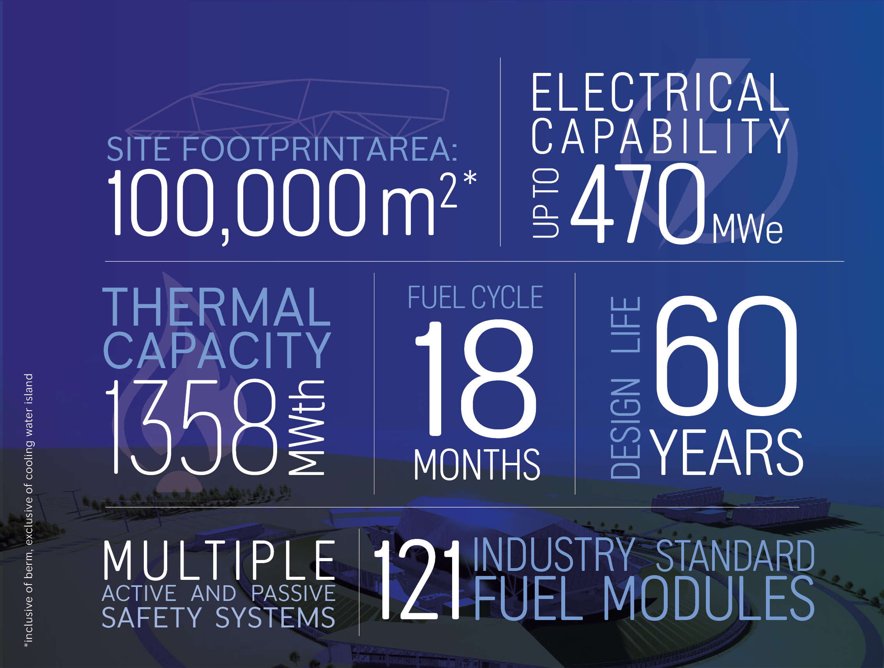
The Rolls-Royce SMR in numbers
Notes:
The Rolls-Royce SMR is small – occupying a 100,000 m2 footprint – to put that into context, it would fit into the Millennium Dome.
At the heart of our SMR design is a Pressurised Water Reactor (PWR) fuelled with Lightly-Enriched Uranium (LEU). This is a tried, tested and well-proven technology, which means that there’s a low amount of risk around licensing.
If you’ve got a data centre that needs about 400 MWe of reliable, low-carbon electricity, co-locating with an SMR might be an attractive proposition.

Slide 4
Content
This presentation provides a brief insight into Secure by Design.
A more complete introduction is available from the Nuclear Innovation Programme, task R3.6.07.
Notes:
Pitch over.
I’ve been involved in developing and applying secure by design to new nuclear for the last seven years. It started as a research project funded by UK Government, which then helped to inform regulation.
Later, I joined the SMR programme and realised that I now had to sleep in the bed that I’d made for myself. This presentation will explain what that bed looks like, what I’ve learned from sleeping in it, and some of the parallels with network engineering.

Slide 5
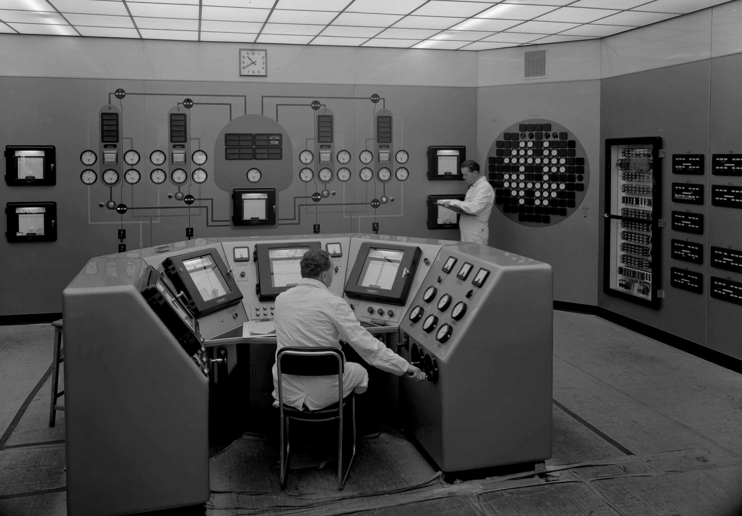
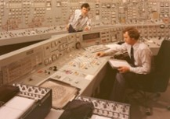
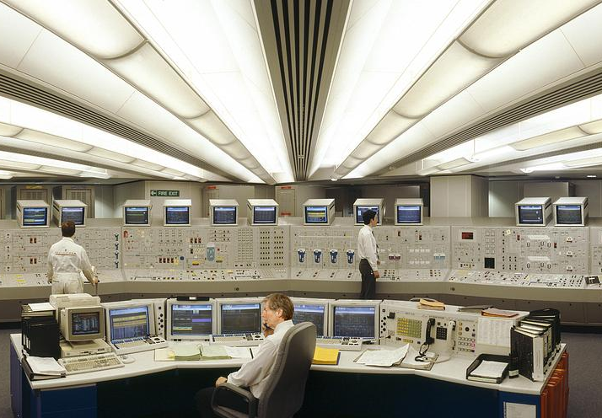
Commercial reactors of the UK
1953
1965
1988
Technological context of nuclear OT
1950s: Analogue electronics, gauges, chart recorders, switches and relays.
1960s: Lights, push buttons, and gauges. Electronics still predominately analogue.
1970s: There were no 1970s.
1980s: Software and programmable electronics. Computer terminals and screens appear in the control room.
Magnox
(UK Design)
Advanced
Gas-cooled
Reactor (AGR)
(UK Design)
Standardized Nuclear Unit Power Plant System (SNUPPS)
(US Design)
Notes:
The first thing to get across is the technology in use in the nuclear industry; it’s old. Partly due to the age of these plants, but also because we like to use tech that has been proved to be reliable.
[run through slide]
Advanced gas reactors still constitute most of the UK fleet. We’re talking lots of lights, push buttons and gauges. The underlying electronics are mostly analogue and transistors are only just starting to replace valves in most applications. Cyber threat? Nah.
After the advanced gas reactors, there are no new UK designs. In 1988, Sizewell B starts being constructed and it’s a US design. We start seeing programmable electronics, but we’re talking late 80s / early 90s tech here. Designers are thinking about computer security, but it’s basic stuff. Computer security is mostly achieved by not connecting them to this new-fangled Internet, which has only just arrived.
Today, the technology is predominately based around distributed control systems built out of industrial control tech like programmable logic controllers, connected to IP backbones that run around the power station. IP has arrived, and with it has come all the attendant risks. However, the most critical systems, those responsible for shutting down the reactor, remain very simple, highly-reliable, and not networked.

Slide 6
Nuclear OT (and IA) in the context of safety
Prevention
Limitation
Hazard
Containment
Mitigation
Availability of plant data to operators
Integrity of plant data
Authenticity of plant data (freshness)
Authorisation of actions affecting safety
Prevention of unsafe inputs (think Airbus)
Correctness of processing
Continued availability of plant data to operators
Availability of safety functions for accident management
PIE
Timely availability of safety response
Correctness of processing
Notes:
This is a safety bow tie diagram. Who likes a good bow tie?
In the centre is a postulated initiating event, or PIE. This could be a fault, failure or malicious act that starts a sequence of events that could lead to an undesirable outcome.
On the left is preventative measures – things we can do to prevent the PIE from manifesting. In NIST cyber land, these are your “Protect” measures. I’ve put in here how Information Assurance principles might be applied as well, so we have availability, integrity and authenticity of the plant data being shown to operators. Confidentiality, on the other hand, doesn’t tend to show up much in safety systems. We might also throw in some authorisation controls, e.g. only certain people may be authorised to increase the reactivity, and limitation controls, i.e. they may be prevented from raising the reactivity too quickly.
On the right is the response to the PIE manifesting. The availability and timely operation of automatic safety measures is king here.

Slide 7
Secure by Design
Securing the Design
Operational Controls
Dedicated Controls
Integrated Controls
Threat
Consequence
Vulnerability
Confidentiality of Design Information
The goal of Secure by Design
The effectiveness of the security solution (i.e. risk reduction) must outweigh the inherent risk of the power station.
We can: reduce inherent risk, or increase effectiveness of security controls, or both.
Secure by Design is how we do the former, and Security Design is how we do the latter.
Notes:
How does secure by design fit into this?
Security is a risk management game. The goal is to bring our risks down to a level that is within the risk appetite. We identify our sources of security risk – vulnerabilities that could be exploited by a threat actor, leading to an undesirable consequence – and then apply controls to reduce the likelihood or impact of that risk manifesting. The quantity and robustness of the controls, and hence their operational and financial costs, are driven by the risk level. Big risk, big control. Small risk, small control. The source of risk is essentially fixed, but what if there was another way?
What if there was a way to reduce our reliance on security controls to manage risks? If we think about security as a balance between risk sources and risk controls, and risk appetite being the point at which they balance, then if we can reduce the amount of stuff on the risk side, we can reduce the amount of stuff on the control side, and maintain that balance.
To do that, we need to drive the sources of security risk, i.e. vulnerabilities, out of the design.

Slide 8


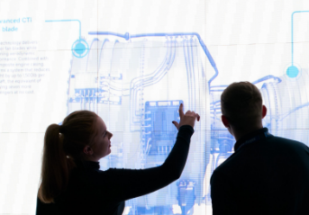
Design principles
Engineering governance
Cross-domain risk management
Building security into engineering
Secure by Design is more than a set of principles, requirements or verification tests - it is an overall approach to engineering security into products; therefore, it must be integrated fully into engineering, and be part of “business as usual”.
Eliminate or reduce hazards at source
Avoid software or programmable electronics for most-critical safety functions
Require security controls on actions affecting safety*
Security is a stakeholder by default – opt-out, not opt-in
Security built into engineering processes
Require formal sign-off from security at review gates
Security controls can increase the difficulty for adversaries
Quality controls can reduce vulnerabilities
Safety controls can prevent or mitigate the impacts from successful attacks
Notes:
This isn’t about finding and fixing vulnerabilities. It’s about avoiding them in the first place.
We are doing this by applying a set of design principles that guide engineers towards designs that avoid unnecessary cyber risk. The more serious the system, the less software the higher the quality of that software. Asking the question: “Does this need to be implemented in software at all?” Sometimes the same effect can be achieved with an electrical or mechanical device. Should that data interface be bi-directional when the information is only supposed to flow in one direction?
We have built security into our engineering governance. A lesson that we learned from the Microsoft Secure Development Lifecycle is that security must be a stakeholder by default. For some systems, our involvement isn’t necessary and we can recuse ourselves, but for things that are potential sources of security risk, we get to be involved and support our engineering colleagues right at the start. There are no nasty surprises!
We apply a cross-domain approach to risk management. Security risks have safety impacts and are (typically) born out of engineering design decisions. We’re all stakeholders in risk management and working together is far more powerful than working alone.

Slide 9
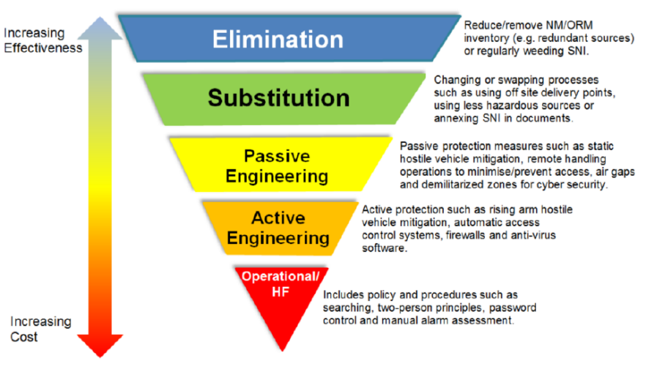
Hierarchy of controls
Nuclear industry approach to Secure by Design
Reproduced from Office for Nuclear Regulation (ONR) CNS-TAST-GD 11.4.1 Issue 1.1
Notes:
I’m only going to cover one of the design principles, otherwise this would take all day. This is the “Security Hierarchy of Controls”. It’s not mine; it has been stolen from my regulator. It should be familiar to anyone who has done any kind of safety management.
Stuff at the top is preferable to stuff at the bottom. We can work through this quickly using email and malicious links as an example.
We could eliminate all hyperlinks from incoming emails. That would be very effective but might impact business operations. Especially if your company has outsourced a load of stuff to cloud-based services.
We could substitute the hyperlinks with links to a service that blocks evil sites, and maybe also tests the destination for malicious behaviour. These services are generally pretty good, but not infallible.
We could apply a passive measure on our own systems through application whitelisting, but if the vulnerability is in an application we already trust, we might still be stuffed.
We could have an active measure that evaluates software behaviour in real time and kills anything that is behaving suspiciously. It might act late, or not at all.
And lastly, we could rely on the tried and tested control of telling our users not to click suspicious links, which we all know works so well.

Slide 10
How we practice Secure by Design
Notes:
I’m not going to spend much time on this. I just want to illustrate how we’ve integrated security activities (bottom three rows of stuff) into the engineering process (top row, running left to right).
The key feature is that certain security activities happen at certain times, and are required for the engineering work to progress through its review gates (the vertical dashed lines).
Traditionally, security is applied only after the design is substantially complete, which is when most of the opportunities to eliminate or reduce risk at source have been missed. By running the security process in parallel with, or preferably as an integrated part of, the engineering process, those opportunities can be realised. Also, any security measures needed to manage remaining risks will be mature earlier, which supports meeting release deadlines, rather than hindering.

Slide 11
The effect of secure by design
Security
Safety
Engineering
Notes:
All models are wrong, but some of them are interesting. This model shows how a threat actor, possessing capabilities and motivated by goals, utilises an attack pattern that exploits vulnerabilities of a targeted asset. The asset is responsible for delivering a safety function, the failure of which leads to safety consequences.
If anyone is familiar with STIX, you will probably recognise some of the words up there as it’s heavily influenced by our approach to threat modelling. What I want to highlight is how this generic threat scenario spans the domains of security, engineering and safety. [click]
Traditionally, we, as security practitioners, might have been expected to work solely within our domain, adding security controls to increase the difficulty for a threat actor, trying to reduce or eliminate the overlap between the capabilities that they possess, and the capabilities required to successfully exploit the vulnerabilities in the system. We may be able to reduce the vulnerabilities of an asset through patching, but we’ve not usually been able to strongly influence what that asset does or how it is implemented or operated. Similarly, in safety, the safety measures are there to protect against random failure, and we may not have been able to extend them to mitigate the consequences of a malicious act.
The difference in Secure by Design is that we, as security engineers, get to cross those lines, join our colleagues in engineering to eliminate potential vulnerabilities, and join our safety colleagues in mitigating the consequences from malicious acts. Threat scenarios cross these boundaries anyway, so why shouldn’t we? This is at the heart of cross-domain risk management.

Slide 12
Examples in network security
Parallels with information technology
Secure by design
  Out-of-band management of infrastructure
  and security devices
  Tunnelled client traffic –
  all untrusted traffic is encapsulated
Integrated security
  Device hardening
  Span ports to support NIDS
There are some important differences: Not knowing the nature of the traffic and what functions it supports means that much of the risk is outside of scope, whereas nuclear site licensees are accountable for all their risks.
Notes:
Lastly, I wanted to point out some parallels with how this is being done in network and IT security. You are already doing some of these things. A lot of what we are doing now in nuclear was stolen from secure software and system development lifecycles from Microsoft and NIST.
Two of my favourite features of a well-designed network: out of band management and tunnelling client traffic. Untrusted traffic never touches a management interface. Encapsulation can also provide some security benefits by flagging quite clearly that the stuff inside is not trusted. It just needs moving from A to B, but other than that, never look inside the box.
In hardware, a great deal of effort has gone into device hardening with unneeded services being disable (eliminate!) and passive/active controls applied to those that must remain.

Slide 13
Lessons learned
Experience from applying Secure by Design to the Rolls-Royce SMR
Security must be a default stakeholder in every system – opt out, not opt in
Do security early and do it often
Have a security team that is adequately resourced to support engineering activity
Keep security involved in design decisions
Challenge the underlying design
Security is a quality, just like safety or reliability and quality is a market differentiator.
A reputation for high-quality products will attract customers.

Slide 14
Next steps
What’s next for SMR security?
GDA Step 3
  Apply methodologies, generate evidence, learn
  Earn our Design Acceptance Certificate (DAC)
First order and site licensing
Beyond - off-site connectivity for:
  Telephony and Wide-Area Network (WAN)
  Equipment health monitoring and remote support
  Security Operations Centre (SOC)
  Emergency preparedness and response
We have completed Generic Design Assessment Step 2, during which our secure by design methodology and supporting security analysis methodologies were assessed by our regulator to be adequate

Slide 15
Summary
Secure by Design in the Rolls-Royce SMR
Establish secure design principles, and support their application
Security is a stakeholder by default
Reduce security risk at source
Practice cross-domain risk management
Integrate security into engineering governance
Greater integration of security measures into existing stuff leads to less reliance on dedicated security measures
Learn more about nuclear Secure by Design from the Nuclear Innovation Programme.
Notes:
To summarise…

Slide 16
rob.barnes@rolls-royce-smr.com
Notes:
Thank you for your attention.

