Slide 1




The Role of Data Centres in Powering AI, Compute, Security & Connectivity
The meeting place for companies, technologies and data

Slide 2



Who we are
History of Cloud
AI Architecture
Digital Realty Solution
Key take aways
© 2023 Digital Realty Trust® Inc.

Slide 3
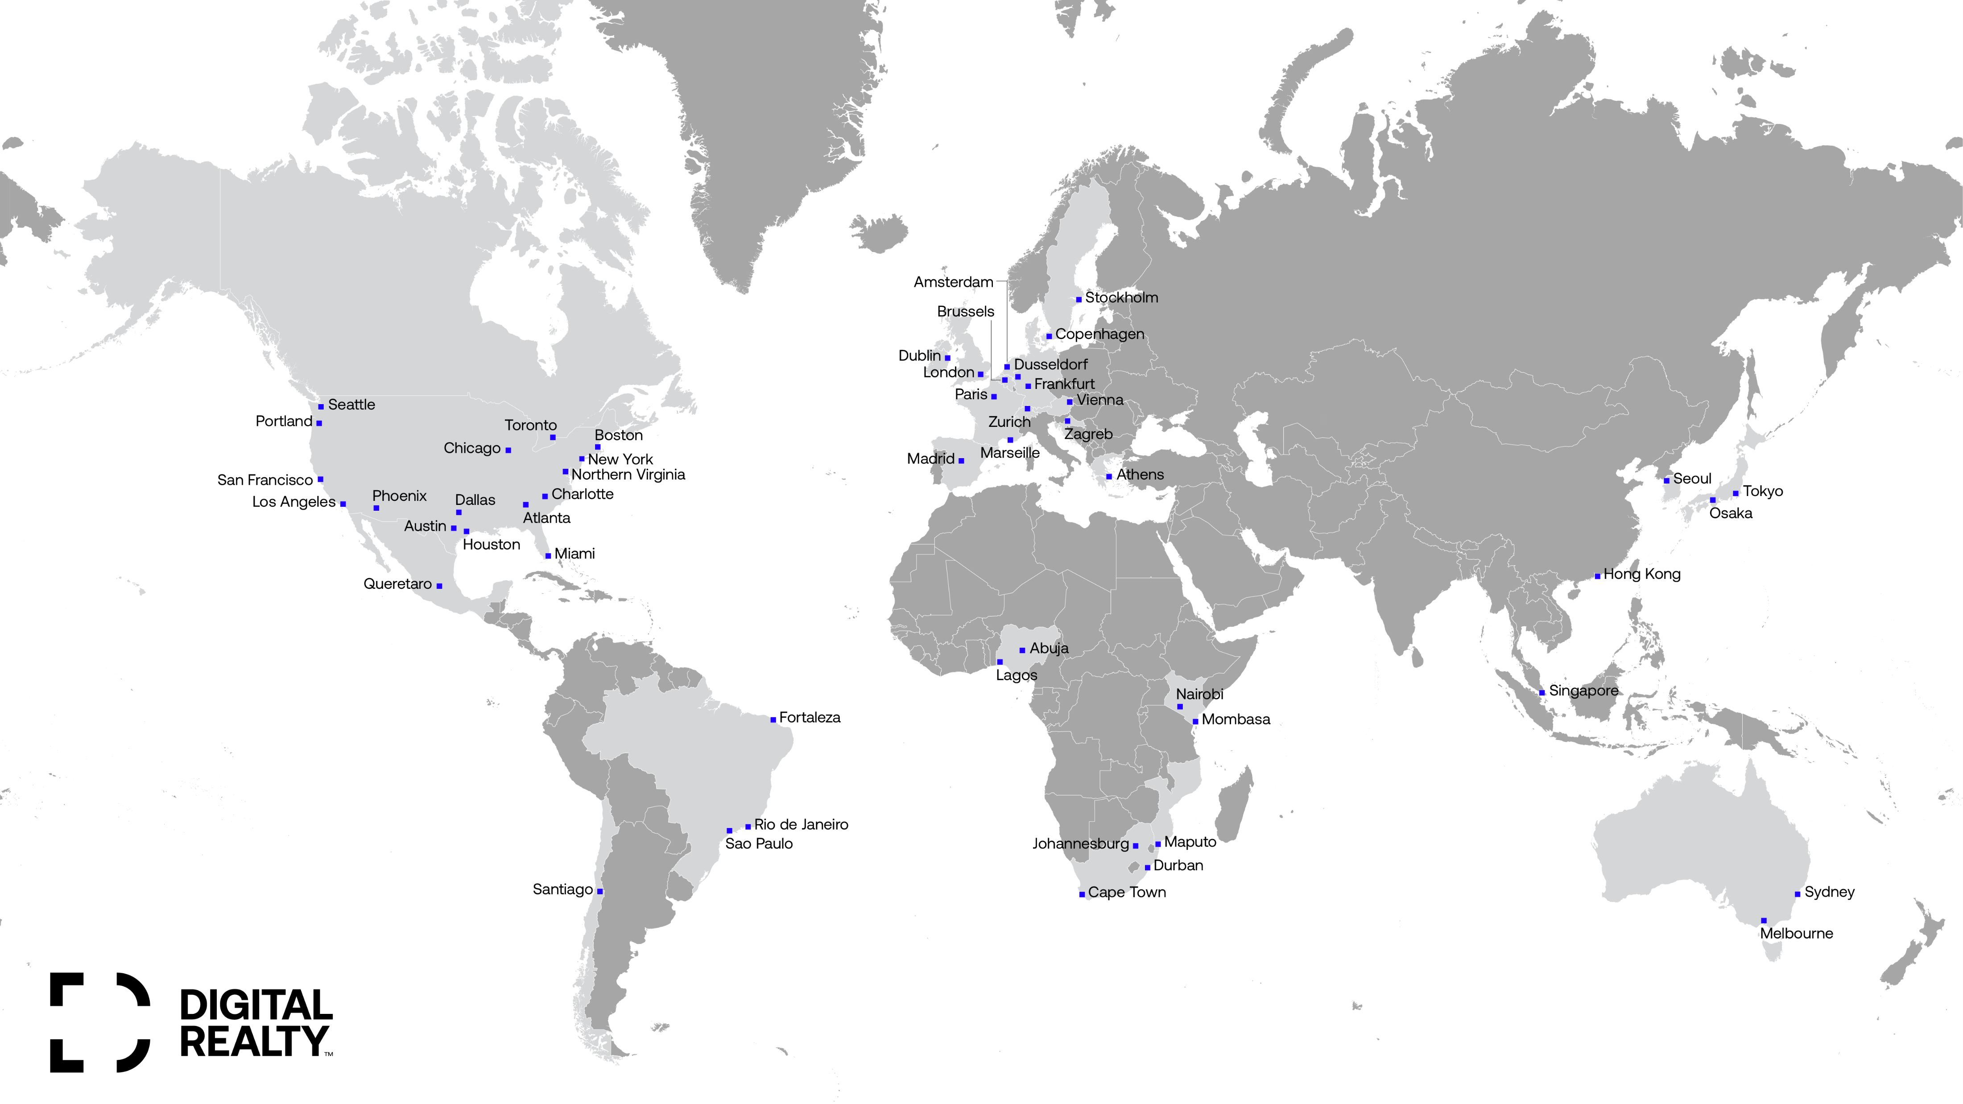







300+
Data centers
50+
Metros
Digital Realty Industry-leading Scale
28
Countries
6
Continents
Telx & Telecity Industry-leading Colocation Sites
5,000+
Customers
Interxion Industry-leading in EMEA
1GW
Renewable Energy
DuPont Fabros Industry-leading Hyperscale
Mitsubishi JV Industry-leading in APAC
South Korea ICN10
Tokyo NRT10
Israel
Osaka KIX12
Madallion Communications Leading Colocation Africa’s Provider
Digital Connexion DC Development in India
India
Hong Kong HKG11
India MAA10
Singapore SIN10,11,12
iColo.io State of the Art Carrier Neutral DC
Jakarta
Ascenty Infrastructure leader across Latin America
Australia SYD14
Teraco Digital Realty SA Leading carrier-neutral Colocation DC
Notes:
I like to begin with who we are
Digital Realty often people thought we were Digital Real-ality
Journey of who we are
Digital Connexion - Digital Connexion is a joint venture (JV) between Brookfield Asset Management (Brookfield) – JIO a subsidiary of Reliance

Slide 4
© 2024 Digital Realty Trust®

Slide 5


Building a Sustainable Future
68%
Global carbon
reduction target
Digital Realty is the largest buyer of renewable energy among data center providers
We cover 100% of our North American colocation business and European portfolios with renewable energy
Digital Realty has certified more green buildings than any
other data center provider.
Digital Realty has more Energy Star-certified data centers than any other data center provider
Digital Realty executed the data center industry’s first green
bond, a nearly half-billion dollar issuance earmarked
exclusively for green projects.
1GW
Renewable
capacity
126
Data centers matched with 100% renewable electricity
12M
Square feet green building certifications
5
© 2024 Digital Realty Trust®

Slide 6








Continuing to Invest and Expand Across the Globe
January 2022
June 2022
August 2022
August 2022
June 2022
February 2023
July 2023
September 2023
Digital Realty opens first carrier-neutral data center in Seoul, South Korea. Digital Seoul 1 (ICN10) will serve as a gateway to global expansion for enterprises in Korea.
Digital Realty forms a joint venture with Mivne to develop and operate data centers in Israel to be operational in 2023.
Digital Realty completes Acquisition of Teraco, a leading carrier-neutral data center and interconnection services provider in South Africa.
Digital Realty announces plans to build its first data center in Crete to expand the presence in Greece, with a strong focus on subsea cables.
Digital Realty expands Mediterranean presence with development of new colocation and connectivity hub in Barcelona.
Digital Realty opens first data center in Maputo, Mozambique expanding the company’s footprint in the eastern coast of Africa.
Digital Realty forms a three-way joint venture (JV) with Brookfield Infrastructure and Reliance Industries Ltd. in India. Operating as Digital Connexion: A Brookfield, Jio and Digital Realty Company.
Digital Realty expands Mediterranean presence with development of new colocation and connectivity hub in Rome.
© 2024 Digital Realty Trust®

Slide 7
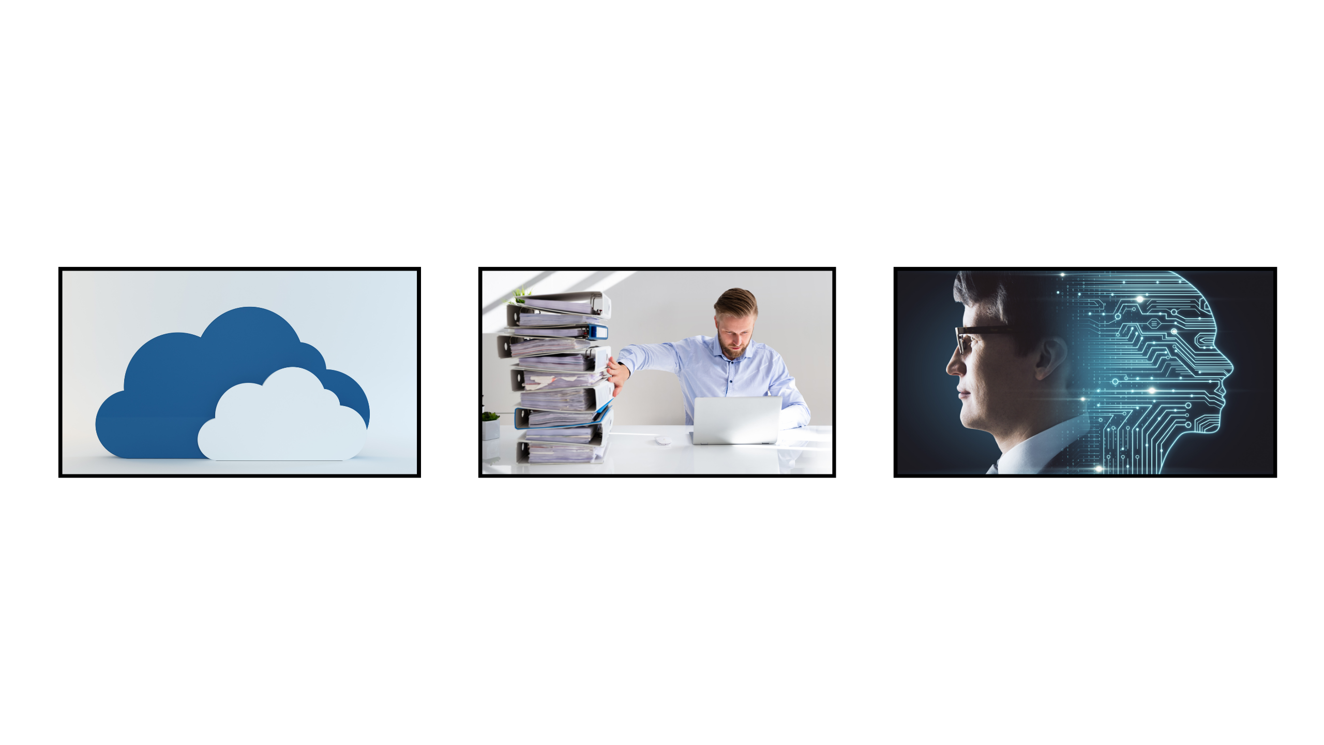

A Brief History of Cloud
2010
2015
2020
Cloud Computing
Cloud Computing
Digital Transformation
Cloud Computing
Digital Transformation
Artificial Intelligence
Q1 2023
© 2024 Digital Realty Trust®
Notes:
Cloud – Hyperscaler, we seen from 2010s onwards the beginning of Cloud Computee
Software as a service (SaaS) allows users to connect to and use cloud-based apps over the Internet. Such as Office365, Emails, and OneDrive
During Cloud Computer- infrastructure as A Service such as virtual machine
Machine learning era started by a few in the early 2000s marked a period of intense research focused on refining machine learning algorithms.
Deep Learning between 2010’s to 2019, leeting AI sort through data and information in a manner that emulates human brain
In 2020
Generative AI - AI will increasingly be monitoring and refining business

Slide 8
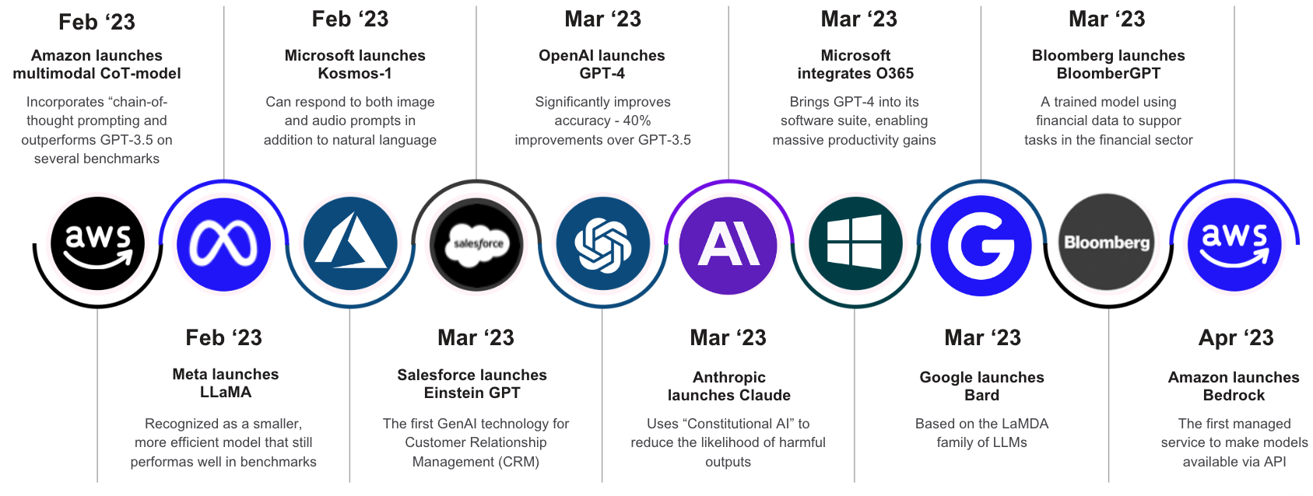
A Brief History
2010
2015
2020
Cloud Computing
Cloud Computing
Digital Transformation
Cloud Computing
Digital Transformation
Artificial Intelligence
Q1 2023
© 2024 Digital Realty Trust®
Notes:
Bard becomes Gemini
ChatGPT gained 1 million users in under a week when it first launched
ChatGPT, the popular artificial intelligence chatbot, has reached 100 million users just two months after launching, according to analysts. It had about 590m visits in January from 100 million unique visitors
How are you responding to Digital Change?
We see an impressive line of sight emerging for AI accelerate innovation, which will be driven by hybrid architecture optimized between public-private cloud services, with new AI Private Cloud
Quantrum Computer As A Service – Which involves provide a service to banks using complex mathematical models to price financial products.
Google rename to Gimini
Meta spent over 30-37 bil for investment in AI modwl

Slide 9





What are the implications of Hybrid IT?
Hybrid IT is the evolution
of Enterprise IT
Hybrid IT
Cloud-to-Cloud
Clouds
Locations
Applications
Data & Data Exchange
Distributed Workflows
Security Controls
Complexity
Public
Cloud
Private Cloud
Non-Cloud
Dedicated
On-Prem
Colocation/
Hosting
Managing and orchestrating infrastructure and application workflow is increasingly complex and highly inconsistent.
Notes:
Hybrid IT is a Result of evolving Digital Transformation

Slide 10

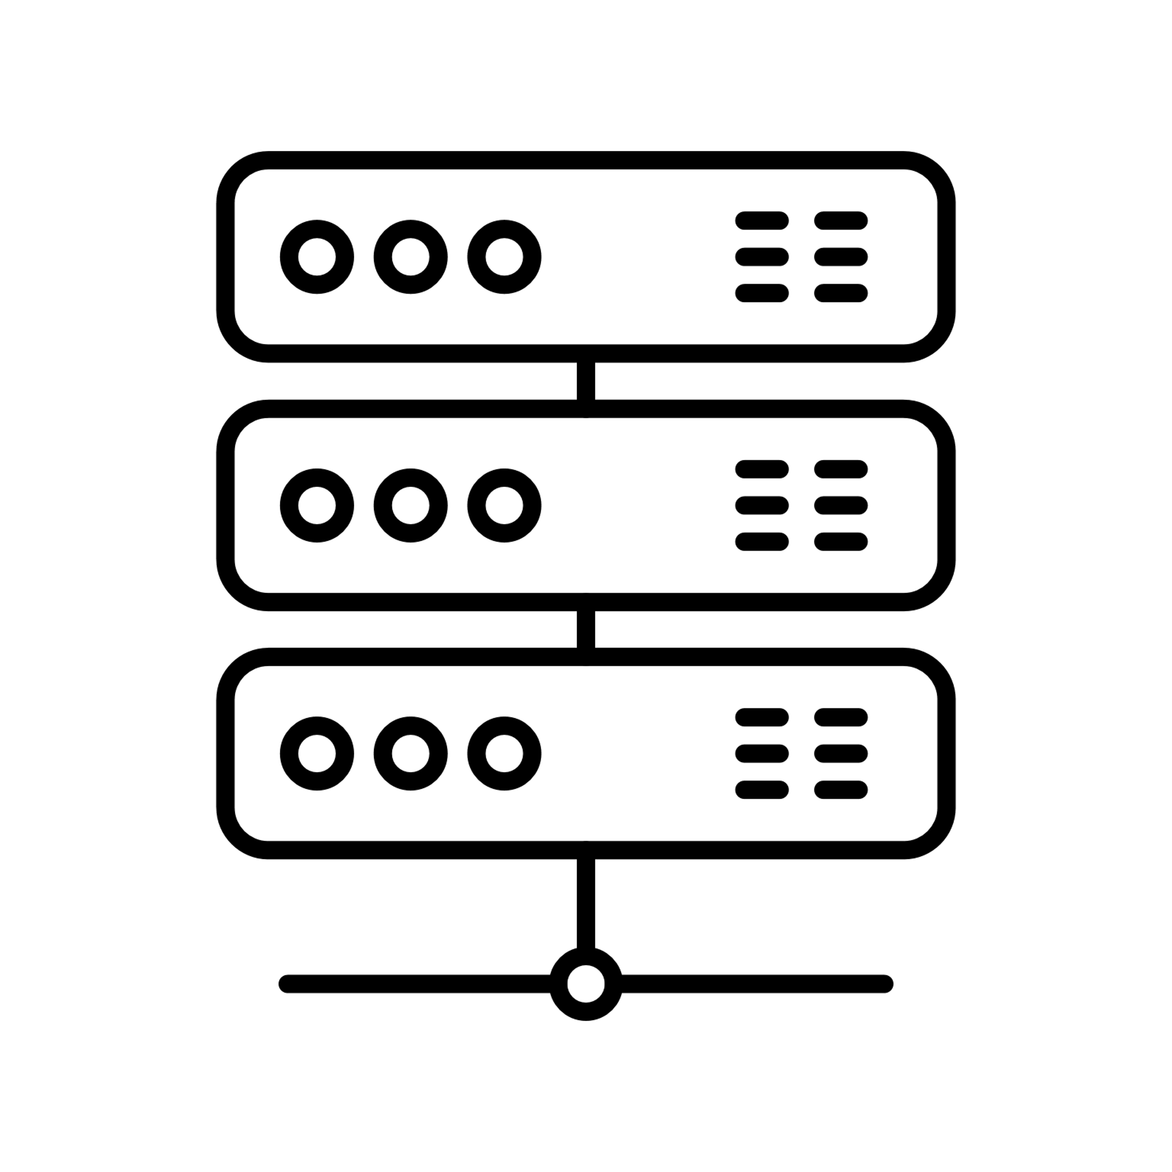




AI Enablement: Applying Cloud Learnings to Accelerate AI
Cloud Architecture Evolution: We’ve Seen This Before
Public
Clouds
Cloud
On-Ramps
Colocation/
Hosting
Non-Cloud
Dedicated
On-Prem
Public
Clouds
Public Internet
Non-Cloud
Dedicated
On-Prem
Private
Cloud
Software-Defined Network Fabric
Early Cloud Challenges
Evolved Cloud Solutions
Limited, unsecure access options
Initially built for single cloud
Quickly evolving regulations
Complex to deploy multi-cloud
Distributed, performant, secure access
Mature service portfolio, including multi-cloud support
Distributed AZs meet regulatory requirements
Software-defined network fabrics remove complexity
AI Architecture Evolution: We See Where This Is Going
Inference &
AI Apps
Hybrid AI (public & private models & infra.)
Colocation/
Hosting
AI Training & Inference
Public Internet
Users & Devices
Data Lakes & Warehouses
AI Workflow Orchestration
Private Network & Interconnects
Early AI Challenges
Future AI Solutions
Limited, unsecure access options
Initially built for single AI
Quickly evolving regulations
Immature use cases limit GPU utilization
Private network & interconnects enable performant, distributed access
Workflow optimization increases infrastructure utilization
Hybrid AI meets latency, security, & regulatory requirements
Distributed inferencing unlocks enterprise data lakes & warehouses
DIGITAL REALTY CONFIDENTIAL – not for distribution without written permission. PATENT PENDING for AIPx and related orchestration, private fabric/exchange, broader.

Slide 11







Types of AI Architectures
Data Lake
Training
Inference
Capacity Block Size
5-15 MW
Capacity Block Size
5-100 MW
Capacity Block Size
1-5 MW
Rack Density
Low to medium
(5 – 15 kW)
Very high
(35 – 100 kW)
Medium to high
(15 – 25 kW)
Rack Density
Rack Density
Air Cooled
Liquid Cooling
Location / Latency Sensitivity
11
11
Notes:
3 Pillars
Data Lakes - AI does not work without access to huge amounts of data -
Training are huge deployments that utilize data lakes to create AI models that are the foundation to AI products and services
Inference are smaller, distributed deployments that actually serve AI products and services to end users using the trained models
Key to understand what is driving AI demand
Air Cool, Liquid Cool – with Inference Location / data sovereignty / latency sensitive require connectivity partner like yourself.

Slide 12
Generative AI Demand: Today
Primarily Demand for Training Deployments
Training
Accelerating incremental demand as AI providers race to build Generative AI models
Notes:
Data Warehouse
huge acceleration of AI demand as providers race to train models - underpin services going forward
Training is not location sensitive and requires vast amounts of cheap power
Data training was affordable by huge enterprises.

Slide 13
Generative AI Demand: 1-2 Years
Transition from Training to Inference as Products Mature
Training
Inference
Models become good enough, limiting incremental training demand. AI products still maturing with limited revenue, limiting inferencing demand
Notes:
As models mature, incremental demand for training will slow and start to shift towards inference
distributed to serve global users and applications
PROXIMITY VALUE – copilot is 3-+ products throughout all of of MSFT
We must identify durable AI workloads
Seeing companies start providing TRAINING as a service

Slide 14

Generative AI Demand: 3-5 Years and Beyond
Inference is Long Tail of Enterprise AI Demand
Inference
Private AI
Training
2nd and 3rd generation AI products reduce need for large-scale training. G2KEs deploy distributed inferencing to serve global users
Notes:
Looking like the CLOUD DEMAND – we solved for that… but FASTER
AI demand will be from enterprises deploying inferencing to serve their users
Similar demand profile as the cloud with large enterprises building Private AI and smaller companies relying more heavily on cloud providers for AI solutions
We are well positioned given engineering heritage, interconnection capabilities, and global reach, and we can only do that with partnership like you.
Data Sovereighty and Model Needs, legal and practical aspects of dataling, a different requirement for AI training vs inference phases.
To private AI

Slide 15
















AI Training / Inference – Hybrid Cloud
AI Training / Inference Cloud Hosted, Data-On-Prem
KEY
Colocation-based Interconnection
Colocation-based Virtual Interconnection
ServiceFabric™
Request
Response
Digital Infrastructure Hub
3
Bring Public Cloud to Private Data
1
Cloud-Hosted AI
Inference / Training
Customer or Partner Provided Equipment
4
Enable Trusted End-User Requests
2
Secure Private
Cloud Interconnect
AI Model
Network
Security
Data Lake
On Ramps
ServiceFabric™
Digital Realty Provided
ServiceFabric™
Firewall
Data Scientist
End User
GPUs
Synthetic Data
Retrieval Augmented
Generation (RAG)​
User
AIaaS / Cloud Provider
Cabinet(s)
HD or Std
Port, Cross Connects
Cage,
Suite, Hall
Colocation & Interconnection
CLOUD
CORE
EDGE
15
Notes:
So now we know Hybrid IT is top of mind for CIOs. Let’s dig deeper. DALL·E 3 Images
What are the implications?
Clouds – connected to more clouds
Locations – more locations where apps and data are located
Applications – more apps, SaaS
Data & Data Exchange – more data to manage, more to move around and track
Distributed Workflows – more done in various places
Security – everyone is worried about it
From the IT manager to the CIO, everything is more complex. It’s not simple; it’s not in their data center, and it’s not like it used to be.
Typical issues using Internet to access the Cloud:
All my traffic is going over the Internet
I expose my workloads and application to security attacks
There is no guarantee about bandwidth and path taken by my traffic
Bandwidth on Internet is shared amongst many.
Latency is high
I am exposed to packet loss
Great number of hops (more chance of outages)
If I run IPsec, I create overhead for my traffic, lower throughput and network performance

Slide 16

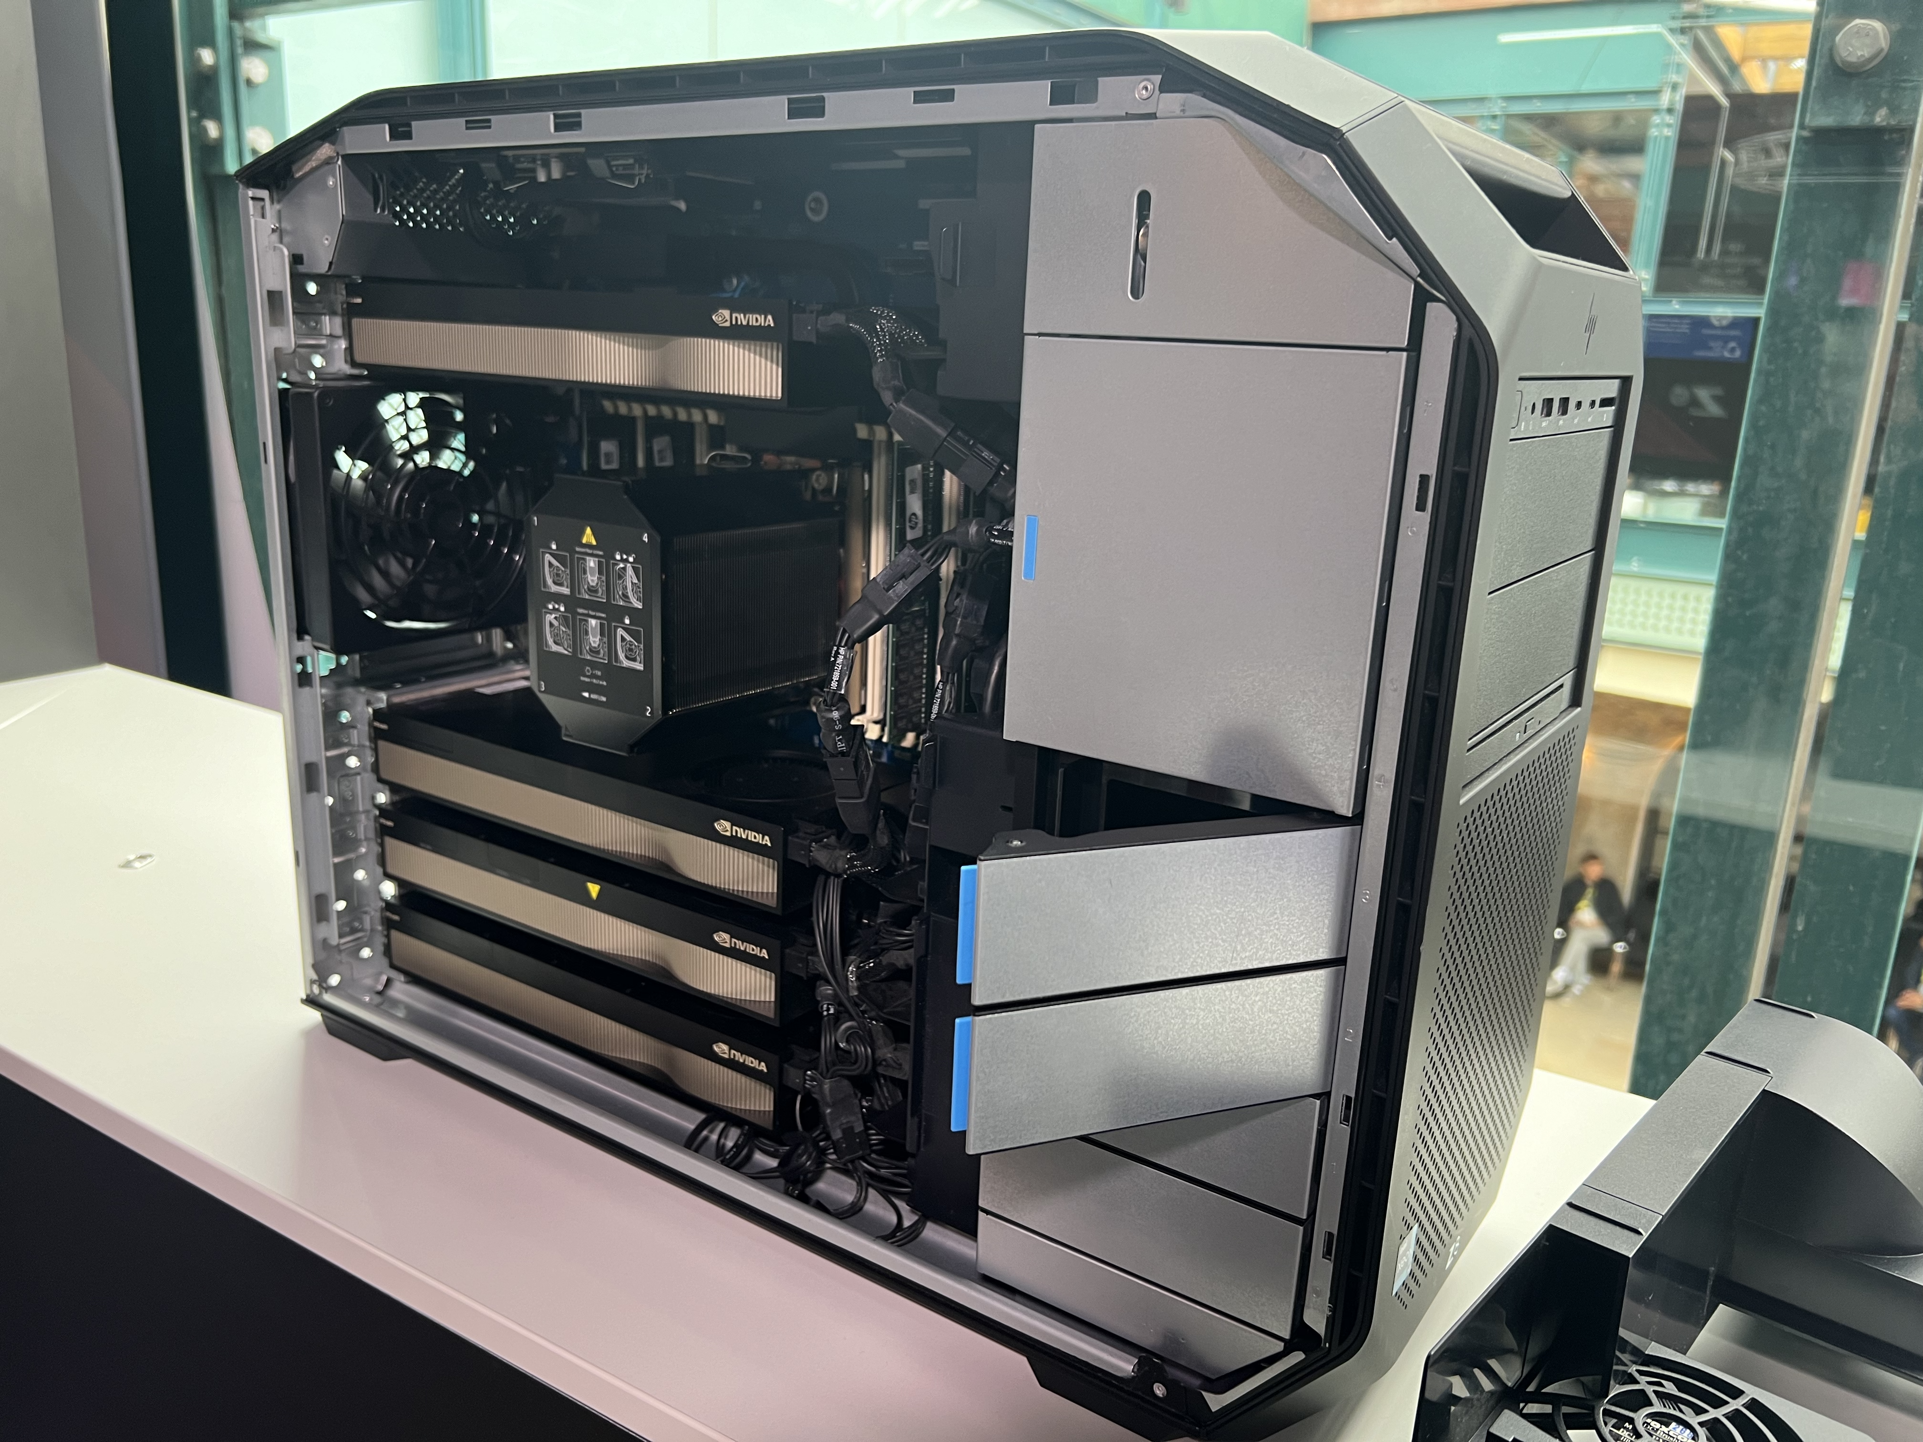
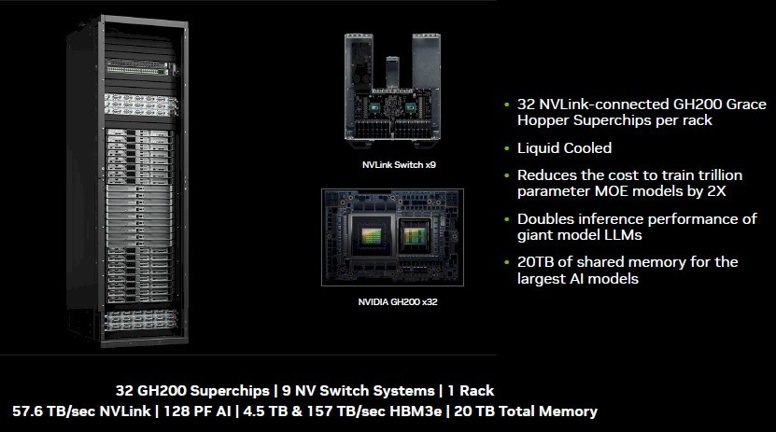
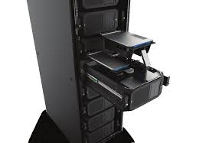
AI Training / Inference
Actually, it can be done with this
Think AI?
Most people think of HPC
Intel® Xeon® W5-3435X (up to 4.7 GHz with Intel® Turbo Boost Technology, 45 MB L3 cache, 16 cores, 32 threads)
Starting with 1125 W to 2250 W can be stack with 4x NVIDIA RTXTM A6000
Studio AI pre-build software
16
© 2024 Digital Realty Trust®
Notes:
1000W-1500W.
What are the implications?
Clouds – connected to more clouds
Locations – more locations where apps and data are located
Applications – more apps, SaaS
Data & Data Exchange – more data to manage, more to move around and track
Distributed Workflows – more done in various places
Security – everyone is worried about it
From the IT manager to the CIO, everything is more complex. It’s not simple; it’s not in their data center, and it’s not like it used to be.
Typical issues using Internet to access the Cloud:
All my traffic is going over the Internet
I expose my workloads and application to security attacks
There is no guarantee about bandwidth and path taken by my traffic
Bandwidth on Internet is shared amongst many.
Latency is high
I am exposed to packet loss
Great number of hops (more chance of outages)
If I run IPsec, I create overhead for my traffic, lower throughput and network performance

Slide 17



PDx®: Data Loss Protection
Data Protection by Customer, Data from Public Clouds & Customer Facilities
Colocation-based Interconnection
Colocation-based Virtual Interconnection
ServiceFabric™
Data Flow
Needs
KEY
Request
Response
Provide Zero Trust Environment to End-Users
Secure private connectivity to trusted data
Performant access to data anywhere
Scalable footprint to support growth
Digital Infrastructure Hub
3
Customer or Partner Provided Equipment
Data
Replication
Challenges
1
Network
Security
Applications
Customer Stored Data
Cost-effective interconnected Metro sites
Unpredictable scaling requirements
Maintaining security and compliance of data
End-to-end control of ingress/egress access points
ServiceFabric™
Digital Realty Provided
ServiceFabric™
1
Customer Data Center
IaaS / PaaS Infrastructure
Cabinet(s)
HD or Std
Port, Cross Connects
Cage,
Suite, Hall
2
Data
Replication
Colocation & Interconnection
Actions
On Ramps
Customer or Partner Provided Equipment
Firewall
Customer Stored Data
Establish direct connections to public cloud
Connect to your private infrastructure
Deploy your private infrastructure in colocation
Operationalize Digital Infrastructure Hub
Archived
Data
Customer Office
Public Cloud Provider
4
Network
Security
Data Lake
ServiceFabric™
Digital Realty Provided
ServiceFabric™
End User
Benefits
Cabinet(s)
HD or Std
Port, Cross Connects
Cage,
Suite, Hall
Establish Zero Trust Environment
Cloud-adjacent colocation reduces latency
Enables direct secure access to public cloud
Security and compliance for data
CORE
User
CLOUD
Colocation & Interconnection
EDGE
1.
Bring Data to
Data Exchange
2.
Secure Private
Cloud Interconnect
3.
Quarantine Bad Traffic, Load Balance Clean Traffic
4.
Zero Trust Environment for End-Users
HYBRID WORK
H3
Enterprise End User
Data Loss Protection
Notes:
Protecting your data, protecting your critical infrastructure

Slide 18
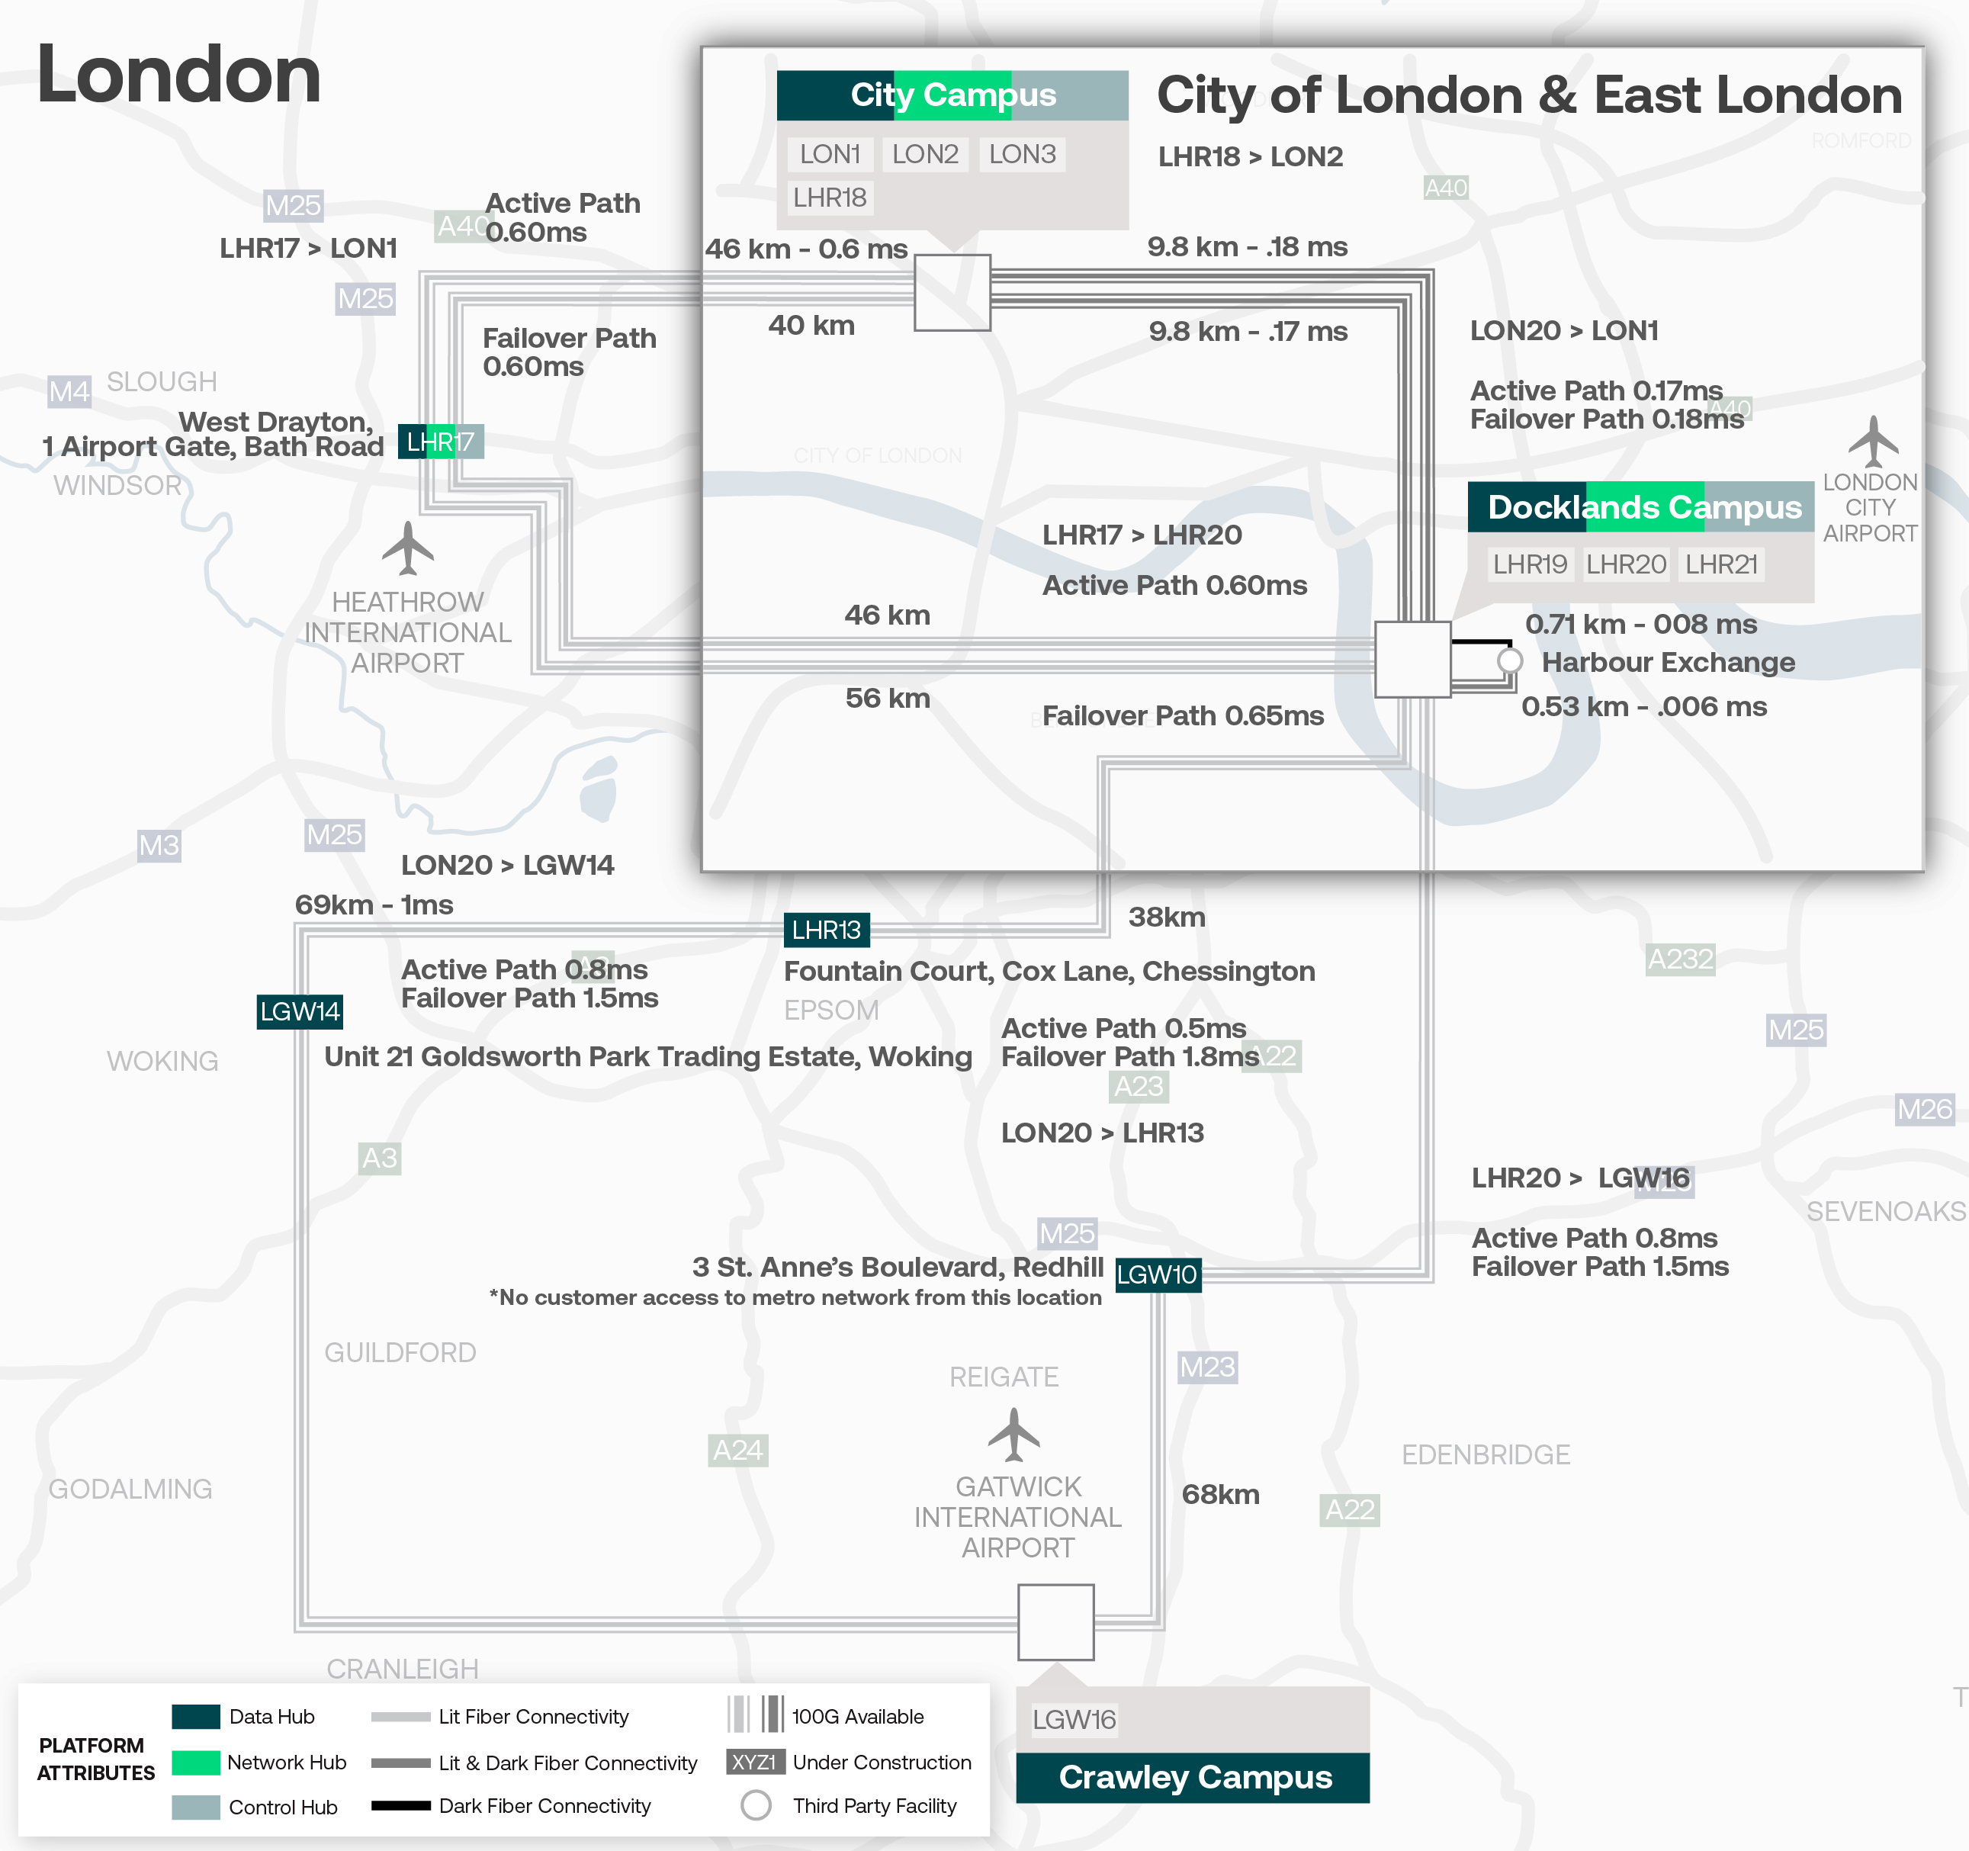
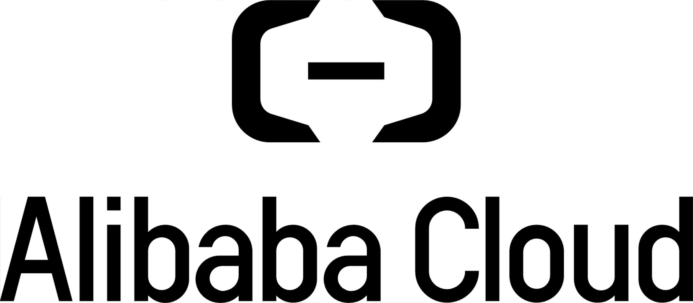


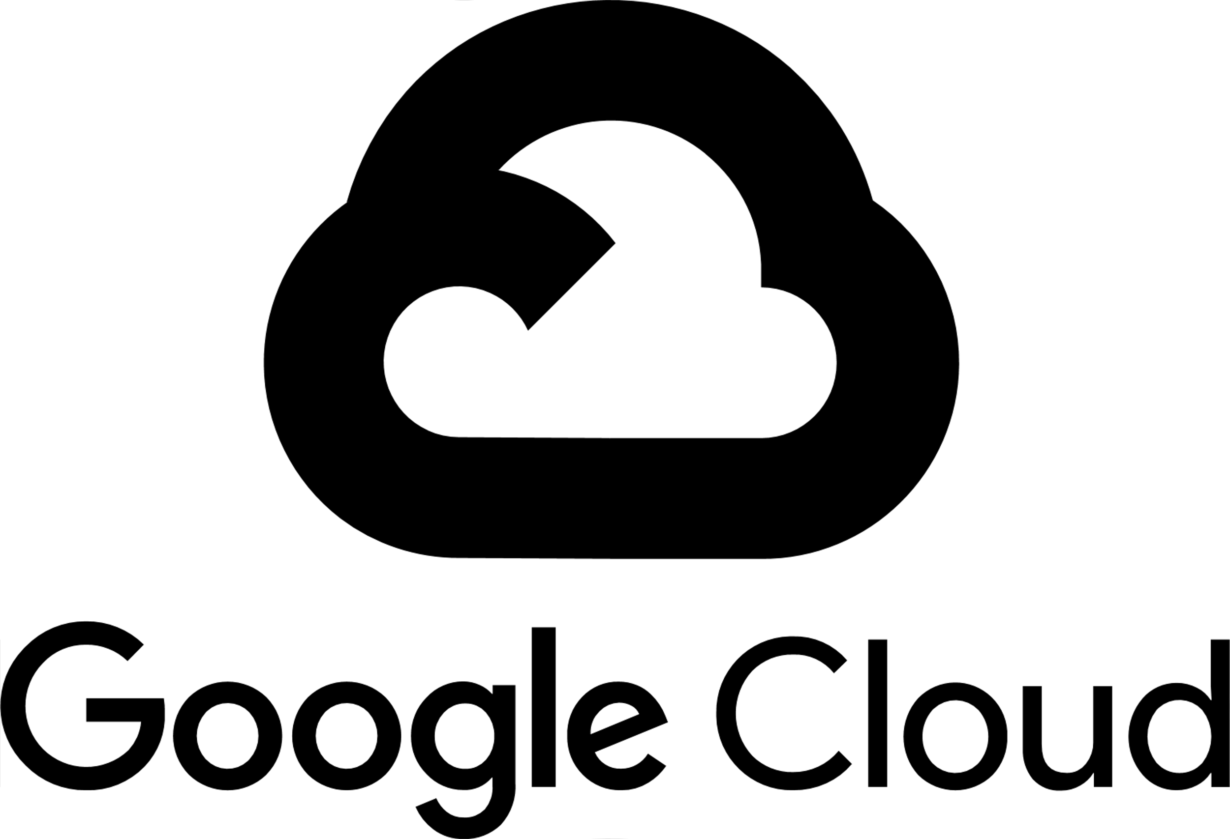

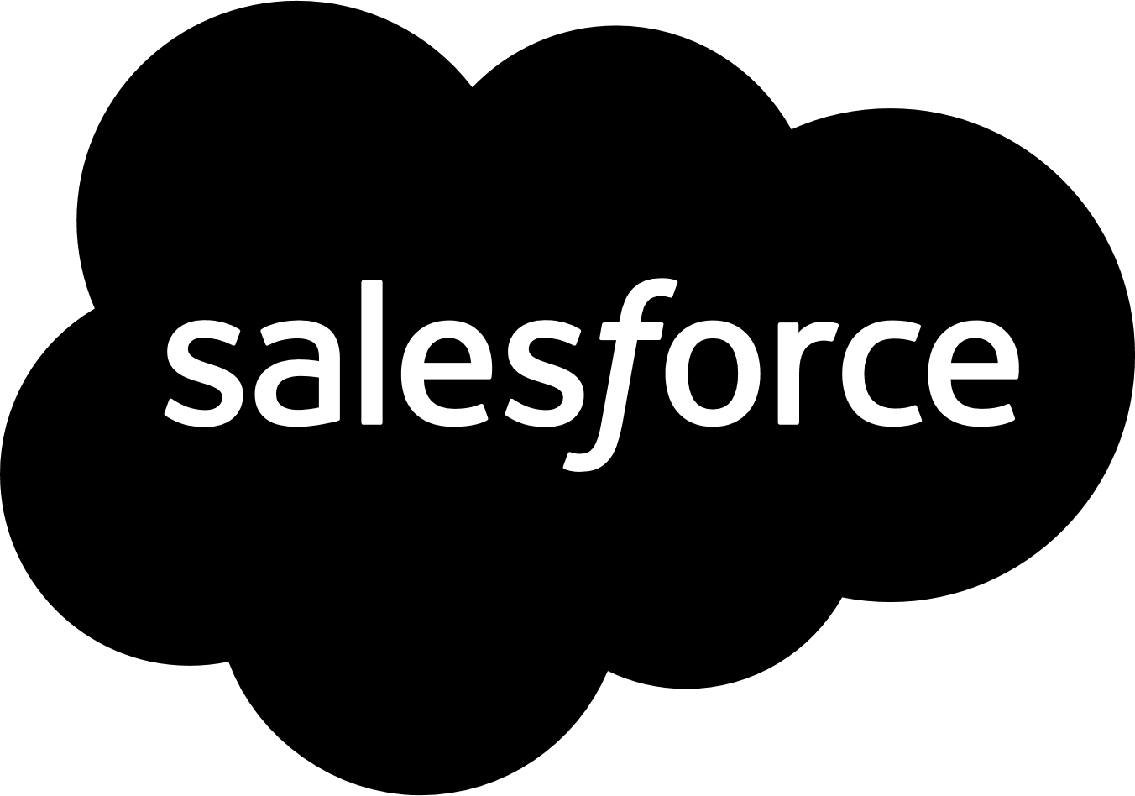


London Metro Connect
6
Interconnected
Campuses
13
Data Centers
75%
of Fortune 500
195+
Carriers
© 2024 Digital Realty Trust®
Notes:
Take active path & failover path to a different slide

Slide 19
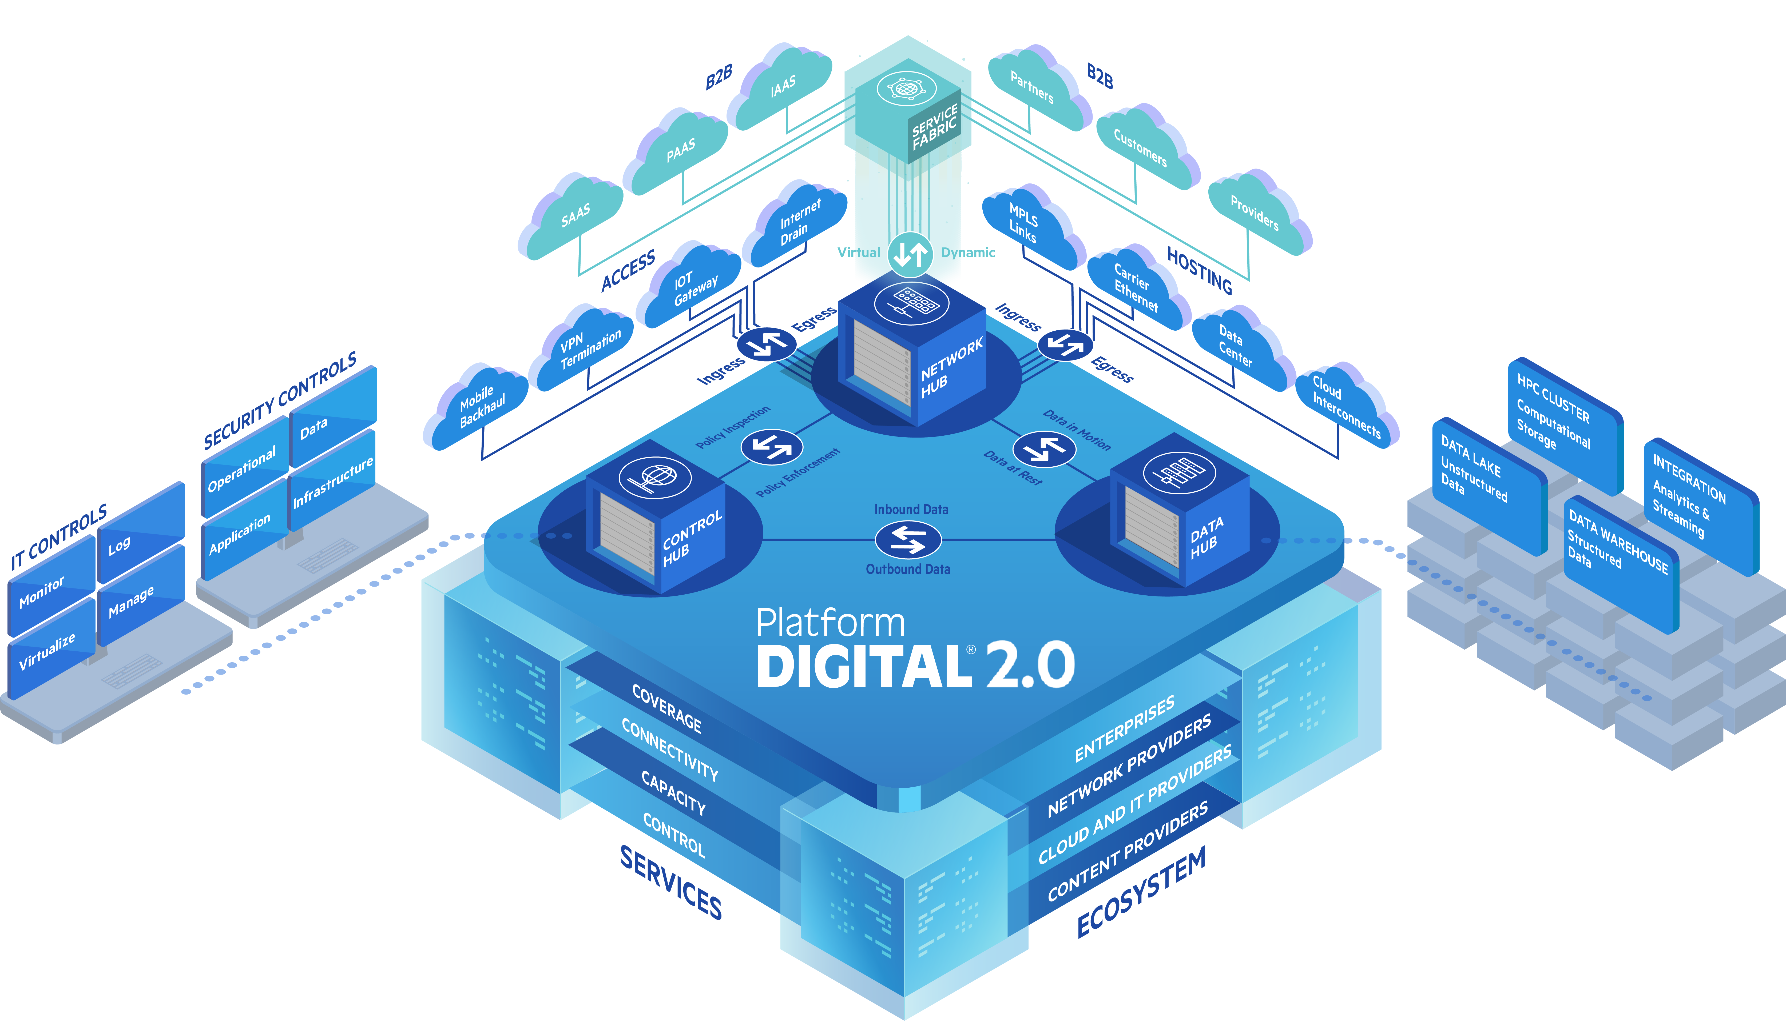


PlatformDIGITAL®
19
© 2024 Digital Realty Trust®
Notes:
Platform – that provide single interface to manage cross-connectivity across the globe

Slide 20
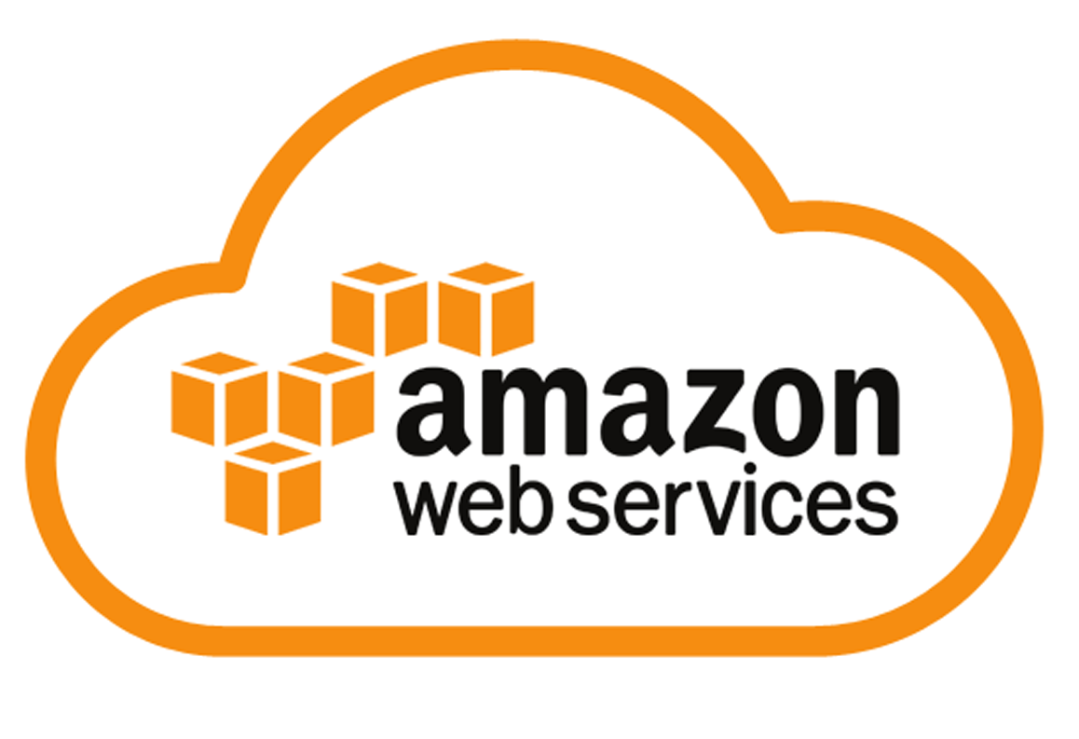
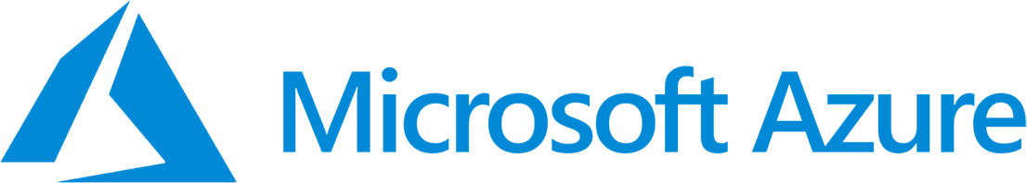
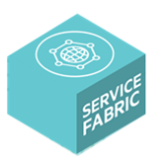
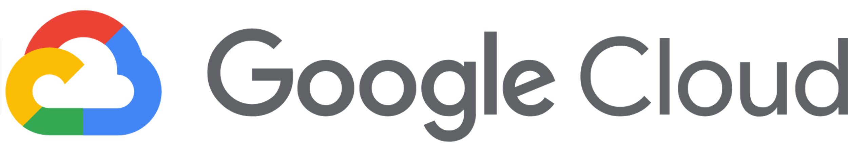
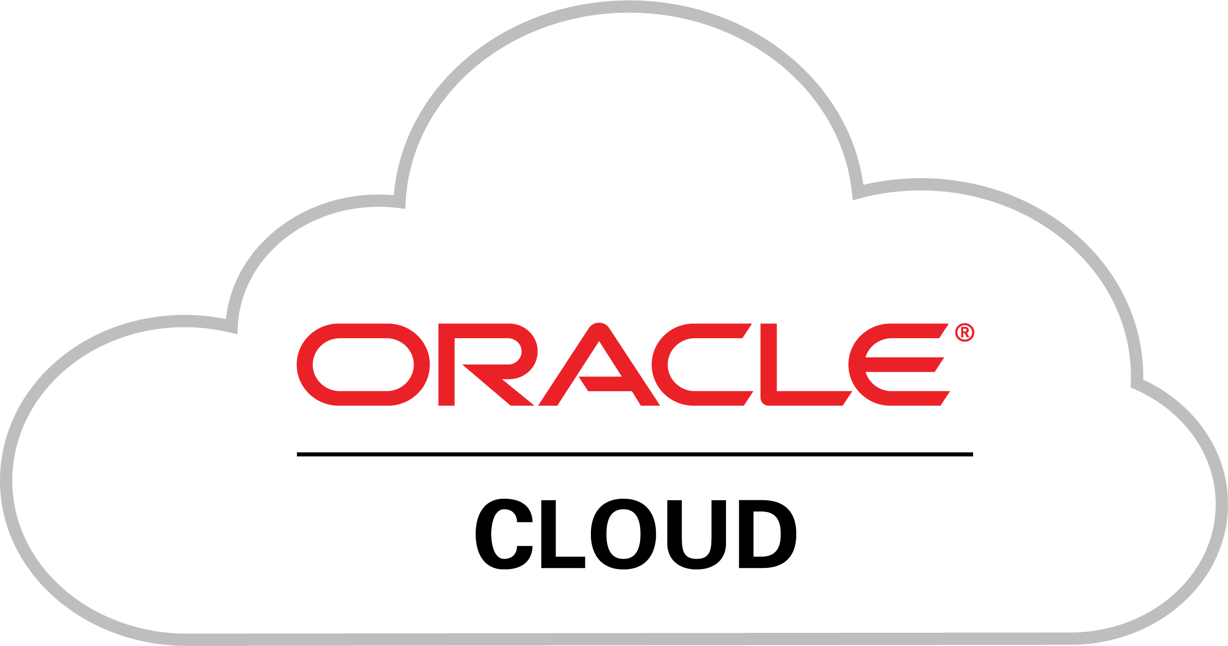
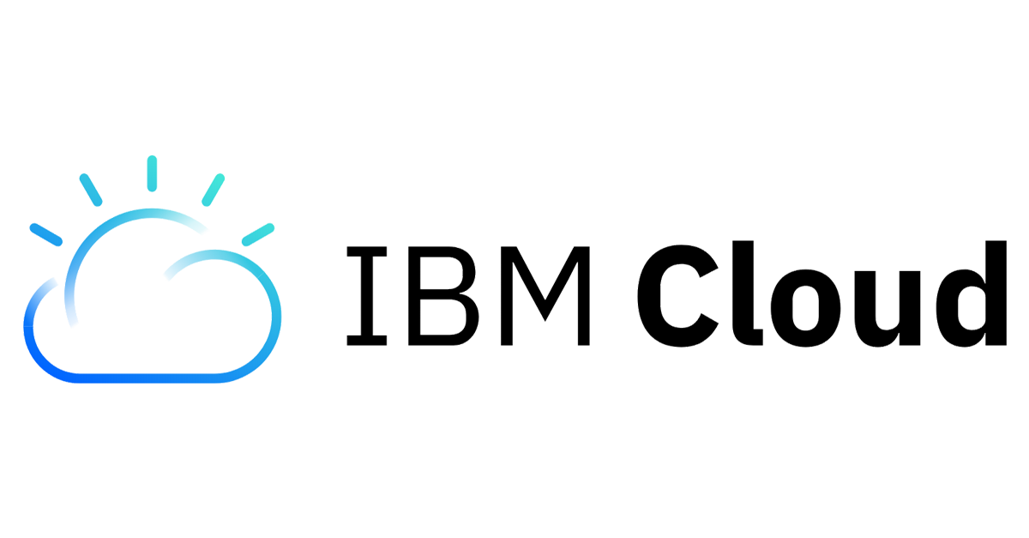


ServiceFabric™ Connect: Private Connections Made Easy
Establish a Port which supports multiple virtual private connections
Create a Link for direct, private connections to multiple Cloud Service Providers, Network Providers, SaaS Providers and other participants of the platform
Add Services (optional) Optimize and secure workflows
Press and the connection will be available within a couple of minutes
Own DC in other metro
Metro
CREATE
Own DC
Own DC at other provider
20
© 2024 Digital Realty Trust®
Notes:
Setting up ServiceFabric Connect is simply easy and quick.
Login into the ServiceFabric Portal at servicefabric.digitalrealty.com
Create a Port or virtual Router (vRouter)
Build connections to other ports, vRouters or Cloud Providers on the ServiceFabric platform
That’s it.

Slide 21
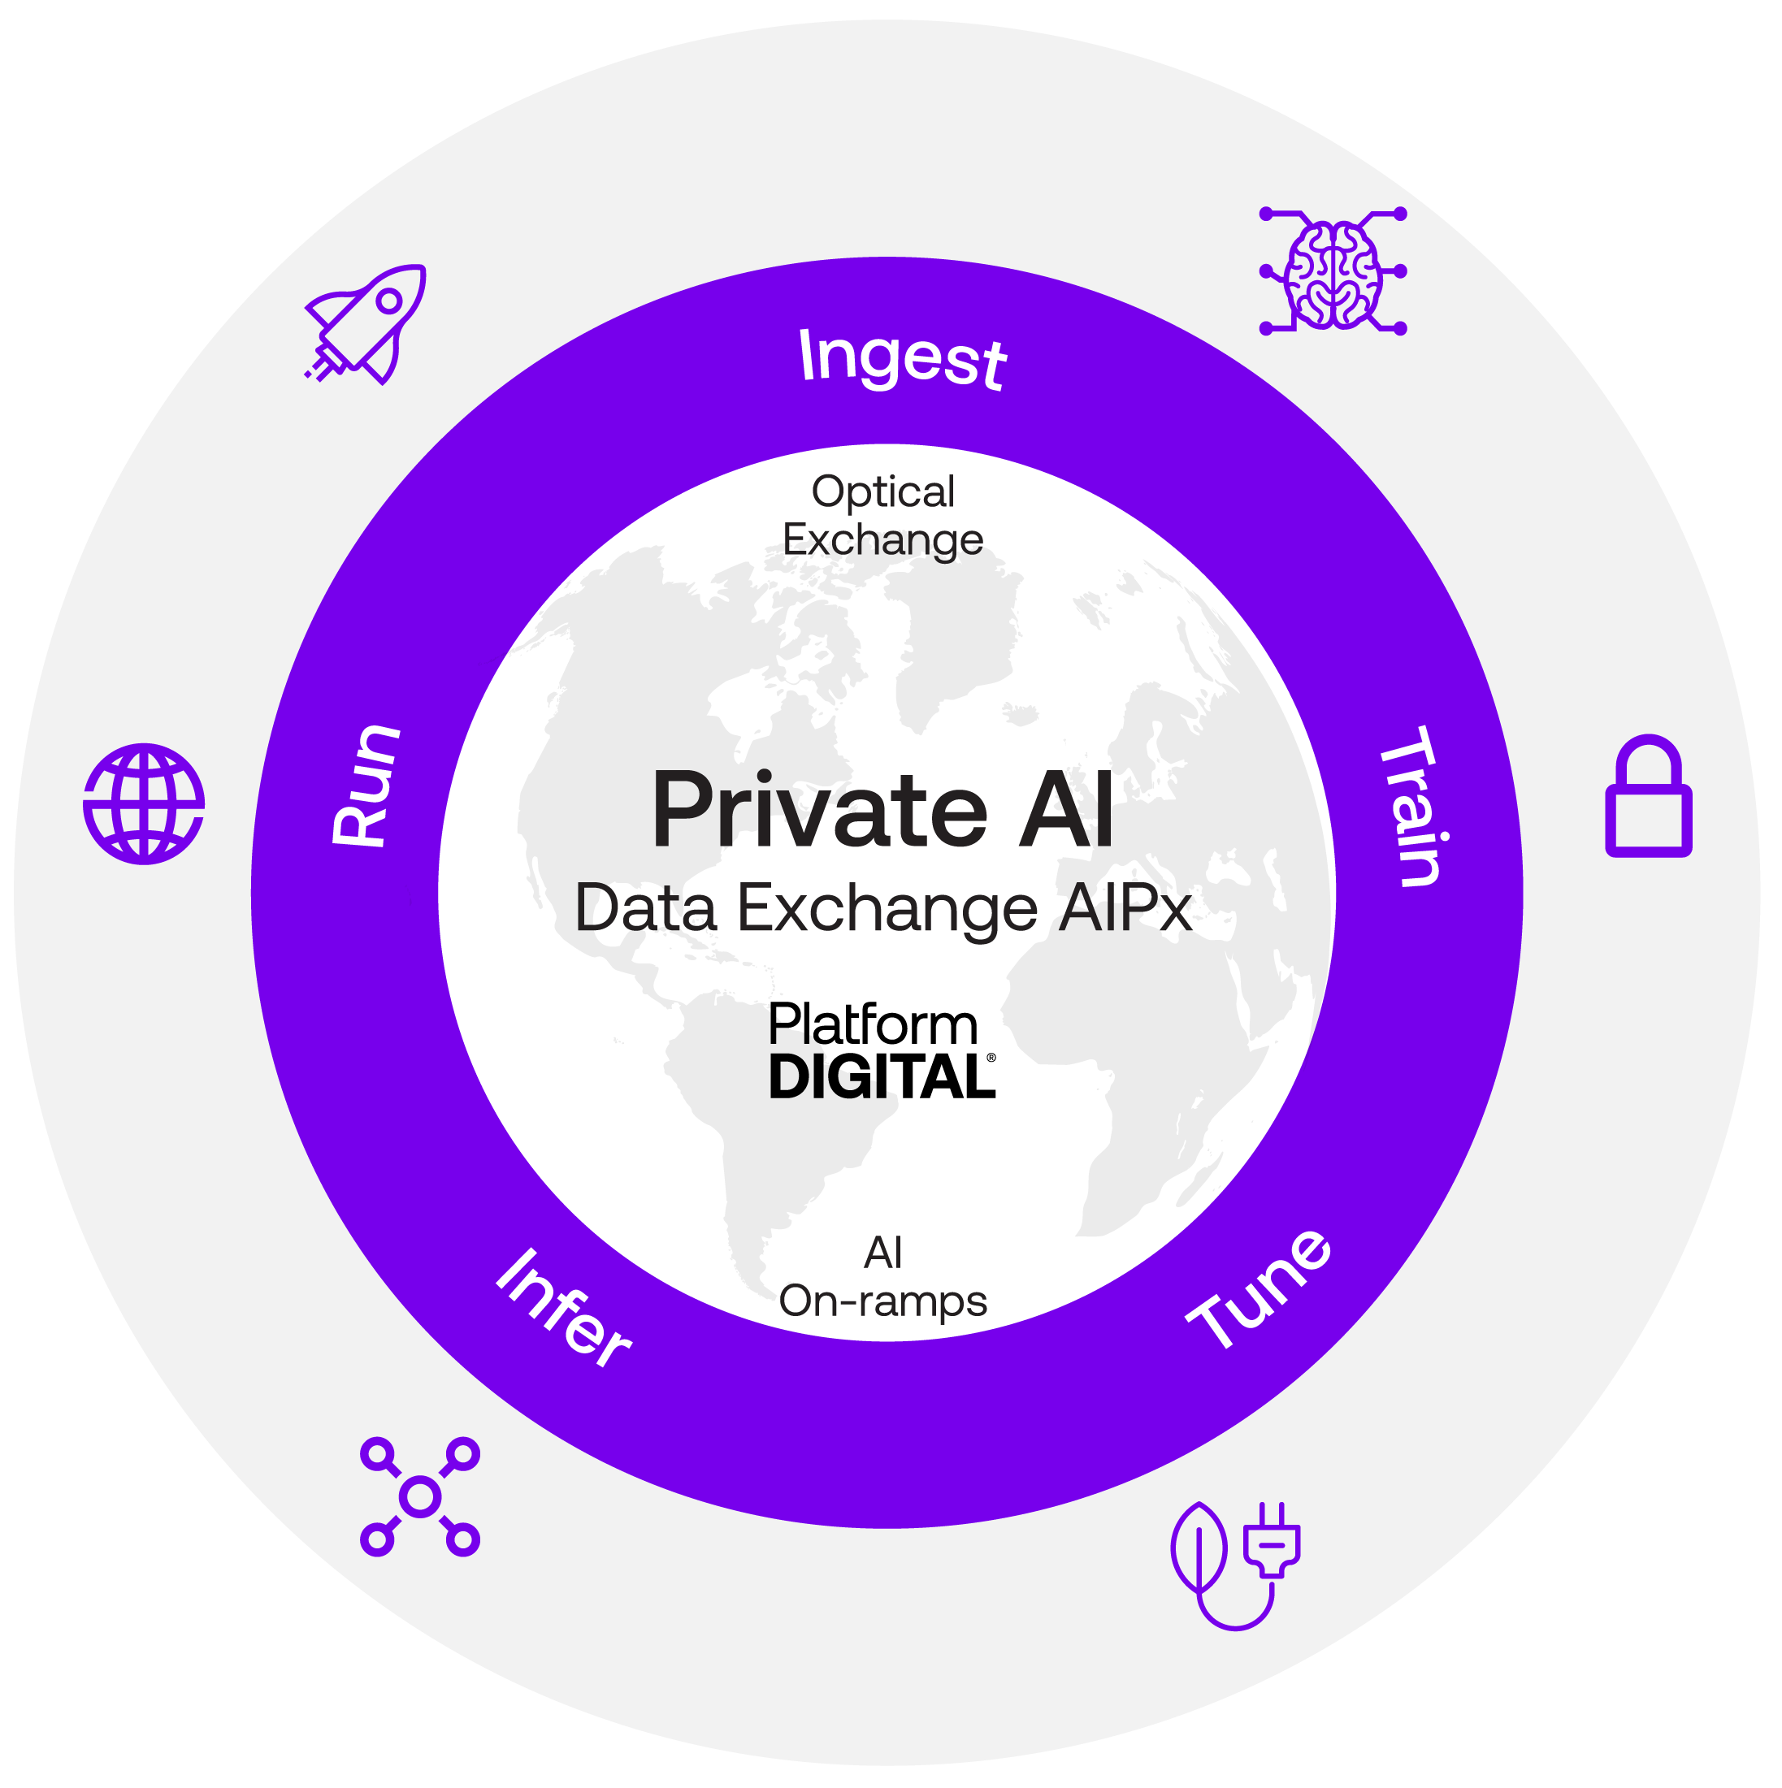
Gain First Mover Advantage by Enabling Private Interconnections
Gain first mover advantage by enabling private interconnections to the AI Ecosystem you (and your customers) need to access. Deploy AIPx solutions on PlatformDIGITAL.
FUTURE-PROOFED
ORCHESTRATION
HD Colo accelerates 70 kW/rack deployments in 34 markets across the global
ServiceFabric enables intelligent AI workflow orchestration via service chaining
GLOBAL
SECURE
Deployed in 50+ metros across 6 continents to meet your customers where they are
Private network, private model access & tuning, distributed in key markets
OPEN
SUSTAINABLE
Access to 5,000 customers, 500 data centers, and 135 services from 80 service providers
126 DCs powered by renewable energy, 1.3 GW of wind and solar capacity globally
© 2024 Digital Realty Trust®
21
DIGITAL REALTY CONFIDENTIAL – not for distribution without written permission. PATENT PENDING for AIPx and related orchestration, private fabric/exchange, broader.
Notes:
Global, Open, Future Proofed

Slide 22
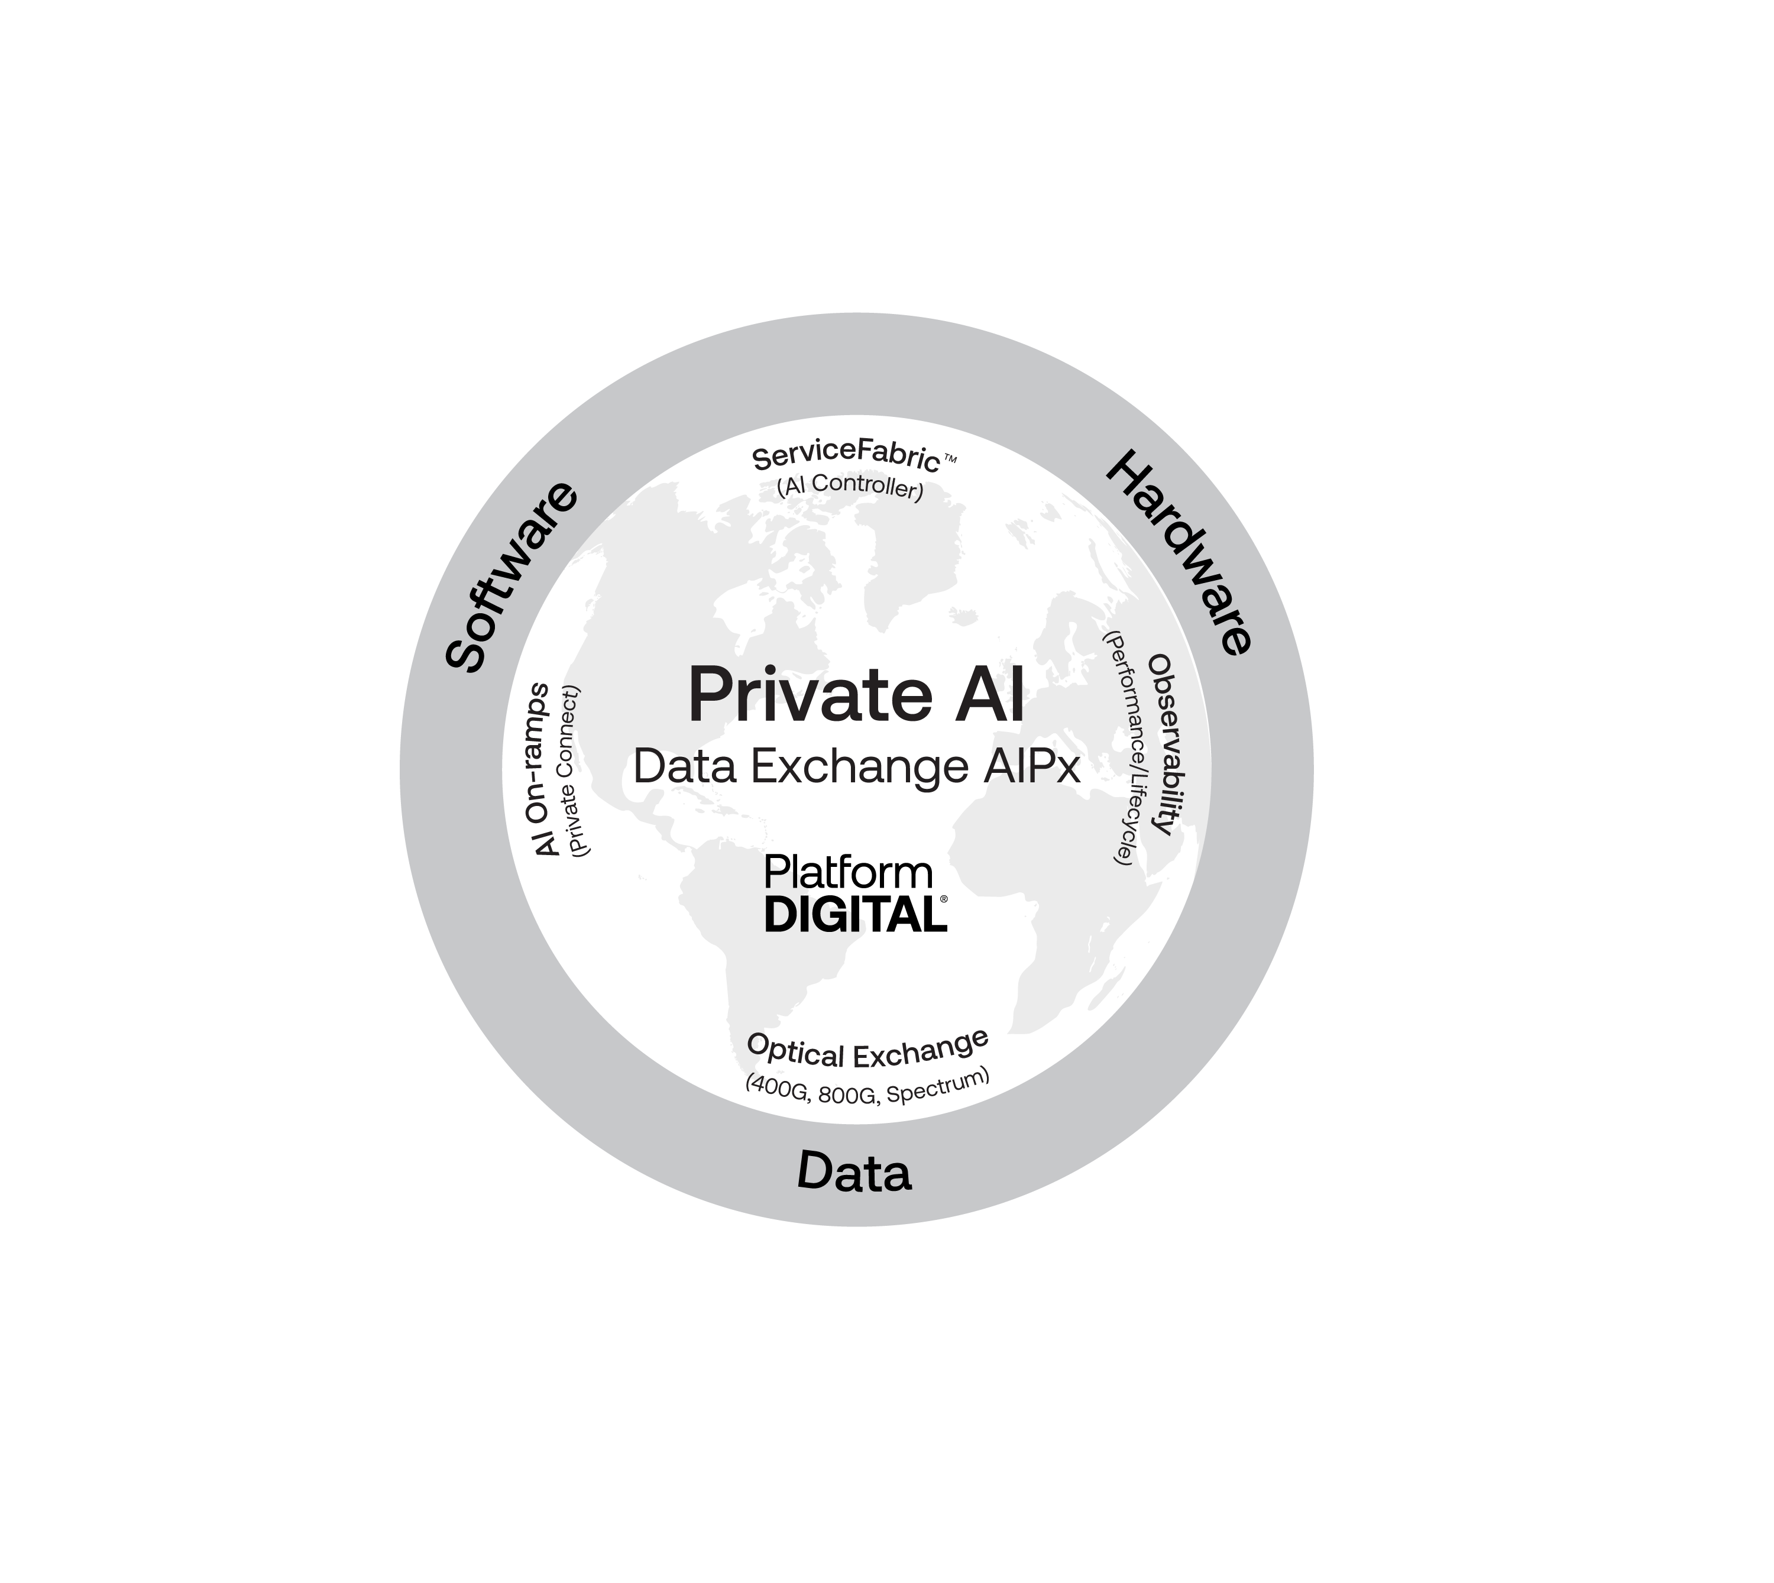


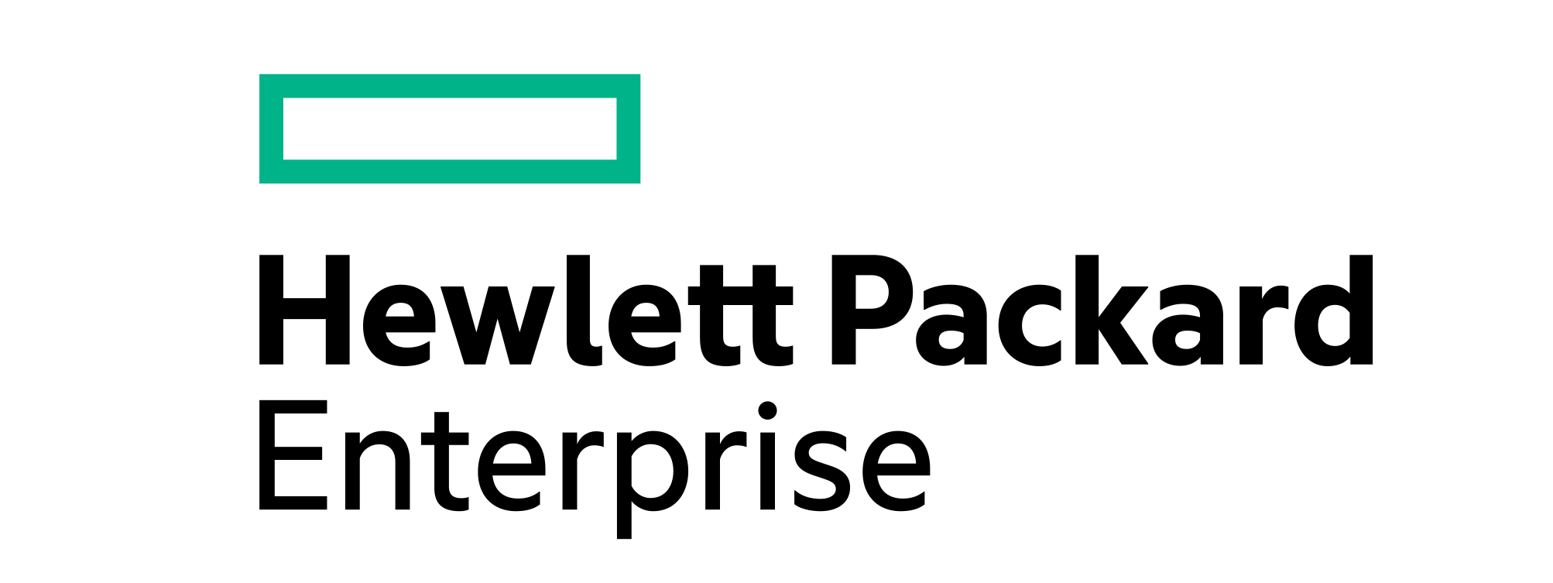


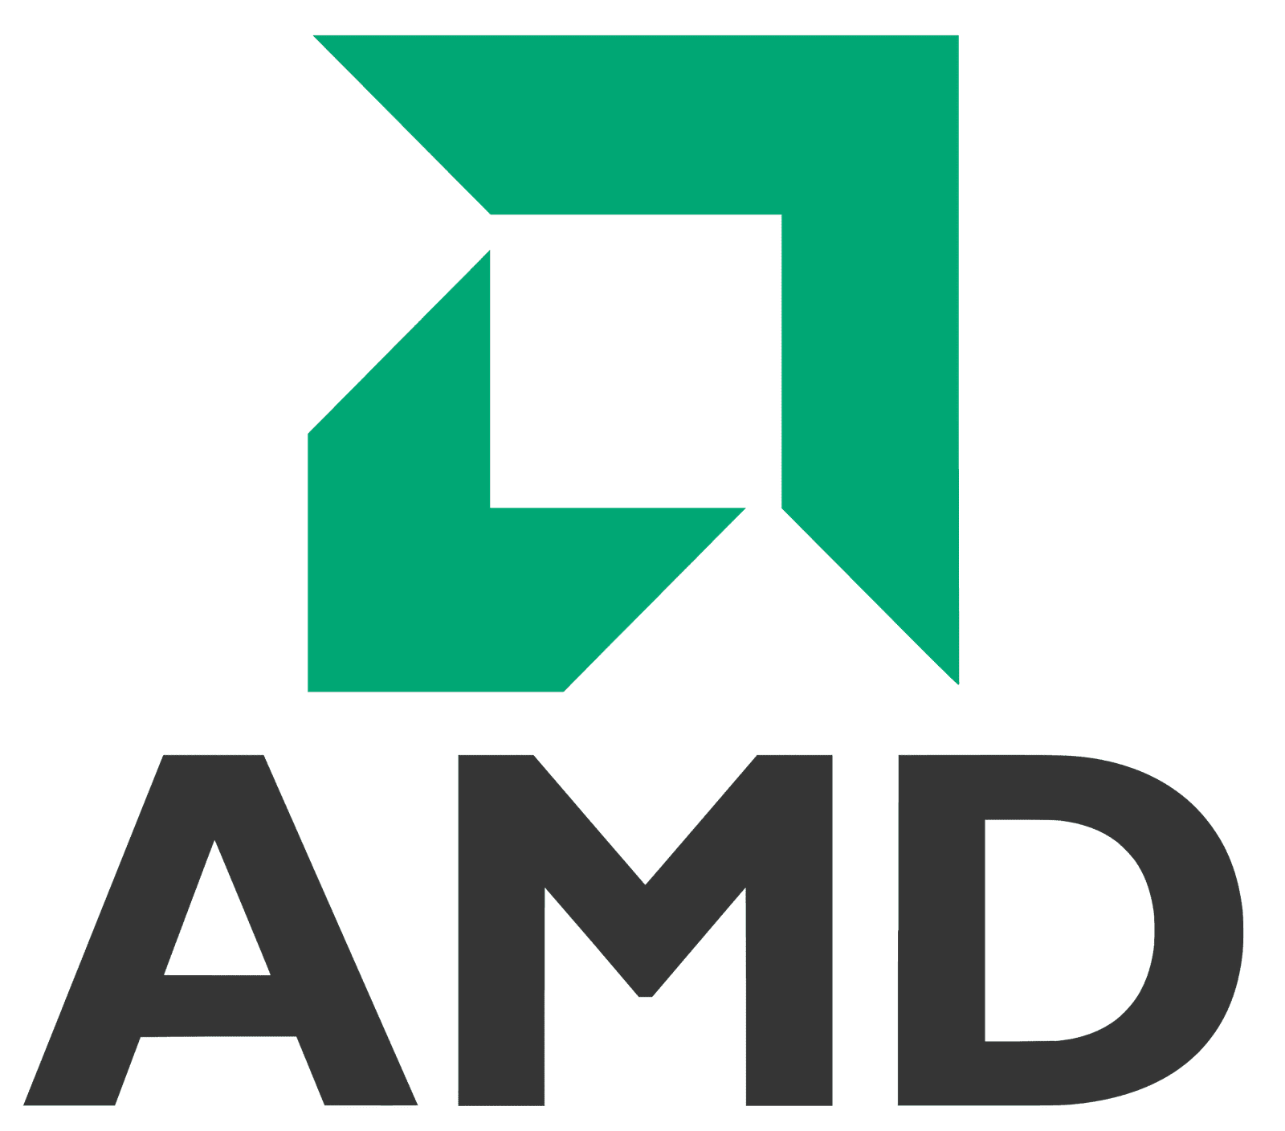

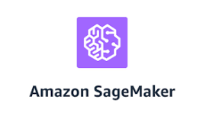








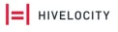
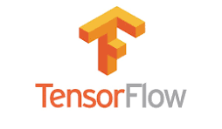

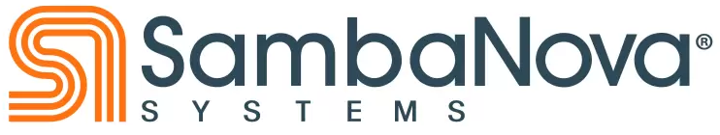
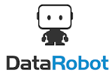


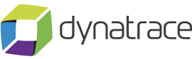
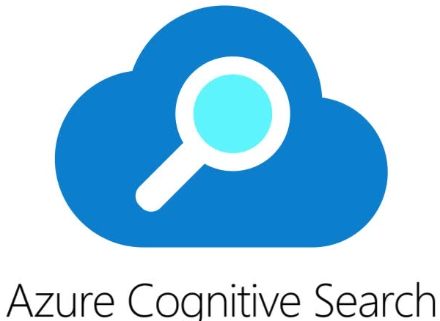
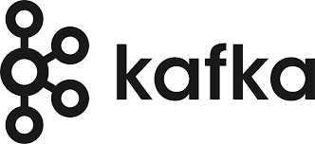


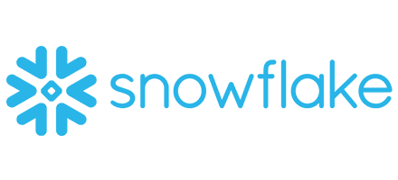
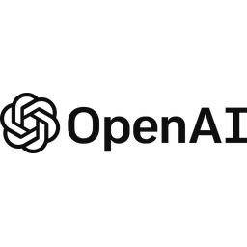
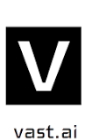

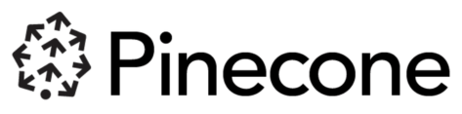

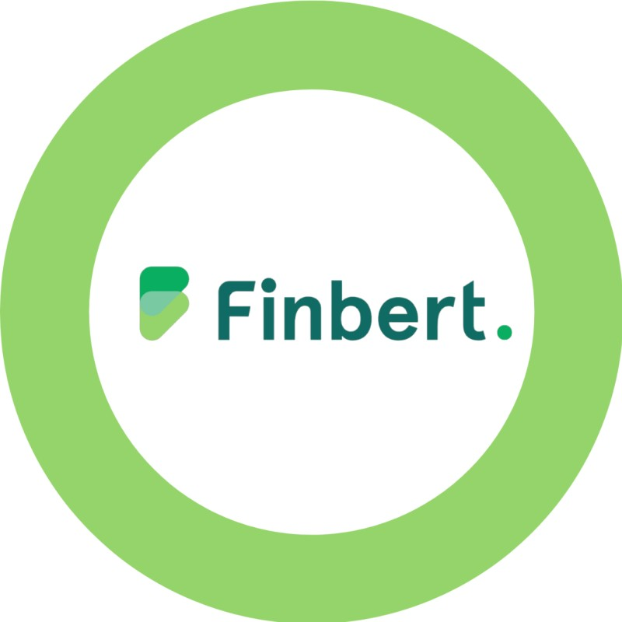
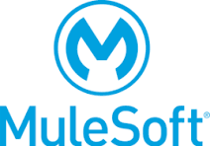

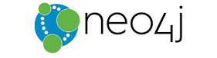



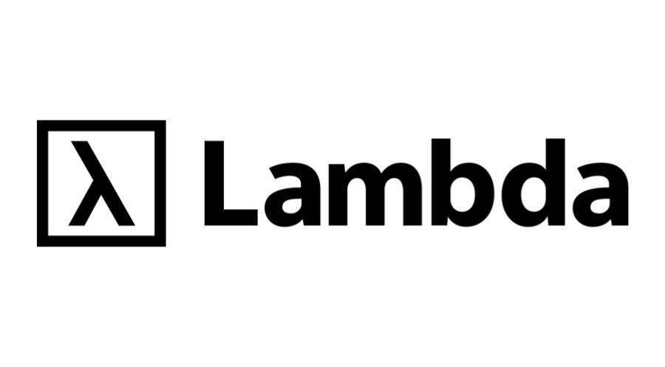




ServiceFabric™ Connect
Private AI Data Exchange (AIPx) leverages ServiceFabric,™ enabling
partners to extend their AI Infrastructure and Services over a single port (private, dedicated, AI On-ramp). The Service Directory, Service Key and Click to Connect features simplify and accelerate service distribution, consumption, and time to revenue to participating Enterprise and Service Provider customers and partners:
Distribution & aggregation ports (AI On-ramps)
Service Directory – Advertise services & manage distribution ports to the AI Ecosystem
Service Key – Enable connections via discrete assignable connection keys
Click to Connect - Designate and manage your click to connect ports, automatically accepting connections
Digital Realty is committed to making frictionless connections across workflow participants, applications, multiple clouds, networks and ecosystems.
Solution Providers
All logos are illustrative only
© 2024 Digital Realty Trust®

Slide 23
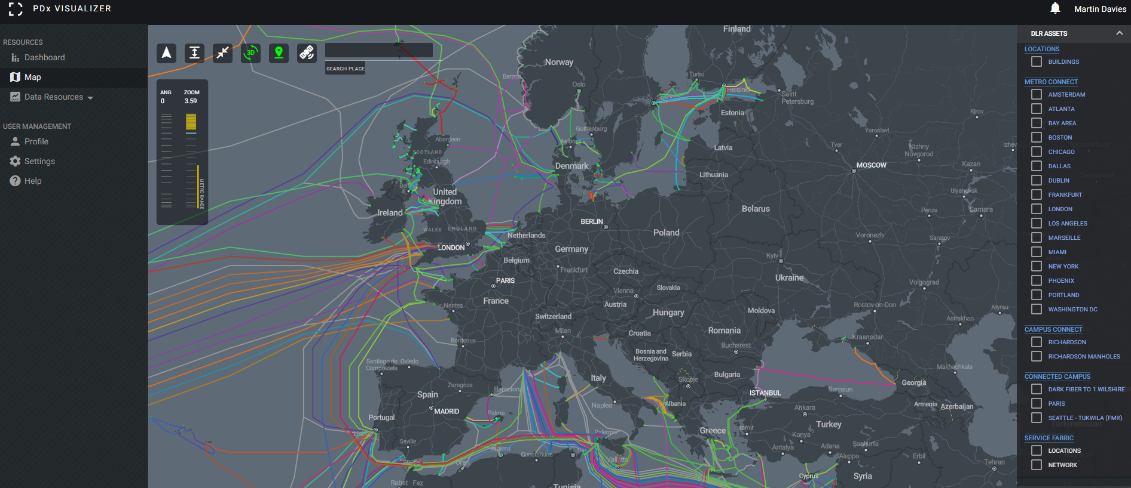
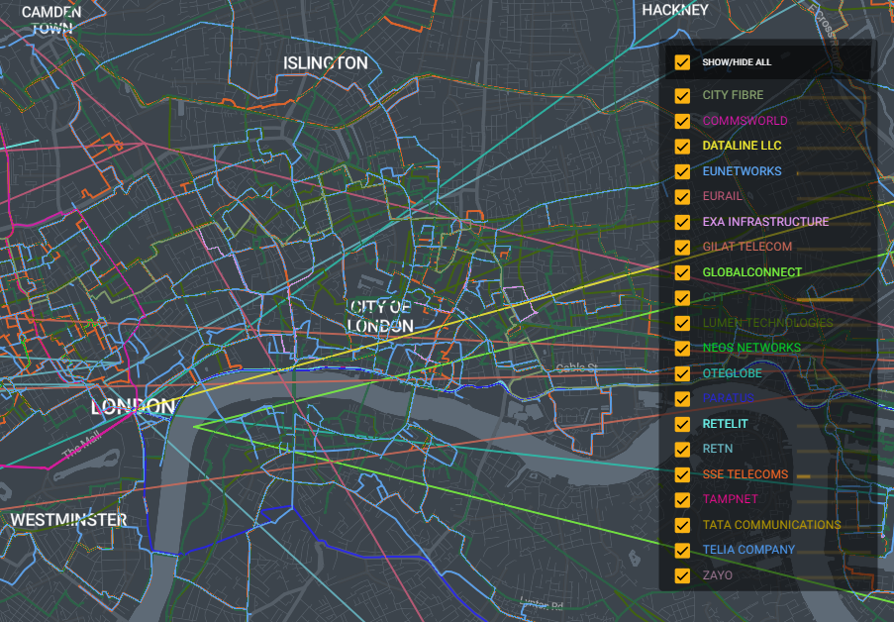
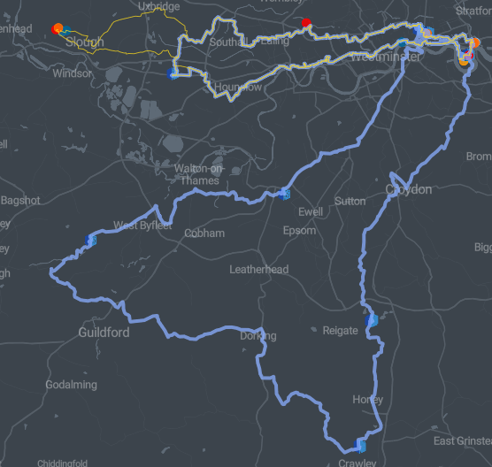
PDx Visualizer: A Virtual Tour of the Ecosystem
© 2024 Digital Realty Trust®

Slide 24
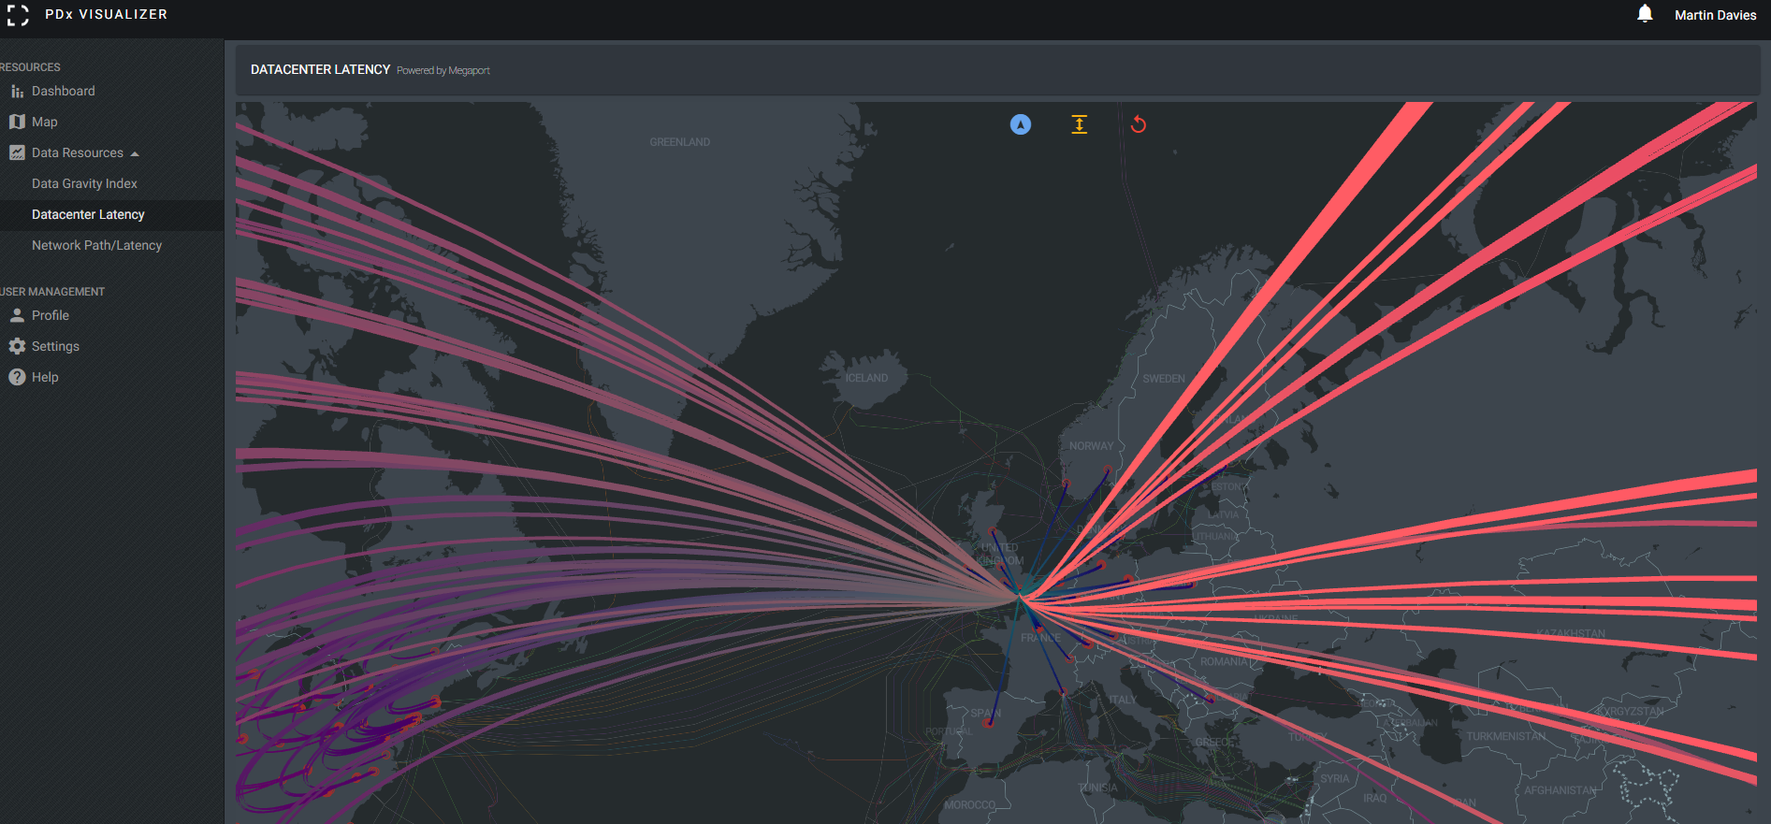
PDx Visualizer: A Virtual Tour of the Ecosystem
© 2024 Digital Realty Trust®

Slide 25
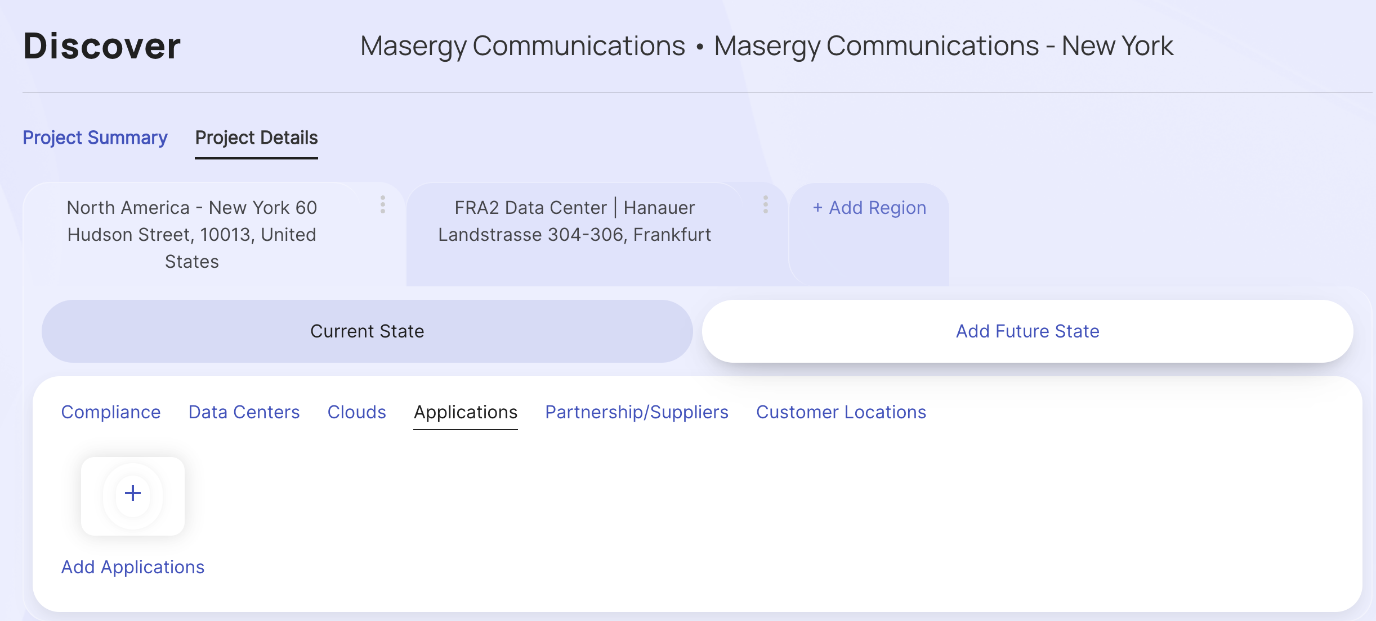
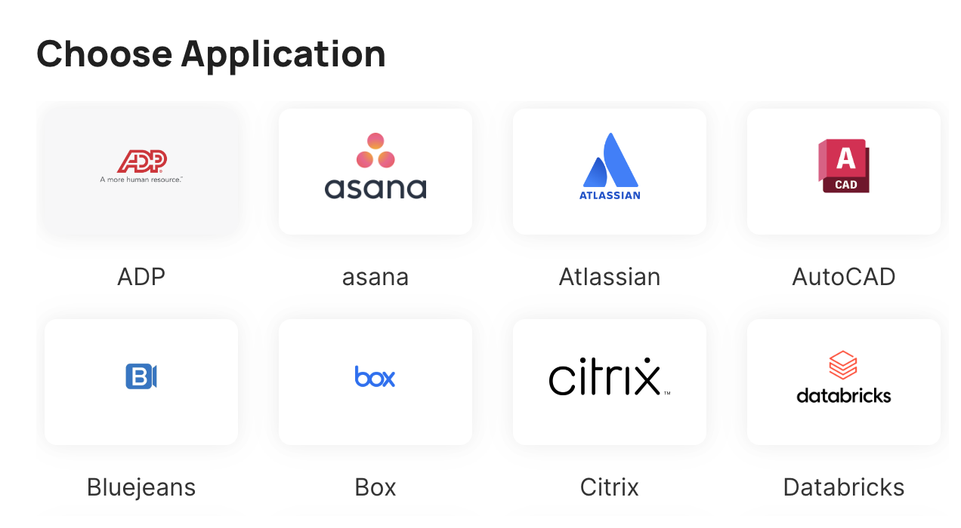
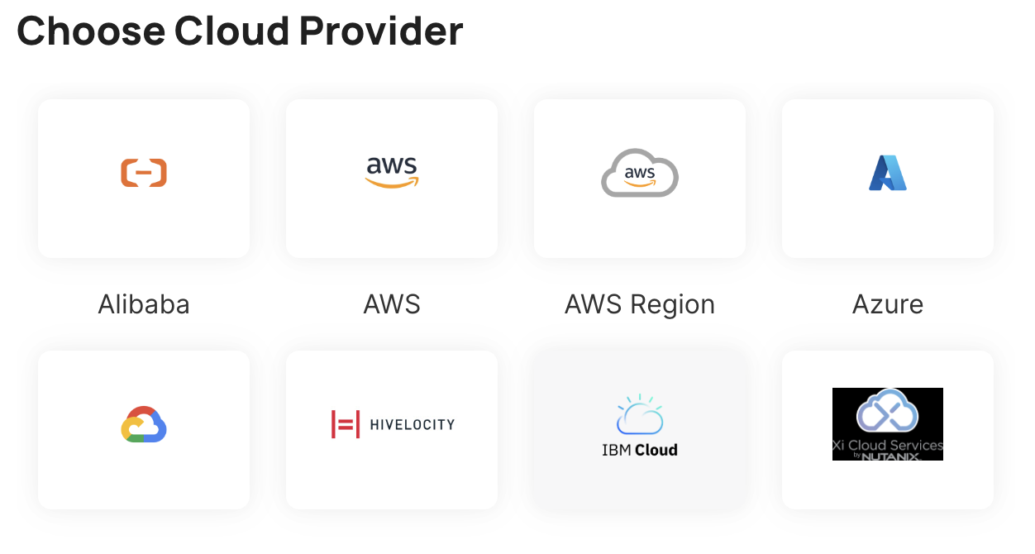
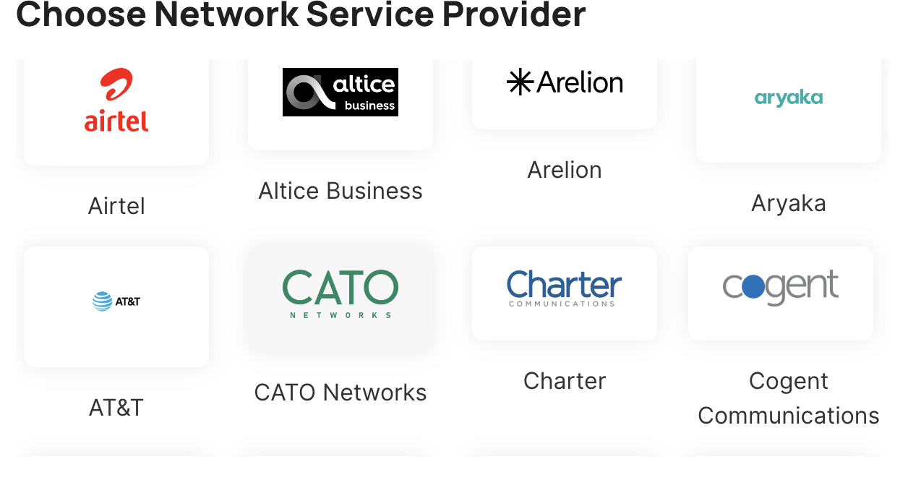
PDx Modeler: Model Customer Future Deployments
25
© 2024 Digital Realty Trust®
Notes:
Workshop – Go to market strategy

Slide 26
KEY TAKE AWAY
Network, increased ability to connect service providers together
Data centres, tackling constraint in high density compute
Connect to anyone, anywhere, anytime
26
© 2024 Digital Realty Trust®
Notes:
Fulfillment
joy
purpose

Slide 27


Thank you.
Connect with Digital Realty
Darren Chan Sr. Solution Architect darrenchan@digitalrealty.com

