Slide 1
NetUK 1
The Inaugural Conference

Slide 2
Securing the Network's Backbone
using 3rd Gen Out-of-Band (OOB) Isolated Management Infrastructure
Rene Neumann
Director of Solution Engineering
ZPE Systems, Inc.

Slide 3
Security Trends in 2024
Resilience and Isolated Management Infrastructure
Isolated Management Infrastructure
Traditional Deployments

Slide 4
Security Trends 2024
Compliance
Supply Chain
Vulnerabilities
Insurance
Ransomware
Resilience
Generative AI

Slide 5
“Our approach must shift from a futile quest for absolute invulnerability to a more realistic strategy of resiliency in which we control the impacts of failures.”
Strategy for Cyber-Physical Resilience
(White House - Feb 2024)
Notes:
“Our approach must shift from a futile quest for absolute invulnerability to a more realistic strategy of resiliency in which we control the impacts of failures.” Strategy for Cyber-Physical Resilience (White House - Feb 2024)

Slide 6
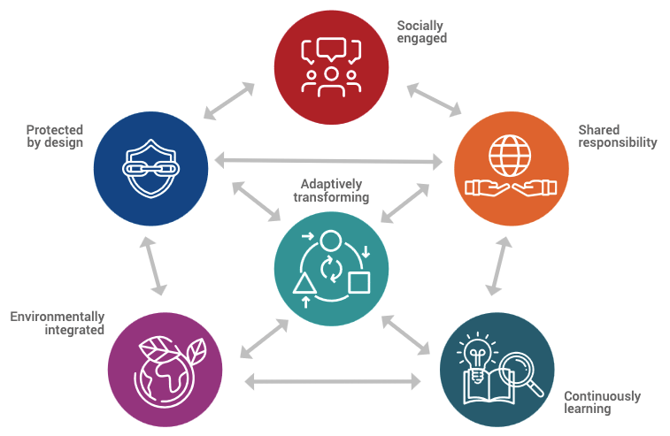
Path to Resiliency:
Isolated Management Infrastructure
Recover
Secure by Design
Shared Responsibility
Adapt and Transform
Fully Integrated
Repeatability
Isolated Management Infrastructure
*Adapted from UNDRR Resilient Infrastructure Principles
The National Security Agency (NSA) cybersecurity collaboration center and the National Institute of Standards and Technology (NIST) strongly recommend the physical isolation of management infrastructure from the production network to segregate management traffic from operational traffic. This isolation enhances security and facilitates rapid recovery in the event of compromise or outages.”
Notes:
https://media.defense.gov/2020/Sep/17/2002499616/-1/-1/0/PERFORMING_OUT_OF_BAND_NETWORK_MANAGEMENT20200911.PDF
https://www.ice.org.uk/news-insight/news-and-blogs/ice-blogs/the-civil-engineer-blog/principles-to-help-engineers-create-resilient-infrastructure
https://globalplatform.undrr.org/sites/default/files/2022-05/UNDRR%202022%20Principles%20for%20Resilient%20Infrastructure.pdf

Slide 7
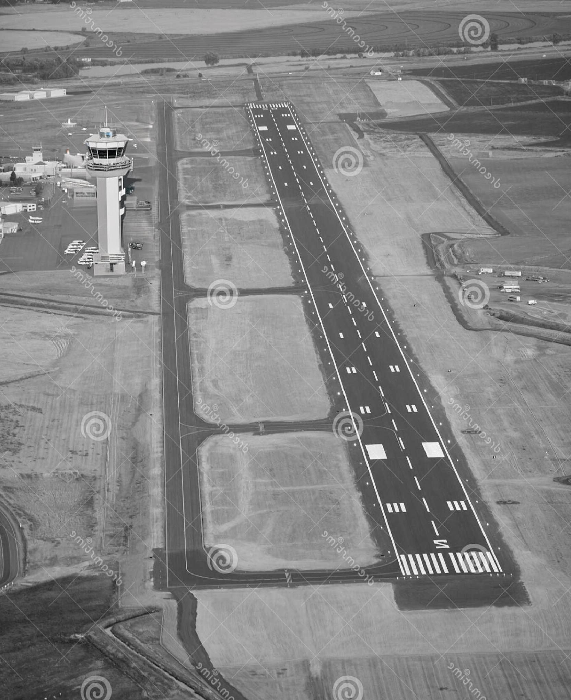
What is Isolated Management Infrastructure (IMI)?
Control
(ZTNA)
Think of IMI as an access road.
It is your direct line of access to the Production Infrastructure should you need it.
Recovery
Physical Segmentation (OOB) of Access to Management Infrastructure
Control and Security (Zero Trust Principles)
Recovery Tools Backup and Restore
Repeatability - Automation
Security & Isolation
Management Infrastructure
Production
Infrastructure
Notes:
Talk track: Reference to CISA recommendation for OOB as means to achieve Isolation.

Slide 8
How do we build IMI with OOB?
Gen 3:
Fully Isolated
Security by Design
Platform Approach
Adaptable
Gen 2:
Protected, Shared Infrastructure
The most Common Implementation Today
Gen 1: Direct Access
Banned by CISA directive

Slide 9
Gen 1: Direct Networked Management Interfaces
Banned by BOD 23-02 (CISA)
Control Plane Infrastructure
Production Infrastructure
Remote Admin
NGFW
What is it? | Gaps
Management Interfaces are directly accessible | No Separation
Admins use insecure protocols (RDP or Telnet) | Vulnerable Management Interfaces
No VPN is used to access management interfaces | Management Interfaces can be Indexed and searched by the public
Spines
Leaf Switches
APICs
APIC
Server 1
APIC
Server 2
APIC
Server 3

Slide 10
Gen 2: Protected Network Management Interfaces
Acceptable by BOD 23-02 (CISA)
Control Plane Infrastructure
Production Infrastructure
Remote
Out-of-Band
NGFW
Jumpbox
Admin
Local
Spines
What is it? | Gaps
Management interfaces accessible via VPN only | No Separation
Admins use a mix of protocols | Vulnerable Management Interfaces
 | Easy to jump between zones
Leaf Switches
APICs
APIC
Server 1
APIC
Server 2
APIC
Server 3

Slide 11
Gen 3: Isolated Management Infrastructure
Strongly Encouraged by BOD 23-02 (CISA)
Control Plane Infrastructure
Production Infrastructure
Remote
Out-of-Band
NGFW
Local
Admin
Spines
Zero Trust
Jumpbox
Services
Security & Isolation
Tools
Leaf Switches
APICs
APIC
Server 1
APIC
Server 2
APIC
Server 3

Slide 12
What goes into implementing Isolated Management Infrastructure?
VM
Applications
Infrastructure Automation
Ansible / Salt
ZTP
Python
DNA Center
ACI
Security
Hardware
VPN/Overlay
Patches
ZTNA
NGFW
Networking Services
Routing
Monitoring
DNS/DHCP /NTP
DNS/DHCP /NTP
Storage
Management Standards
RS232
Redfish
HTTPS
RESTful API
RDP/VPN API
Connectivity
OOB
LAN
WAN
4G/5G
Satellite
Hardware
Connectivity
Compute
Storage
Full Physical Isolation
Switching
Isolated Management Platform

Slide 13
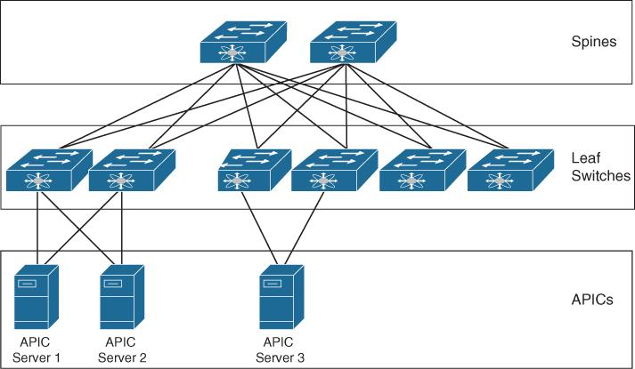
Generation 3 Out-of-Band (OOB) Management design and deploy
VPN
Control Plane Infrastructure
Production Infrastructure
Cellular 4G LTE / 5G
Remote
Out-of-Band
VPN
Local
NGFW
Admin
Zero Trust
Jumpbox
Security & Isolation
Gen 3 Out-of-Band Device
OOB
APPLICATION
AUTOMATION
SSH,RS232
TOOLS
ANSIBLE
IPMI, WEB
RECOVERY
PYTHON

Slide 14
Benefits of Isolated Management Infrastructure based on Gen 3 OOB
Improved Compliance
Lower IT Costs
Faster Vulnerability Patching
Improved Business Continuity
Resilience
Faster Ransomware Recovery
Future-Proof Platform

