Slide 1
Notes:
Good Afternoon everyone. Welcome to NetUK 1, the inaugural event. Thanks to everyone for coming, I’m glad we’re all here and honestly I’m just as surprised as everyone that we managed to pull this off. Anyway, for those that don’t know me I’m Dave Pumford, the NetUK Management Committee Chair. I’ve got a few introductory slides to go through before I hand you over for the conference content, don’t worry I’ll be quick so you don’t have to listen to my accent for too long.

Slide 2
Feedback Session
Thank you for participating in the feedback session productively. We have collected dozens of answers to the questions posed.
Now I’m going to ask you some more questions!
Notes:
So. NetUK, the UK’s latest network infrastructure community (and hopefully at some point the largest). Since late 2023, we’ve been building up to today to build a new community that takes on and expands the incredible work of UKNOF. With that, I just want to take a moment to highlight and thank the incredible work done previously by the wider UKNOF teams with Keith, Danesh and co. - UKNOF played a positive role for so long for upcoming engineers to understand the scale and reach of network engineering as a skill. And while all good things do indeed come to an end, I hope NetUK can be a positive and respected custodian for their ground work as we continue to develop a community that is truly passionate about the United Kingdom’s network infrastructure industry. We hope NetUK really builds on the regional successes of NetLdn, MetMcr and NetDiff - providing a national platform that really showcases the UK’s experience an innovative nature across the industry.

Slide 3
Feedback session
What does the community seek to build together? The answer is going to be in the room! Seek clarity, confirmation, support, agreement, or “other” on the question responses Establish any “north stars” and red-lines, as the community builds an understanding of its purpose & the community’s needs, hopes, and expectations Inform today’s/future management committee

Slide 4
NetUK Future
What would encourage you to promote the NetUK community to your peers?
Who is missing from NetUK today?
What could inhibit you from showing up at NetUK in the future?
What types of commercial collaborations could make NetUK a model for ethical sponsorships in the industry?
How shall NetUK fail spectacularly?
It’s NetUK 10 today! What/or who do you expect to see on stage?

Slide 5
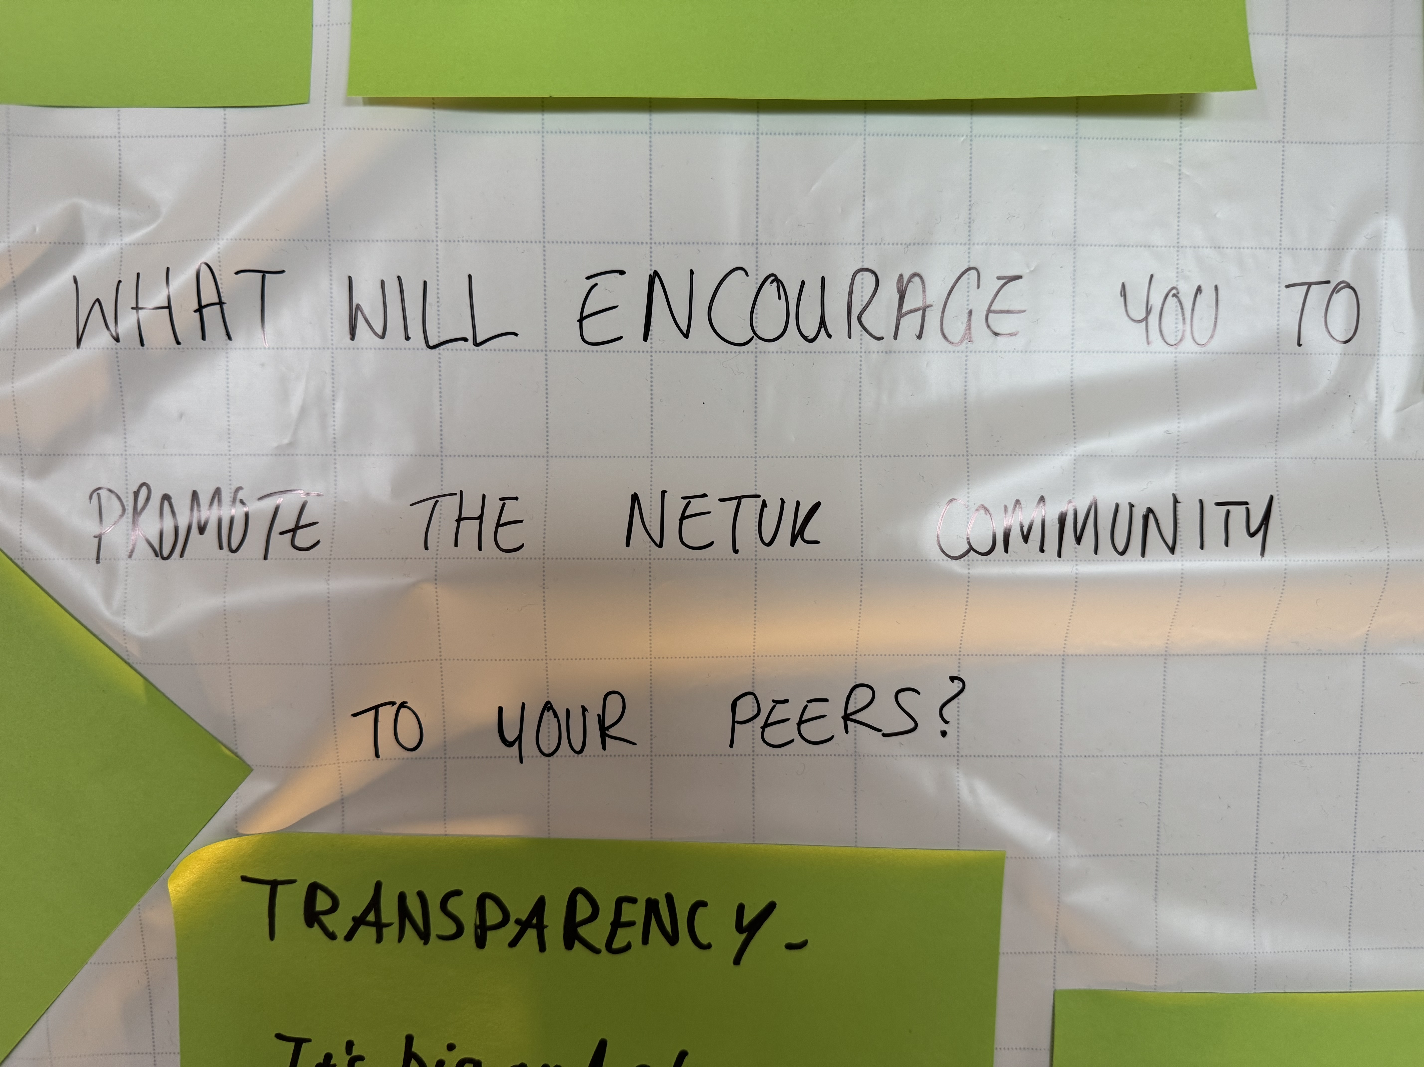

Slide 6
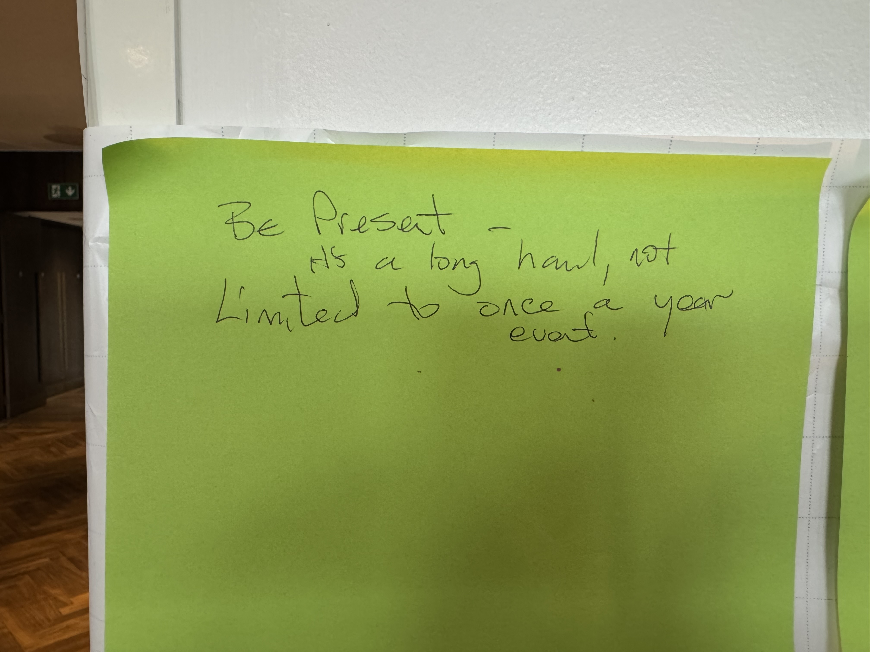

Slide 7
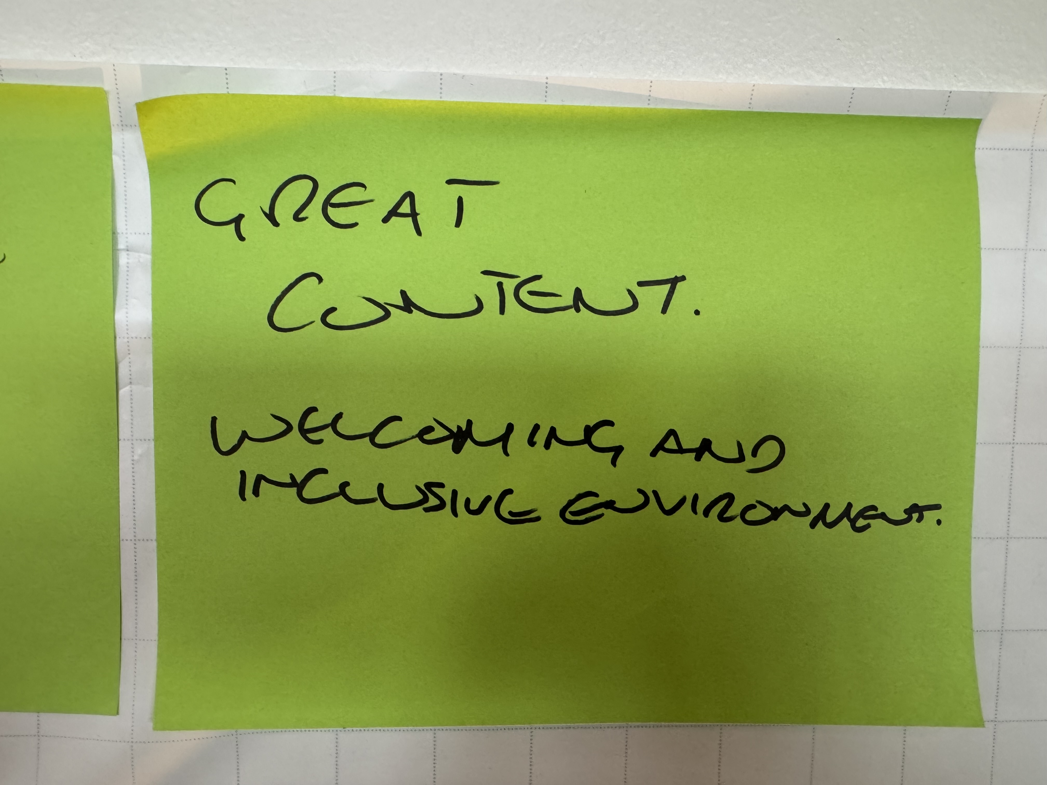

Slide 8
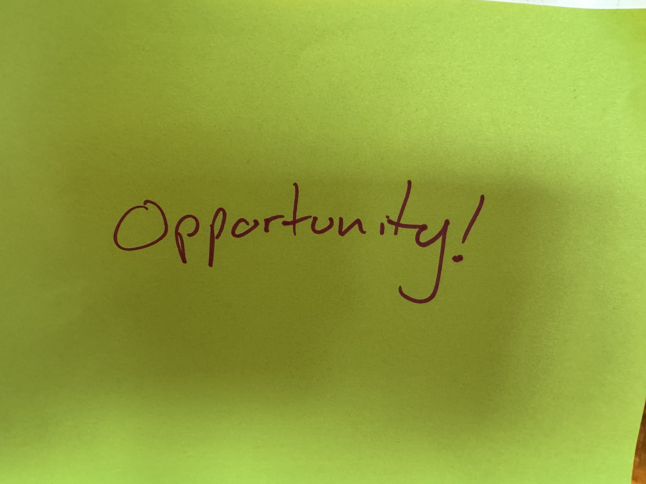

Slide 9
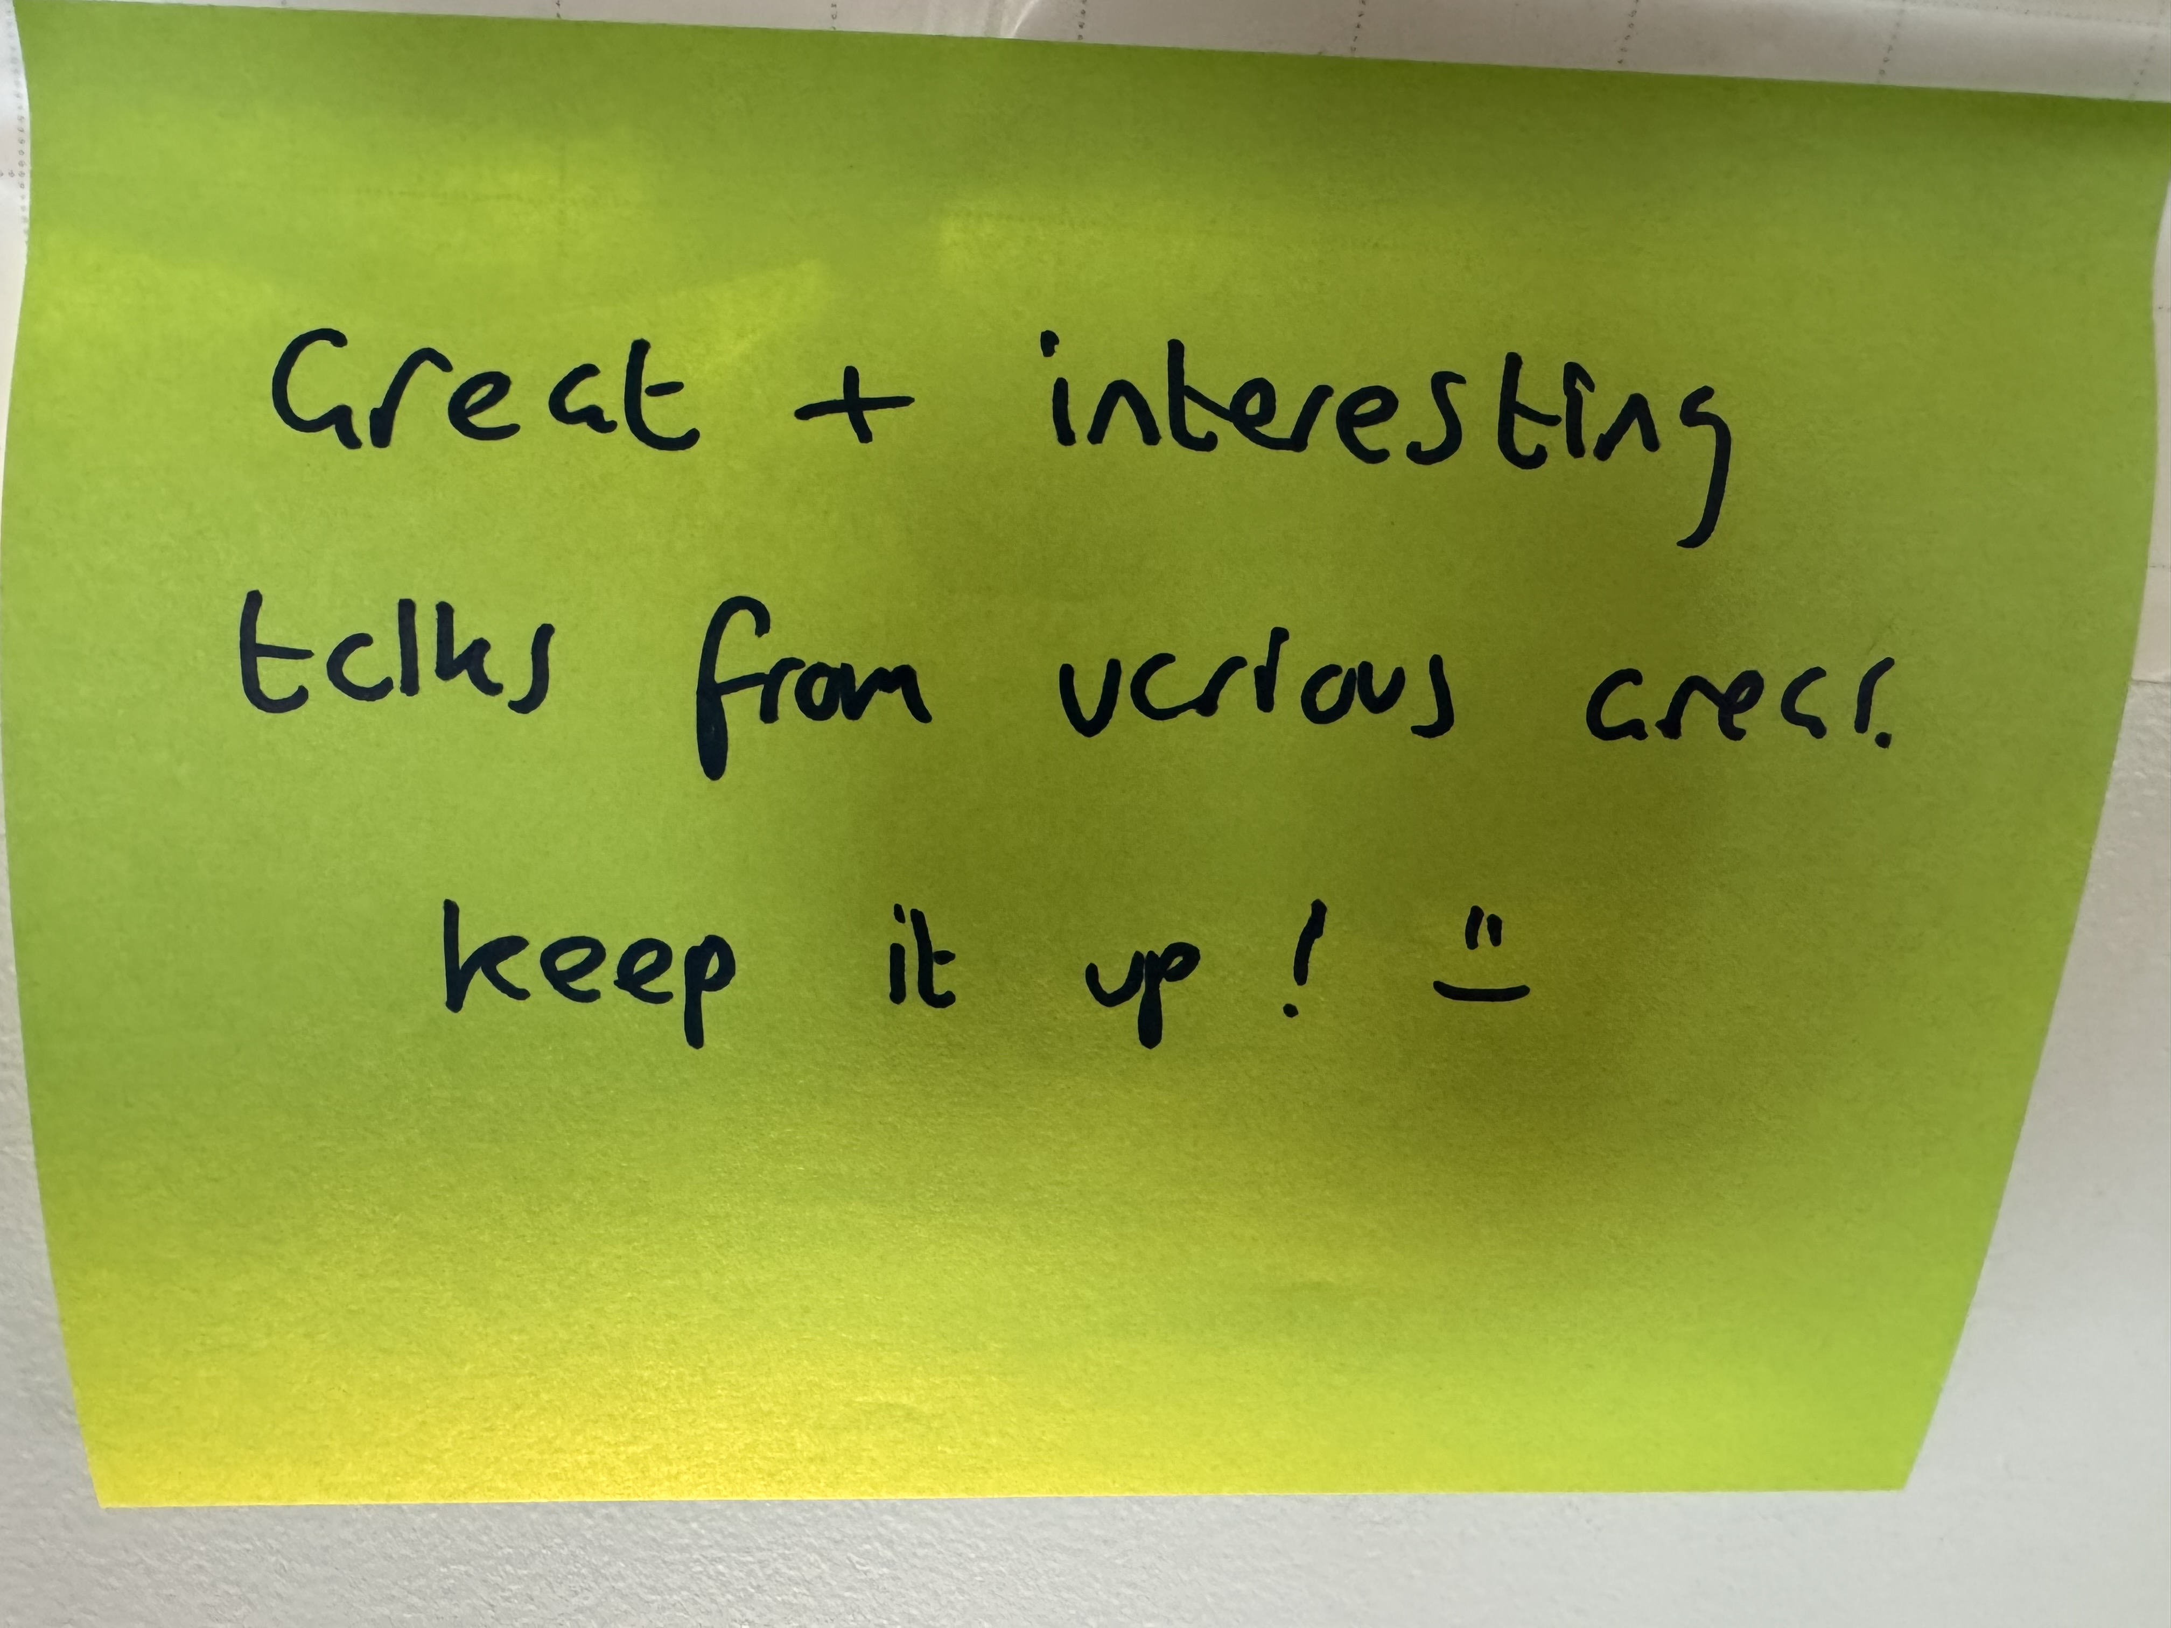

Slide 10
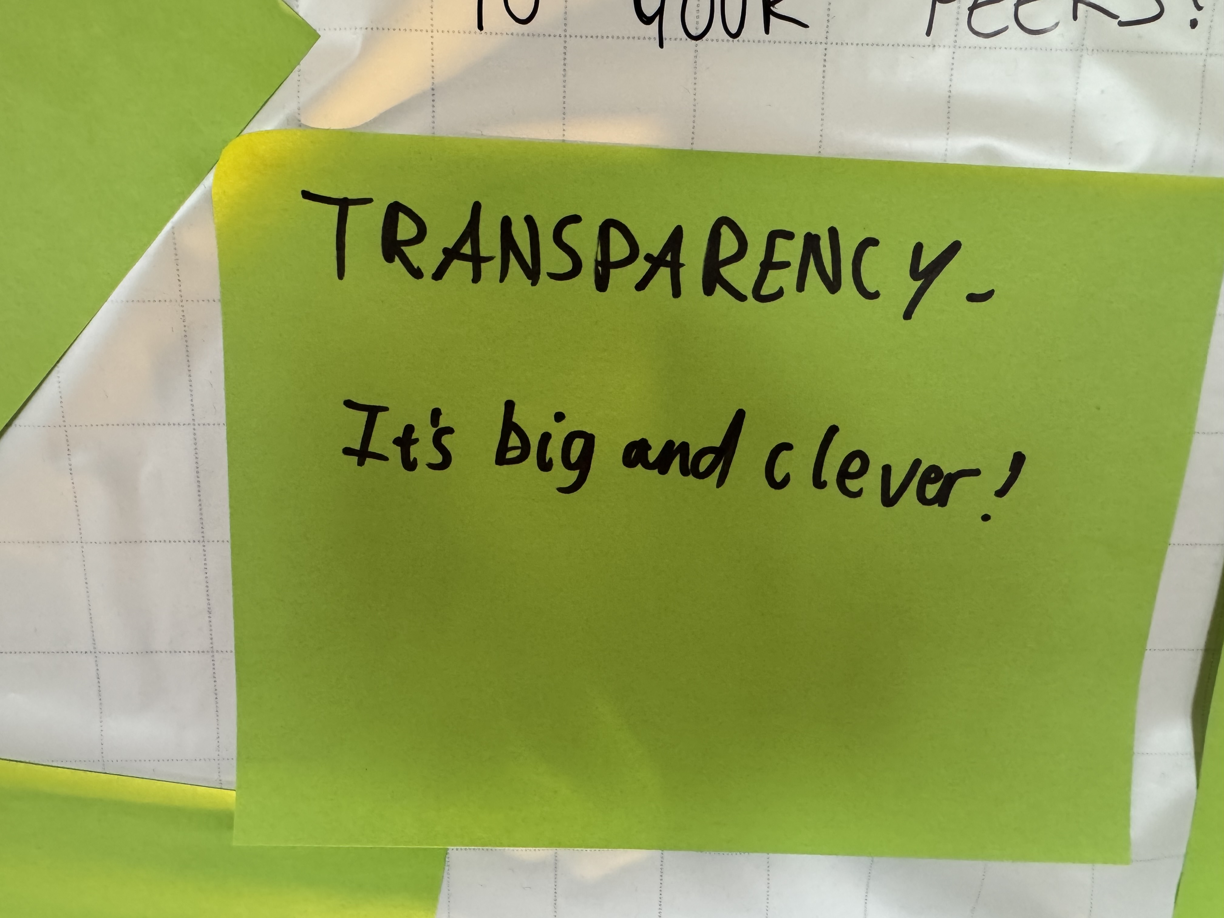

Slide 11
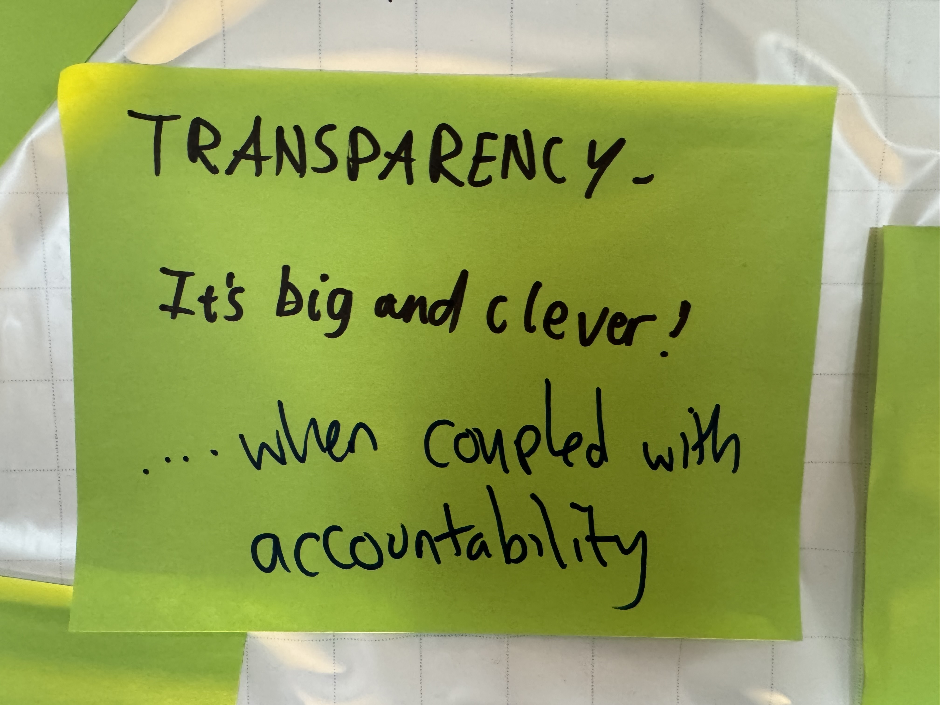

Slide 12
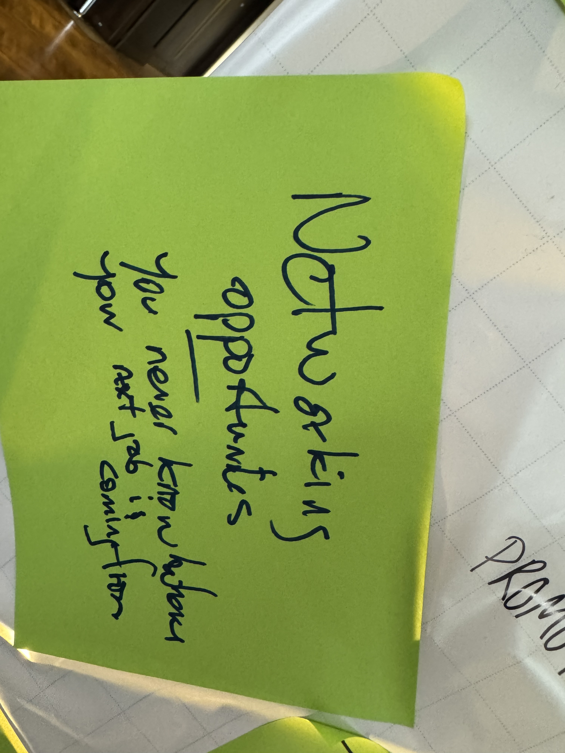

Slide 13
What encourages community growth
Being present
Creating opportunity
Providing value
Sharing the best content
Transparency & Accountability from community leadership
What opportunities do we need to originate within the community?
What does accountability and transparency mean to you?

Slide 14
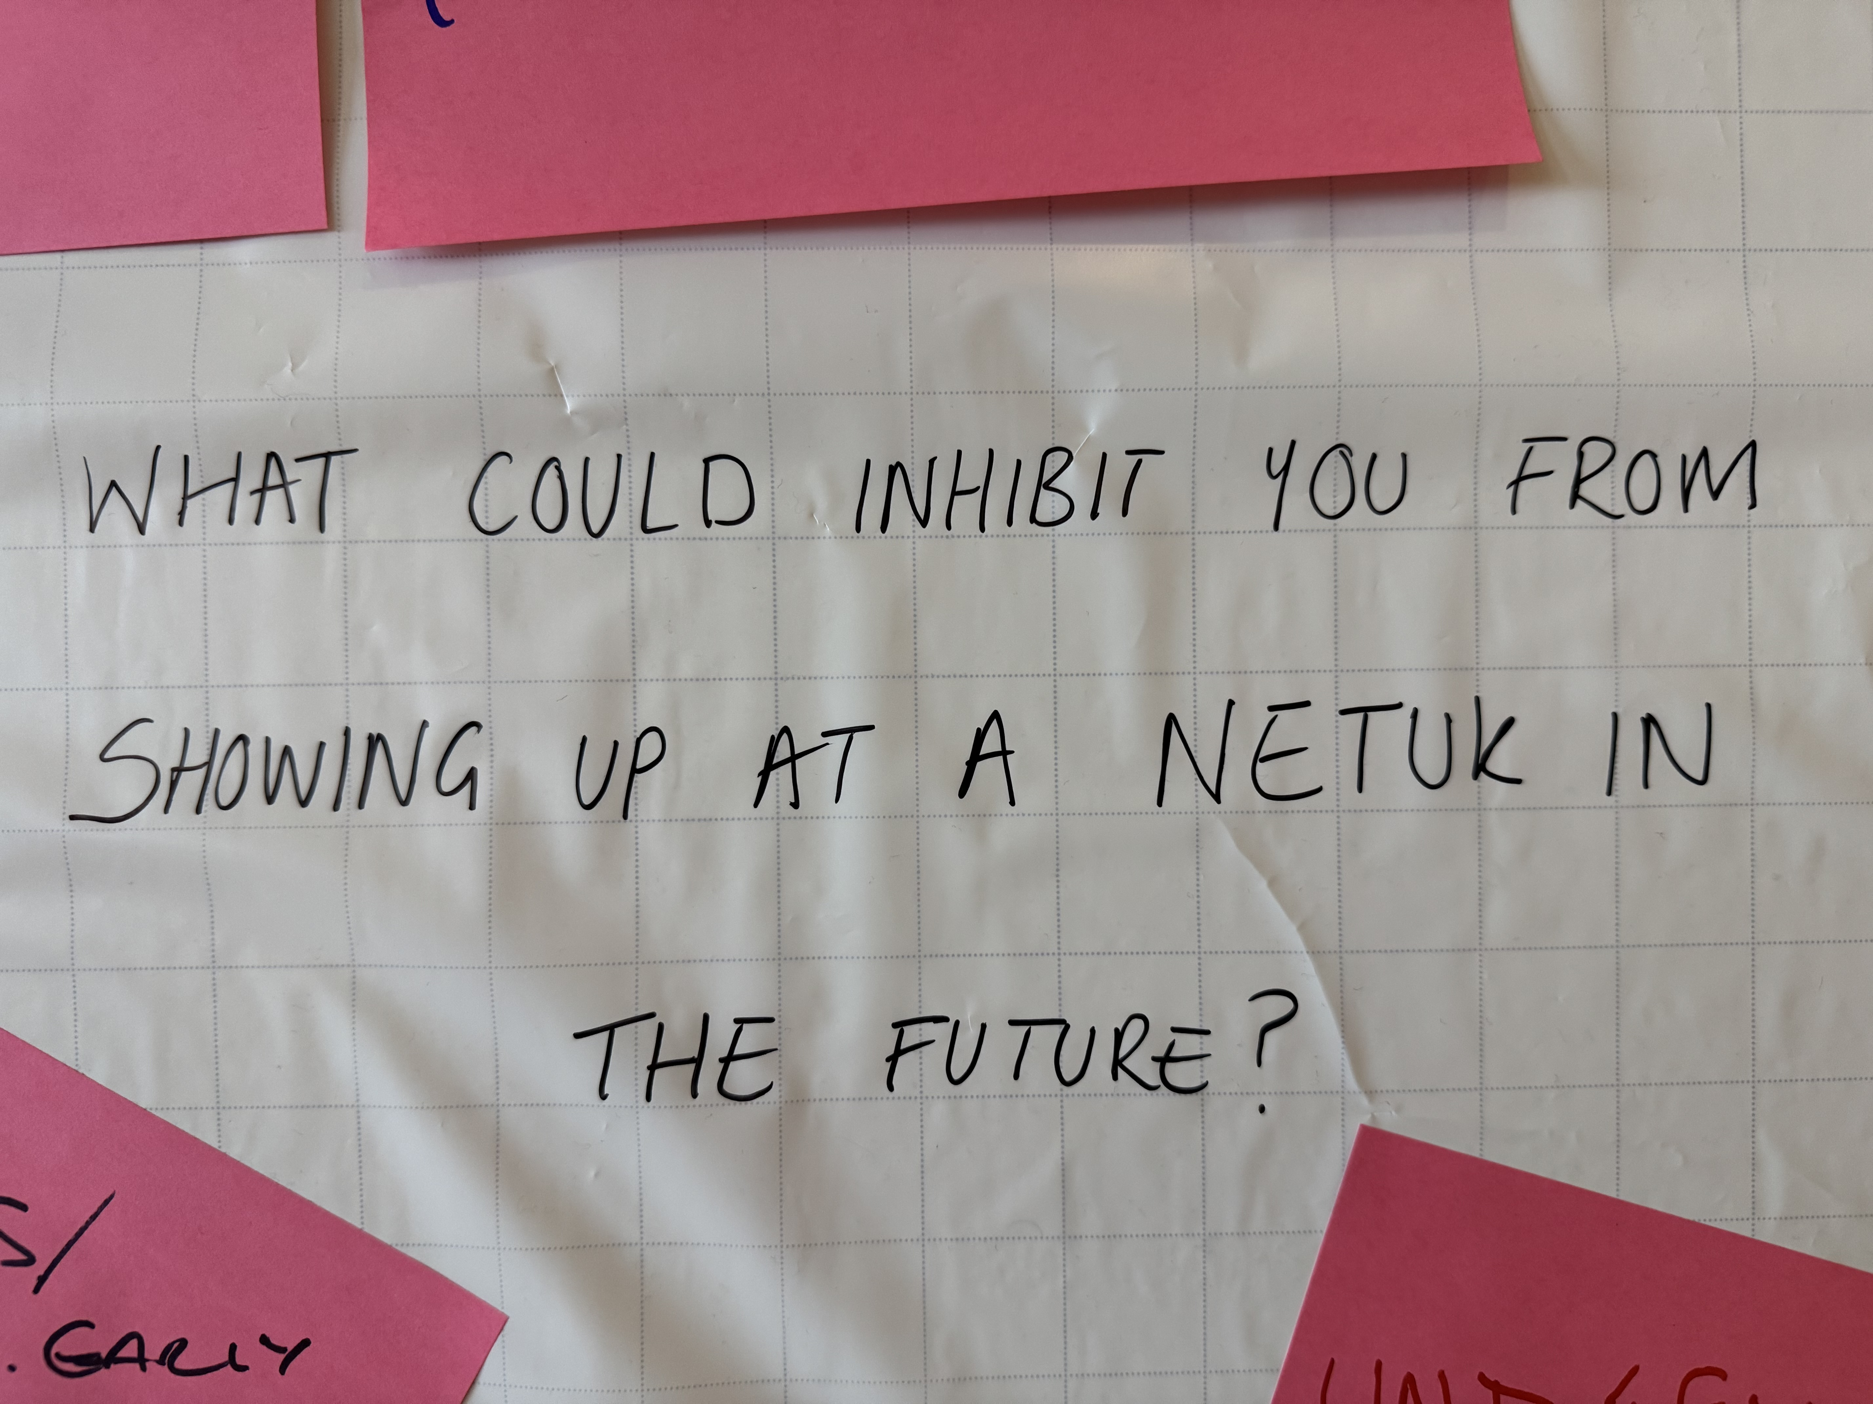

Slide 15
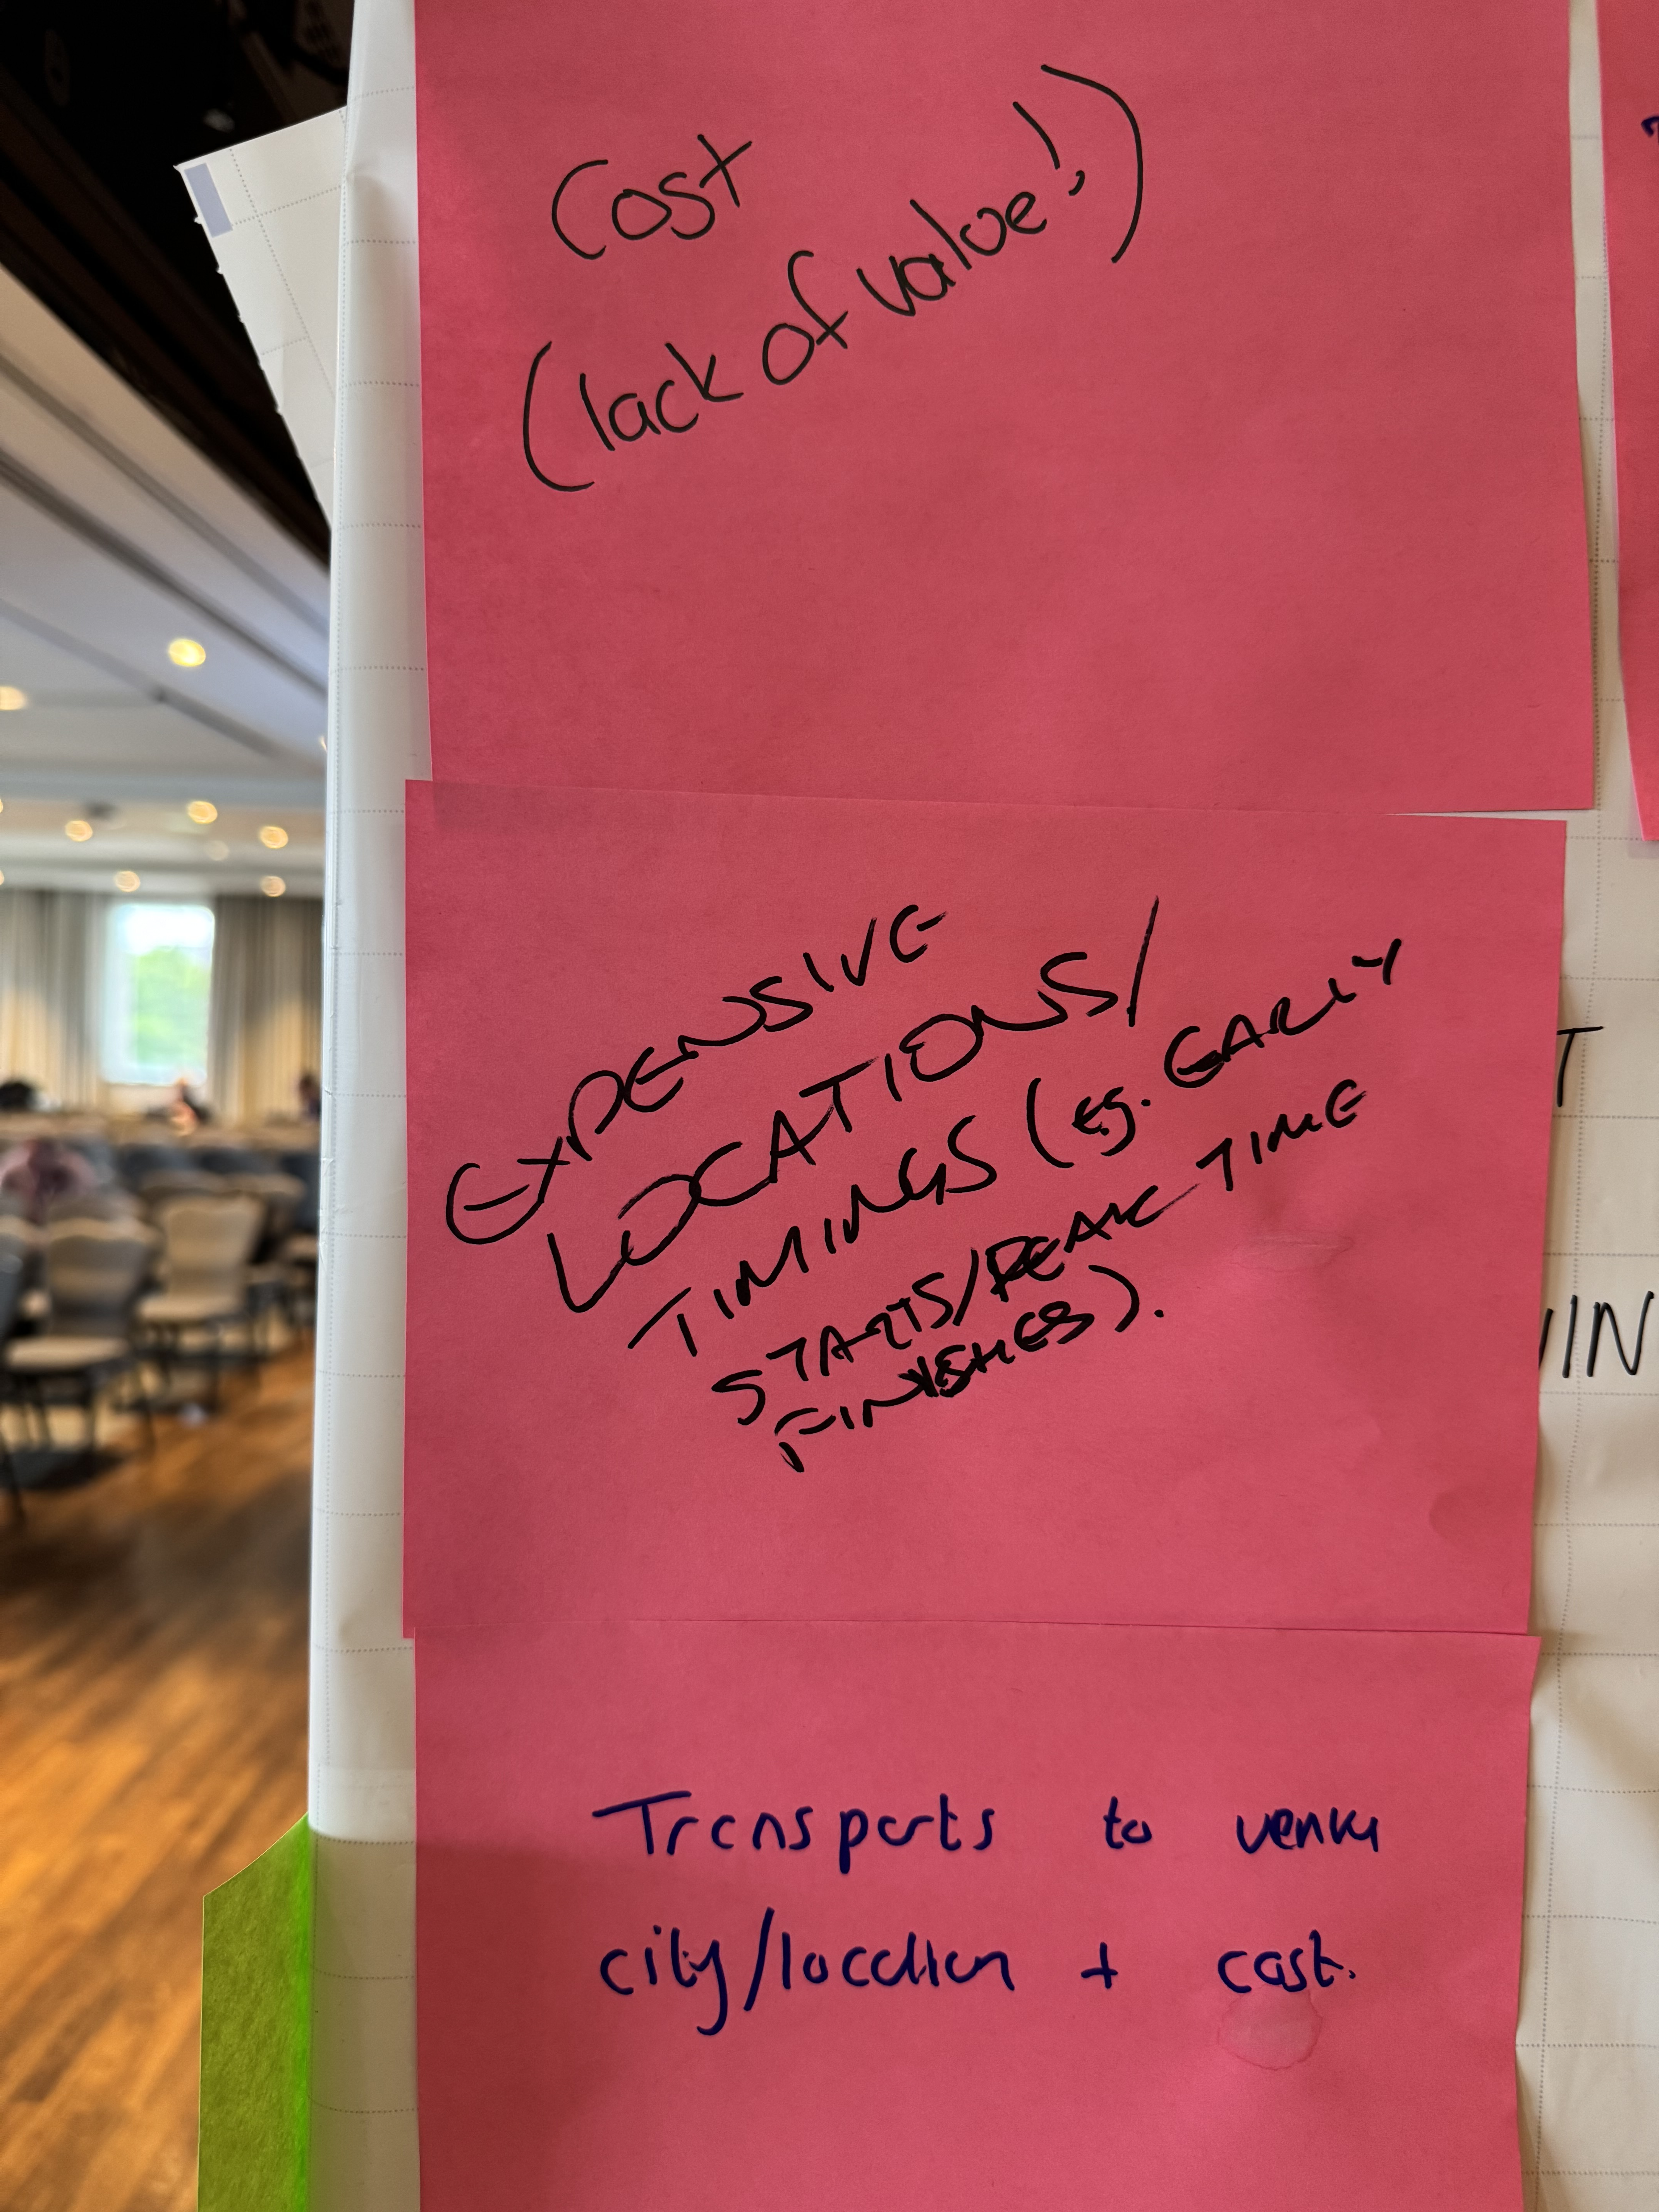

Slide 16
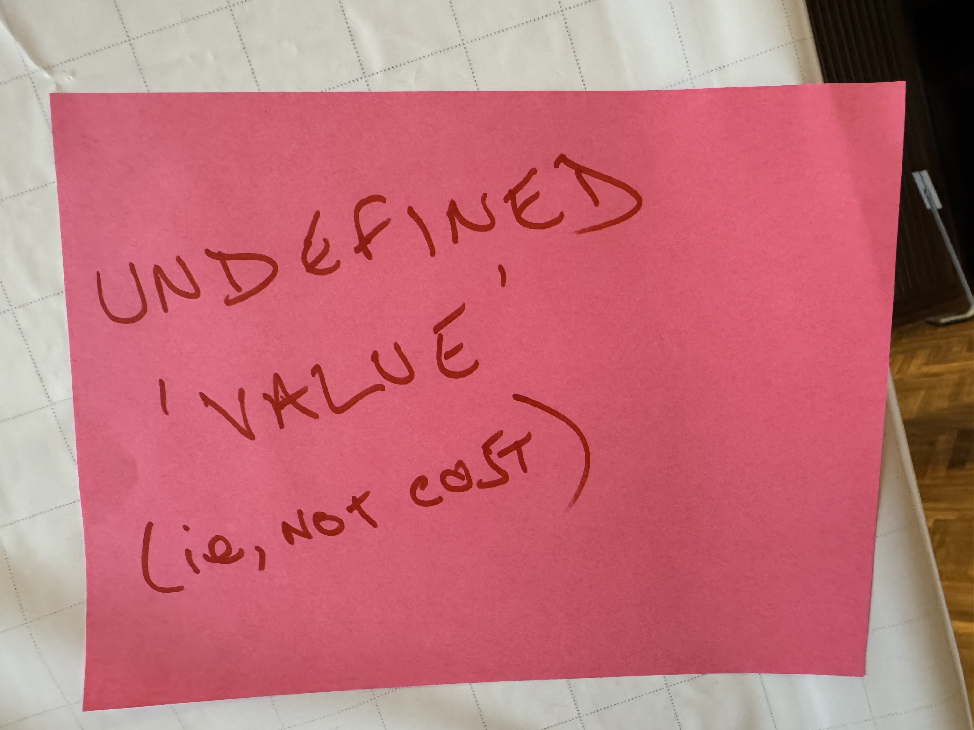

Slide 17
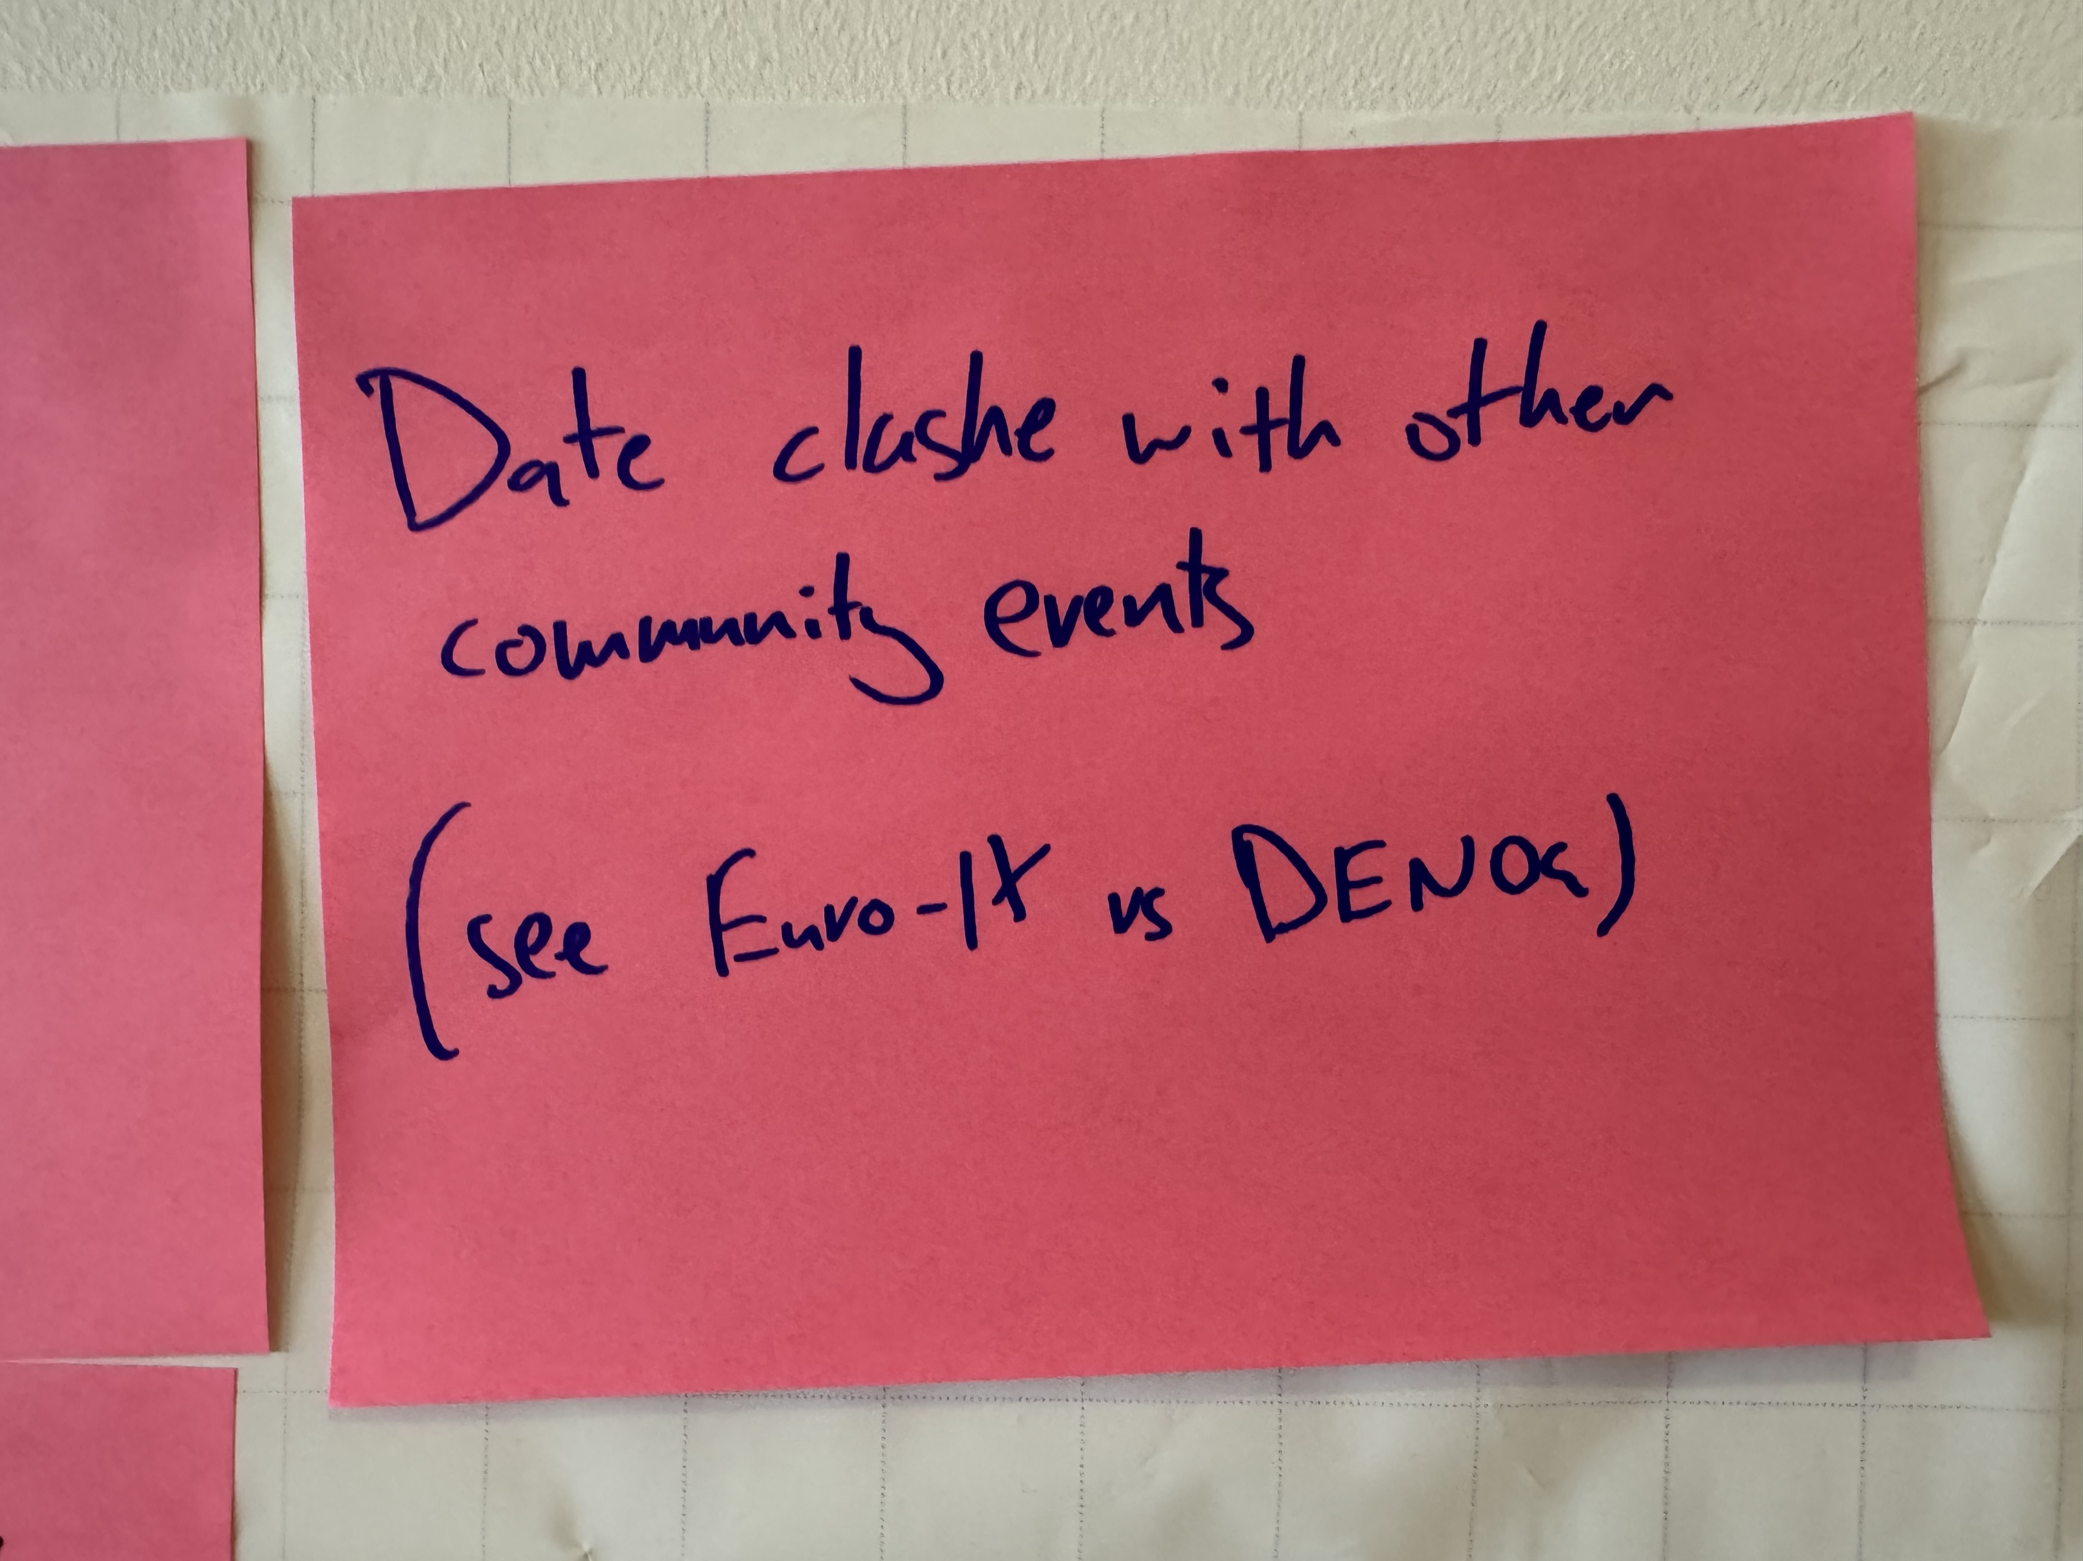

Slide 18
Deriving community benefit
Concept of “Value”
But this is not defined in your answers
- could those who ”sold” their attendance in the organisation talk about the value they described internally at the mic?

Slide 20
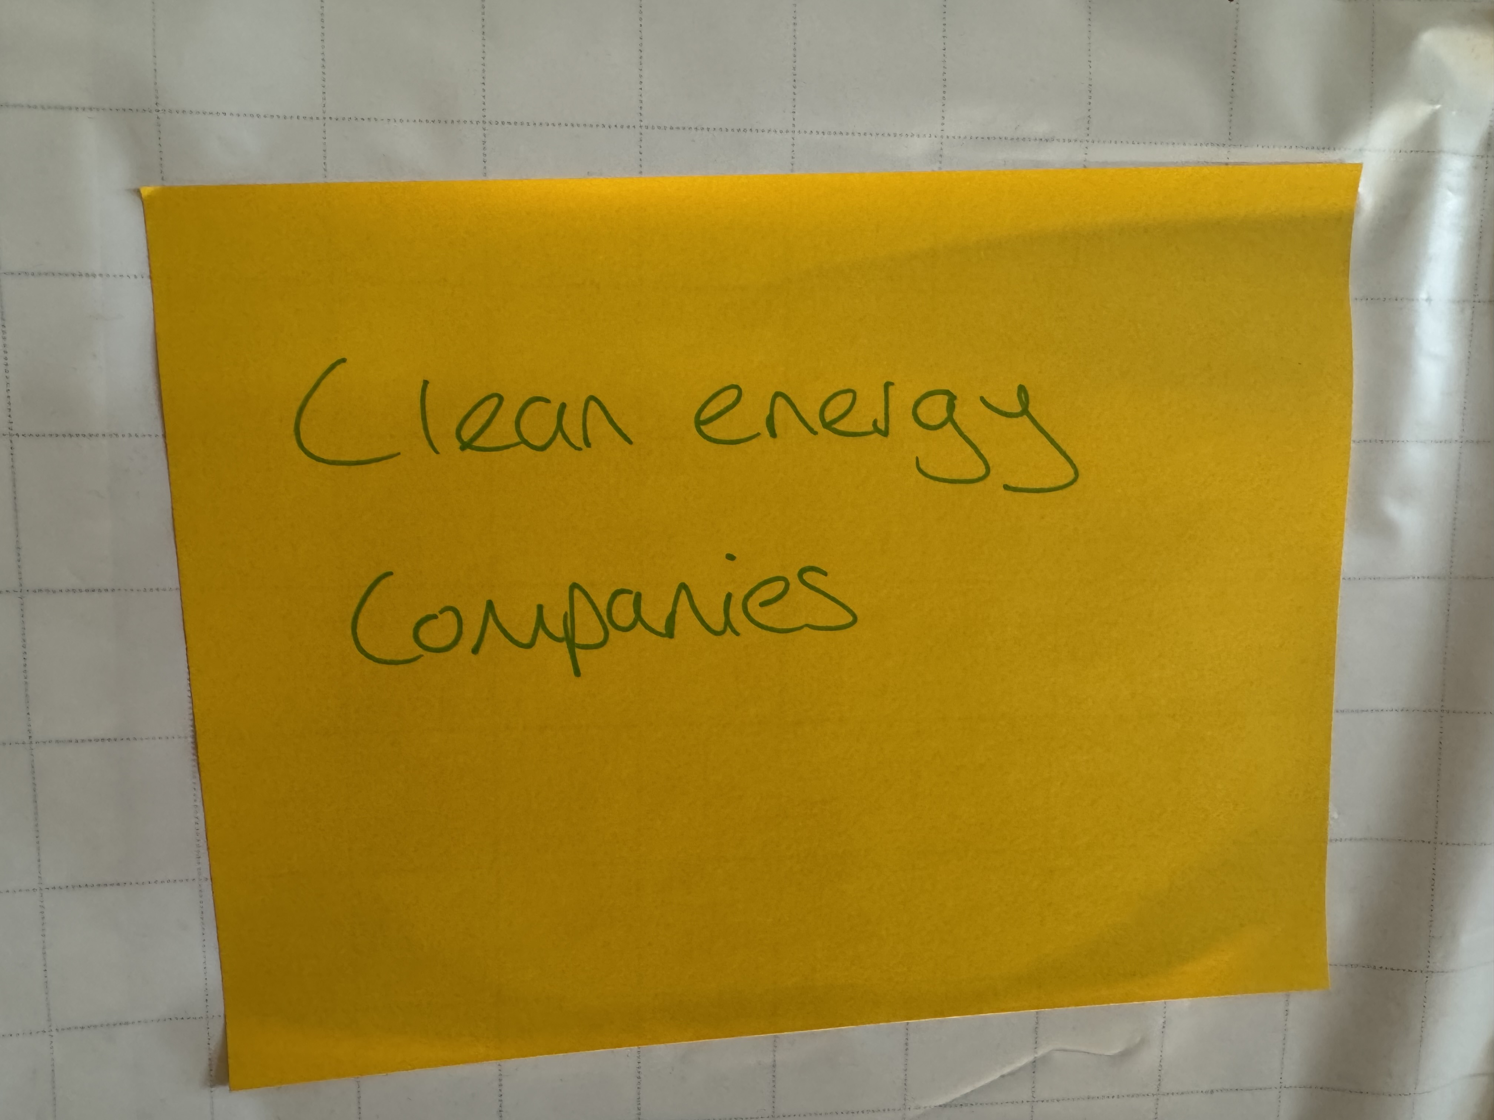

Slide 21
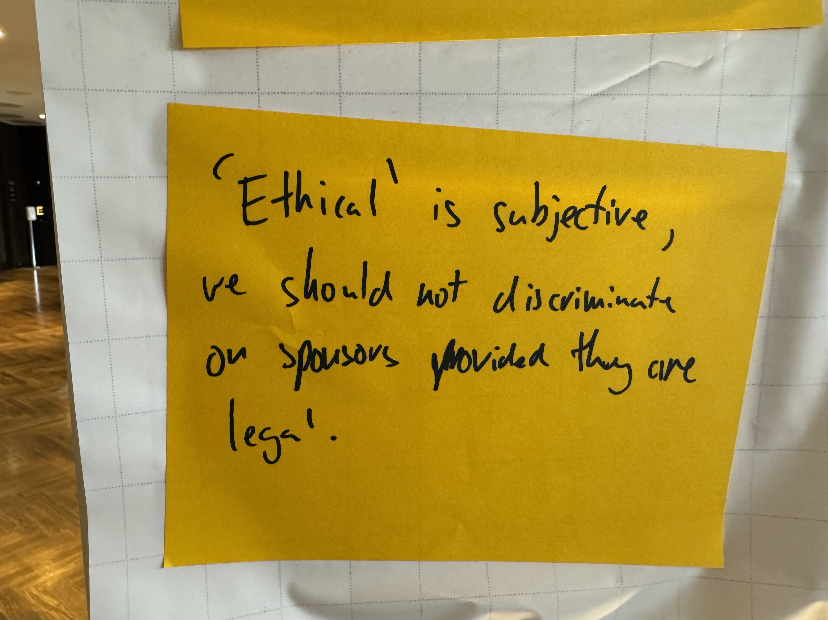

Slide 22
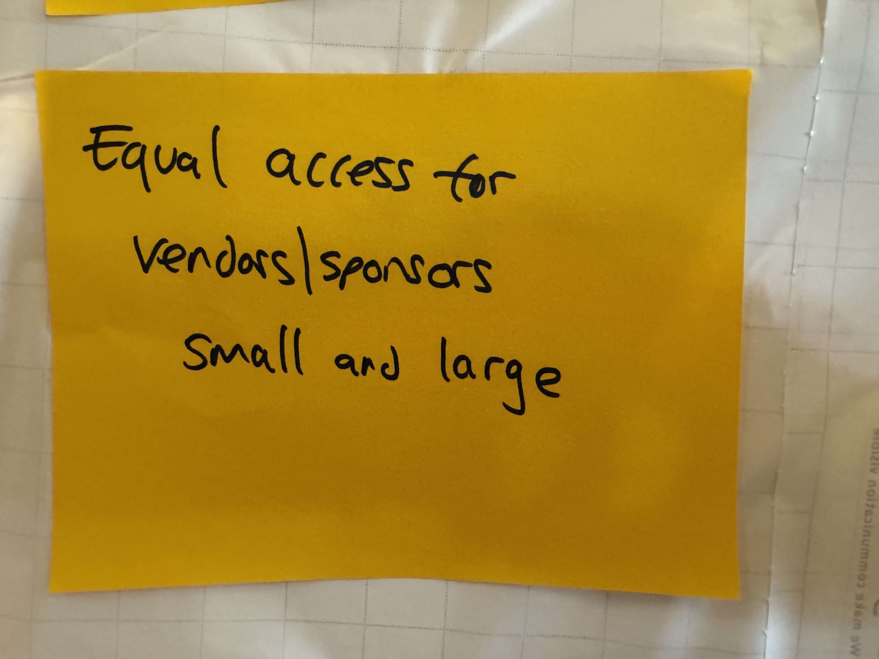

Slide 23
Sustainable sponsorship model
Hard to pick “themes” from this set of replies, except the theme that there is a category of sponsors you want to hear from
Access for emerging businesses

Slide 25
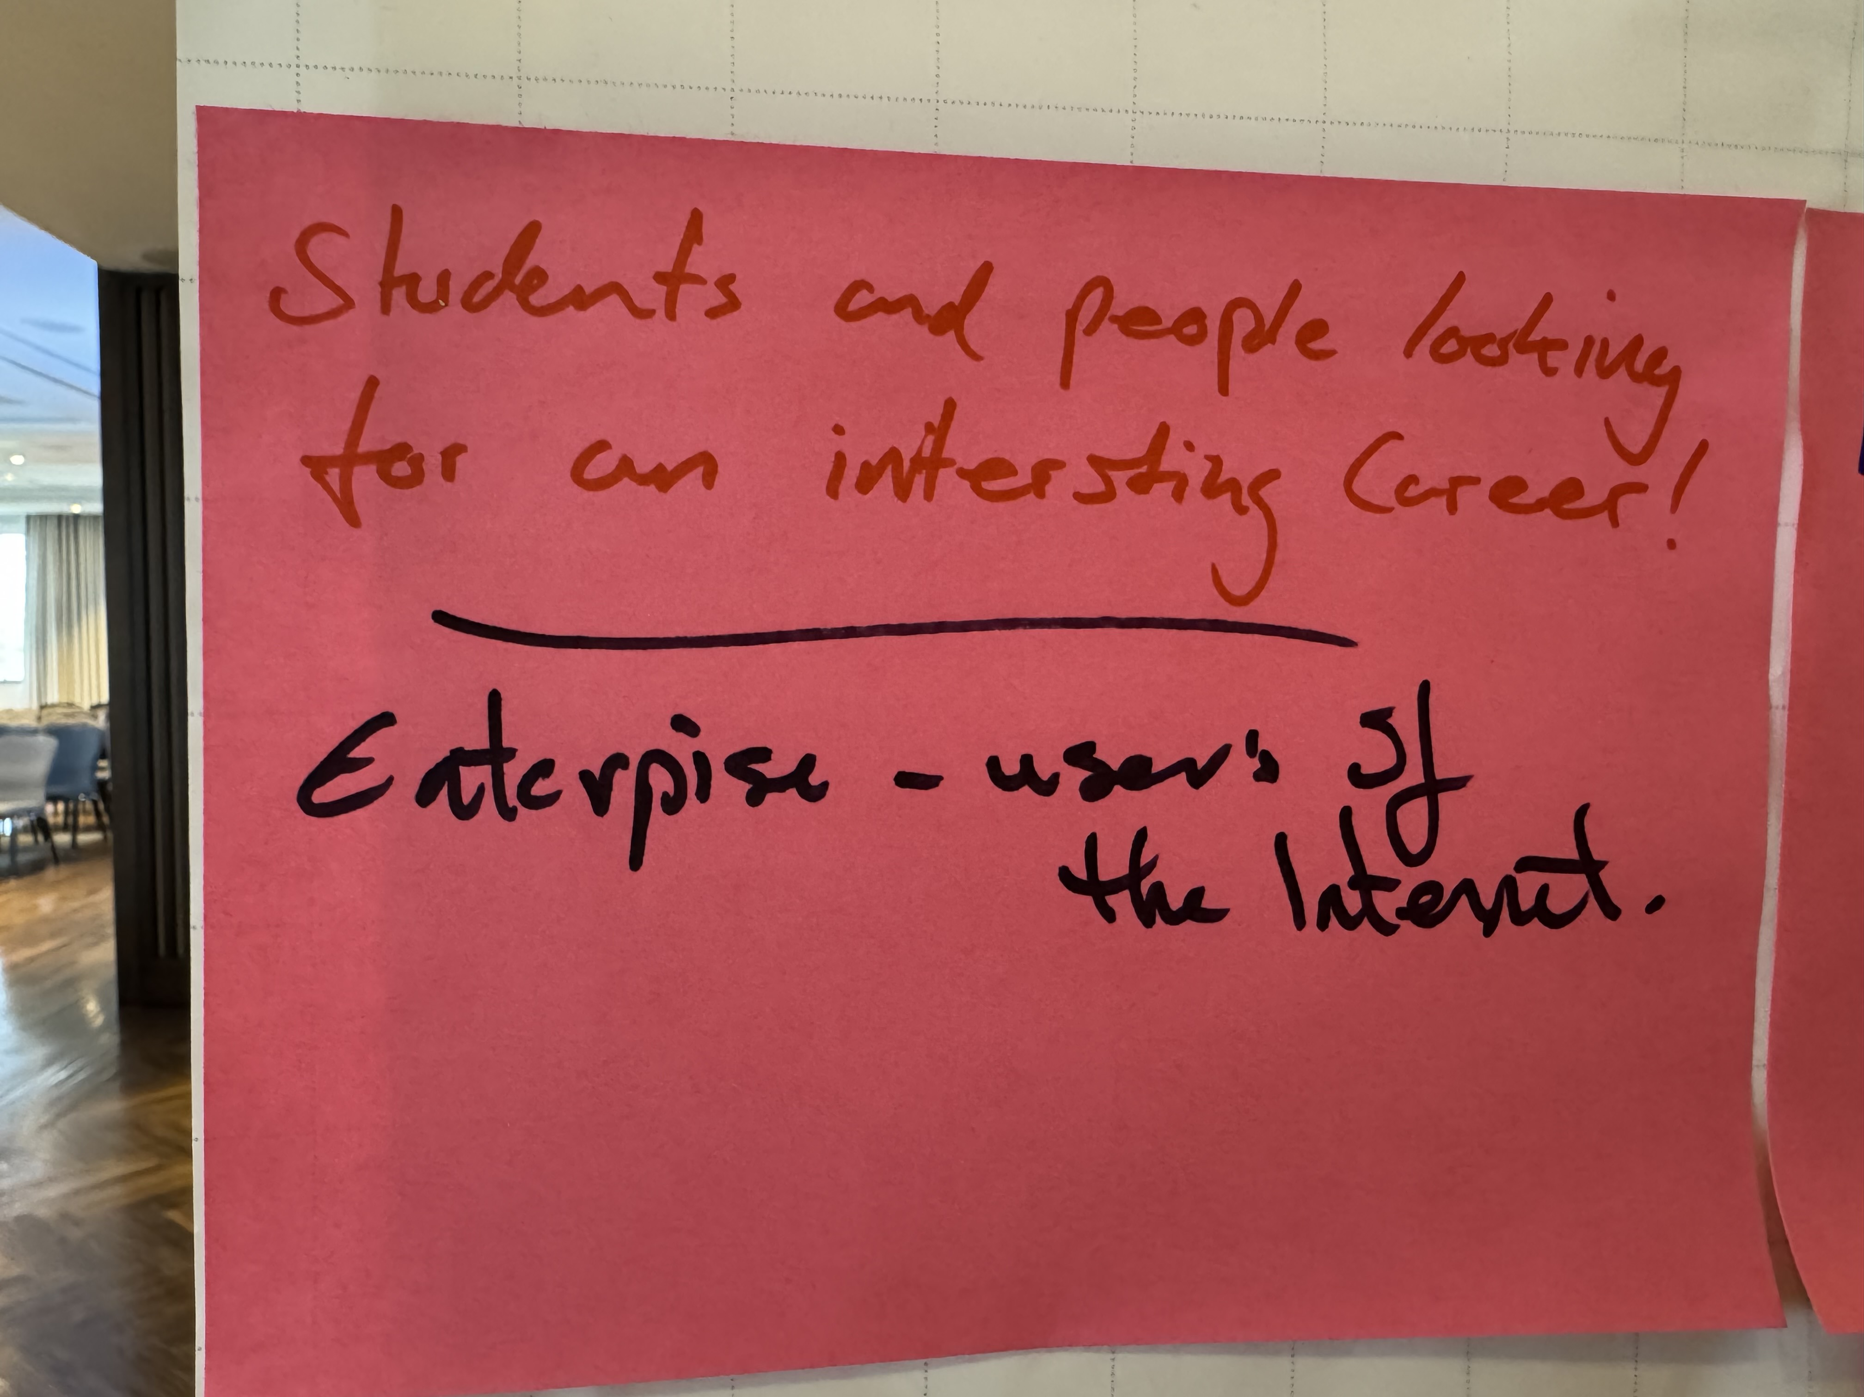

Slide 26
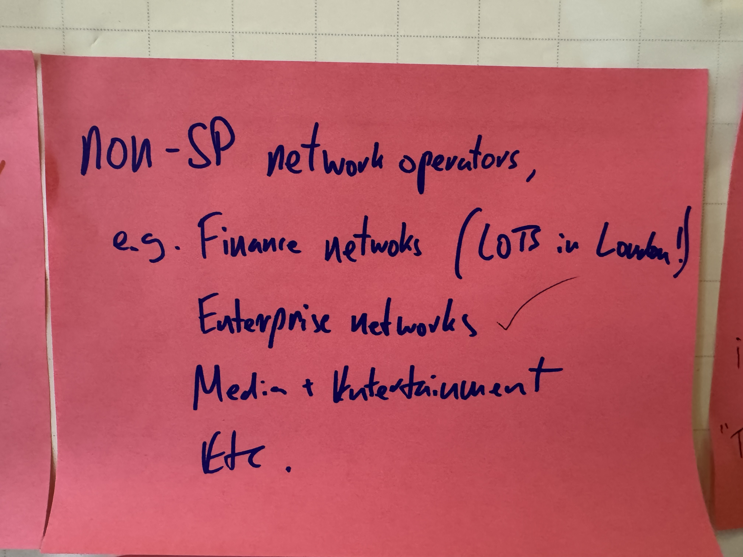

Slide 27
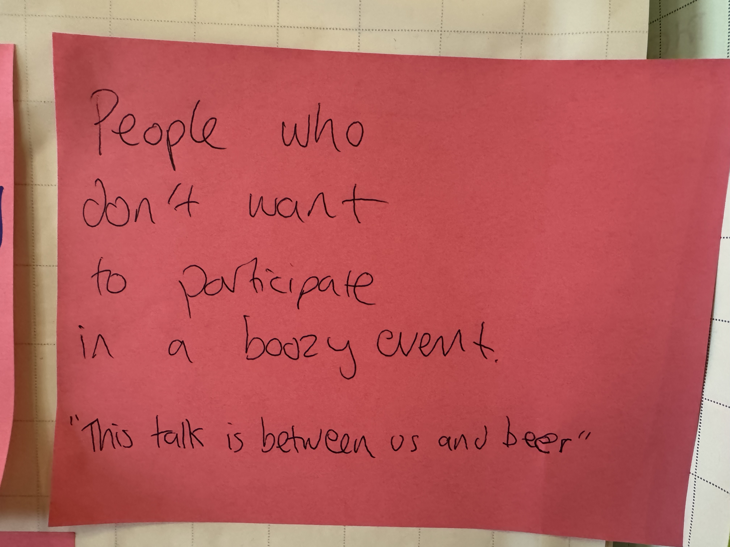

Slide 28
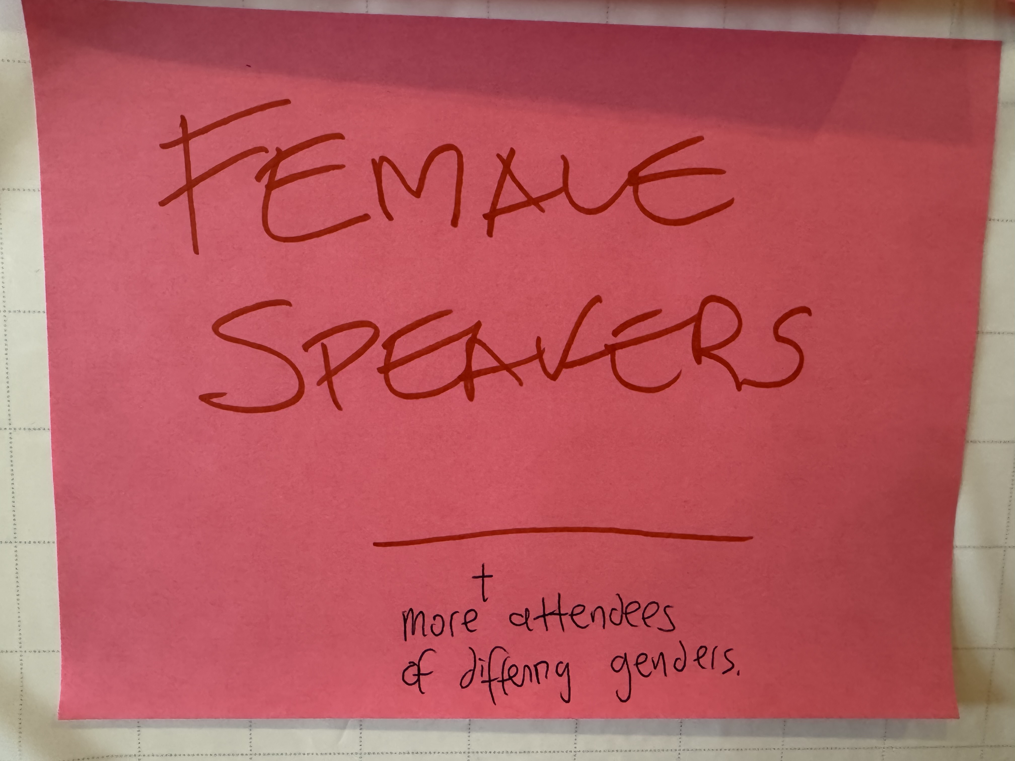

Slide 30
Who is missing
Speakers who don’t look like me
Non service providers
- How would we, the service providers, engage with them?
Policy people
How can we drive interactive socials which do not exclude missing delegates?

Slide 31
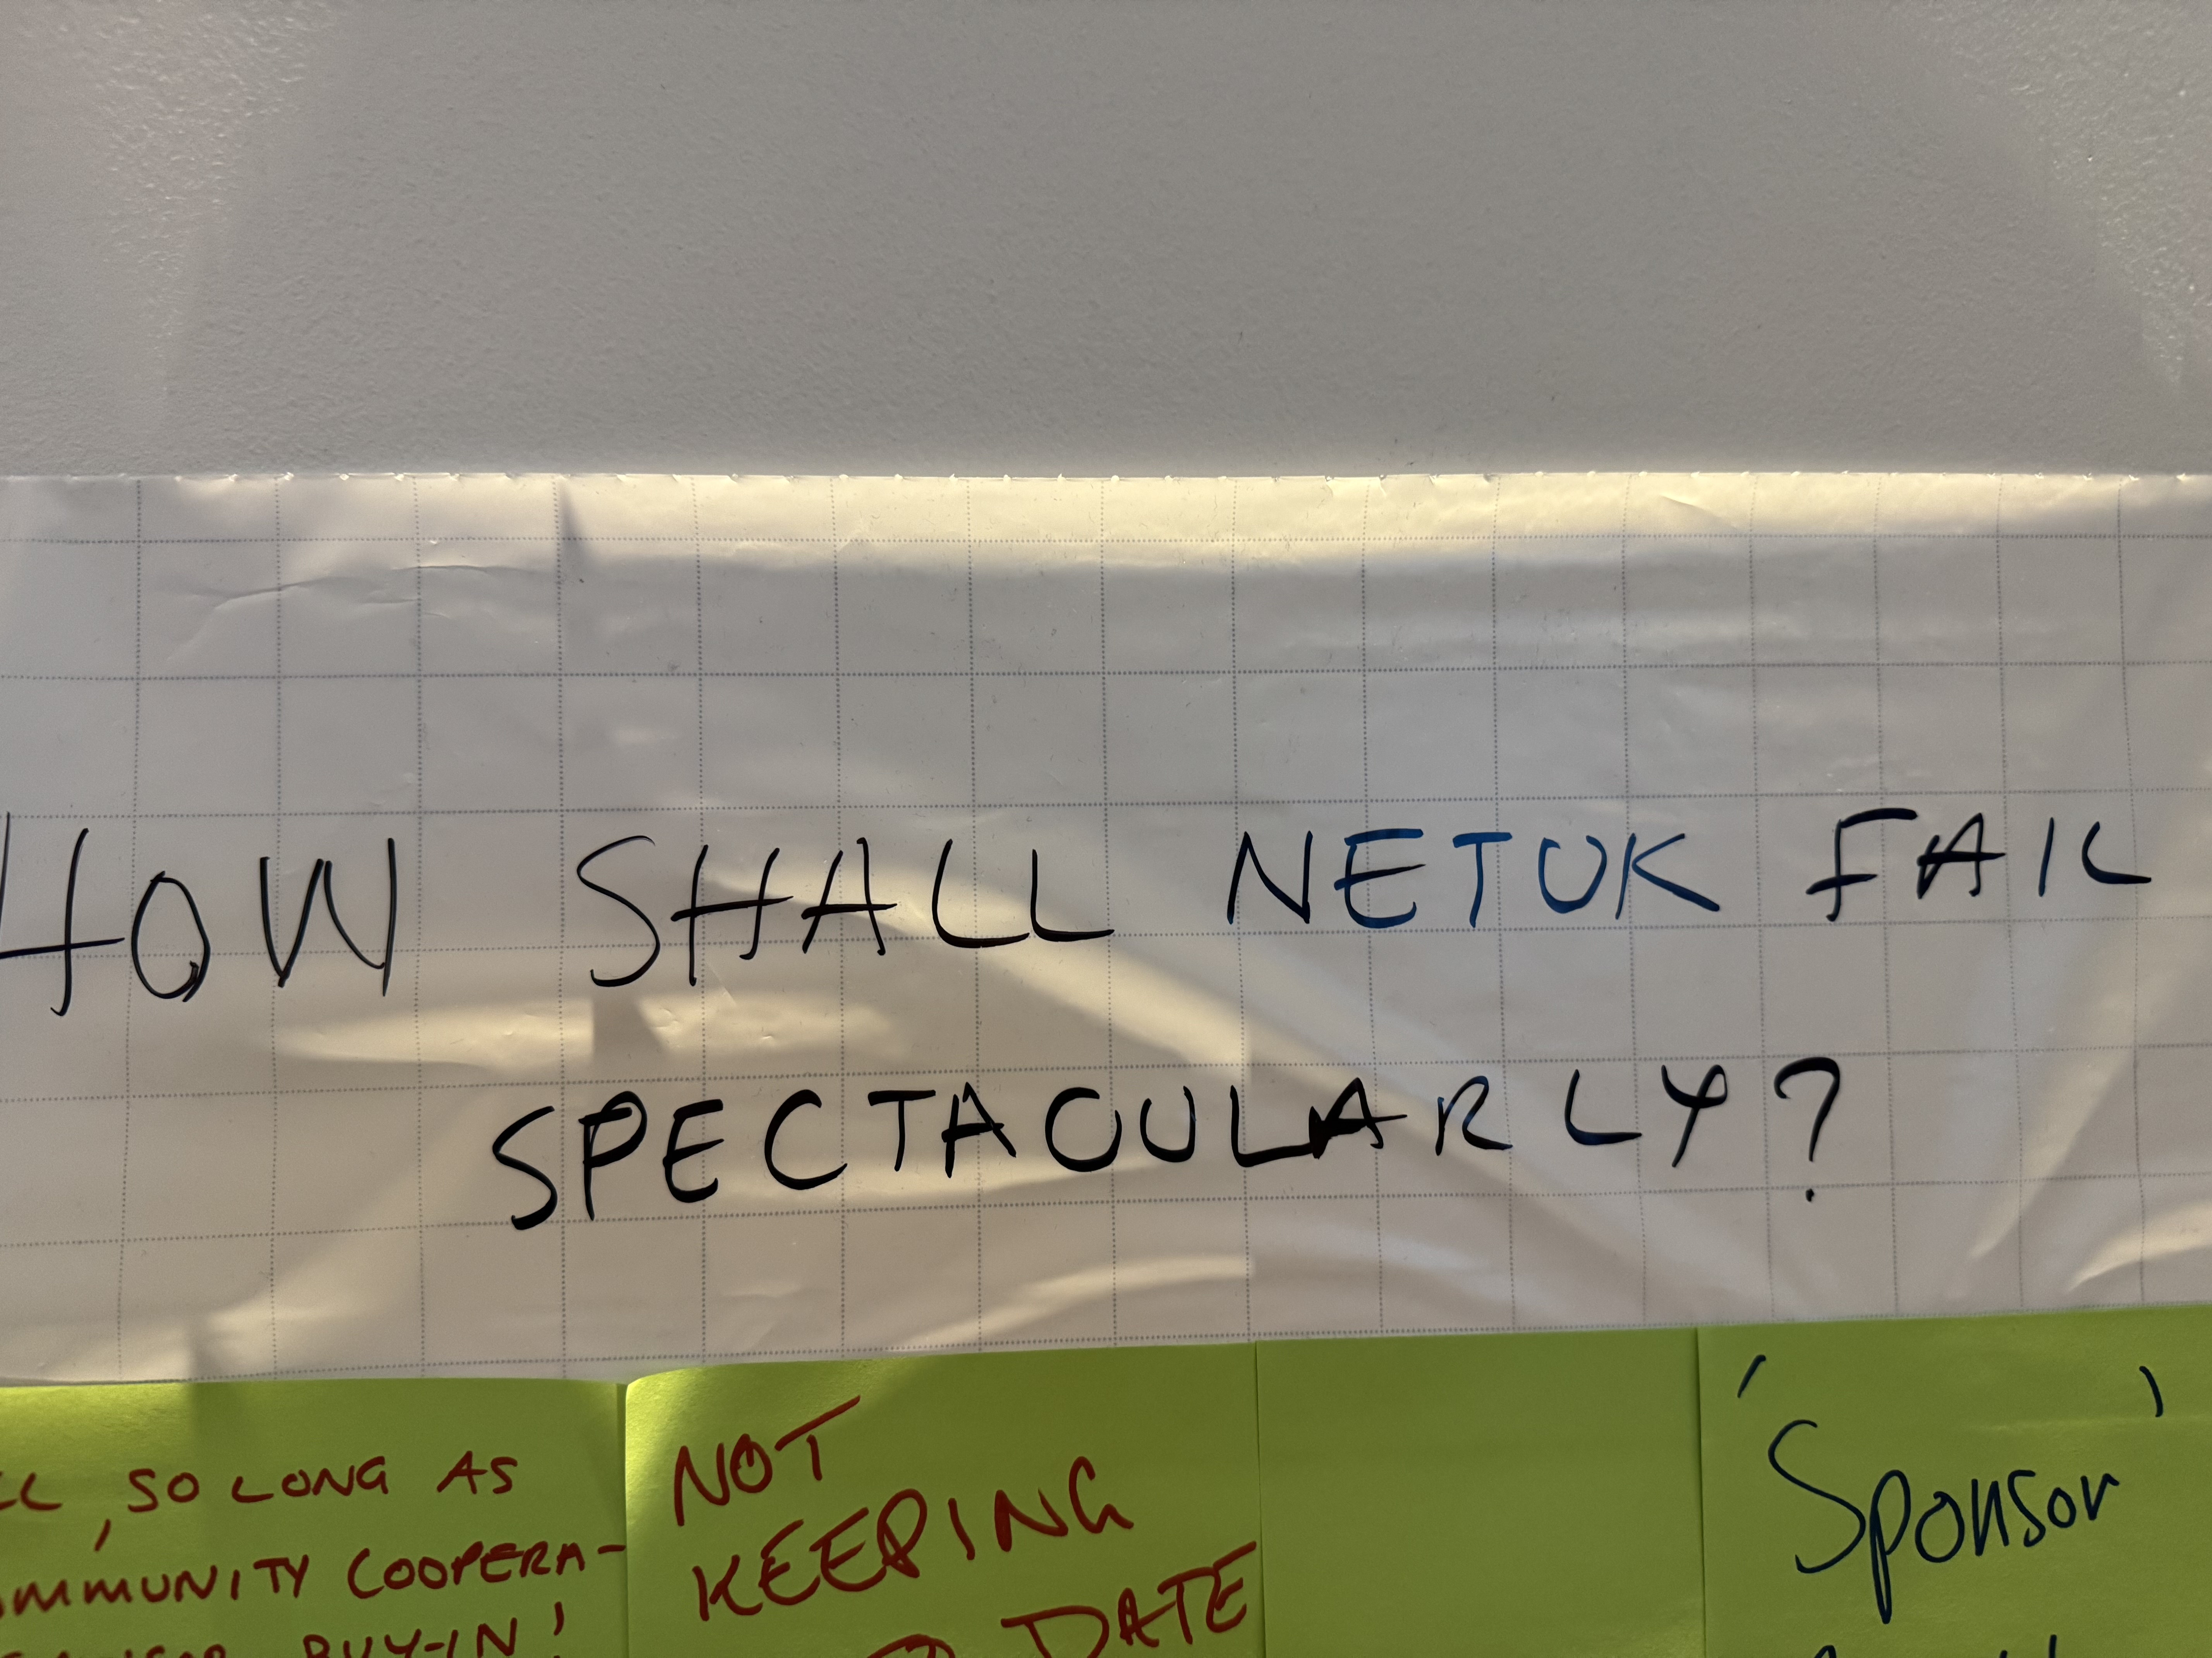

Slide 33
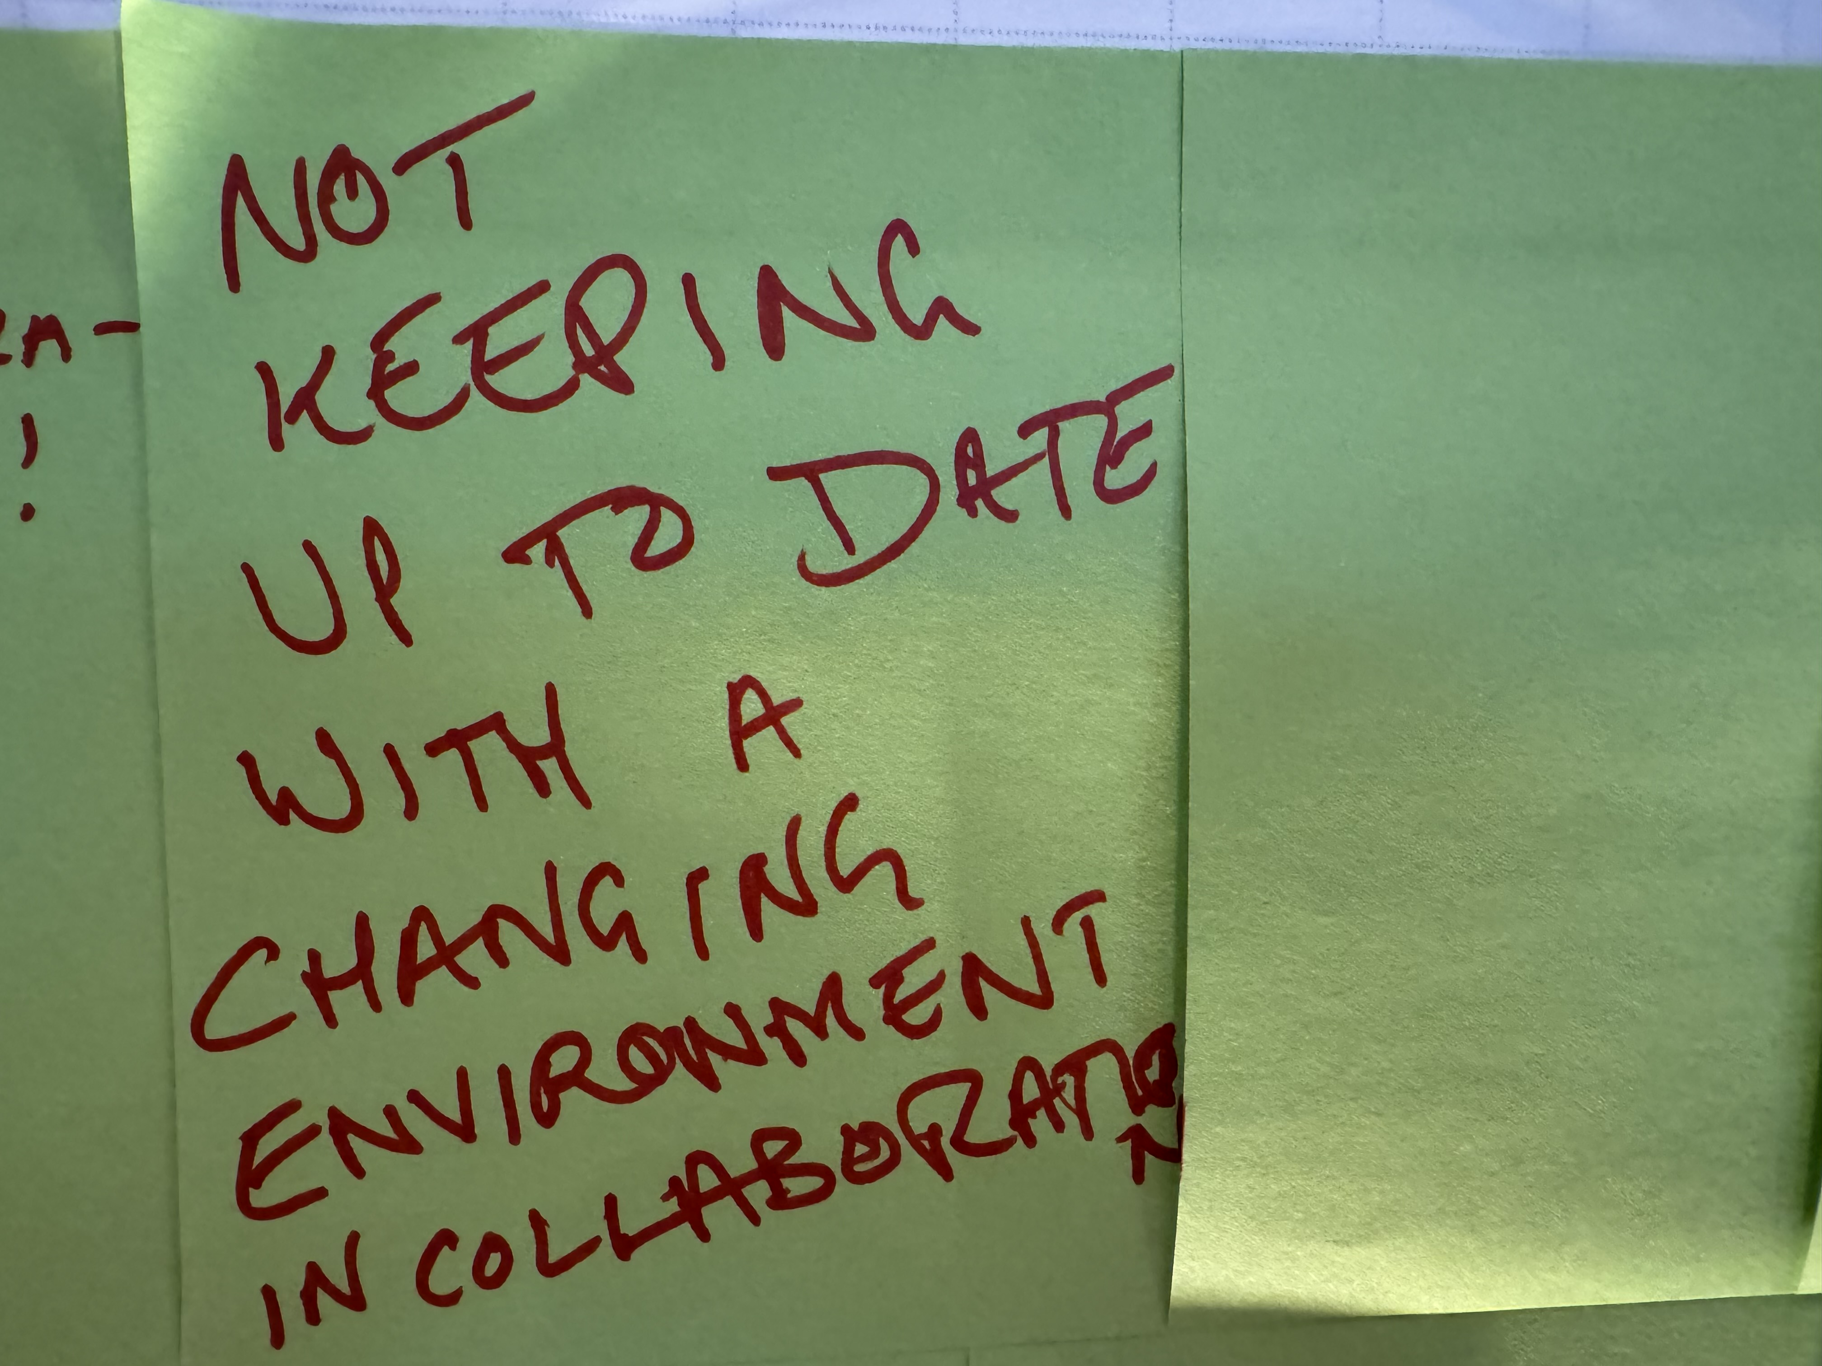

Slide 35
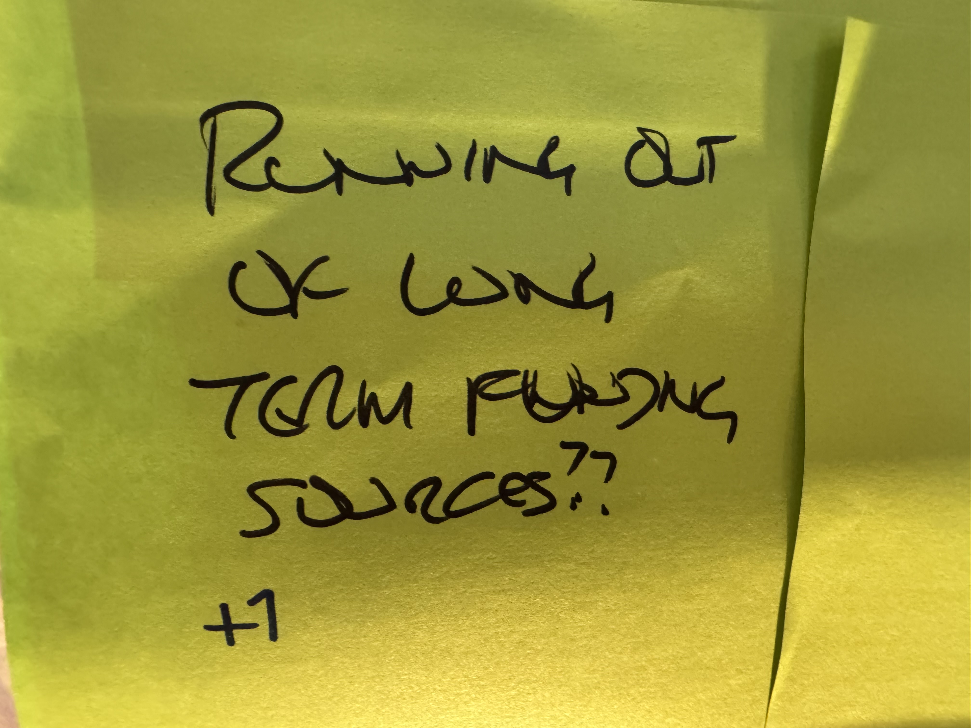

Slide 36
Organisational sustainability?
Committees need to link to a regularly changing environment
Sustainable funding
Sponsor engagement

Slide 37
What didn’t I ask?
?

