Slide 1
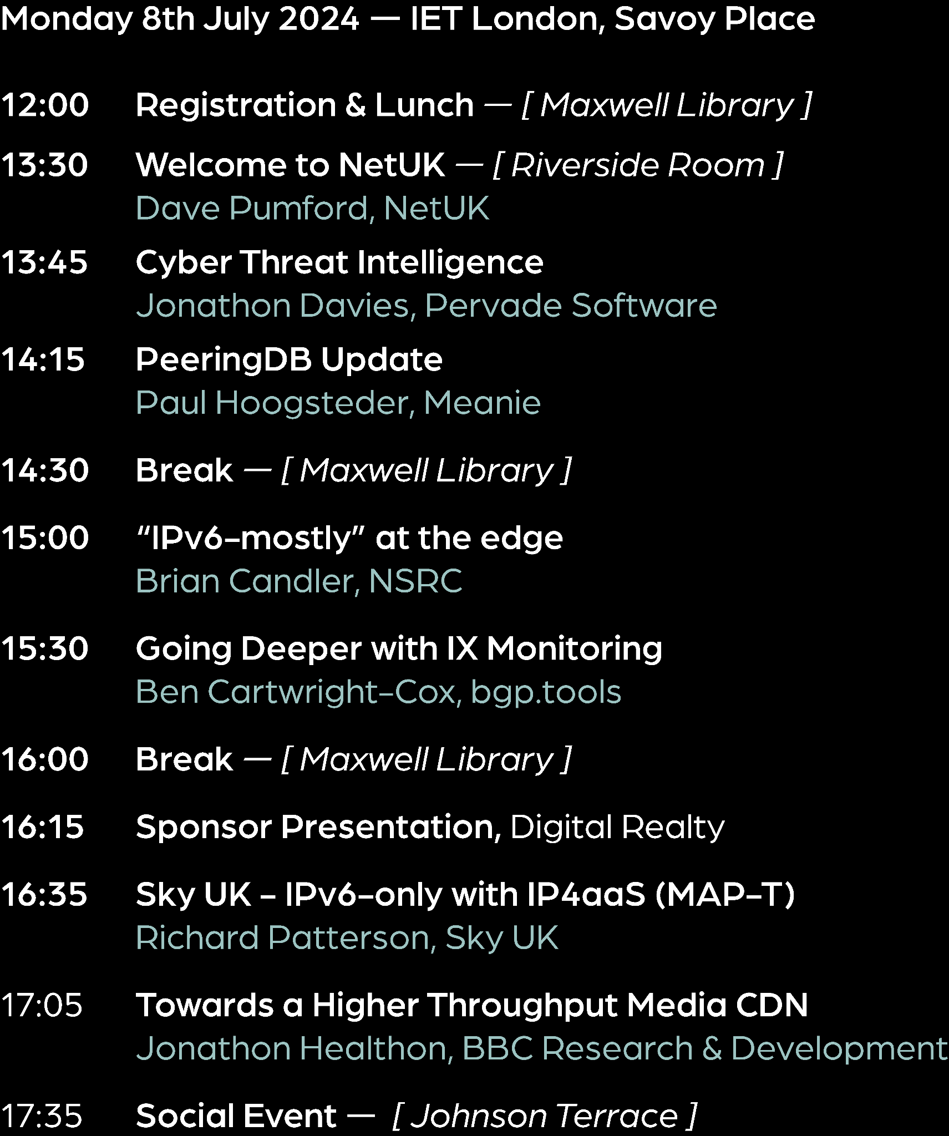
NetUK 1, Management Committee update

Slide 2
Expenses and income
Per person = £ 295 + VAT for two days
Social on Monday pp £125 + VAT
Total £80,500 + VAT
200 attendees of which 130 are paid regular tickets generating £6,340 after fees.
£37,000 from commercial sponsors
3 x £25,000 from LINX, LONAP & Nominet
Notes:
22 Sponsor tickets
13 Speaker tickets
15 Student tickets
26 PC and

Slide 3
NetUK PC Brandon Butterworth Dave Wilson Fearghas Mckay James Bensley Josh Levett Matt Jepp (PC Chair) Mo Shivji Nick Ryce Paul Dunbar Paulius Judickas Rebecca Class-Peter Sergey Myasoedov Steve Karmeinsky
NetUK MC Dave Pumford (PTX Technologies)
Jennifer Holmes (LINX)
Matt Jepp (PC Rep)
Nick Wenban-Smith (Nominet)
Richard Irving (LONAP)
Additional support
Holly Ruff
Julia Munday
Megan Atkins
Rebecca Class-Peter
Rob Lister

Slide 4
Questions?

