Slide 1
Introduction to Service Provider networks
(Everything you wanted to know about networks, but were afraid to ask…)
Rob Lister
training@lonap.net
7 July 2025
netUK, London

Slide 2
Housekeeping
Toilets
Fire alarm
Quiet room
Breaks, Lunch…

Slide 3
Introduction
Introductions…

Slide 4
Agenda

Slide 5
Peering
PEERING:
What do you understand it to mean?
Discuss peering…
Notes:
‘Peering’ is the reason that Internet Exchanges exist. So it’s important to understand the basics of peering.
What do you understand peering to mean?

Slide 6
Networks
Notes:
A typical (very simplified!) ISP network might look like this.
They have a bunch of users, connecting somehow (DSL, etc.) to a network, which has some servers to provide various services, such as e-mail, web servers, e-commerce servers, database servers etc.

Slide 7
Networks
Notes:
So it’s clear that ISPs must connect to each other somehow, so that
a user on one network can access, say, a web server on another, and so that, for example, e-mails and files can flow between users.
Some networks may be primary users (access networks), while other networks will be mainly content. (Content network)
It is efficient for Access Networks to peer directly with Content Networks. The content is as “close” to the users as possible.

Slide 8
INTERconnected NETworks
Notes:
These two clouds represent networks, and for them to communicate, they must connect to each other somehow. (This is basically a piece of cable, or a leased line.)
The early ISPs did just this.

Slide 9
Interconnected Networks
‘Peering’
Notes:
And so on…
A new network comes along, so… where could they connect to?
Right

Slide 10
Interconnected Networks
‘Peering’
Notes:
So they’ve decided to connect to network B first off.
Network A peers with network B, and Network B peers with network C.
But can anyone see what network B could do now?

Slide 11
Peers and transit
‘Transit provider’
 | 1.3.1 Relationships between ISPs: peering and transit (p.18)
Notes:
Yes. They could in theory connect network A to network C by using their own network.
Network B would become a ‘transit network’
In the early days of the Internet, this wasn’t too much of a problem if everybody agreed certain traffic limits and played nicely.
It was mostly done (and funded) by academic networks who happily did this, and to help the Internet to expand and become what it is today.

Slide 12
Peers and transit
☹ (££)
Notes:
But sometimes those agreements can go wrong…
Can you see what would happen if networks A and C started sending lots of traffic between each other, via network B?
Suddenly it might cost network B or C a lot, or overload their line’s capacity….
Scuffles might break out about who is going to pay for that, or network B could charge for this transit service.
“Transit Provider”

Slide 13
Direct Peering
☺
Notes:
So….
The answer might be for all the networks to connect directly to each other. Then everybody is happy again (for the moment!)

Slide 14
The new network…
☹ (£££)
Notes:
Now….
Supposing a new network wants to join this club.
He has to connect to three different networks to be considered “equal” to the others?
Expensive.

Slide 15
Transit only: new net pays C
Notes:
Maybe he just wants to connect to one for now…
So, new network goes to network C, and agree to pay network C to provide them with all their internet connectivity. A Transit agreement.

Slide 16
Transit vs peering cost
☹ (£££)
Notes:
Transit works well for new net, until the traffic to other networks grows.
Then maybe it would work out cheaper and more efficient for new network and network A to connect to each other…

Slide 17
Direct peering can save money
Notes:
So they connect to each other.

Slide 18
Peering mesh
Notes:
And so… the process continues. Networks connect, grow, expand….
Connect to each other…

Slide 19
Peering mesh
Notes:
Another new network has to join the club…
This time they have to get five new connections!
Connecting up starts to get very expensive (and time consuming!) the more networks there are to connect to….

Slide 20
Internet Exchange
 | 1.3.2 Internet Exchange Point (p.19)
Notes:
Enter…. The Internet Exchange! (IXP)

Slide 21
Bi-lateral peering
Notes:
Now it’s simple for a network to connect, and then agree with the other networks already there, peering sessions.
This can be configured between their routers.

Slide 22
‘Tiers’ of networks
Some networks are larger than others
Peering is not universal
A mixture of transit and peering market
Varied peering policies
Transit can cost more than peering…
…although this is not always the case (depends on traffic
levels ‘price per Mbit’)
Content networks as well as ISPs
Notes:
So far, I’ve presented quite a simple picture of how things work…
And all things being equal, that is how it would work!
But all things are not equal.

Slide 23
‘Tiers’ of networks
 | 1.3.3 ISP Classification (p.20)
Notes:
Here we see a bunch of networks of different sizes.
The big networks are termed “Tier 1”, and below them, “Tier 2”
and so on. Tier 1 networks generally have international networks with their own dedicated cabling. Tier 2 networks are generally larger national ISPs, or have networks in some countries but not all.
And smaller ISPs who exist only in one country, or city.
The blue lines are peering connections, maybe via an IXP, and the red lines are other connections, perhaps paid for Transit connections….
You can see that none of the big guys peer with the little guys.
Why do you think that is?
They would rather sell them transit, as the traffic between their networks would probably not be even in both directions. (I.e, more incoming traffic than outgoing.)
i.e. it would not really be mutually beneficial.

Slide 24
‘Tiers’ of networks
Big networks won’t usually peer with their customers.
Different peering policies
What is TV Corp’s peering policy?
Broad hierarchy but not strict.
Notes:
Tiers of networks are not strict, though.
Peering policies vary from restrictive to completely open.
Look at TV Corp. What is their peering policy? (The blue lines are peering, and the red lines are paid transit connections.)
You can see that TV Corp has an open peering policy and will peer with anyone.

Slide 25
Peering via an IXP
It’s all the same to the IXP!
Any network could peer with any other via the IXP.
Who peers with who is controlled by member networks. (Not IXP)
They don’t all peer with each other.
Notes:
If we unfold all this, you can see that all of these networks are physically connected to the IXP, but they might have other connections between them.
It is possible for them all to peer via the IXP, even if they don’t because of peering policy.
And that is Peering and Transit!
Q and A on peering before we move on.

Slide 26
Autonomous Systems
Notes:
[ slide not used in BGP / Peering course. It appears later in the BGP section. But used in quick overview presentations ]
So an AS is just a collection of routers that are all under the control of one operator.
Within each AS there are a number of routers. Every router in an AS is configured with the same AS number.
The full details of the internal network within each AS need not be announced to neighbouring peers. Usually only a summary of their network range (prefix allocation)
So for example, although we have many sites and customers within our network, there is no need to announce the full details all this to our peers, as all the traffic would go the same way anyway. So, we only announce our routes to our peers. This prefix includes all of the little networks inside our network.
This is called route summarisation, or aggregation.
Sometimes networks announce lots of little networks either deliberately (maybe they have lots of networks all scattered about and not one central routing, or they just do this by accident! de-aggregation!

Slide 27
Open network standards
Connect different types of devices
From different manufacturers
Via different types of network interface
Notes:
Obviously, for all this lot to work, and for everything to be compatible
There need to be open standards.
This allows equipment from different manufacturers to be connected.
The whole point of the internet is to connect devices together.
So they need to speak a common language.

Slide 28
IEEE
IEEE (Institute of Electrical and Electronics Engineers)
IEEE 802 Family of Working Groups
Defines the standards for Ethernet
  IEEE 802.3 – Ethernet
  IEEE 802.11 – Wireless LANS
  IEEE 802.3ad – Link aggregation (Now IEEE 802.1AX)
  IEEE 802.3ba – 40/100Gb
  IEEE 802.1D – LAN Switches
Notes:
The IEEE is a consortium of people, mostly network operators and equipment manufacturers, that sit down and agree the standards.
They deliver specifications for all sorts of things, including the standard IEEE 802.3, which defines Ethernet.
Ethernet is a common language that computers and other devices use to communicate, making interconnection possible.

Slide 29
IETF
The Internet Engineering Task Force
Oversees Internet standards development
  Internet Drafts/Standards
  Request for Comment (RFCs)
    RFC 2822/2821 – E-Mail (SMTP)
    RFC 2126 – Hypertext Transfer Protocol (HTTP)
    RFC 1771 / RFC 4271 – Border Gateway Protocol (BGP)
    RFC 3261 – Session Initiation Protocol (SIP)
  Best Current Practice (BCP)
    BCP 38 - Network Ingress Filtering/Anti-Spoofing
    BCP 214 - Mitigating the Negative Impact of Maintenance through BGP Session Culling
http://www.ietf.org/
Notes:
The IETF (and a bunch of other bodies) oversee various working groups that develop other standards for individual internet specific protocols and Open Standards.
This is ultimately what makes E-Mail possible, the web (which came along in about 1994, years after the Internet was created)
Anyone can contribute.
Good ideas take off, are developed and become standards.

Slide 30
7 Layer OSI Model
Notes:
No Network training would be complete without mentioning the 7 Layer OSI Model…!
Anyone want to have a go at naming the layers?

Slide 31
7 Layer OSI Model
Notes:
This is the 7 layer model. It loosely defines layers at which network processes and computers communicate.
The OSI (Open Systems Interconnection) model is used for all sorts of things, including some telecoms standards, ISDN, GSM etc.
You may hear often, engineers talking about “Layer 2” and “Layer 3”
What might Layer 1, the Physical layer do?
And Layer 2, Data Link?

Slide 32
7 Layer OSI Model
Notes:
Each layer has a specific function. It does a specific task and then passes data to the next layer. Each layer may add its own data or as information to your data (sometimes called headers) and then pass de it on to the next layer. The top four layers are software functions, and are not always clearly represented, but when designing network protocols, it helps to think about them in terms of layers.
It’s debatable exactly what sits where at the upper layers.
Not every protocol (such as IP) uses all seven layers.
Put simply, is it so that applications that we use do not have to worry about the lower layers of communication. For example, your web browser or e-mail client is not concerned with the underlying network protocols. When it wants to access a web page, or send an e-mail, it just passes the request down to the lower layers.
So it does not matter to your web browser or mail client, for example how your computer
connects up, as this is dealt with by the lower layers.
TCP = Transmission Control Protocol
UDP = User Datagram Protocol
IP = Internet Protocol

Slide 33
Model Comparison
1980 – 1984 ISO 7498
1978 - 1989
https://datatracker.ietf.org/doc/html/rfc1122
Notes:
Comparison of OSI model vs earlier IP model layers.
Open Systems Interconnection 7 layer model (OSI) is a conceptual model.
We often talk about OSI layers, but what we’re really dealing with is the IP Model.

Slide 34
Layers
Different stages of transmitting and receiving data
For example, sending an e-mail from e-mail application, across a network and receiving at the other end.
Allows for different hardware and software components to be developed separately.
Makes new development and compatibility possible without having to change everything.
Open Systems Interconnection 7 layer model (OSI) is a conceptual model.
Not everything fits “neatly” into the 7 layers
… because IP was in use before OSI Model

Slide 35
7 Layer OSI Model
Why bother thinking about Layers?
What’s the point?
… discuss!
Notes:
Why do we refer to things in Layers?
What’s the point?
How might this help your troubleshooting?

Slide 36
Encapsulation
TCP/UDP
IP
Ethernet
…Cable
Notes:
The Application layer may pass data to be encrypted, or somehow formatted, down to the presentation layer, The ‘Presentation’ layer deals with the formatting of the data, for example ASCII (text) or .GIF/JPG for images etc. It is then passed down to the ‘session’ layer. (not all protocols strictly have a Session layer, but the functions of the session layer and transport layers are combined into one process.) The session layer may deal with authentication or locating other services needed. (co-operation between different streams, for example sound and video synchronisation, making sure that these two streams (which make up a session) are established and in sync.
The Session layer, (if there is one), passes it down the Transport layer. The Transport Layer does lots of things, but it has three main functions. Firstly, it adds TCP or UDP ‘port’ numbers to the data. These numbers identify which application the data is for, on the receiving machine. For example, a server can run many applications all at once (e-mail, web, video) etc. The transport layer adds the information about which application this data is intended for. The transport layer also adds a serial (or sequence) number to every bit of data. This is so that the receiving machine is able to determine if any of the data has gone missing, and that it can re-assemble the data in the correct order. In the case of TCP, if the data has gone missing, it will request that the missing data be retransmitted. UDP does not perform this error correction, and is mostly used for real-time applications such a voice and video.
The Network layer (layer 3). Deals with sending the data to where it needs to go, making decisions about how to get it there. Again, errors that occur at this layer are reported to the upper layers. (for example, the network or machine might be unreachable or down.)
The Data Link layer (layer 2) is concerned with how to physically turn the data into something suitable for transmission via some sort of physical media, so for example Ethernet, ADSL, a phone line. It adds any information needed for the specific method of connection. It also checks that the connection is actually up, and it’s ready to be used.
Finally the Physical layer… (layer 1) the media (bit of cable, fibre, wireless etc.)

Slide 37
Decapsulation
Notes:
Then, once received, the whole process of Encapsulation is reversed.
Decapsulation.
Data received on the cable is passed up to the data link layer, and so on, until the receiving application gets the data.

Slide 38
Layer 2 / 3
Routing = Layer 3
Switching/Ethernet = Layer 2
Notes:
Core networks are only generally concerned with the bottom three of these layers.
So you will be pleased to know that you don’t have to understand all the layers today!
Although core networks might get involved in some layer 4, for example QoS and security, protocols and port numbers etc.

Slide 39
Bits/Bytes
A ‘bit’ represents a single binary digit
(0 or 1)
A byte is a fixed-length binary ‘word’ of 8 characters.
256 possible combinations from:
00000000 to 11111111
Notes:
Data is transmitted in a similar way to Morse code, except that the ‘words’ and sentences are a fixed length, and we don’t have to wait for the gaps between them. As they are a fixed length, it’s also easier to insert error checking bits to detect transmission problems.
A bit is a 1 or 0, represented usually by an electrical ON or OFF impulse.
Each ‘word’ is 8 ‘bits’ long, making a “byte”
It’s easier and more efficient for computers to think about things in terms of binary.

Slide 40
Layer 1:
Physical

Slide 41
Cables
Copper cabling
Fibre Cabling
Digital signals are transmitted as a stream of binary. (1 and 0s)
Either electrical impulses or light pulses.
Notes:
Co-axial
CAT5
Fibre
Electrical or Light impulses.
Let’s look at the cable types…

Slide 42
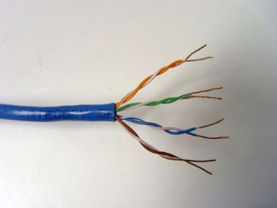
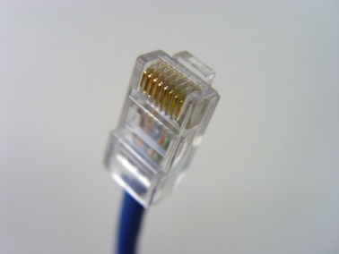
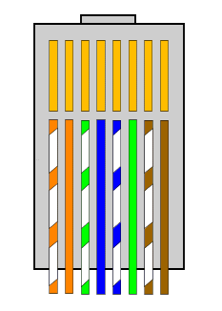
Copper
T568B
Wiring order
“8P8C” Plug
(aka RJ45)
Category 5/CAT5e/CAT6 cables
10/100BASE-T only uses 2 pairs. (orange + green)
Gigabit over copper signalling is radically different to 10/100
  Uses all 4 pairs. This can mean a cable that was fine on 10/100 may not work when used for Gigabit!
Newer kit is now “Auto-MDIX” but old “cross-over” cables will not work at Gigabit: only 2 pairs crossed!
Some equipment attempts to “auto-correct” this situation.
Auto-Negotiation is mandatory for 1000BASE-T interfaces, but NOT for older Gigabit only (SFP/GBIC) interfaces which don’t support 10/100 – Limited or no auto neg support!
Notes:
…Copper cabling.
Standard used today is either CAT5e or CAT6 cables.
Four twisted pairs.
(Usually) RJ45 Plugs and Sockets.
Pretty much all cables for network use are wired according to the
TIA “T568B” order. This is designed to reduce crosstalk and interference between pairs.
We can run 10Meg, 100Meg and Gigabit Ethernet (1000Meg) over copper cabling.
What is the maximum distance for Ethernet over Copper Cabling?

Slide 43
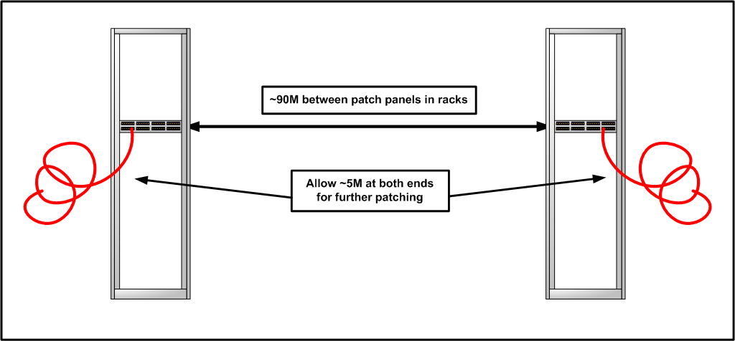
Copper Channel Length
Ethernet spec up to 100 Meters total channel length
This includes all building wiring and patch cords!
Can be forgotten when cabling in shared data centres
Installer’s cable tester only indicates “FAIL” at > 100M
Notes:
Maximum distance for Ethernet over copper is up to 100 Meters.
BUT…
This is the total channel length between devices.
As a guideline, I would suggest that a “safe” maximum for building wiring between racks is about 90 meters, allowing 5 meters on the ends for further patching. Patch cable might just go to the same rack, or it could be patched again to another rack in the same room.
As the official standard is 100M, a cable installer’s cable tester will typically only indicate a “fail” if the length actually exceeds 100Meters.
A good cable tester will warn you at 90 Meters (If the tester is set up correctly for testing patch panels and not total channel cable.)
A good cable installer will warn you!
This tends to happen more in data centres than in office blocks. Typical office blocks will have a cabinet on each floor with a switch.
Devices are cabled to the nearest cabinet.
Data Centres typically want to go a long distance with a copper cable between customers on different floors.
No one person exceeded 100M. When it’s all plugged together.. exceeds 100M!
Sometimes what you could get away with at 10/100 you will NOT get away with at Gigabit. Problem sometimes surfaces when upgrading to gigabit. It doesn’t always work out… It may be just too far, or you have to use a bizarre cable route. Sometimes you need Fibre……

Slide 44
Ethernet Copper Faults
Faulty cable install/crimping
Auto-Negotiation or duplex mismatches
Interference from power cables, lighting, other kit
Physical damage to cabling, plugs or interfaces
Kinks or sharp bends in the cable
“old cables”
Notes:
In general auto-neg should “Just work” in most situations and in newer hardware.
However, with a variety of equipment and vendors, some vendors implemented it differently, causing compatibility problems.
When working with carriers/leased lines etc. Auto-neg problems commonly occur. This can be due to the kit, or a configuration error – auto-neg at one end, but not at the other.
Shows up as packet loss, Late Collisions/Collisions, CRC errors on the link.
Typically traffic in one direction affected worse than the other in the case of a duplex mismatch.
Generally, you should try auto-negotiation first and check that both ends have negotiated the same.
If problems occur, nail it to Full Duplex at the correct speed.
“Half Duplex” these days is generally useless. If it only comes up at half duplex it is more than likely a fault/config issue.

Slide 45
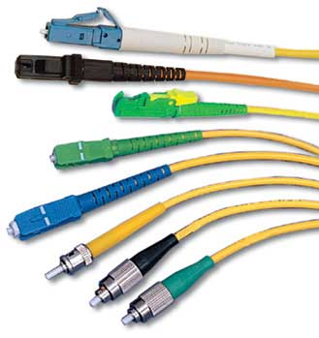
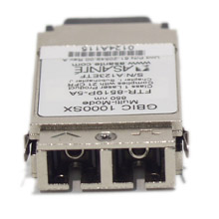
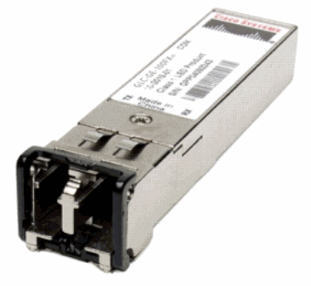
Fibre Optics
Glass strands
Generally installed in pairs of strands, one for transmit, another for receive. (TX/RX)
Connects to an optic at either end
SX (short haul) optic = Multi Mode
LX (long haul) optic = Single Mode
LC
MU
E2000
SC
ST
FC
Notes:
Fibre is possibly simpler to understand than copper cabling.
There is not so much to go wrong in the cable itself. It is just a light path.
(Show fibre)
There are two types of fibre cable in use: Multi-Mode and Single Mode.
For most Ethernet applications, we use them in pairs. One for Transmit (TX), and the other for Receive (RX)
It is by its nature, Full Duplex. “Half Duplex” not possible.
There are many connector types, but most network kit these days uses LC, and some older kit, SC.
This is mostly because as the technology has evolved, the fibre has got better and connectors need to be smaller, so we can have more ports on devices and patch panels to support smaller hardware, and higher density applications. A large switch can have hundreds of fibres coming in to it, and this would not be practical with SC connectors.

Slide 46
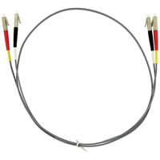
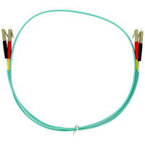
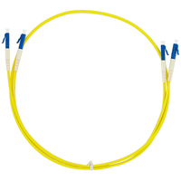
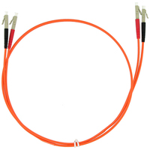
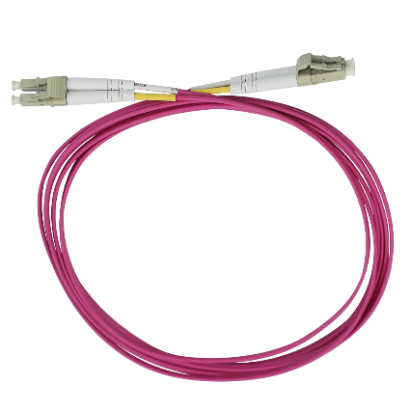
Fibre Optic Patch Leads
Almost all new installations are
Single Mode. Use this one!
Colour is usually significant! (TIA-598C)
Multi Mode
62.5/125µm
(OM1)
1G/10G
Multi Mode
50/125µm
(OM3)
up to 100G
Single Mode
9/125µm
(OS1)
Multi Mode
50/125µm
(OM2)
1G/10G
Multi Mode
50/125µm
(OM4)
up to 100G
Notes:
Fibre patch leads can be manufactured in any colour, however, usually the colours follow a de-facto standard. Most sites use the following colour scheme to distinguish between the different types of fibre:
GREY, ORANGE and AQUA are all MULTI-MODE.
Most multi-mode applications use 62.5/125 unless otherwise specified.
10G applications sometimes use 50/125 OM2 or OM3 (Check specifications.)
Also check what any building wiring you are connecting up to is!
SINGLE MODE is generally YELLOW and has BLUE or GREEN ends 9/125
The numbers mean the size of the core (microns) and the cladding around the core,
so 62.5/125 is a 62.5 micron core with a 125 micron cladding.
Single mode is only 9 microns.
Leads come with dust caps to help keep them clean when not in use.

Slide 47
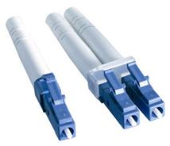
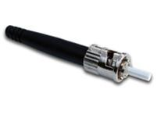
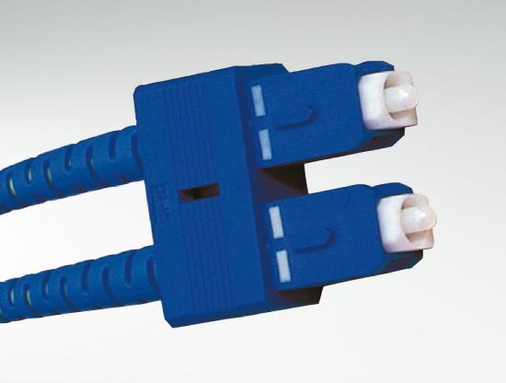
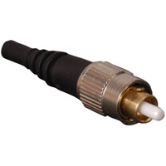
Common Fibre Connectors
LC
SC
ST
FC
Notes:
Here are four of the most common fibre optic connector types.
Note that usually a blue connector means single mode. Grey/Black/Beige is multi-mode.
Green is also single mode.

Slide 48
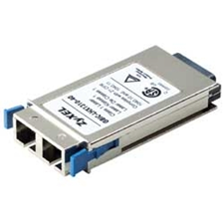
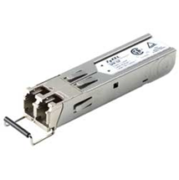
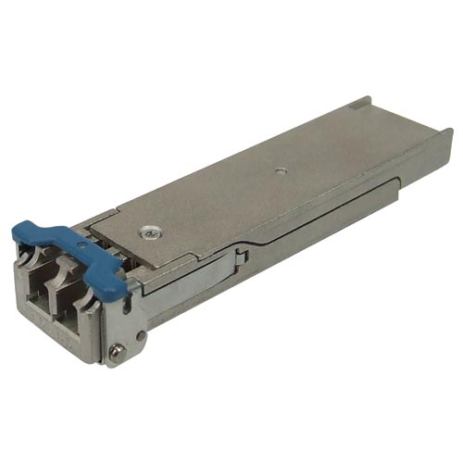
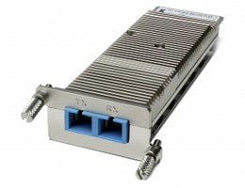
Optics (aka transceivers)
Optic Form Factor |  | Connector
SFP (1G) SFP+ (1G/10G) |  | LC
XFP (10G) |  | LC
Optic Form Factor |  | Connector
GBIC (Old 1G) |  | SC
XENPAK (Old 10G) |  | SC

Slide 49
Optics (aka transceivers)
Optic Form Factor |  | Connector
SFP (1G) SFP+ (1G/10G) |  | LC
XFP (10G) |  | LC
Optic Form Factor |  | Connector
GBIC (Old 1G) |  | SC
XENPAK (Old 10G) |  | SC
Colour of clips or aperture indicates mode/wavelength
Grey/Black = Multi Mode
BLUE = Single Mode
Others = Single Mode (WDM)

Slide 50
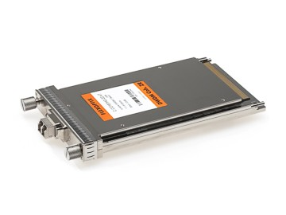
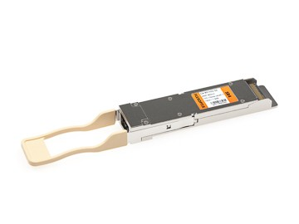
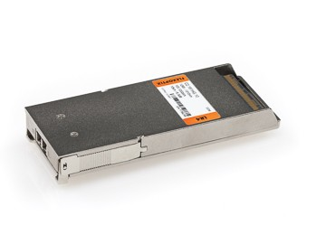

Optics – 40G and 100G
Optic Form Factor
CFP 10×10G or 4×25G lanes
CFP2 10×10G, 4×25G, 8×25G, or 8×50G lanes
Optic Form Factor
CFP4 4×10G or 4×25G lanes
QSFP+ (40G) QSFP28 (100G)
Notes:
Earlier generations of 40 and 100G optics:
CFP 10×10G or 4×25G lanes
10×10G, 4×25G, 8×25G, or 8×50G lanes
CFP4 4×10G or 4×25G lanes
4x10 Gbit/s for QSFP+
4x28 Gbit/s for QSFP28

Slide 51
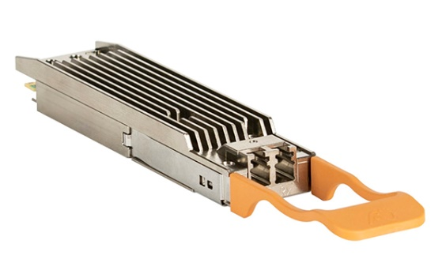
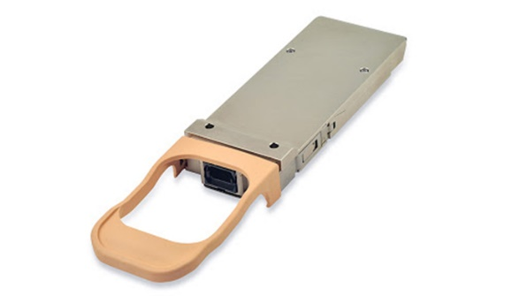
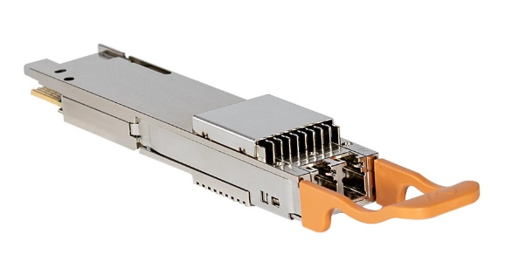
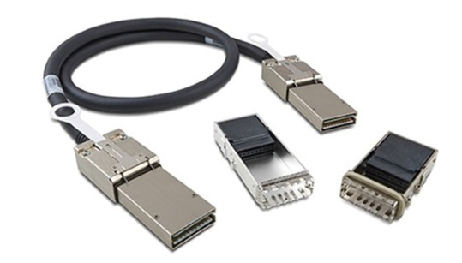
Optics – 400G
Optic Form Factor
OSFP Octal Small Formfactor Pluggable
QSFP-DD Quad Small Form Factor Pluggable-Double Density
Optic Form Factor
CFP8 C form-factor pluggable
CDFP (Older standard)

Slide 52
Layer 2:
Data Link

Slide 53
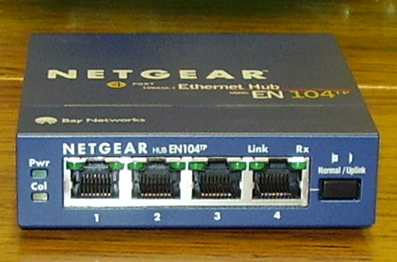

Switches and Hubs
What is a hub?
What is a switch?
Notes:
We’re going to look now at the hardware involved, and how it works.
There are two common devices that are used in Ethernet Networks,
The HUB and the SWITCH.

Slide 54
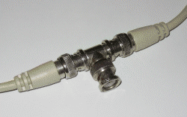
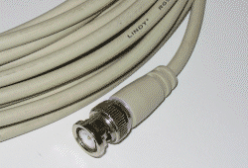
“Original” Ethernet LAN
10BASE2
Notes:
To understand what a hub does, you need to see how Ethernet has evolved.
Before hubs, ‘Ethernets’ (or LANs) were made up of many machines connected with a single cable. Everything shared this cable.
Data can be sent, but only if another device is not already trying to send data. We have to wait for the cable to be free before trying to use it.
What would happen if we all tried to send at once? Or all talk at the same time?
This is not a problem as data is split up into lots of little pieces, or frames, and all of this happens within microseconds.
If two devices try to use the cable at once, they both back off and try again a random amount of time later.
Importantly, data can only be sent, OR received at any one time.
This is called Half Duplex.

Slide 55
“Original” Ethernet LAN - MAC
00:30:05:8d:f9:3f
CSMA/CD
Carrier sense multiple access with collision detection
00:30:05:4E:DB:27
Media
Access
Control
00:01:e6:5d:7b:76
00:40:8c:6f:dc:ce
Single Collision Domain
Single Broadcast Domain
ff:ff:ff:ff:ff:ff
= broadcast
00:30:48:77:a5:62
00:0a:e4:3b:84:06
Notes:
Every device is assigned by the manufacturer, a unique address.
In this network, every device receives all the traffic on the whole network, but it only processes data destined for itself. (and broadcasts)
It just discards any other data that is not addressed to it.

Slide 56
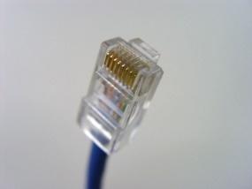
Hub
00:30:05:8d:f9:3f
00:30:05:4E:DB:27
CSMA/CD
00:01:e6:5d:7b:76
00:40:8c:6f:dc:ce
00:30:48:77:A5:62
00:0a:e4:3b:84:06
Notes:
A hub might be cabled differently, but it works in exactly the same way.
Another name for a hub is a repeater.
It just repeats everything on one port out of all the other ports.
It’s just a dumb bit of kit.
This is better, but still only one COLLISION DOMAIN. Collisions can occur when two stations try to transmit at the same time.

Slide 57
Switch – Forwarding table
00:30:05:8d:f9:3f
00:30:05:4E:DB:27
Port : MAC Address
1 : 00:01:e6:5d:7b:76
2 : 00:30:48:77:A5:62
3 : 00:0a:e4:3b:84:06
4 : 00:40:8c:6f:dc:ce
5 : 00:30:05:4E:DB:27
6 : 00:30:05:8d:f9:3f
7 :
8 :
…
00:01:e6:5d:7b:76
Half Duplex ports each have
a Single Collision Domain
Full Duplex ports have
No Collision Domain
Single Broadcast Domain
00:40:8c:6f:dc:ce
00:30:48:77:A5:62
00:0a:e4:3b:84:06
Notes:
Then along came the switch.
These were initially very expensive, but are now pretty cheap.
A switch works in the same way as a hub, except that it has a brain.
As traffic comes in to the switch, it learns the address of each device, and which port the data was received on.
Then, when any traffic for that address is received on another port, it does not send the data out of every port, but out of the port it learned that address on.
This means that more capacity is available, and each device only sees the traffic destined for it. There are no ‘collisions’.
Each port is said to be in its own COLLISION DOMAIN.
If it receives traffic for a MAC address it has not learned, it sends it out of every port… like a hub. (sometimes called flooding)
The special MAC address FF:FF:FF:FF:FF:FF (all 1s in binary!) is the broadcast address. The switch forwards these out of every port.
Full duplex communication is possible, as the cable is not shared by all devices.

Slide 58
Layer 3:
Network

Slide 59
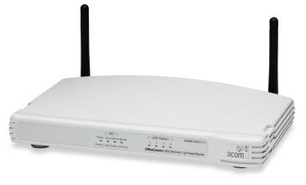
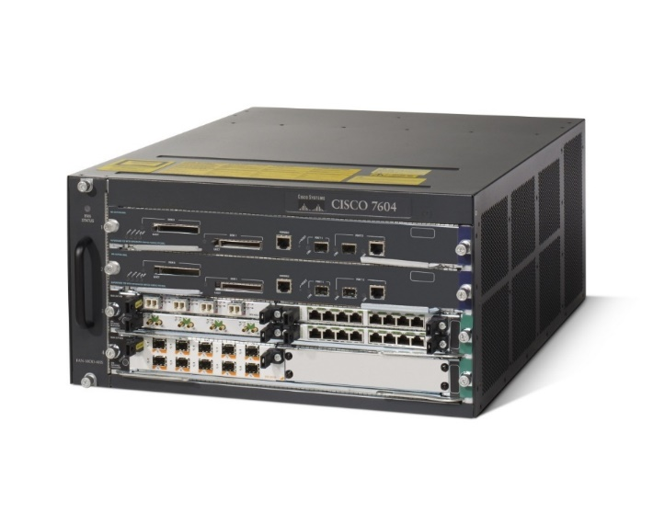
Routers
What is a router?
Notes:
Routers are the brains of the whole operation…
It intelligently makes decisions about where to send traffic, especially between networks.
It can also perform certain other functions for us, for example security access lists, quality of service, link redundancy and failover.

Slide 60
Router
A router is basically a computer with a bunch of interfaces!
Each interface is connected to a different (Layer 2) network
Routers look at the destination of packets and decide an interface to forward it out on, using IP (Layer 3 Subnets)
Modern (decent!) routers perform many Layer 2 and Layer 3 forwarding functions in hardware
Also possibility for hardware redundancy (PSUs, processors etc.)

Slide 61
Subnets
What is a subnet?
…
Notes:
‘Peering’ is the reason that Internet Exchanges exist. So it’s important to understand the basics of peering.
What do you understand peering to mean?

Slide 62
Subnets
Subnets allow larger networks to be split up
Routers ‘route’ between different subnets
Subnets are groups of IP addresses that represent IP networks.
(Layer 3)
Subnets can be various sizes, defined by a subnet mask
Notes:
In IP terms, different networks can be called ‘Subnets’
IP addresses must be globally unique, and are assigned in blocks.

Slide 63
IPv4 Subnets
IP: 192.168.1.1
Mask: 255.255.255.0
Gateway: 192.168.1.200
IP: 11000000.10101000.00000001.00000001
Mask: 11111111.11111111.11111111.00000000
Network: 192.168.1.0/24
32 bits long in binary
Notes:
An IP address is 32 bits long. Back to ones and zeros again!
Every IP address is actually split into two parts.
The first part of the IP address decides how big the subnet (network) is, and the second part is assigned to hosts in that network.
This is decided by something called a Subnet Mask, which tells the computer (or router) which addresses are on the same network. If data is to be sent to another device on the same network, then it is able to go directly there across the LAN. Otherwise, the data must be sent to a router, or Gateway (which will hopefully know what to do next!)

Slide 64
IPv4 Subnets
IP: 10.50.9.1
Mask: 255.0.0.0
Gateway: 10.0.0.2
IP: 00001010.00110010.00001001.00000001
Mask: 11111111.00000000.00000000.00000000
Network: 10.0.0.0/8
Notes:
An IP address is 32 bits long. Back to ones and zeros again!
Every IP address is actually split into two parts.
The first part of the IP address decides how big the subnet (network) is, and the second part is assigned to hosts in that network.
This is decided by something called a Subnet Mask, which tells the computer (or router) which addresses are on the same network. If data is to be sent to another device on the same network, then it is able to go directly there across the LAN. Otherwise, the data must be sent to a router, or Gateway (which will hopefully know what to do next!)

Slide 65
IPv4 Subnets - CIDR
Classless Inter-Domain Routing (CIDR)
IP Allocations managed by Regional Internet Registries (RIRs)
such as RIPE.
CIDR replaced old “Class A, B, C” system in mid ‘90s to conserve address space.
Class A: (0.0.0.0 – 126.255.255.255) 10.0.0.0 (/8 prefix) (~16,777,216 addresses)
Class B: (128.0.0.0 – 191.255.255.255) 172.16.0.0 (/16 prefix) (~65,536 addresses)
Class C: (192.0.0.0 – 223.255.255.255) 192.168.1.0 (/24 prefix) (~256 addresses)
LONAP Allocation: 5.57.80.0/20 (4096 addresses)
Office: 5.57.95.0/25 (~128 addresses)

Slide 66
IPv4 Subnets - CIDR
LONAP Allocation: 5.57.80.0/20 (4096 addresses)
Total range: 5.57.80.0 - 5.57.95.255
Office: 5.57.95.0/25 (~128 addresses – half a /24)
IP: 5.57.95.10
Mask: 255.255.255.128
IP: 00000101.00111001.01011111.00001010
Mask: ?

Slide 67
IPv4 Subnets - CIDR
LONAP Allocation: 5.57.80.0/20 (4096 addresses)
Office: 5.57.95.0/25 (~128 addresses – half a /24)
IP: 5.57.95.10
Mask: 255.255.255.128
IP: 00000101.00111001.01011111.00001010
Mask: 11111111.11111111.11111111.10000000

Slide 68
Determine what is local / remote
My IP: 5.57.95.10
Mask: 255.255.255.128 (/25)
Destination: 5.57.95.11
IP: 00000101.00111001.01011111.00001010
Mask: 11111111.11111111.11111111.10000000
Logical AND: 00000101.00111001.01011111.00000000
Destination: 00000101.00111001.01011111.00001011
Mask: 11111111.11111111.11111111.10000000
Logical AND: 00000101.00111001.01011111.00000000
Logical AND
0 AND 0 = 0
0 AND 1 = 0
1 AND 1 = 1
Compare Logical AND
results.
If they are identical,
Destination is on same
subnet. ARP for this host.

Slide 69
Determine what is local / remote
My IP: 5.57.95.10
Mask: 255.255.255.128 (/25)
Destination: 5.57.95.11
Logical AND
0 AND 0 = 0
0 AND 1 = 0
1 AND 0 = 0
1 AND 1 = 1
My IP:
00000101.00111001.01011111.00001010
11111111.11111111.11111111.10000000
Mask:
11111111.11111111.11111111.10000000
00000101.00111001.01011111.00000000
Dest IP:
00000101.00111001.01011111.00001011
Compare Logical AND
results:
If they are identical,
Destination is on same
subnet. ARP for this host.
Mask:
00000101.00111001.01011111.00000000

Slide 70
ARP (Address Resolution Protocol)
When an IPv4 host is on the same subnet, send an ARP broadcast.
-> "Hi Everyone. Will the host at 5.57.95.11 please respond with your MAC address"
<- "Hi. I am 5.57.95.11. My MAC address is 00:50:c2:46:60:0b"
mon0:~# arp -n -i eth0
5.57.95.37 ether 00:50:c2:46:60:25 C eth0
5.57.95.31 ether 00:22:19:cd:52:1f C eth0
5.57.95.25 ether 00:50:c2:46:60:19 C eth0
5.57.95.10 ether 00:50:c2:46:60:0a C eth0
5.57.95.7 (incomplete) eth0
5.57.95.32 ether 00:50:c2:46:60:01 C eth0
5.57.95.26 ether 00:50:c2:46:60:1a C eth0
5.57.95.20 ether 44:1e:a1:61:cc:16 C eth0
5.57.95.11 ether 00:50:c2:46:60:0b C eth0

Slide 71
Determine what is local / remote
My IP: 5.57.95.10
Mask: 255.255.255.128 (/25)
Destination: 5.57.80.1
Logical AND
0 AND 0 = 0
0 AND 1 = 0
1 AND 0 = 0
1 AND 1 = 1
5
57
95
10
My IP:
00000101.00111001.01011111.00001010
11111111.11111111.11111111.10000000
Mask:
11111111.11111111.11111111.10000000
= (Net: 5.57.95.0/25)
00000101.00111001.01011111.00000000
5
57
80
1
Dest IP:
00000101.00111001.01010000.00000001
Compare Logical AND results:
If they differ,
destination is on remote subnet. Send to router.
Mask:
= (Net: 5.57.80.0)
00000101.00111001.01010000.00000000

Slide 72
Determine what is local / remote
My IP: 5.57.95.10
Mask: 255.255.240.0 (/20)
Destination: 5.57.80.1
Logical AND
0 AND 0 = 0
0 AND 1 = 0
1 AND 0 = 0
1 AND 1 = 1
5
57
95
10
My IP:
00000101.00111001.01011111.00001010
Mask:
11111111.11111111.11110000.00000000
11111111.11111111.11110000.00000000
= (Net: 5.57.80.0/20)
00000101.00111001.01010000.00000000
5
57
80
1
Dest IP:
00000101.00111001.01010000.00000001
Compare Logical AND
results:
If they are the same,
destination is on the
same subnet. ARP and send
directly to destination host.
Mask:
00000101.00111001.01010000.00000000

Slide 73
Determine what is local / remote
My IP: 5.57.95.10
Mask: 255.255.255.128 (/25)
Destination: 5.57.80.1
IP: 00000101.00111001.01011111.00001010
Mask: 11111111.11111111.11111111.10000000
Logical AND: 00000101.00111001.01011111.00001010
Destination: 00000101.00111001.01010000.00000001
Mask: 11111111.11111111.11111111.10000000
Logical AND: 00000101.00111001.01010000.00000000
Logical AND
0 AND 0 = 0
0 AND 1 = 0
1 AND 1 = 1
Compare Logical AND
results.
If they differ,
destination is on
remote subnet.
send to router.

Slide 74
Addresses | Prefix | Subnet Mask | Cisco Wildcard
4 | /30 | 255.255.255.252 | 0.0.0.3
8 | /29 | 255.255.255.248 | 0.0.0.7
16 | /28 | 255.255.255.240 | 0.0.0.15
32 | /27 | 255.255.255.224 | 0.0.0.31
64 | /26 | 255.255.255.192 | 0.0.0.63
128 | /25 | 255.255.255.128 | 0.0.0.127
256 | /24 | 255.255.255.0 | 0.0.0.255
512 | /23 | 255.255.254.0 | 0.0.1.255
1,024 | /22 | 255.255.252.0 | 0.0.3.255
2,048 | /21 | 255.255.248.0 | 0.0.7.255
4,096 | /20 | 255.255.240.0 | 0.0.15.255
8,192 | /19 | 255.255.224.0 | 0.0.31.255
16,384 | /18 | 255.255.192.0 | 0.0.63.255
32,768 | /17 | 255.255.128.0 | 0.0.127.255
65,536 | /16 | 255.255.0.0 | 0.0.255.255
131,072 | /15 | 255.254.0.0 | 0.1.255.255
262,144 | /14 | 255.252.0.0 | 0.3.255.255
524,288 | /13 | 255.248.0.0 | 0.7.255.255
1,048,576 | /12 | 255.240.0.0 | 0.15.255.255
2,097,152 | /11 | 255.224.0.0 | 0.31.255.255
4,194,304 | /10 | 255.192.0.0 | 0.63.255.255
8,388,608 | /9 | 255.128.0.0 | 0.127.255.255
16,777,216 | /8 | 255.0.0.0 | 0.255.255.255
IPv4 CIDR Subnetting

Slide 75
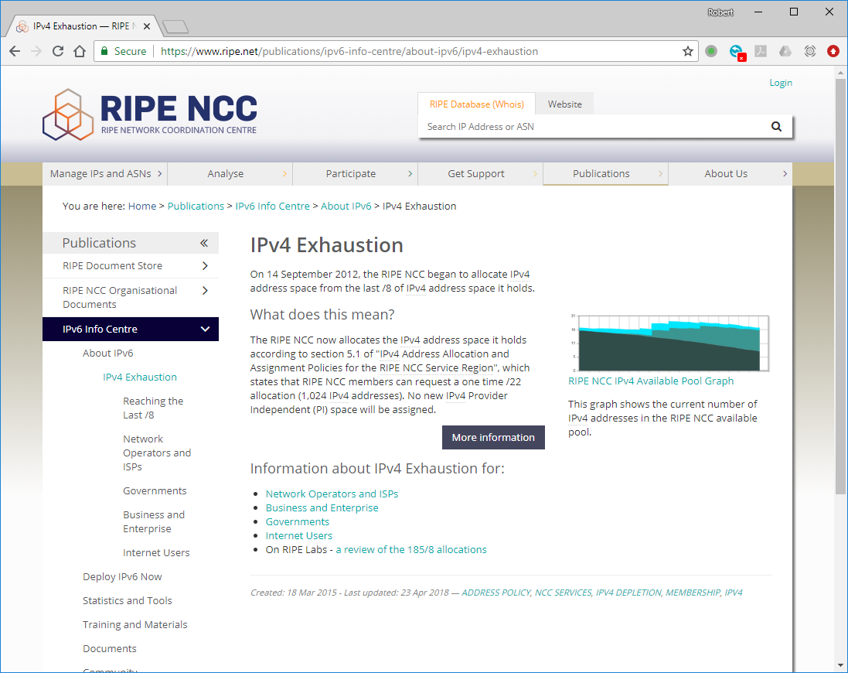
IPv6
Notes:
In case you've been hiding under a rock, we've run out of IPv4 space now.

Slide 76
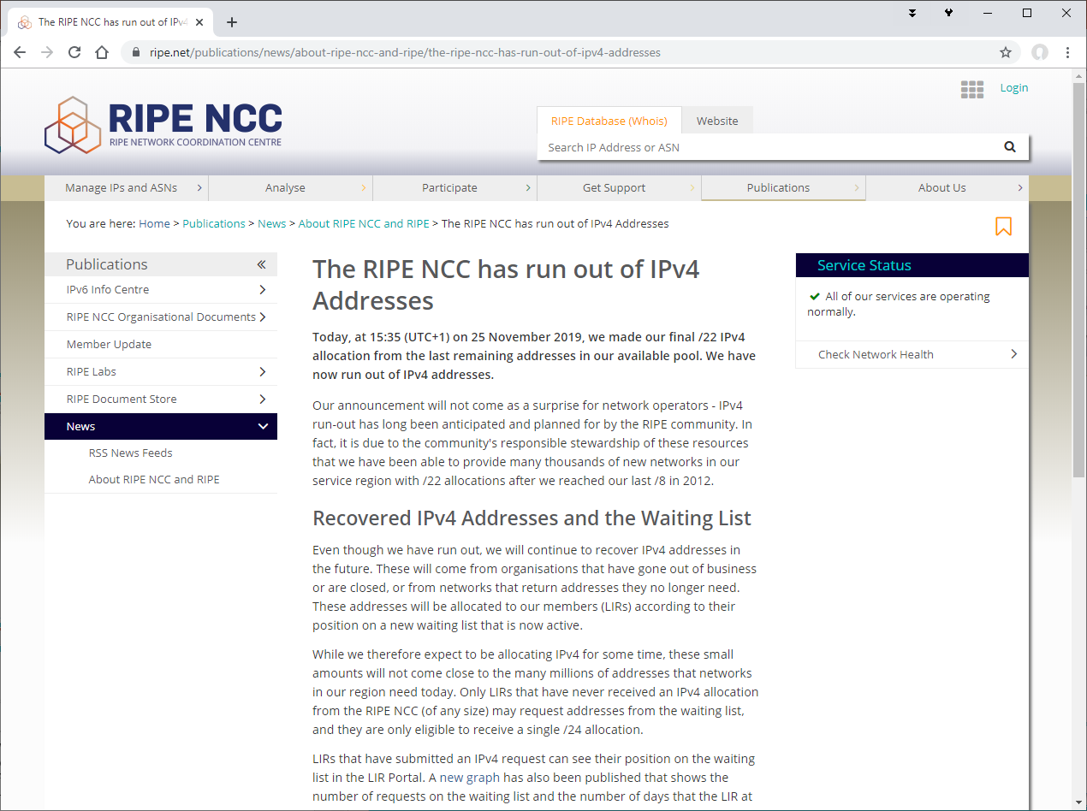
IPv6
Notes:
In case you've been hiding under a rock, we've run out of IPv4 space now.

Slide 77
IPv6
The ‘Internet’ has run out of IPv4 address space
(~4.2 billion addresses)
CIDR, NAT, Policy and other things have conserved IPv4 address space… but we have to address it some day!
IPv6 – 128 bit address space, 2¹²⁸
(~340 undecillion) unique addresses!
…That’s a lot.
340,282,366,920,938,463,463,374,607,431,768,211,456

Slide 78
IPv6 Subnets
LONAP Allocation: 2a00:eb20::/32 (lots!)
Total Range: 2a00:eb20:0000:0000:0000:0000:0000:0000 – 2a00:eb20:ffff:ffff:ffff:ffff:ffff:ffff
Office: 2a00:eb20:100::/64 (18,446,744,073,709,551,616 addresses)
IP: 2a00:eb20:0100:0000:0000:0000:0000:0011
Mask: /64
IP:
Mask:
0010101000000000:1110101100100000:0000000100000000:0000000000000000:0000000000000000:0000000000000000:0000000000000000:0000000000010001
1111111111111111:1111111111111111:1111111111111111:1111111111111111:0000000000000000:0000000000000000:0000000000000000:0000000000000000

Slide 79
IPv6 Addresses
Consecutive zeros between colons can be ‘compressed’ with double colons “::”
Leading zeros in hextets can be stripped:
  :0def: = :def:
  ‘:0000:’ can be shortened to :0:
2001:0db8:0000:cd30:0000:0000:0000:0000/60
Can also be compressed as:
  2001:db8:0:cd30::/60
  2001:db8::cd30:0:0:0:0/60 (…Don’t!)
…But you can only do “::” ONCE in an address:
  2001:db8:0:cd30::/60 not 2001:db8::cd30::/60
“::” can also be used to compress ‘all zeros’ addresses - ::1
RFC 5952: https://datatracker.ietf.org/doc/html/rfc5952

Slide 80
IPv6 Address Examples
Long IPv6 Address | Compressed | Description
2001:0db8:0:0:8:800:200c:417a | 2001:db8::8:800:200c:417a | A unicast address
ff01:0:0:0:0:0:0:101 | ff01::101 | A multicast address
0:0:0:0:0:0:0:1 | ::1 | The loopback address
0:0:0:0:0:0:0:0 | :: | The unspecified address
0:0:0:0:0:0:0:0/0 | ::/0 | “Default gateway”
RFC 4291: http://tools.ietf.org/html/rfc4291 (Here’s lots of ways to write IPv6 addresses…)
RFC 5952: http://tools.ietf.org/html/rfc5952 (This got annoying. Write them like this please!)

Slide 81
IPv6 Address Space
IPv6 Prefix Allocation Reference Note
0000::/8 Reserved by IETF [RFC4291] [1][5][6]
0100::/8 Reserved by IETF [RFC4291]
0200::/7 Reserved by IETF [RFC4048] [2]
0400::/6 Reserved by IETF [RFC4291]
0800::/5 Reserved by IETF [RFC4291]
1000::/4 Reserved by IETF [RFC4291]
2000::/3 Global Unicast [RFC4291] [3]
4000::/3 Reserved by IETF [RFC4291]
6000::/3 Reserved by IETF [RFC4291]
8000::/3 Reserved by IETF [RFC4291]
A000::/3 Reserved by IETF [RFC4291]
C000::/3 Reserved by IETF [RFC4291]
E000::/4 Reserved by IETF [RFC4291]
F000::/5 Reserved by IETF [RFC4291]
F800::/6 Reserved by IETF [RFC4291]
FC00::/7 Unique Local Unicast [RFC4193]
FE00::/9 Reserved by IETF [RFC4291]
FE80::/10 Link Local Unicast [RFC4291]
FEC0::/10 Reserved by IETF [RFC3879] [4]
FF00::/8 Multicast [RFC4291]
[3] The IPv6 Unicast space encompasses the entire IPv6 address range except for FF00::/8. [RFC4291] IANA unicast address assignments are currently limited to the IPv6 unicast address range of 2000::/3. IANA assignments from this block are registered in the IANA registry:
ipv6-unicast-address-assignments.

Slide 82
Prefix | /48s | /56s | /64s
/24 | 16M | 4G | 1T
/25 | 8M | 2G | 512G
/26 | 4M | 1G | 256G
/27 | 2M | 512M | 128G
/28 | 1M | 256M | 64G
/29 | 512K | 128M | 32G
/30 | 256K | 64M | 16G
/31 | 128K | 32M | 8G
/32 | 64K | 16M | 4G
/33 | 32K | 8M | 2G
/34 | 16K | 4M | 1G
/35 | 8K | 2M | 512M
/36 | 4K | 1M | 256M
/37 | 2K | 512K | 128M
/38 | 1K | 256K | 64M
/39 | 512 | 128K | 32M
/40 | 256 | 64K | 16M
/41 | 128 | 32K | 8M
/42 | 64 | 16K | 4M
/43 | 32 | 8K | 1M
/44 | 16 | 4K | 1M
Prefix | /48s | /56s | /64s
/45 | 8 | 2K | 512K
/46 | 4 | 1K | 256K
/47 | 2 | 512 | 128K
/48 | 1 | 256 | 64K
/49 |  | 128 | 32K
/50 |  | 64 | 16K
/51 |  | 32 | 8K
/52 |  | 16 | 4K
/53 |  | 8 | 2K
/54 |  | 4 | 1K
/55 |  | 2 | 512
/56 |  | 1 | 256
/57 |  |  | 128
/58 |  |  | 64
/59 |  |  | 32
/60 |  |  | 16
/61 |  |  | 8
/62 |  |  | 4
/63 |  |  | 2
/64 |  |  | 1
IPv6 Subnetting

Slide 83
Service Provider Networks
Network hardware (!!)
Location with good connectivity
IP Addresses (IPv4 and IPv6)
AS Number
Connectivity (transit and maybe peering)
Notes:
Where do we get AS numbers and IP addresses from?

Slide 84
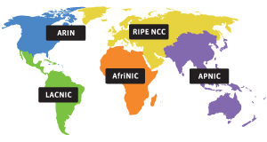
Regional Internet Registries (RIRs)
RIRs manage resources (IPs, ASNs) in a service region
Registry | Area Covered
AfriNIC | Africa Region
APNIC | Asia/Pacific Region
ARIN | Canada, United States, some Caribbean nations
LACNIC | Latin America and some Caribbean nations
RIPE NCC | Europe, Russia, Middle East, and Central Asia
LACNIC NIRs
nic.br NIC Mexico nic.mx NIC Brazil
APNIC NIRs
APJII, CNNIC, JPNIC, KRNIC, TWNIC, VNNIC, IRINN
Notes:
The five RIRs each cover a service region.
The RIR for Europe is RIPE NCC, based in Amsterdam.
They manage all public IP space allocations and AS numbers in their region.
APNIC is slightly different – it’s more of an umbrella body of registries for further regions.
The following National Internet Registries (NIRs) are currently operating in the APNIC region:
APJII (Asosiasi Penyelenggara Jasa Internet Indonesia), Indonesian ISP Association
CNNIC, China Internet Network Information Center
JPNIC, Japan Network Information Center
KRNIC, Korea Internet & Security Agency
TWNIC, Taiwan Network Information Center
VNNIC, Vietnam Internet Network Information Center
IRINN - Indian Registry for Internet Names and Numbers
The following NIRs are currently operating in the Latin American (LACNIC) region:
NIC Mexico
NIC Brazil
There are no NIRs operating in the RIPE NCC region.

Slide 85
Local Internet Registries (LIRs)
An LIR is a member of an RIR (or NIR)
Generally an LIR is a service provider wanting their own
IP address space and AS number
Provider Aggregatable (PA) IP space
RIR makes an ALLOCATION to the LIR
LIR makes ASSIGNMENTS to customers
RIPE region is Europe, the Middle East, and Central Asia
Notes:
Most service providers have to become a member of RIPE, and become an LIR.

Slide 86
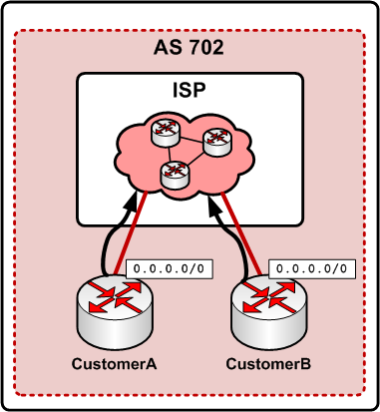
Single Homed – ‘Before’
Customer gets IPs from ISP
Customer is inside the ISP’s AS
Customer points default gateway at ISP
Most businesses,
end-users/residential customers
Cannot usually use same IP range with two ISPs.
Notes:
In the Single homed setup, the customer or end-user just has a default gateway to their ISP.
Their IP addresses come from their ISP.
They are part of the ISPs network, as they come under the IP range and AS.
They have a default gateway, which points to their ISP. They leave it to their ISP to worry about how
the traffic actually gets to its final destination.
The ISP backbone has NO default routes. If it doesn’t exist in the routing table, we cannot get to it!
Somebody somewhere needs to know where the destination is…. on the internet!

Slide 87
Multi Homed – ‘After’
Customer has own IPs
Customer has own AS
Multiple upstream transit providers
BGP sessions to each, uses full table. BGP selects ‘best’ path
Can move and add ISPs and peers without changing IP ranges
Notes:
In the multi-homed setup, there is usually no default route.
The Customer’s network has its own AS, and usually own IP ranges (from RIPE)
The customer does BGP with two or more transit providers (ISPs) and these send a full table (around 700,000 routes.)
The customer ADVERTISES their prefix to both transit providers, who in turn, advertise it to everyone else.
(All their peers, any upstreams, and their other customers….) – This is a transit arrangement.
The customer router decides “best” path between the two ISPs.
If one goes down… the other takes over (resiliency)
Customer can select preference between the upstreams. (Well… a bit!)

Slide 88
Why bother?
Advantages
  ‘independent’ network can be truly multi-homed
  ‘own’ IP address space
  Multiple transit providers, seamless to switch
  Increase network resilience
  Ready for peering at exchanges
  More control where traffic goes and why (policy)
  Easy expansion

Slide 89
Why bother?
Disadvantages…
  Re-number IPs on existing network
  Requires big routers
  Complex procedures to get started
  Increases configuration complexity
  Requires specialist knowledge/skills
    Knowledge: Learn BGP and lots more!
    Skills: Apply knowledge, gain experience, do it well
  Not cost-effective for every network

Slide 90
BGP ROUTING

Slide 91
Routing Protocols
What is a routing protocol?
Discuss…
Notes:
What is a Routing Protocol?

Slide 92
Routing Protocols
Routers use routing protocols to learn and distribute which networks are connected via which interfaces.
Routing protocols also help make decisions about the ‘best’ path to take.
BGP4 (Border Gateway Protocol) mostly used between networks on the Internet. (EGP)
OSPF, RIP, EIGRP, ISIS.. are all Interior routing protocols. (IGP) that operate within an AS
Most commonly OSPF or ISIS in ISPs
Can use only BGP to do everything. Most have IGP+BGP for scaling.
Notes:
BGP requires FULL MESH within an AS, that is, every BGP router must have sessions to every other BGP router. (Unless you start implementing route reflectors or tricks with default routes in BGP.)

Slide 93
BGP4
Every network has an Autonomous System Number (AS Number)
AS numbers assigned by RIR
Every router inside each network has the same AS number.
  BGP sessions configured in the same ASN = iBGP (Internal)
BGP Sessions established between ASNs = eBGP (External)
No ‘magic router discovery’: every session must be configured.
Path Vector routing protocol
 | 1.4 Basic operation (p.21)
Notes:
BGP requires every network to have a unique Autonomous System Number.
BGP sessions usually have to be manually configured between networks.
The job of the Peering Coordinator is to agree with other networks on peering arrangements.
Once the peering has been agreed between two networks, the BGP sessions can be configured between them.
There is no magic discovery between Autonomous Systems, but the network prefixes are advertised between networks once the session has been configured between the two networks. (So in one BGP session, I might receive one prefix, or several thousand.) This does not have to be manually configured, but each AS can decide if they want to accept those routes or not. (Filtering/Routing Policy)

Slide 94
BGP4
Networks can be ‘multi-homed’ – not dependent on a single ‘upstream’ provider.
…providing they have their own IP addresses
Strict control of routing policy
Control which prefixes are advertised where
  Peers
  Transit
  Downstream customers
Set preferences AS-wide: preferred routes
 | 1.4.4 Routing Policies (p.25)
Notes:
BGP allows a network to be truly multi-homed.
Allows control of policy between ASNs and to set which routes we're going to use where.

Slide 95
Autonomous Systems
Notes:
So an AS is just a collection of routers that are all under the control of one operator.
Within each AS there are a number of routers. Every router in an AS is configured with the same AS number.
The full details of the internal network within each AS need not be advertised to neighbouring peers. Usually only a summary of their network range (prefix)
So for example, if we have many offices and sites within our network, there is no need to advertise the full details of this to our peers, as all the traffic would take the same path anyway.
So, we only advertise a bigger prefix to our peers. This prefix includes all of the little networks inside our network.
This is called route summarisation, or aggregation.
Sometimes networks advertise lots of little networks either deliberately (maybe they have lots of networks all scattered about and not one central routing, or they just do this by accident! de-aggregation!

Slide 96
AS Path

Slide 97
BGP Routing Table
Origin network is right-most ASN in path
Notes:
An AS is the origin for a prefix that is allocated to it

Slide 98
Recap

