Slide 2
Power Consumption Considerations in Optical Metro Transport Networks

Slide 3
The Importance of Power Consumption in Telecoms
Steve Harris, Digital Transformation / Orange Enterprise (March 2023):
  “The telecoms industry is responsible for 2-3% of the total power consumption of humankind. According to GSMA research, energy costs today represent between 20% and 40% of a telecoms company’s OPEX” (www.orange-business.com/en/blogs/greening-telecoms-network)
McKinsey Study “The growing imperative of energy optimization for Telco Networks”(Nov 2024):
  “large operators have seen their energy cost increases outpace sales growth by more than 50 percent.”
  “Pressure is likely also to come from regulators around the world, as they begin to adopt their own decarbonisation goals and factor sustainability considerations into their policies.” https://www.mckinsey.com/industries/technology-media-and-telecommunications/our-insights/the-growing-imperative-of-energy-optimization-for-telco-networks

Slide 4
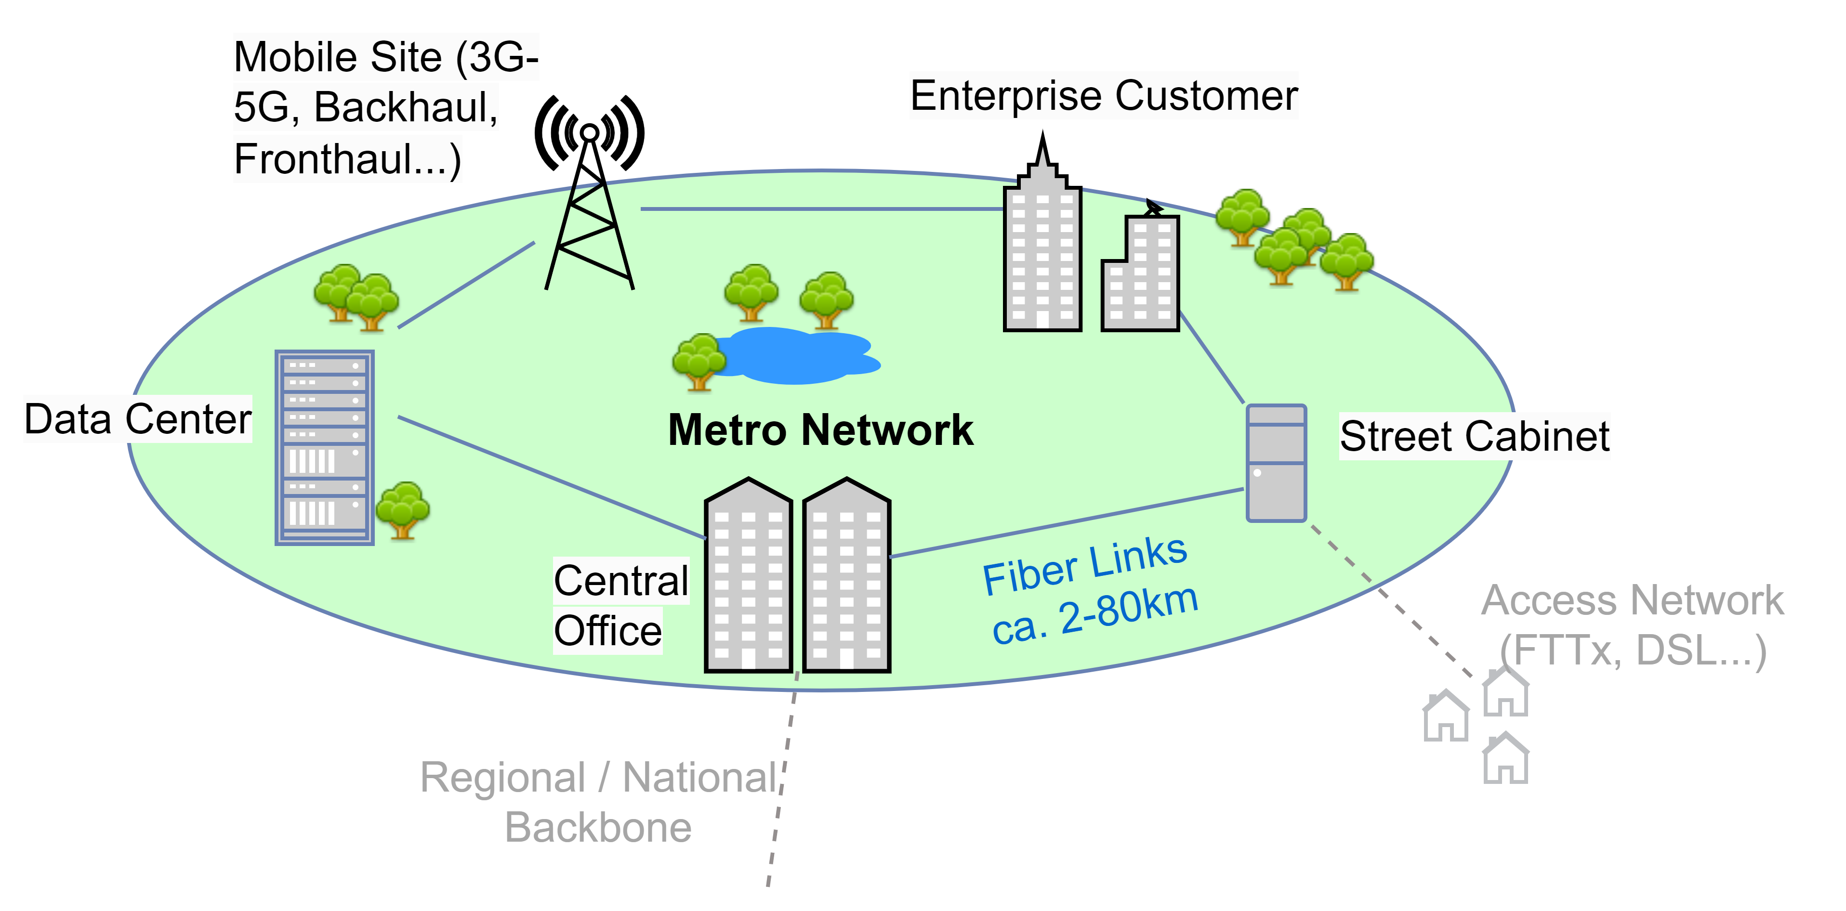
Focus on Metro Transport Networks
Fiber based link distances ca. 2 to 80km
Topologies: Ring, Point-2-Point daisy chain…
Protocols: Ethernet, CPRI, eCPRI, FiberChannel, OTN, SDH etc
Data Rates: 1Gig to multiple 400Gig
Various applications (often on same fiber link): Backhauling of Residential Access (DSL, FTTx…), Mobile Front/Mid/Backhauling, DC Interconnect, Enterprise Access, Private Networks etc
Two Basic Technologies used in Network Nodes to transport data from node to node: Passive Transport vs. Active Transport

Slide 5
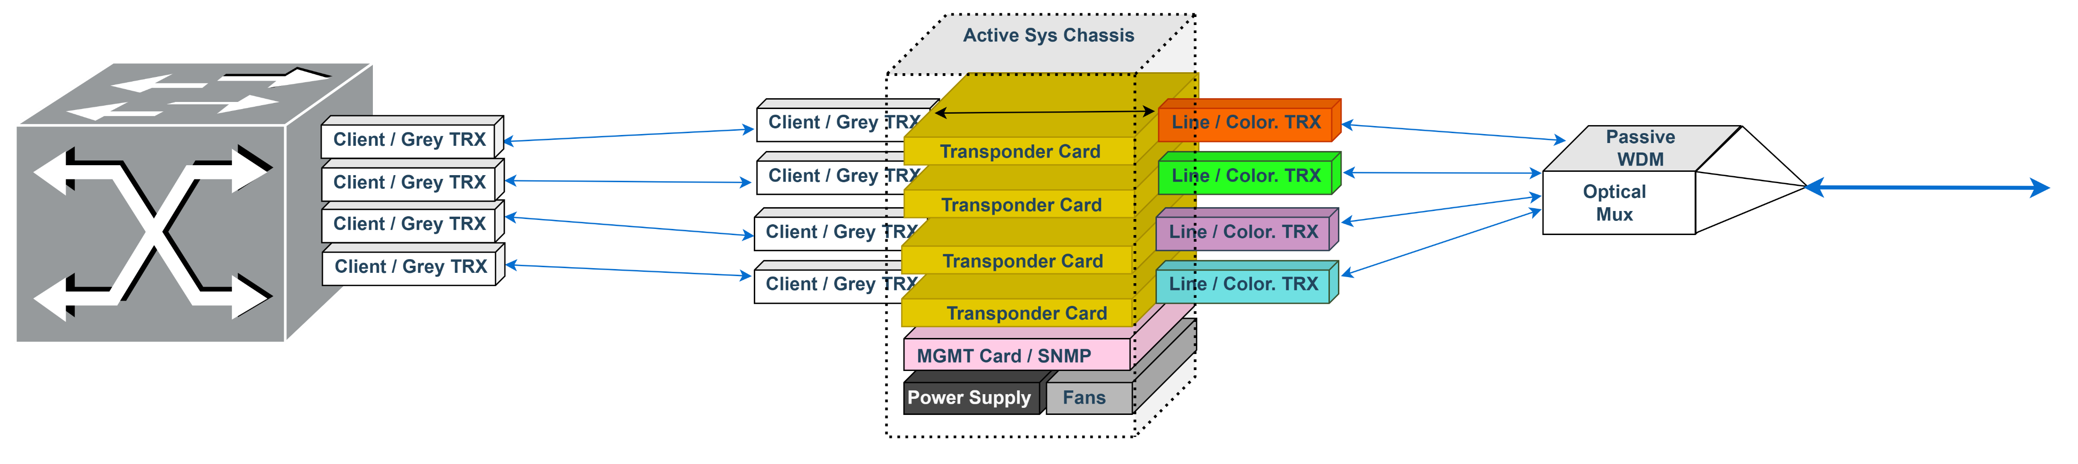
Traditional Approach: Active (WDM) Transport Systems – Transponding
Metro Network Node / Site
Ca. 2-80km transmission fiber link to next site
1m Patch Cord

Slide 6
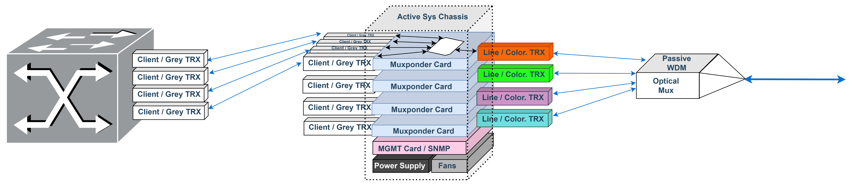
Traditional Approach: Active (WDM) Transport Systems – Muxponding
Metro Network Node / Site
1m Patch Cord
Ca. 2-80km transmission fiber link to next site

Slide 7
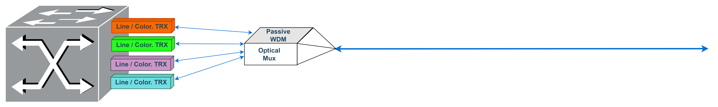
„Modern“ Approach: Passive (WDM) Transport Systems (aka IPoDWDM)
Metro Network Node / Site
Ca. 2-80km transmission fiber link to next site

Slide 8
Methodology
METRO Links = “typical distances of around 10-80km”
Only comparing the Transport Technology, NOT including the “L2/L3”, i.e. routers, switches, Radios etc…
Does not include additional items, eg amplifiers.
  These would come on top in all cases
Comparing power on per link base (incl. both nodes), looking at data rates of 1G, 10G, 25G, 100G, 400G
Power normalised on per link base:
  the power consumed by the chassis itself, the power supplies themselves etc is broken down for 1 line in said active system and related to 1 coloured TRX at client speed in the host
Model allows calculation of specific scenarios by multiplying services
Muxponding based on equivalent Client data rate for comparison with Line TRX (e.g. 100G client aggregation into 400G Line, we need to compare it to the alternative of 100G transport, not 400G Coloured Transceivers in the host)

Slide 9
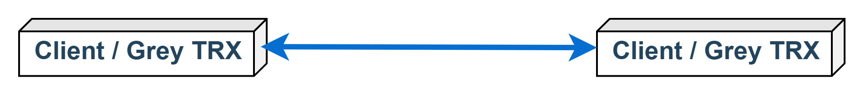
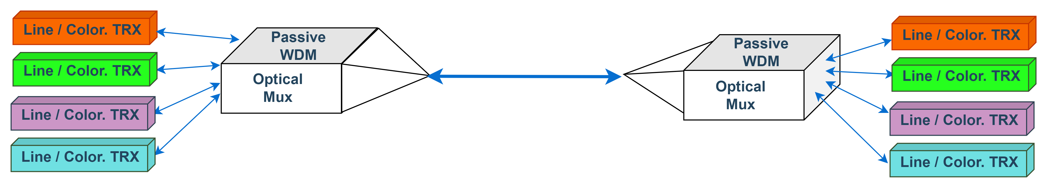
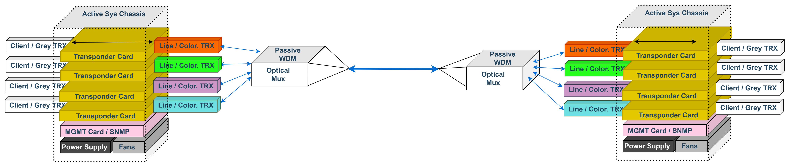
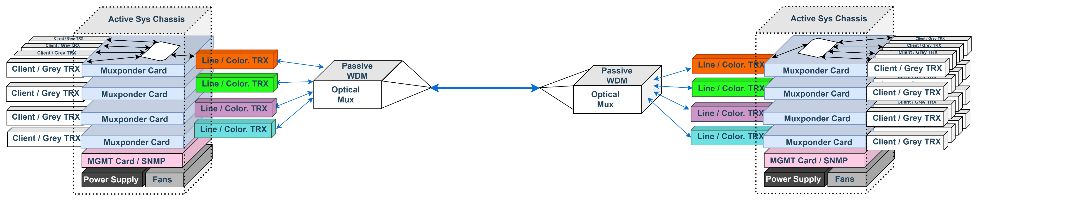
Power Consumption PER LINK for 4 Transport Scenarios assume 10G
Scenario | Fully included Equipment | Proportionately included Equipment
Grey TRX | 2pcs Grey (long reach) TRX
pWDM | 2pcs Coloured WDM Line TRX
Trans-ponding | 4pcs Grey (shortest reach) TRX 2pcs Coloured WDM Line TRX | 2pcs Transponder Card 2pcs Chassis, each incl. 2 Fan 2pcs redundant Power Supply 2pcs Management Cards
Mux-ponding¹ | 4pcs Grey (shortest reach) TRX | 2pcs Muxponder Card 2pcs Line TRX (colored or not) 2pcs Chassis, each incl. 2 Fans 2pcs redundant Power Supply 2pcs Management Card
Passive Transport
Active Transport

Slide 10
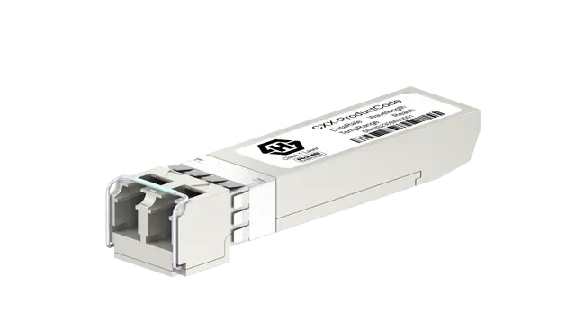
Device Power Consumption per Data Sheet – Transceivers (1-25Gig)
(almost) independent of data rate (at 1-25G)!
Maximum reach has / has no significant influence on power usage.
Specified operating case (!) temperature range (Standard 0 to 70°C vs. Ind. Temp. -40° to 85°C) makes a difference
Coloured WDMs (often) use Temperature Controllers
Note: example TRX is Huber+Suhner CUBO TRX. However, underlying data used in this model originates from ca. 10 manufacturers. Shown values are average values over multiple makers, however, are mostly anyway identical

Slide 11
TRX Power Consumption: Data Sheet vs Part to Part Variation
Example 1G LX SFP
1G SFP LX
Product number 85210507
Identifier CSS-303A11
Variation: 10km, 1310nm, LC/PC duplex, Singlemode
Type 1G SFP LX
Media Reach Type10km, 1310nm, Singlemode fiber
Protocol 1G Ethernet, 1G Fiber Channel, CPRI 2
https://www.hubersuhner.com/en/shop/product/transceivers/pluggable-transceivers/1g-2-5g-6g-8g-10g/85210507/1g-sfp-lx
Key features
Multi-protocol support
Data rate 125 Mbps and 1.0625...1.25 Gbps
Reach up to 10km
Wavelength 1310nm
LC/PC duplex connector
Singlemode fiber
Temp. range 0 ... 70°C
Link budget at least 11 dB
Power consumption < 1 W
97% of products consume less than 50% of specified power

Slide 12
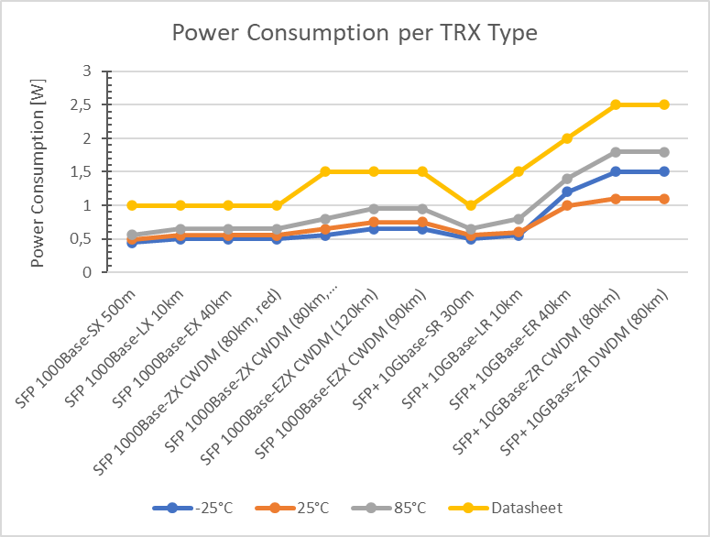
TRX Power Consumption: Influence of Case Temperature
Power Consumption of Client & Line TRX at 1 & 10Gig highly depending on case temperature
But always only a fraction of data sheet values
Note: example TRX is Huber+Suhner CUBO TRX. However, underlying data used in this model originates from ca. 10 manufacturers. Shown values are average values over multiple makers, however, are mostly anyway identical

Slide 13
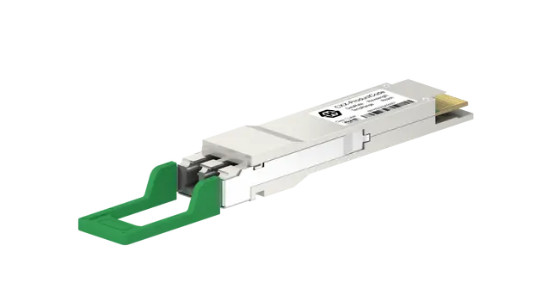
Device Power Consumption per Data Sheet – Transceivers (100-400Gig)
Power Consumption:
Very dependent on data rate!
Different product designs can make a difference
Main driver is modulation technology, i.e. “Direct Detect” vs. “Coherent”
Importance of CAUI for ≥100G
Note: example TRX is Huber+Suhner CUBO TRX. However, underlying data used in this model originates from ca. 10 manufacturers. Shown values are average values over multiple makers, however, are mostly anyway identical

Slide 14
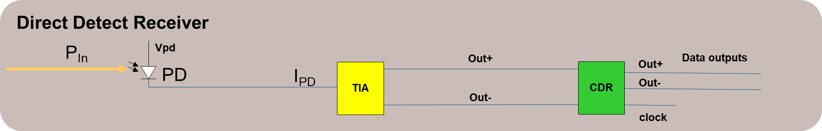
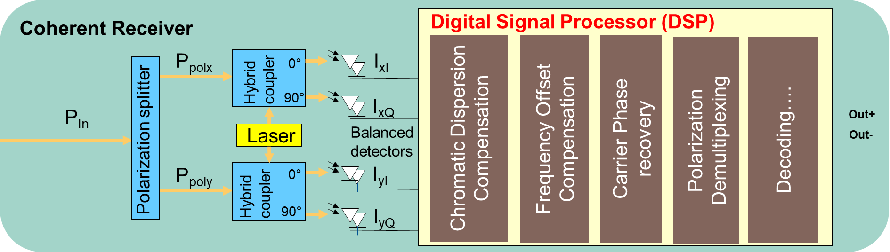
Direct Detect vs. Coherent TRX: Main Difference are the Receivers
Direct Detect TRX:
few & simple optoelectronics
Coherent TRX
Much more (opto-)electronics
Extremely power-hungry DSP processor chip
Which also contains Muxponder and data processing functionalities

Slide 15
Summary on Transceiver Power Consumption
Data Sheets state the maximum power consumption. Can differ hugely from actual power consumption.
Model is based on typical power consumption. i.e. average of part-to-part variation and 25°C as case temperature (& ambient temperature for Active Systems)
Direct Detect TRX 1G, 10G, 25G (100G) typically consume 40-60% of their given maximum
  57% used in model
Coherent TRX (≥ 100G) depending on specific DSP designs, typical power is around 75-90% of data sheet (max) value
  87% used in model

Slide 16
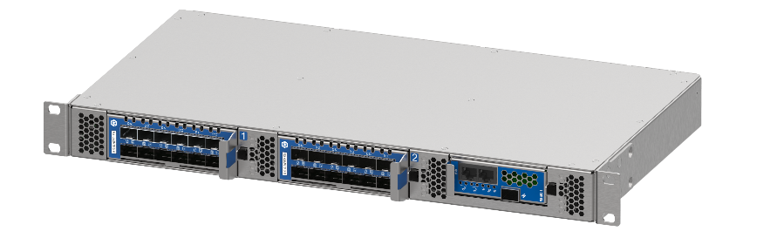
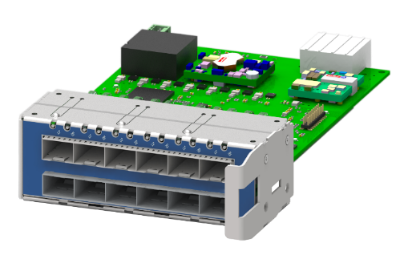
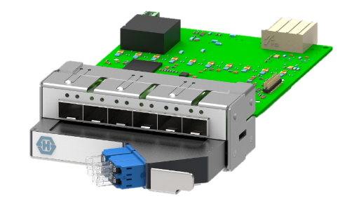
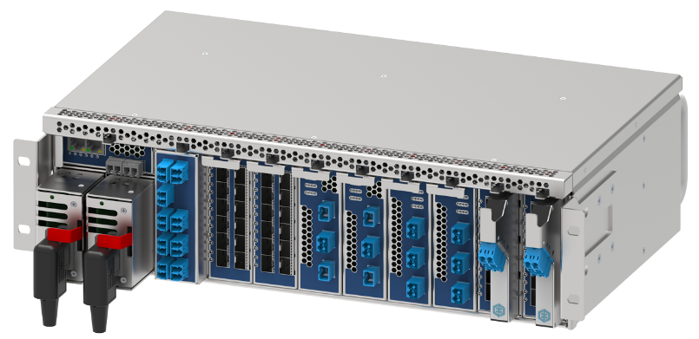
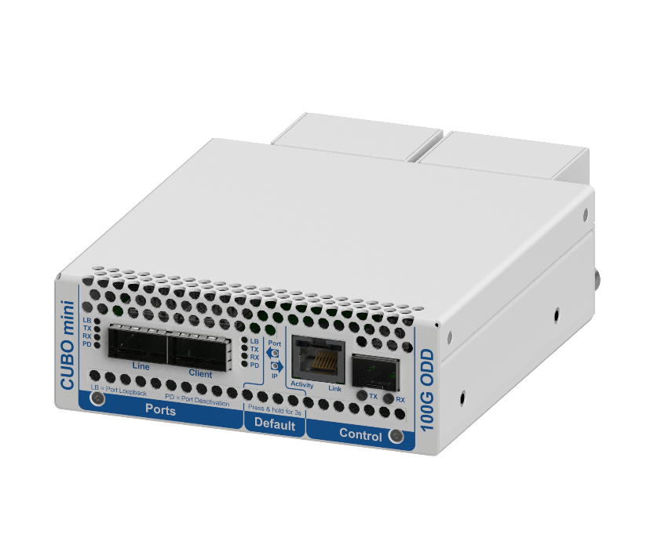
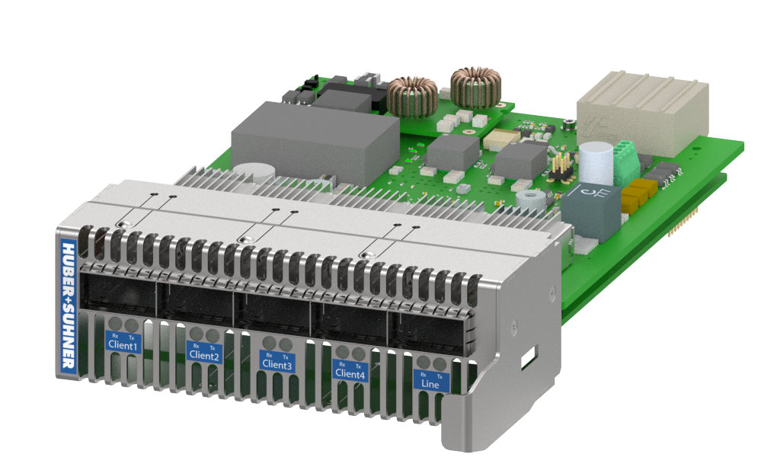
Notes on Active Transport System Power Consumption
The power consumption (actual, typical, max.) greatly varies from vendor to vendor, caused by differing design (used electronics and chips…) and additional features
Biggest variation is on muxponding variants.
A not “fully loaded” / utilised chassis, line card etc consumes much more power per service.
Power consumption of electronics rises with ambient temperature (here “typical” assumed as 25°C!)
“Typical” power consumption values represent a best-case scenario based on
  A) lowest power system
  B) fully loaded smallest possible set-up (i.e. no 3HU Chassis with 2 line cards for 1 service)
Active Transport solutions tend to use much more power than our “Typical Model”!
Note: Depicted example Active System products originate from Huber+Suhner. However, underlying data used in this model originates from various vendors.

Slide 17
Notes on Cooling / Air Conditioning
All scenarios are calculated with and without external (AC) cooling, reflecting only additional cooling for the transport, not the routers etc.
Again, how much energy is needed for cooling e.g. 1W?
  depends on too many varied factors to be precisely reflected in this presentation.
Is “over cooling” an issue?
  cooling capacity can be over dimensioned (data sheet based calculations!), which can lead to additional (significant) power consumption.
As an approximation of power for cooling we used a factor of 2, i.e. every Watt that you have on transport requires (at very least) another Watt for cooling.
  external cooling will at least double the power used of power needed to transport data.

Slide 18
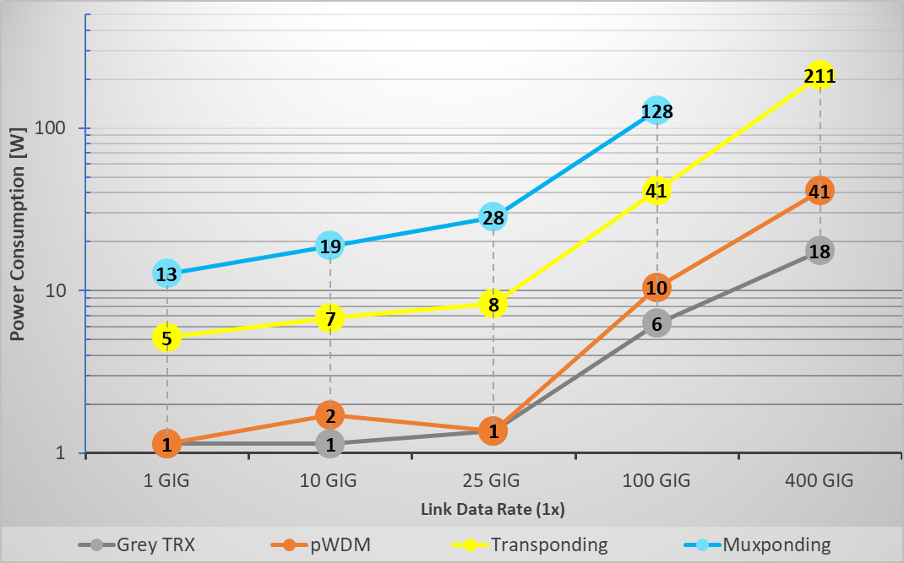


Typical Power Consumption per Link [W] – Excl. external Cooling
Given client data rate muxponded in next higher line data rate
Acknowledgement that cost (power) per bit carried is lower at higher speeds
Transponding uses approx. 4-5 times higher power consumption vs pWDM
Muxponding uses approx. 10-20 times higher power consumption vs pWDM
25°C ambient Temp
lowest power Client TRX used
Most efficient Act Sys design, “fully loaded”
Modulation Tech Change
Coherent with optimized DSP
8x
Direct Detect with intern. SOA Amp

Slide 19
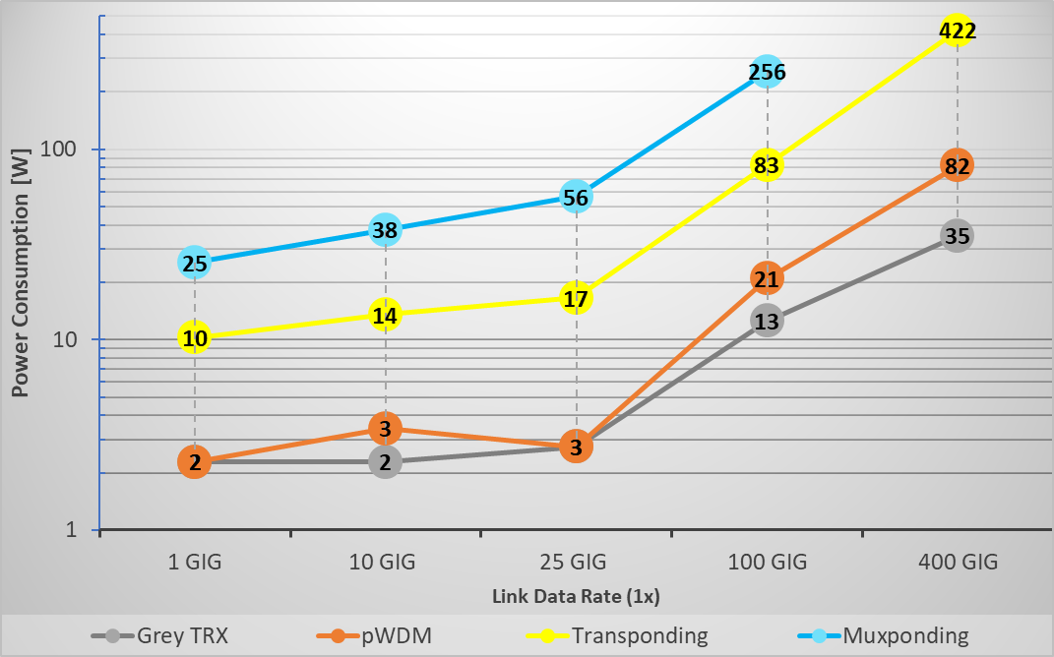
Typical Power Consumption per Link [W] – Incl. external Cooling
25°C ambient Temp – through additional external (AC) cooling
lowest power Client TRX used
Most efficient Act Sys design, “fully loaded”
Based on model assumptions
all power consumption, including Cooling, will simply double.
However, it makes a huge difference if you double e.g 2W vs. 38W (especially if you operate more than 1 link)
Modulation Tech Change

Slide 20
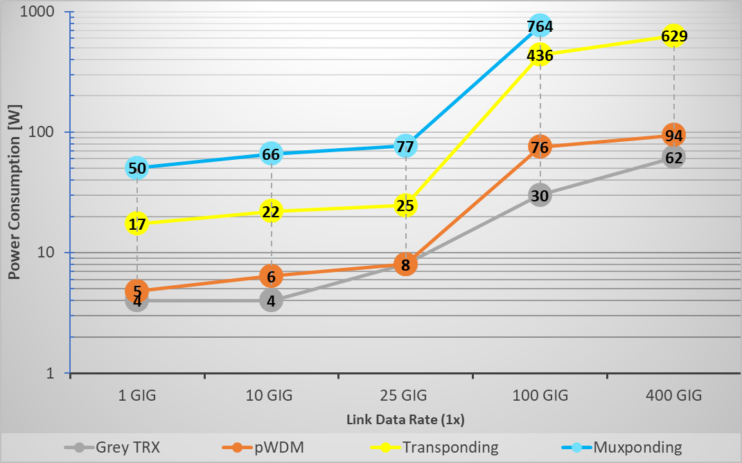
Comparing “Max.” Power Consumption per Link [W] – Excl. external Cooling
Devices at high operating temp limit
Commonly used Client TRX (LR) applied
Common but not power efficient Act Sys design (but still “fully loaded”!
Notes:
  Operating devices at high operating temperature can impact performance over time
  Use of “Industrial Temp” TRX and common LR TRX as Client
Active System use power – even when not fully populated ,ie not power optimized designs
  Results in ~2-3 times of power consumption for pWDM compared to “Typical (incl. cooling”) scenarios
  Increase ~4-5 times for Active Transport
Can increase necessary power consumption by a factor >100 times!
5x
4x

Slide 21
Summary
With the continued trend of increasing data rates in transport networks, the power usage will increase further.
Some scenarios can result in consuming up to >100 times more electrical power than technologically necessary for transporting services
This energy inefficiency combined with the growing data rate is becoming an OPEX threat for carriers.
Passive Transport is cutting down those (direct energy and CO2) costs by at least a factor of 5 to 20!
We do not suggest using only Passive WDM.
  Many operators mix passive & active systems on same Metro Optical network
Note, less power used by the network means a significant reduction of CO2 Scope 3
(Scope 3 = CO2 generated at production of devices at suppliers)

