Slide 1
Notes:
Good Afternoon everyone. Welcome to NetUK 1, the inaugural event. Thanks to everyone for coming, I’m glad we’re all here and honestly I’m just as surprised as everyone that we managed to pull this off. Anyway, for those that don’t know me I’m Dave Pumford, the NetUK Management Committee Chair. I’ve got a few introductory slides to go through before I hand you over for the conference content, don’t worry I’ll be quick so you don’t have to listen to my accent for too long.

Slide 2
Housekeeping
[ WIFI ]
Brewery_WiFi
[ LOCATIONS ]
King George III
Breaks + Lunch
The Porter Tun All presentations
Brewery Courtyard
Event Social
[ EMERGENCY EXITS ]
Follow the green exit signage

Slide 3
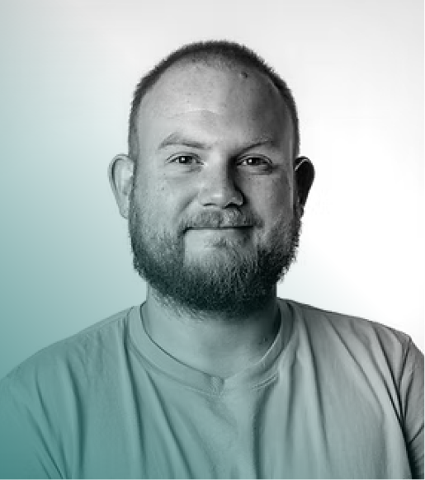
Welcome to #NetUK2!
On behalf of the Management, Program and Organisation Committees, I would like to welcome you all to #NetUK2.
We have an incredible agenda for you over the next two days that we hope you enjoy, learn and meet people of interest.
Please explore our new home at The Brewery, if you need any assistance reach out to anyone wearing a NetUK polo.
Dave Pumford Chair, Management Committee at NetUK

Slide 4
#NetUK2 Conference Statistics
215 In-person Attendees
30 Virtual Attendees
20 Student Attendees
245* Attendees
* As of 8am 07/07
Notes:
d next year for tickets / agenda now the heavy lifting is complete.

Slide 5
| Official Sponsors

Slide 6
#NetUK2 Ticket Cost
Running a conference in Central London, in July, is expensive, who knew?
More financial details to be provided by the Management Committee tomorrow.
Please support our Sponsors during the event, they really do make this all possible.
£100 Cost for Attendees
£395 Planned Cost PP
£495 Actual Cost PP

Slide 7
Our Mission
NetUK aims to foster a vibrant community of individuals and organisations that are passionate about the United Kingdom’s network infrastructure industry.

Slide 8
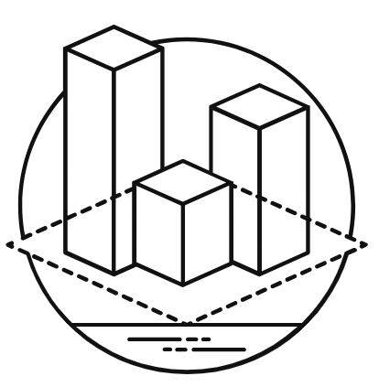
Our Objectives
We aim to promote:
Knowledge Sharing
Facilitate the exchange
of ideas and insights through conferences
and workshops.
Professional Exposure
Provide valuable opportunities for both individuals and sponsors to collaborate and advance within the industry.
Community Development
Foster a collaborative spirit that thrives on a shared passion for technological achievements.
Inclusivity & Diversity
Promote participation from all corners of the community, regardless of background or experience.
Notes:
We believe we can build this community up by focusing on the following core objectives. Knowledge Sharing - Facilitate the exchange of ideas, insights and experience through events and conferences,
ensuring members stay at the forefront of the evolving internet infrastructure landscape. Community Development - Foster a collaborative spirit that thrives on a shared passion for regional achievements
within grassroots communities such as NetLdn, NetMcr and NetDiff, while supporting the establishment of new regional
communities. Professional Exposure - Provide valuable opportunities for individuals and sponsors to build industry connections, find
collaborators, and advance their careers within the internet industry.
Inclusivity & Diversity - Promote participation from all corners of the community, regardless of background or
experience, believing everyone deserves a voice in shaping the future of the internet.
Collectively, the MC and PC both believe remaining focused on these objectives will help us achieve our overall mission.

Slide 9
Social Links
members-subscribe@lists.netuk.org
members-unsubscribe@lists.netuk.org
LINKEDIN
NetUK
YOUTUBE
NetUKorg
SLACK
netukorg

Slide 10
Hybrid Event & Questions
NetUK 2 webcast is live on YouTube.
Please join our Slack and the channel #NetUK2 to engage with all conference attendees.
If you have any questions for our speakers at the end of their talk:
In Person: Please line up to the microphone stand, identify yourself and ask your question when the session chair confirms.
Virtual: Please ask in the Slack channel #NetUK2 with #question added to the end, it will then be asked by one of our session chairs.

Slide 11
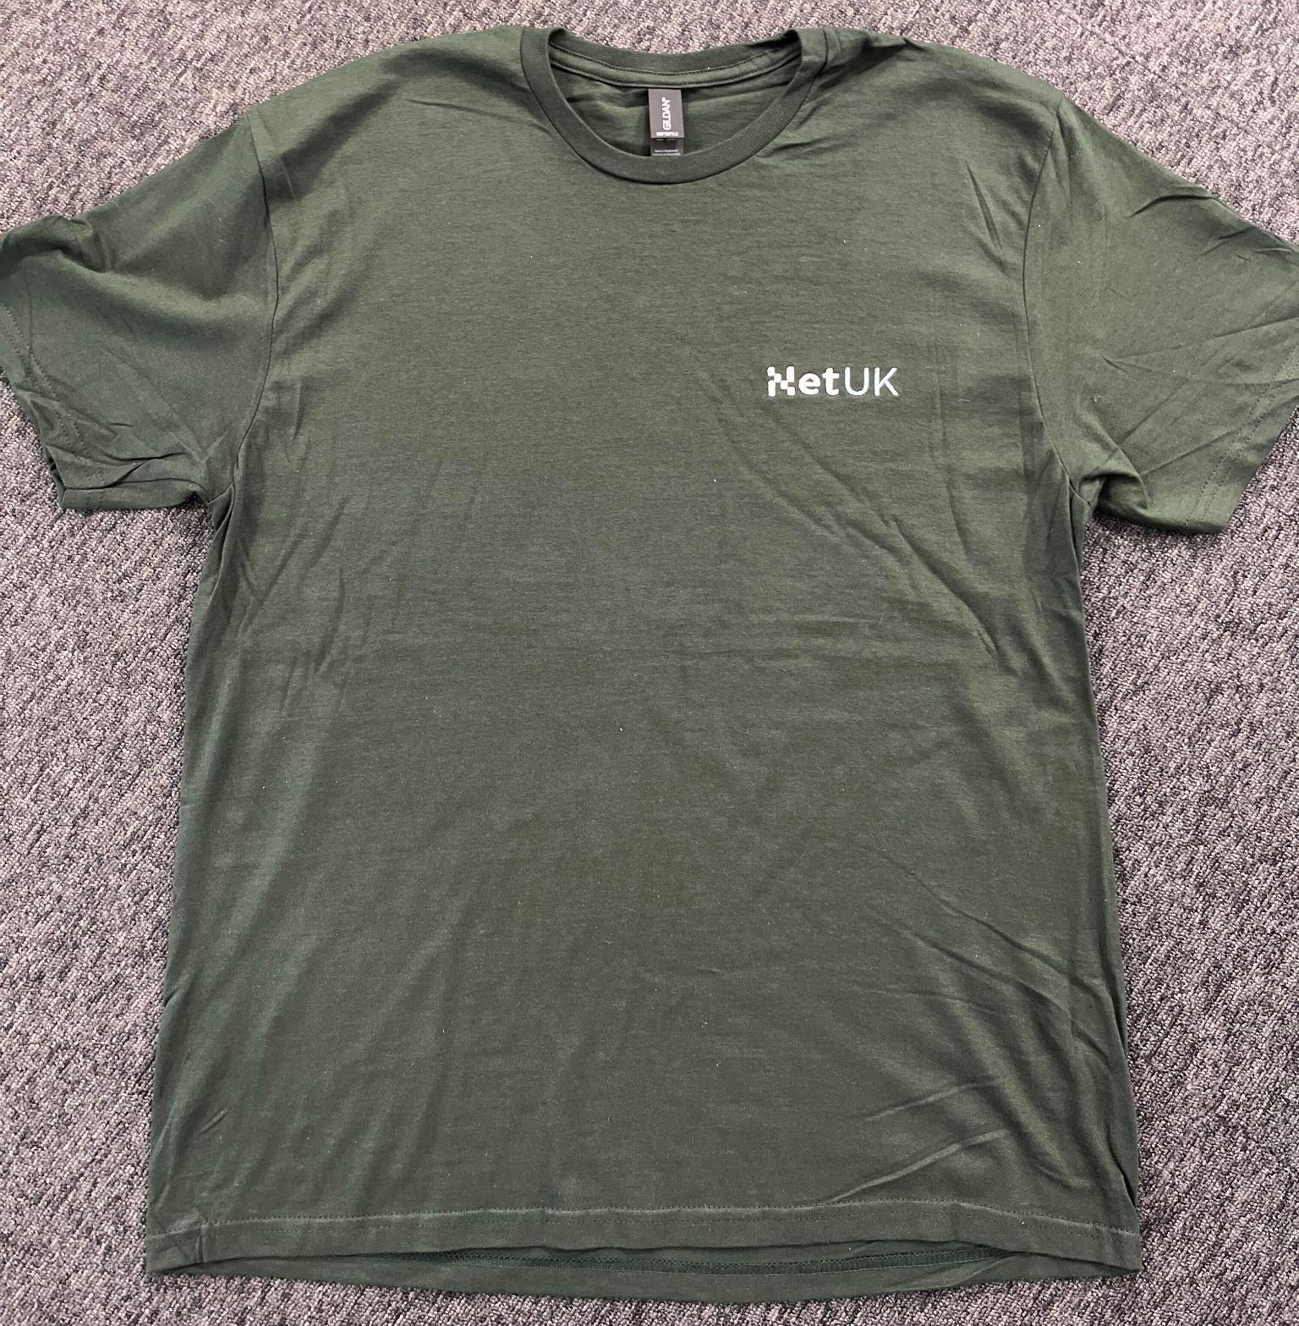
#NetUK2 Event T-Shirt
[ FREE MERCH ] Please ensure you collect your free #NetUK2 T-Shirt! + Exclusive for this event only.

Slide 12
Respect + Code of Conduct
Everyone agreed to NetUK/LONAP’s Code of Conduct when purchasing a ticket.
Our Code of Conduct can be found here: [ www.lonap.net/code-of-conduct ]
Please follow this during the event both in person and virtually.
If you wish to raise an issue please find a MC or PC member.

Slide 13
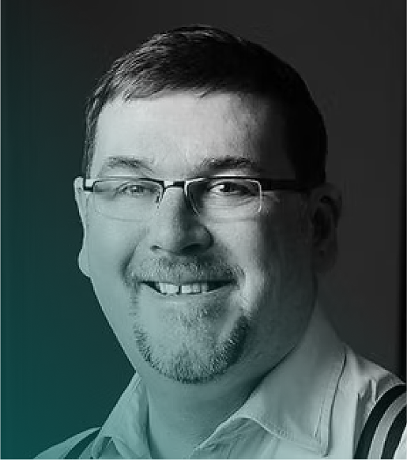
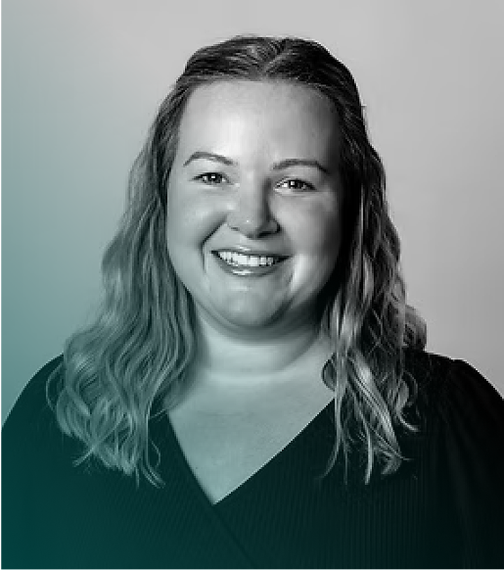
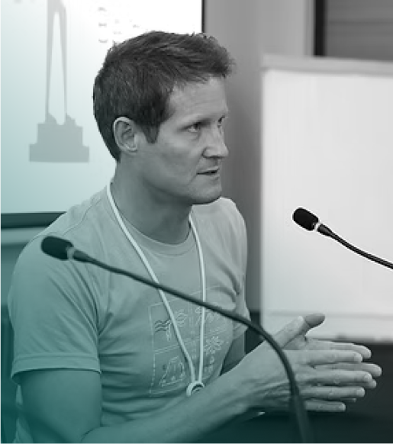
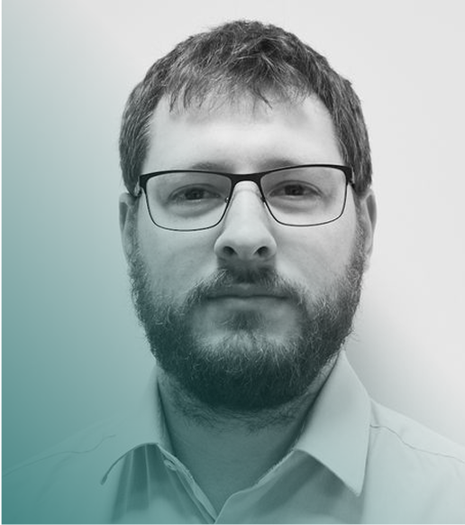
Management Committee
Dave Pumford
PTX Technologies
[ MC Chair ]
Richard Irving
LONAP
Megan Atkins
LINX
Nick
Wenban-Smith
Nominet
Matt Jepp
SG.GS [ PC Chair ]

Slide 14
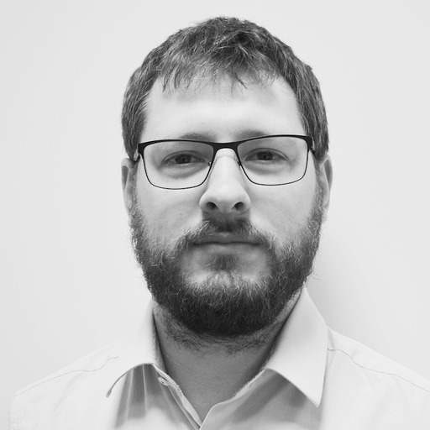
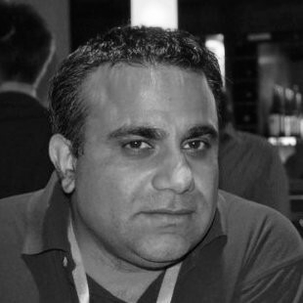
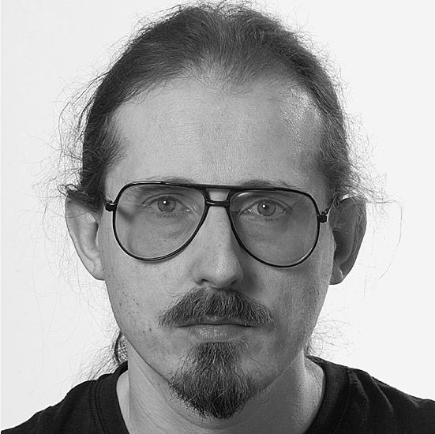
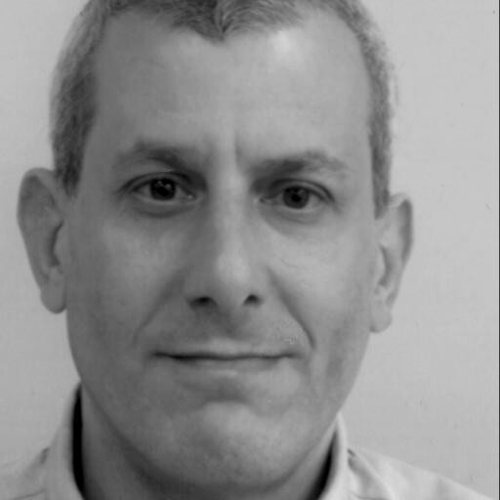
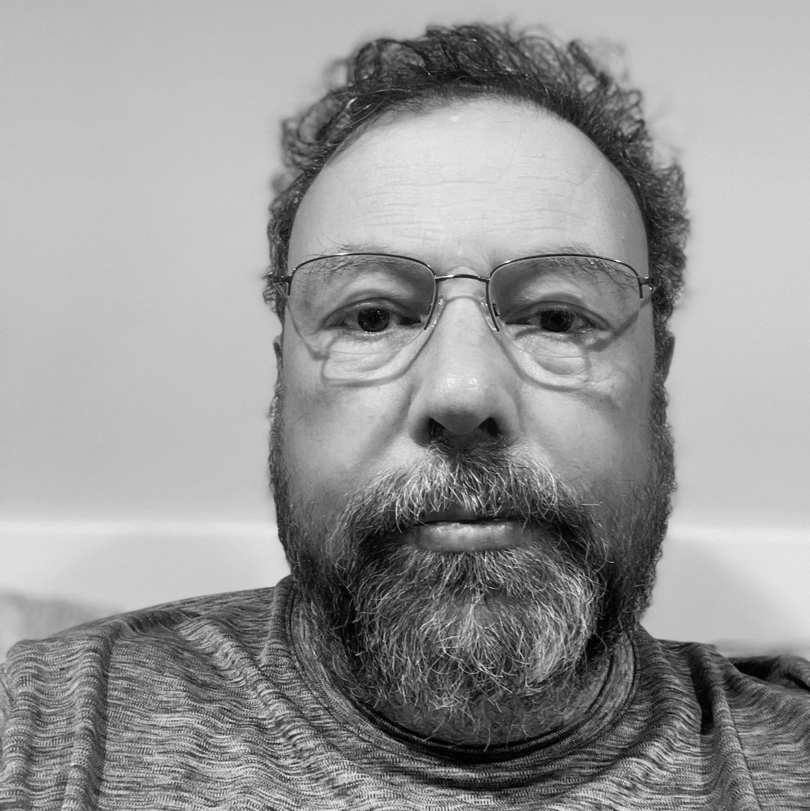
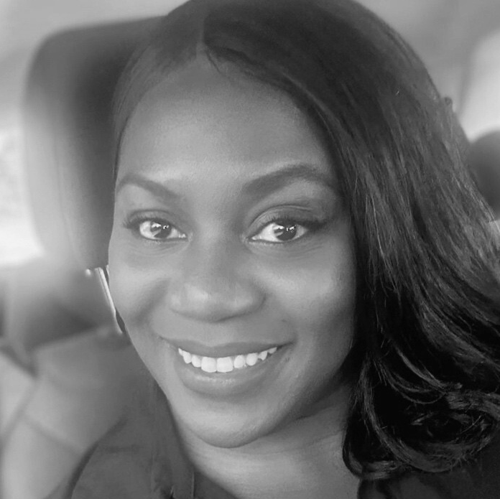
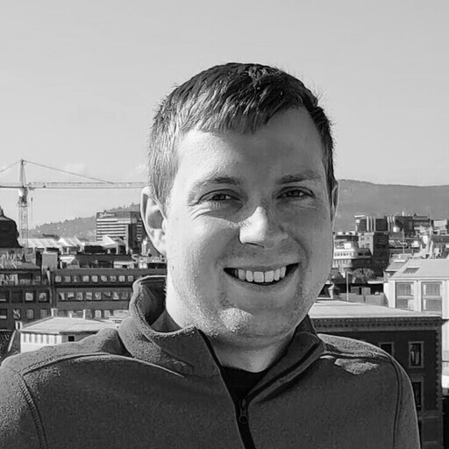
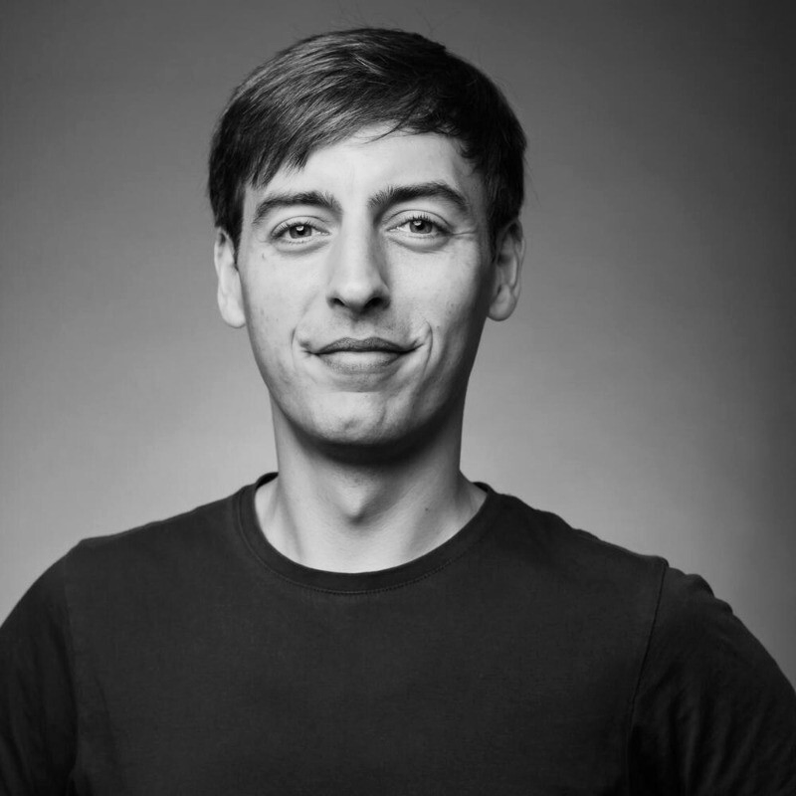
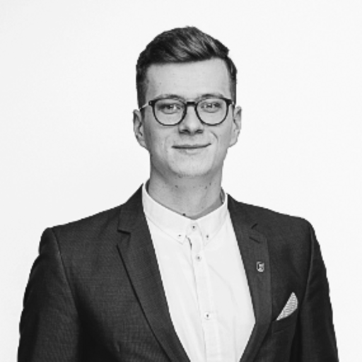
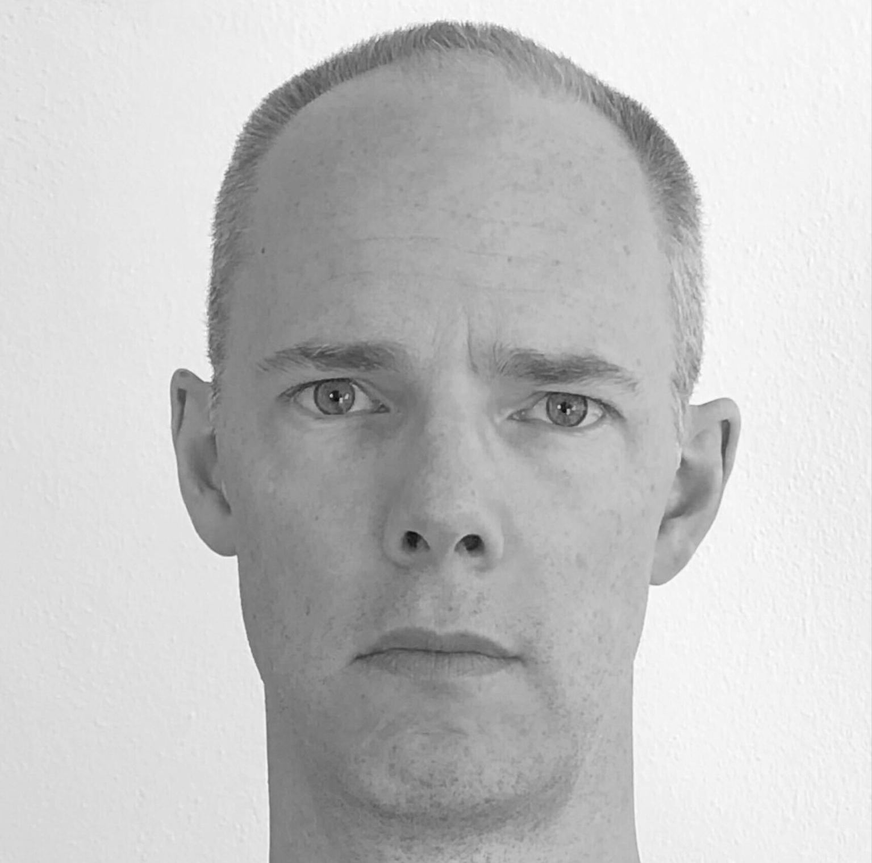
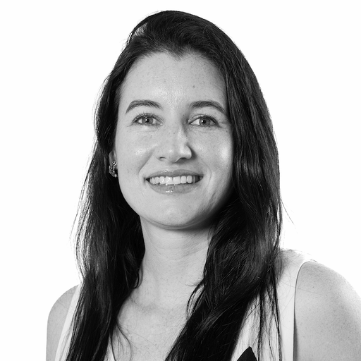
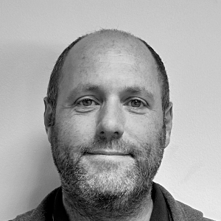
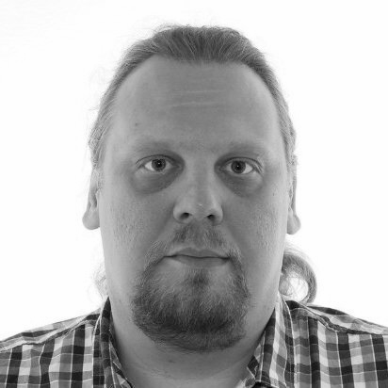
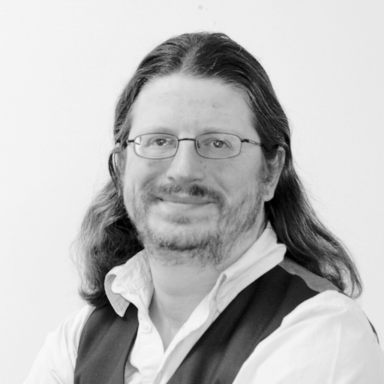
Programme Committee
Matt Jepp
[ PC Chair ]
Mo Shivji
Brandon Butterworth
Steve Karmeinsky
Fearghas McKay
Rebecca Class-Peter
Josh Levett
James Bensley
Paulius Judickas
Paul Dunbar
Elisa Peirano
Nick Ryce
Sergey Myasoedov
Dave Wilson

Slide 15
Thank you

