Slide 1
Day 2 wrap-up
Richard Irving, NetUK/LONAP

Slide 2
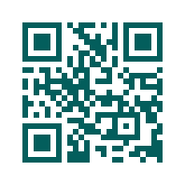
#NetUK2 Event Survey
https://www.netuk.org/survey/
Notes:
If you could complete this survey it would be great so we improve for #NetUK3.

Slide 3
| Official Sponsors

Slide 4
[ See you at ]
#NetUK3!
6–7 JULY 2026 The Brewery,London

