Slide 1




Building a National NOG Community
The UK Network Operators’ Forum, 2005-2023
Keith Mitchell
NetUK3, London
July 6-7th 2026

Slide 2
Overview
UKNOF back-story, motivation, formation, Charter
UKNOF’s history, growth and successes
Sustainability challenges
What worked and what didn’t work
Lessons learned on NOG sustainability and governance
Professional development through Community
UKNOF’s Legacy and Archives
This talk is in a personal capacity, and I do not speak for any other current or formerly affiliated organisation
Notes:
Please talk to Sue if you didn't get your voting paper, or are unclear who your organization's voting rep is.

Slide 3
My Career History
Graduated Computer Science: ed.ac.uk, ucl.ac.uk
Acorn Computer, Spider Systems 1984-1991
Co-founder: PIPEX, LINX, Nominet, UKNOF, XPE
President: DNS-OARC 2006..2012-2023
First RIPE NCC Board Chair; RIPE WG Chair & Arbiter
ISC (VP Eng) and various other nonprofits
Now “mostly retired”, still self-employed and trying to be useful:
  OARC Co. Secretary, NANOG Mentorship Committee
TL;DR: https://www.keithmitchell.co.uk/biography.html
Notes:
Please talk to Sue if you didn't get your voting paper, or are unclear who your organization's voting rep is.

Slide 4
Inspiration/Motivation for UKNOF
Network Operator Groups in other regions and countries
  NANOG, RIPE
  Switzerland, France in early noughties
Need for open forum
  Closed membership model of existing UK ISP bodies
  (something I quit LINX over in 2000)
Skills shortage, need for professional development
Geographic over-centralisation of UK ISP industry
National infrastructure sovereignty
Notes:
Please talk to Sue if you didn't get your voting paper, or are unclear who your organization's voting rep is.

Slide 5
UKNOF Pre-formation
It seemed to me around 2002 that a UK national NOG could be a good idea, but my then-employer, despite being motivated to open up the IXP space, would not approve the commitment to support the project
Some young folks created a “UKNOG” initiative around 2003-ish, but it did not gain traction
Per-capita wrt respect to NANOG and RIPE regions (about 1/5th-1/6th the population), a UK NOG ought to be able to pull in 150-200 people regularly
But even at ~200 attendees * £100 registration * 3 days per year, it was never going to pay for anyone to run it full-time
Notes:
Please talk to Sue if you didn't get your voting paper, or are unclear who your organization's voting rep is.

Slide 6
UKIF and UKNOF Formation
I took a career break in 2004-05, and was finally able to pursue setting up UKNOF
At the same time, some other usual suspects were trying to set up an alternative UK ISP Trade Association, the “UK Internet Forum”
  UKIF Ltd legal entity
  Company limited by guarantee
  Operated on not-for-profit basis
By making UKNOF one of its 3 fora, this helped a lot with the overheads and sustainability challenges
Another essential step was recruiting a Programme Committee
(there was of course some Very British detraction..)
Notes:
Please talk to Sue if you didn't get your voting paper, or are unclear who your organization's voting rep is.

Slide 7
UKNOF’s Mission and Charter
From Charter https://index.uknof.org.uk/charter-v1_1.html :
  “To act as an open forum for operational, technical and engineering information exchange, co-operation and co-ordination between Internet, Ethernet and other public telecommunications network operators within the United Kingdom.”
  “To pro-actively support the sharing of knowledge, ideas and best practices to enhance the effective, stable and secure operation of the UK's Internet infrastructure as a whole.”
  “UKNOF's remit is technical”
  “To hold meetings at least 3-4 times a year, operate informational mailing lists, and host a web site in support of the aims.”
  “at least one meeting per year each inside, and outside of, London area”
Notes:
Please talk to Sue if you didn't get your voting paper, or are unclear who your organization's voting rep is.

Slide 8
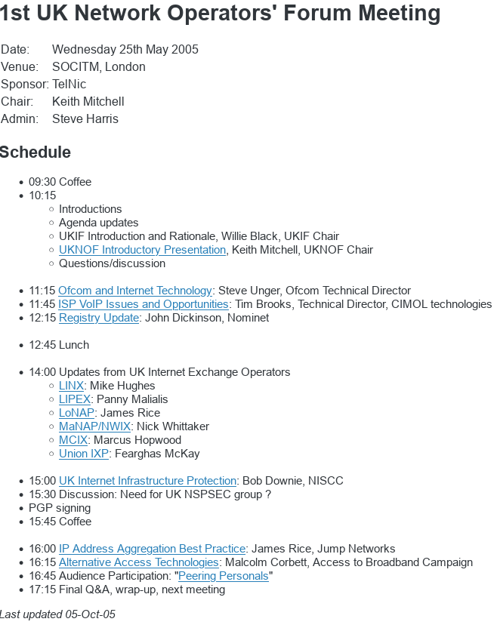
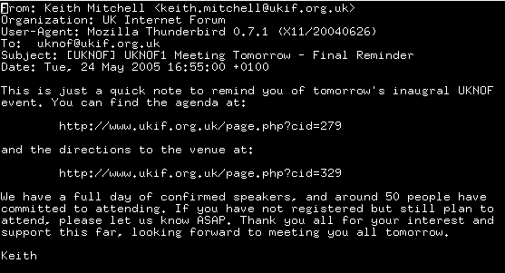
First Meeting – UKNOF1!

Slide 9
Early Days
For the first 20-odd meetings, things were run fairly informally
  donated venues, platforms
  the PC, Board, and a few other volunteers did nearly everything
Attendance steadily grew from 50 to over 120 registrations 2005-12
  clearly we were filling a need
  but sometimes the wheels fell off logistically: packed venues, waitlists, technical scrambles, bad food, flaky sponsors
  this was the era of the pre-meeting curry :-)
  I was juggling with a US-resident $dayjob
As all this happened, it began to feel like a distinct community
Notes:
Please talk to Sue if you didn't get your voting paper, or are unclear who your organization's voting rep is.

Slide 10
Scaling Step Functions
Around 2012, it was clear UKNOF’s potential was being limited by various “success disaster” scaling issues
There were also some opportunities
  non-UKNOF activities at UKIF had withered
  I changed employment and had more time to devote to UKNOF
  Denesh became available to proactively bring in sponsor money
Changes were made:
  key volunteers co-opted onto Board
  additional committees, Meetings, Advisory
  UKIF Ltd legal entity became dedicated solely to running UKNOF
  use new revenue streams to pay for right-sized venues, cloud platforms, and professional services
Notes:
Please talk to Sue if you didn't get your voting paper, or are unclear who your organization's voting rep is.

Slide 11
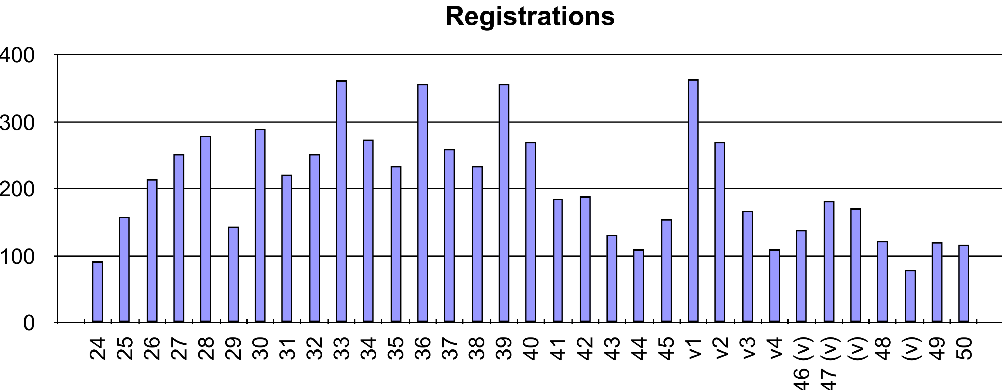
Peak Years 2013-2019
Highest in-person attendance 360 at UKNOF33 in London, Jan 2016
Highest online attendance 365 at virtualUKNOF, May 2020
Internet history presentations from Nigel Titley, Rob Blokzijl, Cliff Stanford,
Daniel Karrenberg, Grahame Davies, Paul Thornton, et al
Tim Robinson’s WISP presentation at UKNOF34 most-viewed on YouTube
UKNOF11 in the Broadcasting House Council Chamber
UKNOF32 with UK&Ireland Peering Forum in Sheffield
Steam-powered social
West Country Cream Tea breaks
Many pints and packets, and pints...

Slide 12
...and some not so high points 🤦
PoE flex
Stadia shortfall
Navigating Edinburgh with 2D maps
Monetize all The Things
Leeds floor-tile lifting competition

Slide 13
A Cold Sustainability Wind
I have worked in and with various countries, and ISTM that the UK has a uniquely tight-fisted corporate culture when it comes to professional development and training of IT staff
  many UKNOF attendees were having to take time off, and fund their own travel, for events which were directly benefitting their day jobs with knowledge not readily obtainable elsewhere
In recognition of this, UKNOF meetings had always been free to attend and entirely sponsor-funded
Around 2018-19, sponsor funding was getting harder to secure, so we did various experiments on registration charging and income diversification, but with mixed success and popularity
Things were mostly still working, but it was also getting harder to bring in fresh blood to help run things, especially the boring non-techie tasks

Slide 14
A Plague Upon UKNOF’s House
zz
Then in 2020, along came COVID-19 ☹
Everything had to pivot to online, especially conferences
At the same time, all of society was heavily dependent on the Internet infrastructure being run by NOG participants
An online place of both community, and operational co-ordination,
became really important
As well as running more frequent online-only events, we also set up a Mattermost-based chat platform
All of this was a lot of work
But in common with many other NOGs, we lost nearly all of our registration revenue, and much sponsor revenue, burning cash reserves

Slide 15
Incomplete Restoration From Backup
The recovery from the pandemic was tricky
Participation and attendance never really got back to “before”
We ran several successful hybrid/in-person meetings 2021-23, but hybrid was much more demanding, and UKNOF’s financial and human resources became depleted to non-viability
Final meeting ☹ was UKNOF52 in Sep 2023
Wrap-up background at:
https://indico.uknof.org.uk/event/63/page/391-uknof-2023-annual-meeting

Slide 16
UKNOF Retrospective in Numbers
52 full meetings
  2 online, plus 6 virtualUKNOFs
Around 8,700 total attendee registrations
680+ speaker presentations
25 venues in 14 cities
Several dozen currys...
Notes:
Please talk to Sue if you didn't get your voting paper, or are unclear who your organization's voting rep is.

Slide 17
What Worked
Engaged, pro-active Programme Committee leading to
high-quality content
Editorial/Operational separation
Online platforms
  Indico open-source conference management
  Chat great for meetings, less so in-between
Getting ahead of scaling step-functions

Slide 18
What Worked
Free registration model
Well-conducted, welcoming community
Cross-UK regional engagement
Regular rotating venues
British ex-pats were some of our strongest supporters

Slide 19
What Didn’t
Donated venue challenges
Migration to paid registration
Succession planning is hard
Leadership as a side-hustle necessitates short-cuts
Volunteer techies don’t like doing sales or finance
Attendee and Board diversity, an industry-wide problem

Slide 20
Sustainability Challenges
Post-pandemic:
  in-person event attendance levels lower
  hybrid events more complex to produce
  higher venue and meeting services costs
  reduced volunteer engagement across nonprofit Internet industry sector
Poor health of post-Brexit UK economy
Reluctance/opposition to conference attendee registration fees
More difficult vendor sponsorship budgets & expectations
Lack of people willing and/or able to take on business support roles

Slide 21
Community Building
Community building takes years
In 30+ years’ of running Internet non-profits and membership orgs, I’ve observed two broad philosophies:
  Communitarian, building upon volunteering and in-kind donations
    run your NOG like a kibbutz
  Capitalistic, building upon sustainability and accountability
    run your NOG like a small business
As a pragmatic engineer, I think it takes a disciplined balanced mixture of these to succeed
  but being centrist is a great way of being demonised by one side as the embodiment of the worst of the other ☹
Notes:
Also:
Network Operator Groups do not themselves operate infrastructure, and are not natural monopolies like IXPs or registries
Non-profits compete for relevance at least as much as revenue

Slide 22
UKNOF/UKIF Governance
This was always a bit of a pragmatic bodge
Given UKNOF’s very finite resource base, we took a lightweight approach, which emphasised transparency and accountability (e.g. Advisory Committee) over direct stakeholder democracy
  Board Directors co-opted rather than elected
It worked until it didn’t, in particular a legal entity succession faceplant at the end

Slide 23
It was however, a lot of fun
50+ meetings between 2005-2023
I like to think we made a difference
Community deserves gratitude and credit for this
Special recognition and remembrance is due to Fearghas McKay, who was a stalwart supporter of UKNOF throughout its history, and is sadly no longer with us

Slide 24
Professional Development through Community
Your industry peers are among the best people to learn from
Develop skills that are grounded in first principles, theory, maths, algorithms, soft-skills, rather than getting too locked-in to specific technologies
Build your network by volunteering, nonprofit, international, activity
Diversify income sources, nurture that side project/hustle
Pivot from doing yourself to enabling, mentoring, promoting & teaching others
NOGs are the perfect place to do all these

Slide 25
UKNOF’s Legacy
Professional and personal growth and development
Knowledge sharing and education
Networks Built
Friendships made
World-class international speakers brought to UK audience
British technical talent and innovation showcased internationally
Much Clue distributed
Baton passed to NetLdn, NetMcr, NetUK

Slide 26

The UKNOF Archives
Meetings, presentation slides: https://indico.uknof.org.uk/
Presentation videos: https://www.youtube.com/user/uknofconf
Old-style meetings index: https://index.uknof.org.uk/
Public mailing lists have been preserved, but need anonymisation
Non-public content has been taken offline, deleted
Various private copies of above public content have been scraped & saved
It has also been flagged/pushed to Internet Archive.org
  lack of interest from British institutional archivists
Additional mirrors of the above are welcome
Major thanks to Marek Isalski at Faelix for hosting the archives

Slide 27
More Personal Internet History
Other “Keith’s memoirs” presentations:
  The DNS is interested in you: 1985-2023 [OARC46]
  https://indico.dns-oarc.net/event/56/contributions/1206/
  Great British IXP Failures: 1997-2010 [UKNOF32]
  https://indico.uknof.org.uk/event/34/contribution/30/material/slides/0.pdf
  Welcome to my Duality: 2017- 2025 [RIPE91]
  https://ripe91.ripe.net/programme/meeting-plan/sessions/24/FYNFZJ/
To follow:
  PIPEX ISP: 1991-1996
  LINX IXP: 1994-2000
Notes:
Please talk to Sue if you didn't get your voting paper, or are unclear who your organization's voting rep is.

Slide 28
Questions ?
https://www.smoti.org
https://www.linkedin.com/in/keithmitchell
https://mastodns.net/@dualkei (professional)
https://hachyderm.io/@dualkei (personal)
https://medium.com/@dualkei
Notes:
Please talk to Sue if you didn't get your voting paper, or are unclear who your organization's voting rep is.

