Slide 1
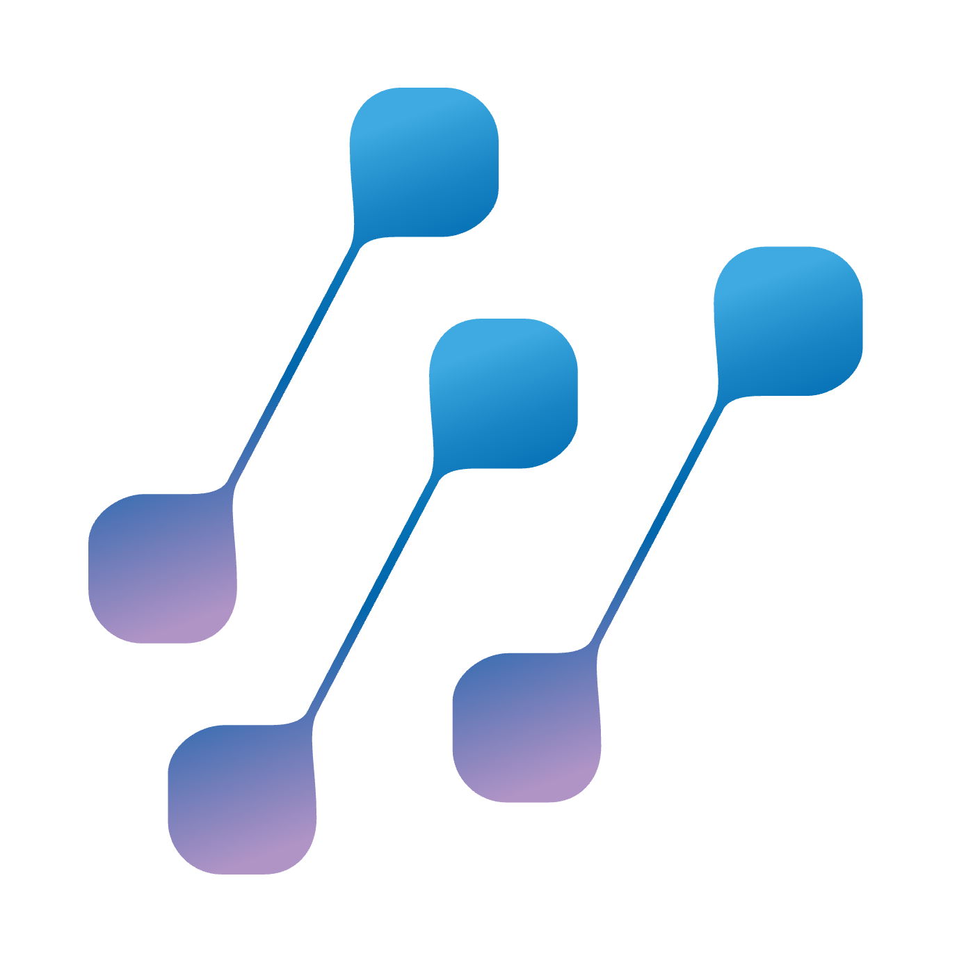
SCION: Secure Path-Aware Internet Routing for Critical Infrastructures
Kevin Meynell, SCION Association kme@scion.org
NetUK 3, 7 July 2026

Slide 2
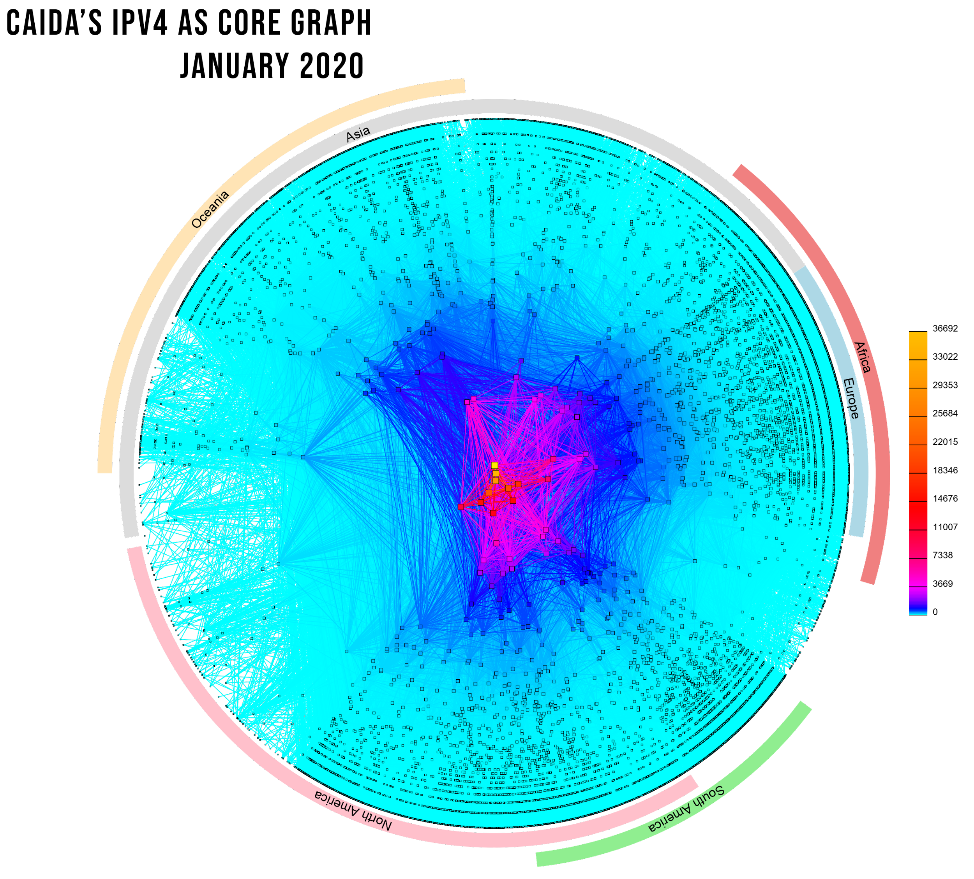
THE ROUTING PROBLEM
Border Gateway Protocol (BGP): the Internet routing protocol
The current Internet routing system is inherently based on unverified trust between networks and does not have predictable route propagation.
No built-in validation that route advertisements are legitimate – in the absence of RPKI and ROV, any network can announce any ASN or IP prefix and thereby cause traffic to be re-routed. Problem = route leaks and hijacks
Sending and receiving networks typically cannot decide the path that intermediate routers direct their traffic across the Internet. Data sovereignty breaches
BGP can send traffic through different jurisdictions thereby creating opportunities for surveillance, compromising security and making regulatory compliance complex Problem - data sovereignty breaches
BGP failover is relatively slow with convergence times of up to 3 minutes

Slide 3
HOW IS THIS BEING ADDRESSED?
Some info @ a glance
EVENT | EXPLANATION | LIMITATIONS
RPKI & ROV Resource Public Key Infrastructure & Route Origin Validation | ROAs (Route Origin Authorisations) provide cryptographic assertions of IP prefix ownership and which ASNs are allowed to originate them. Routers can validate ROAs and generate appropriate route filters. | Requires widespread deployment to be effective (62% of IP prefixes are signed in mid-2026) Few network operators currently use ROV (8%). Only does origin validation and does not validate paths through the Internet.
BGPSEC BGP Security | Builds on RPKI to provide cryptographic assertions that every router (hop) en-route to a destination has authorized the advertisement of that route. Prevents unauthorised insertion of ASNs into a path to circumvent RPKI. | Needs to be explicitly supported by all routers along a path to achieve full benefits. Computationally intensive and introduces significant delays in route convergence. Explicit path selection is not possible. Almost no deployment.
ASPA Autonomous System Provider Authorization | ASPA objects are similar to ROAs, but allow ASNs to authorize other ASNs to carry their traffic through the Internet. Works out-of-band so doesn’t need to be deployed on all routers. | Developmental technology and not yet an Internet standard. Does not provide assurances that traffic will actually follow validated paths.
SCION | Inter-domain routing architecture offering secure path awareness and selection. | Needs to be supported by border routers.

Slide 4

CRITICAL INFRASTRUCTURE
Legacy infrastructure needs replacing
Example: Air Traffic Control
Many critical infrastructures in power, transport, emergency services etc.. run on legacy infrastructures
Many important legacy infrastructures are still not fully networked and/or are not IP based
It is expensive, inefficient and becoming harder to support these legacy infrastructures
The Internet is now able to provide sufficiently reliable and resilient connectivity, like the power grid
Critical infrastructure operators want to take advantage of commodity Internet services as they offer cost and resilience advantages, but higher trust and data sovereignty assurances are required
True inter-domain and multi-ISP support is highly desirable or required
Terminal Control Centers
Eurocontrol
Receives flight plans and assigns slots
Slots:
OLDI Protocol
P2P links
P2P
Phone
P2P
Area
Control
Centers
Flight Plans:
OLDI Protocol
and Phone
RADAR, ILS
Radio
Aircraft
Radio
Airport Tower & Apron
Airline Operational Control Centers
Star centered around Area Control Centers
Radar & ILS physically connected to control towers
No connectivity between Control Centers beyond phone
Aircraft can only be managed within radio range of Control Center (so cannot be slowed/speed-up by destination)
OLDI protocol is based on data layer similar to RS232
Aircraft transponders can be spoofed and jammed
Limited coordination means inefficient management of slots
System heavily reliant on closed loop and implicit trust

Slide 5
WHAT IS SCION?
SCION is a resilient multi-domain path-aware architecture
ENHANCED TRUST
Establishes trust domains with self-governance model that are not reliant on third-party Certificate Authorities (such as RPKI)
ASes are admitted and verified with X.509 certificates
ISP
AS3
Cloud
PATH CONTROL
Office
ISP
AS1
ISP
AS6
Source endpoints select paths across SCION-enabled ASes
Paths can be selected based on requirements (e.g. latency)
Geofencing & Hijacking prevention
ISP
AS4
ISP
AS8
ISP
AS2
ISP
AS7
MULTI-PATH DISCOVERY & FAILOVER
Fast path switching when connections fail (in ~RTT, 1-2 secs)
Multiple paths can be used concurrently
ISP
AS5
SCION runs over IPv4 and IPv6 and provides benefits similar to leased lines, but in a resilient multi-operator and multipath environment.
Remote Users
Office

Slide 6
TRUST-ENHANCED NETWORKING
Trust model is based on Isolation Domains (ISDs)
  An ISD is a logical grouping of ASes sharing a uniform trust environment (e.g. a common jurisdiction)
  Each ISD is administered by one or more Voting ASes
  Every ISD has its own trust root specified in the Trust Root Configuration - a collection of X.509 certificates with ISD information
  TRC is negotiated by the Voting ASes according to its own trust policy
  Not reliant on third-party CAs
  The CAs in an ISD can only create certificates for ASes in their respective ISD
  Each ISD must have at least one Core AS to initiate path discovery and construction (which may also be Voting ASes)
Intra-ISD connection
Inter-ISD connection
Voting AS
Certificate Authority AS
Core ASes
Core ASes
ISP
AS1
ISP
AS2
ISP
AS8
ISP
AS9
ISP
AS3
ISP
AS4
ISP
AS5
ISP
AS10
ISP
AS11
ISP
AS12
ISP
AS6
ISP
AS7
ISP
AS13
ISP
AS14
ISD1
ISD2
ISDs are the building blocks of SCION

Slide 7
HOW IT WORKS
SCION core components in a nutshell
CONTROL PLANE - BEACONING
Establishes paths based on AS rather than prefixes
Beacon server uses path segment construction beacons (PCBs) to build path segments and routing paths
Path server stores paths to AS discovered during beaconing
PKI authenticates path information
Isolation Domain (ISD)
Grouping of Autonomous Systems (AS)
Each ISD has its own trust root
Isolates AS control planes and reduces communications overhead
ISD
0
Core
I
J
A
B
Core
Core
K
M
L
C
E
DATA PLANE – PACKET FORWARDING
Runs over IPv4 and/or IPv6
Endpoints combine path segments into end-to-end paths, supporting multiple paths and fast failover
SCION packets contain end-to-end ISD-AS path
Border routers forward SCION packets to next SCION router or end destination based on end-to-end path
D
N
P
O
F
H
Packet P1
G
Q
S
F➔C➔A
R
A➔I➔J➔M
AS
M➔P➔S
ISD
ISD
Payload
Packet from AS F to AS S

Slide 8
DEPLOYMENT MODEL
SCION ROUTERS
SCION Service Provider
SCION routers are set up at the borders of an AS
Border routers peer with other SCION-enabled networks and collect customer traffic
Control services discover, map and validate network paths
No change to the internal network infrastructure needed
Endpoints run a SCION stack
Legacy endpoints can use SCION gateways
C
CONTROL SERVICES (PER AS)
AS
Beacon server – propagates and receives PCBs to construct path segments and routing paths
Path server – store mappings of AS to path discovered during beaconing
Certificate server – caches copies of TRCs and AS certificates and key management for inter-AS comms
C
Control Services
Border router
Internal router

Slide 9
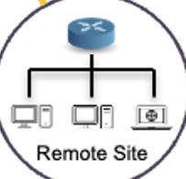
SCION IP GATEWAYS
Integrating IP networks and hosts with SCION
ENTERPRISE DEPLOYMENT
S
SCION Router
SCION link
SIGs support communication between IP-based hosts that are not running SCION
SIGs tunnel IP over SCION networks and allow existing networks to be integrated with SCION
SIGs can protect against DDoS attacks and malicious traffic by only allowing traffic to/from authorized Ases
SIGs can render networks invisible to anyone outside of the trusted ASes within a SCION network, therefore reducing potential attack surfaces
SIGs can be configured with path selection and failover policies
No changes to internal networks required
G
SCION IP Gateway
IP Link
S
Data Centre
ISP
AS3
G
Remote User
ISP
AS1
ISP
AS6
ISP
AS4
ISP
AS8
Internet
S
G
Head Office
ISP
AS2
ISP
AS7
ISP
AS5
G
G
Remote User
Remote User
Example SCION IP Gateway Deployment

Slide 10









REAL-WORLD DEPLOYMENT:
SECURE SWISS FINANCE NETWORK (SSFN)
Swiss inter-banking network for 300+ finance institutions, handling ~200 billion CHF/day worth of transactions between banks and other critical real-time financial services
From 2019 to 2021, SIX and Swiss National Bank built SSFN to replace older MPLS-based FinanceIP Net
Centralized “Hub and Spoke” architecture
Internet ecosystem “any-to-any” architecture

Slide 11

LEGACY NETWORK: POINT-TO-POINT PRIVATE CIRCUITS
Great control & predictability, but costly and inflexible as ecosystems grew (many sites, many partners)
Reliability is designed by over-building: lots of links, long procurement cycles, complex contracts
The more parties you connect, the complex the topology and more difficult to manage

Slide 12
LEGACY NETWORK: MPLS
MPLS provides simpler connectivity model than many P2P lines, but typically single operator at the network layer, or operator-provided NNIs required
Routing choices sit mostly with the operator or a central coordination entity
Requires dedicated infrastructure so unsuitable for many edge locations and remote users.
Third-party and supply chain risk management is increasingly good practice and mandated by NIS2, whilst optionality/sovereignty matter as much as raw uptime

Slide 13
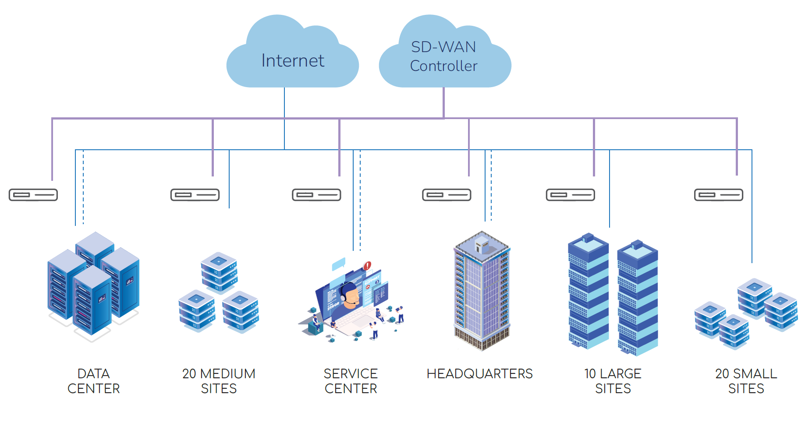
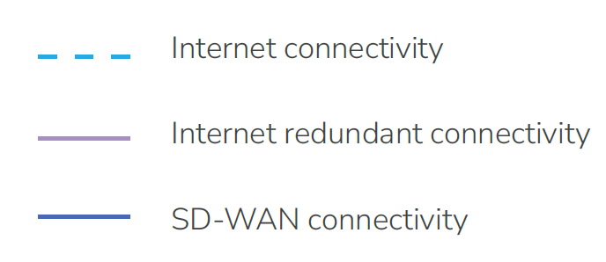
THE SD-WAN OPTION
Pros
Allows secure private networks to be built using commercially available Internet access provided by different ISPs
Offers some resilience, traffic prioritization and QoS capabilities
Cons
Connectivity is dependent on the underlying Internet connections and thus vulnerable to shared attack surfaces and DoS attacks
Each vendor has its own proprietary standards which limit interoperability and encourage vendor lock-in
Limited path control capability

Slide 14
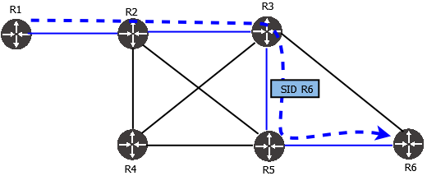
WHY NOT SEGMENT ROUTING?
Pros
Works over multiple ISPs and does not need to be supported by all routers on a path.
Offers path control capability, faster path convergence, and traffic prioritization.
Cons
Requires MPLS or IPv6 networks
Connectivity is only possible over limited domain
Limited vendor support and interoperability
Lack of cryptographic verification of paths
Configuration and management is complex and requires understanding of underlying networks
Credit: APNIC

Slide 15
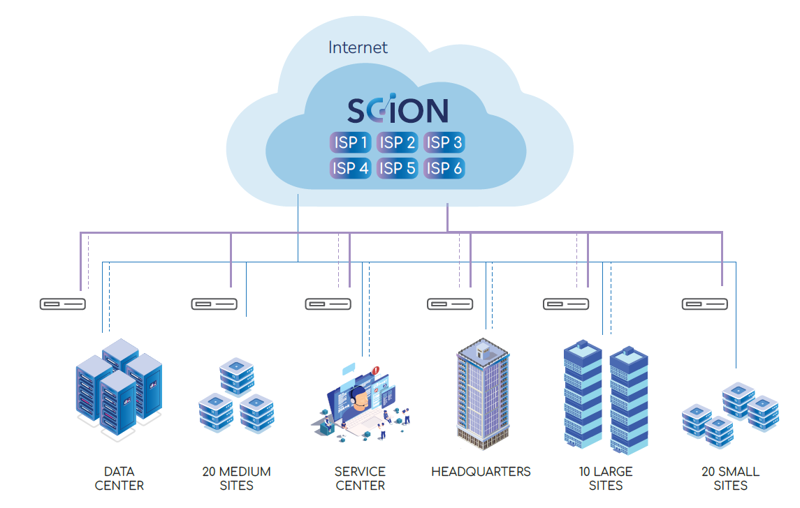
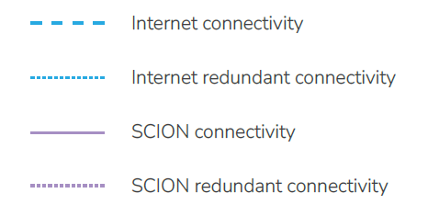
THE SCION OPTION
SCION provides the security and control of private connections whilst being able to utilize commodity Internet connections
Open protocol that works with different vendors and ISPs
Allows establishment of trust domains with governance, control over participation, and cryptographic verification (i.e .who can acces or transit a network)
Provides path control to direct traffic across SCION-enabled networks, with multi-path and fast failover capabilities
Offers data optionality and aligns with regulatory requirements

Slide 16
SSFN DEPLOYMENT EXPERIENCES
LESSONS LEARNED
Establishment of an ISD requires the creation of admission criteria, process documentation, and legal agreements
Initial establishment of ISDs requires key-signing ceremony involving voting ASes
Manual checks are needed when onboarding candidate ASes to ensure they meet admission criteria
Building the PKI and management integration of the services was challenging (although SSFN offers managed service)
Certificate revocation not possible, although they expire within 72 hours
SCION products are still relatively new and not all features are implemented yet
Inter-ISD path control is currently limited
The community and sources of expertise are currently limited
Practical experience has been that path failover and fallback occurs within a few seconds.

Slide 17
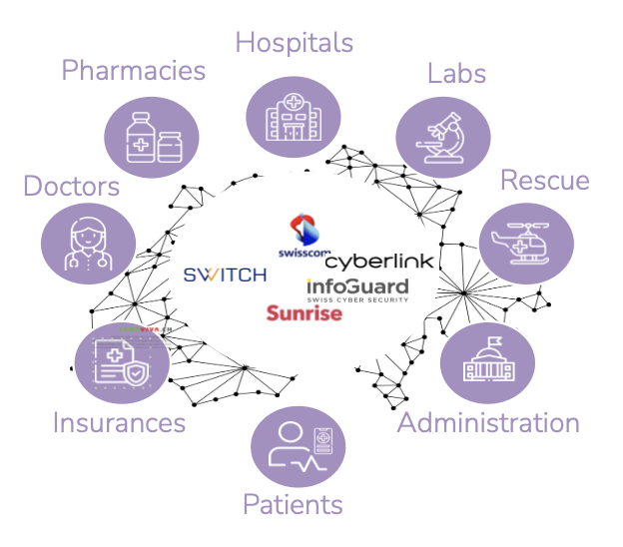
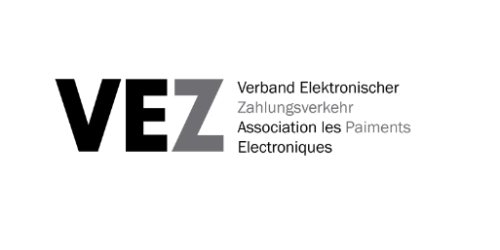



REAL-WORLD DEPLOYMENT:
FINANCE, HEALTHCARE, POWER & EDUCATION
PAYMENTS
HEALTHCARE
POWER
EDUCATION
The Secure EFTPOS Network (SEPN) leverages SCION technology to deliver unmatched resilience, security, and flexibility in cashless payments.
HIN adopts SCION to interconnect Swiss hospitals and thousands of doctors.
The Association of Swiss Electricity Companies has completed the concept for the Secure Swiss Utility Network (SSUN).
This is a community network, designed to integrate validated ecosystem and industry platforms, cloud applications, BPO providers, IoT, technicians, remote workers, security operation centers, and more…
The SCION Education, Research & Academic Network (SCIERA) connects campuses with path-aware high performance SCION connectivity

Slide 18
RETURN ON INVESTMENT
ENTERPRISE WAN CONNECTIVITY
REMOTE ACCESS
SCION VS LEASED LINES
SCION VS MPLS
SCION VS SD-WAN
SCION GATE BY ANAPAYA + CURRENT SOLUTION
HIGH AVAILABILITY WAN
BRANCH NETWORKING
WEB SERVICES & APPS
91%
1.34M
81%
600K
33%
315K
142K
average annual savings across 3 years
reduction of yearly costs
annual savings
reduction of yearly costs
annual savings
reduction of yearly costs
annual savings
2389%
1110%
228%
71.6%
ROI
ROI
ROI
ROI (using 3-year amortized cost basis)
<1 MONTH
<1 MONTH
<4 MONTH
9 MONTHS
payback time
payback time
payback time
payback time
Notes:
LC:
5 min White paper results presentation ROI
SCION technology has absolutely proven itself to increase security and reliability in network connectivity.
However, how economically viable it the implementation of SCION
We worked together with SIX, eraneos, and Anapaya to provide a cost/benefit analysis across different use cases:
These are:
Replacing leased lines with SCION for enterprise WAN
Replacing MPLS with SCION for enterprise networking
SCION instead of a SD-WAN for a large ecosystem
- Adding SCION GATE by Anapaya for remote access to the existing cybersecurity solutions
Although analysis is based on Swiss market, easy to replicate across other markets.
These finding are summarized in a white paper, which you can download from our website

Slide 19
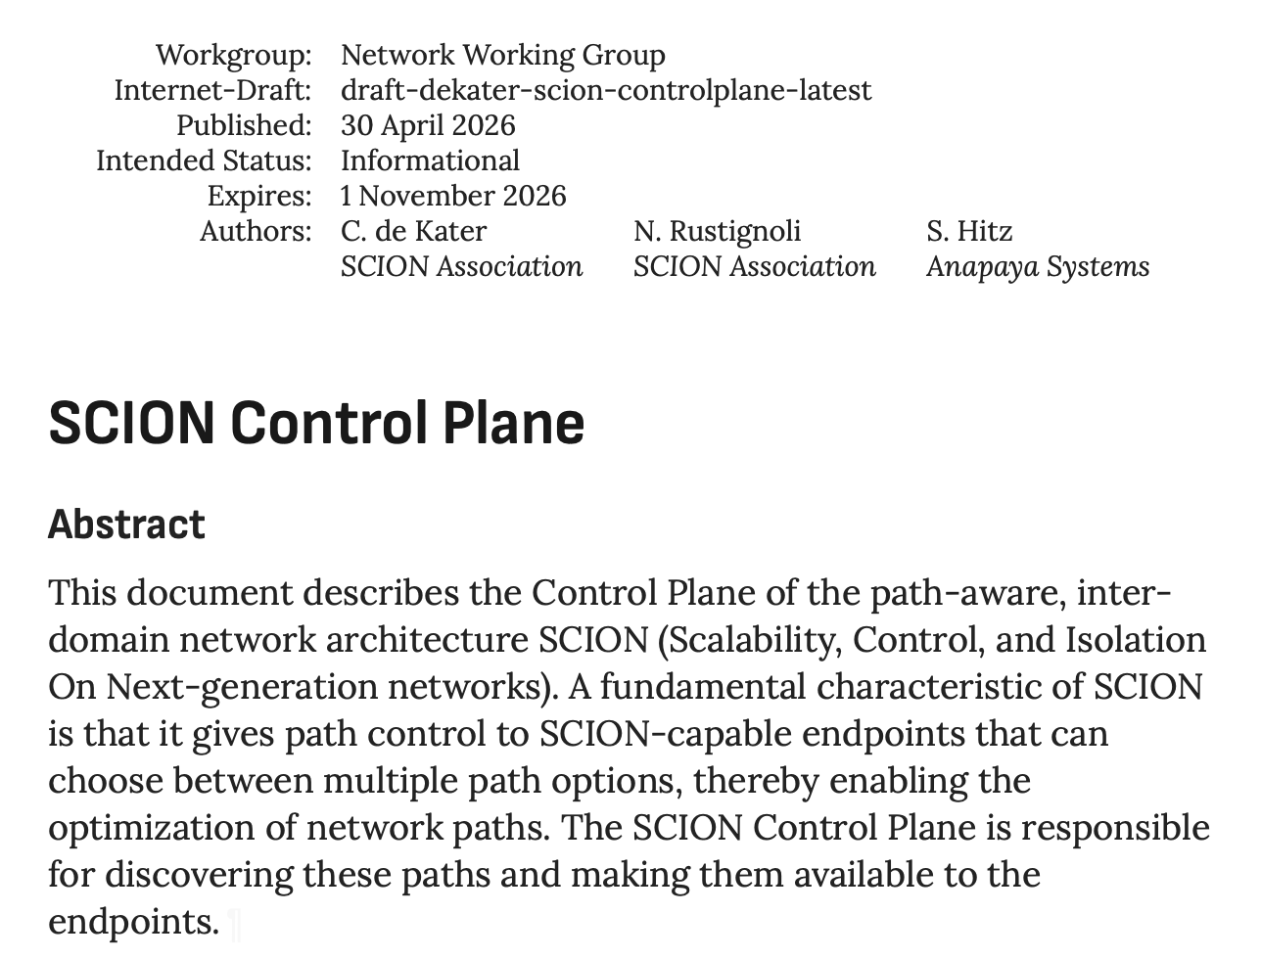
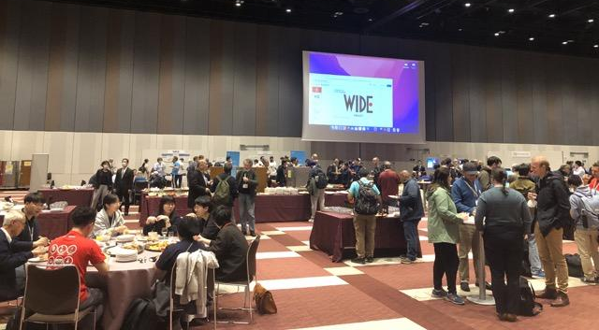
INTERNET ENGINEERING
TASK FORCE
Open specifications are important for interoperability and to encourage other implementations
SCION core components and functionality are documented in 3 Internet Drafts
Currently in RFC publication queue in IETF Independent Submission Stream
Internet Drafts:
SCION PKI draft-dekater-scion-pki
SCION Control Plane draft-dekater-scion-controlplane
SCION Data Plane draft-dekater-scion-dataplane

Slide 20
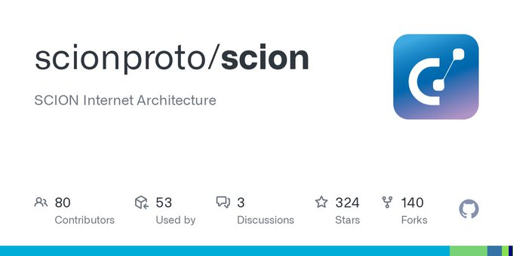

COMMERCIAL & OPEN-SOURCE IMPLEMENTATIONS
If you’re interested in deploying SCION, there are currently two options:
Commercial
Open Source
Other implementations under development: P4, Rust, OpenWRT
SCION Association formed by deployers and early adopters to support open source development, standardization, and community involvement.

Slide 21
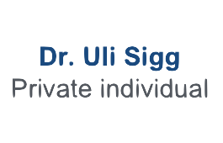



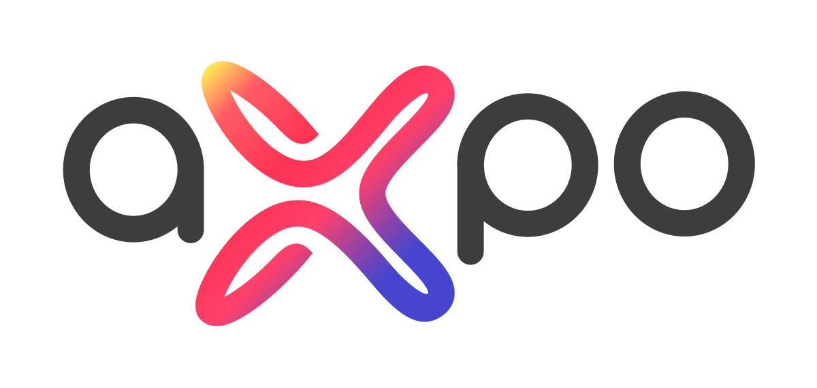
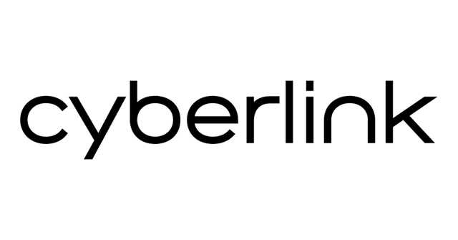








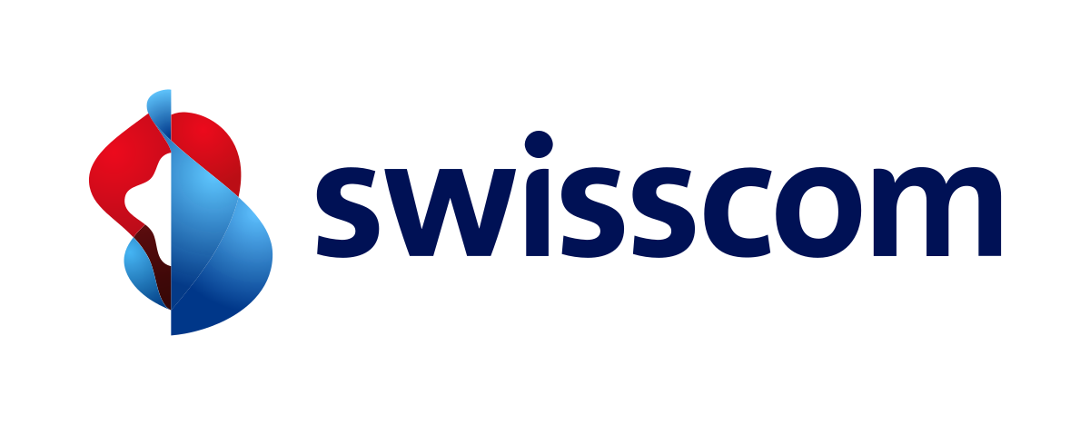





THE SCION ASSOCIATION
Promoting openness and collaboration to unlock the full potential of SCION
Non-profit association established in 2022
Open for membership to all entities interested in SCION
https://www.scion.org
COMMUNITY
Raising awareness of SCION, promoting the benefits and encouraging adoption, developing its community, and providing marketing support to implementors and deployers
STANDARDIZATION
Developing the specifications to implement SCION, with the goal of making it an interoperable Internet standard
OPEN SOURCE
Maintaining and coordinating the SCION implementation for research, development, and experimental deployments

Slide 22





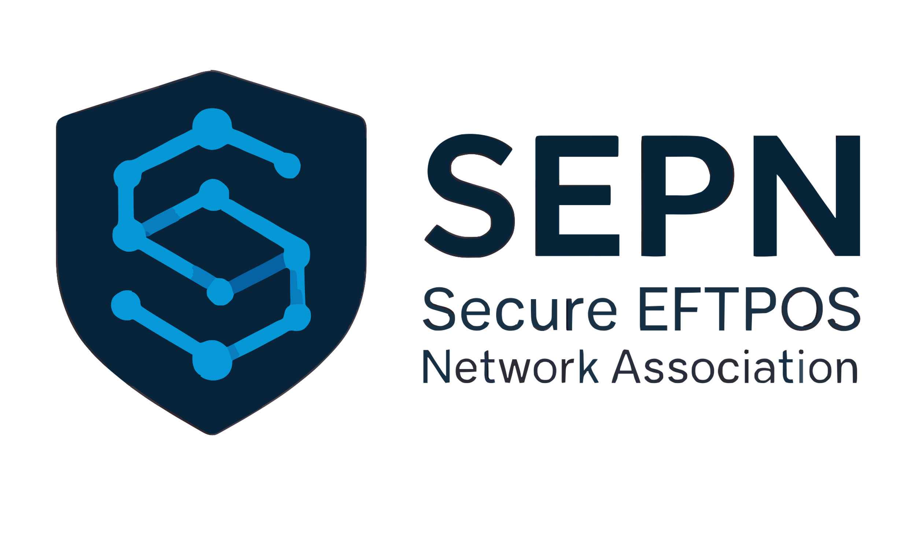

















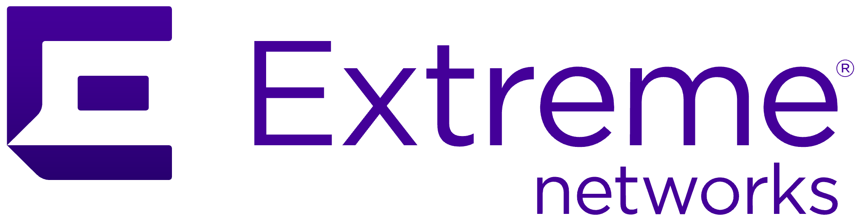

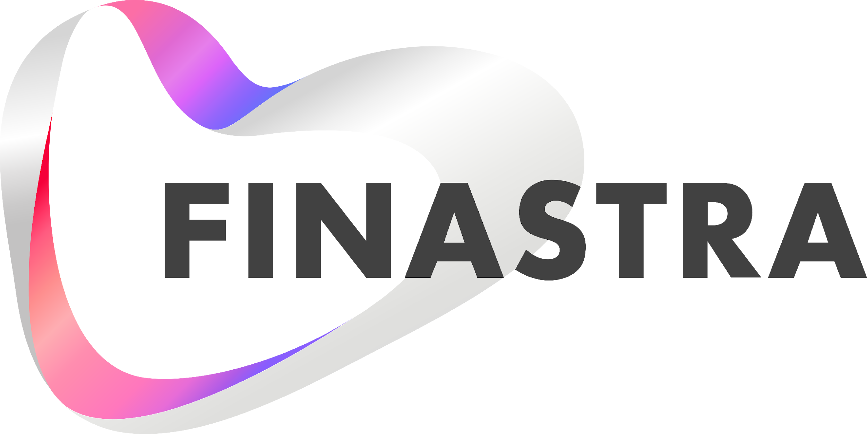

















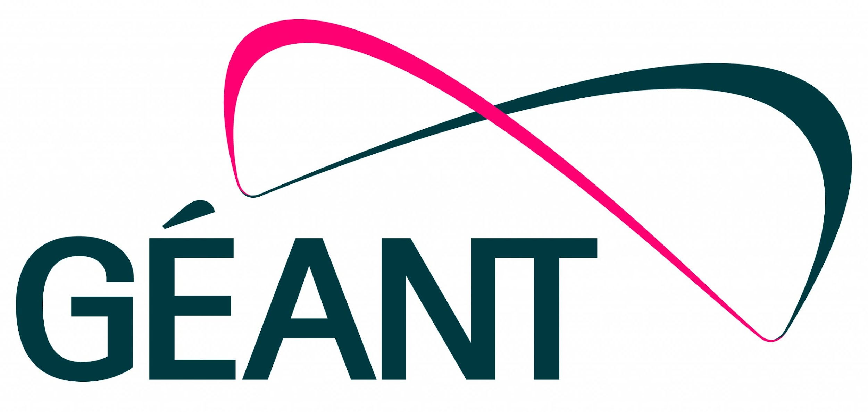

























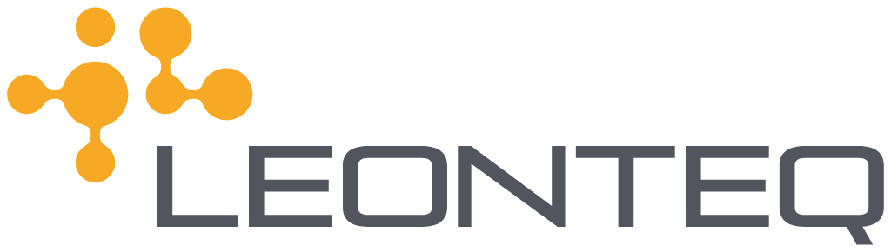



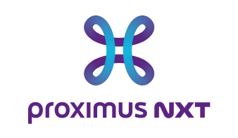

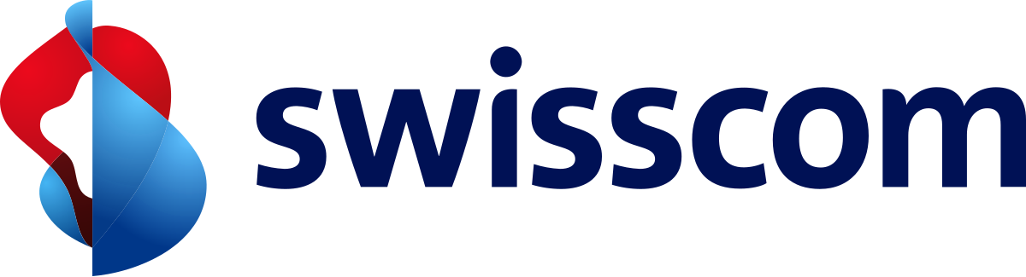





















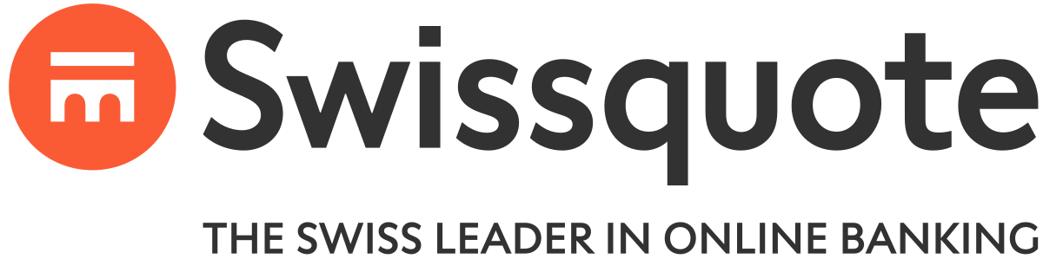





SCION TODAY
A growing ecoystem
SERVICE PROVIDERS
USERS
RESEARCHERS

Slide 23

THANK YOU!
More information:
SCION Association: https://www.scion.org
Reference & Developer Docs: https://docs.scion.org/
Research: https://scion-architecture.net
Vendor: https://www.anapaya.net/resources
Latest Release: https://github.com/scionproto/scion/releases/
The Complete Guide to SCION
Springer Verlag, 2022

