Slide 2
Hollow-Core Fiber:
Nothing is Better Than Glass?
Notes:
Can I start by thinking the programme committee for allowing me to speak to you today. We’re told that if you’re the smartest person the room you’re in the wrong room. Well with this audience – I know I’m in the right room
Good afternoon. My name is Steve Jones, from Huber Suhner a Swiss German manufacturer of a wide range of fibre optics products. I’m here today to talk to you about Hollow Core Fibre - & raise the question « Is NOTHING better than Glass?

Slide 3

Hollow Core Fiber
“Nothing is better than glass for guiding light”
Francesco Poletti, ORC
Notes:
I’m was a telecoms engineer who many years ago passed over the dark side of sales many years ago but I’m still retain an interest in technology.
A moment of audience participation: Could I ask for a show of hands about when you started working with optical fiber….. more than 10 years ago? ……… than 30 years ago? Ok, I’m nearly the last one standing here… Unfortunately that also tells you something about my age ☺
I guess few of us can remember when single-mode fiber was first commercially deployed in the early 1980s. We’re at a similar inflection point in history with hollow-core fiber: we have initial commercial HFC deployments, and we’re going to have more commercial deployments in years to come. So in a sense it’s a historic moment in time.
I’ve called this presentation ‘ nothing is better than glass for guiding light’? That’s based on a phrase by Francesco Poletti, who is a researcher at the University of Southampton, and who helped invent HCF.

Slide 4
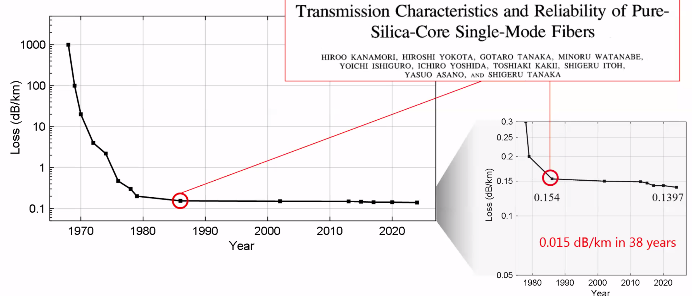
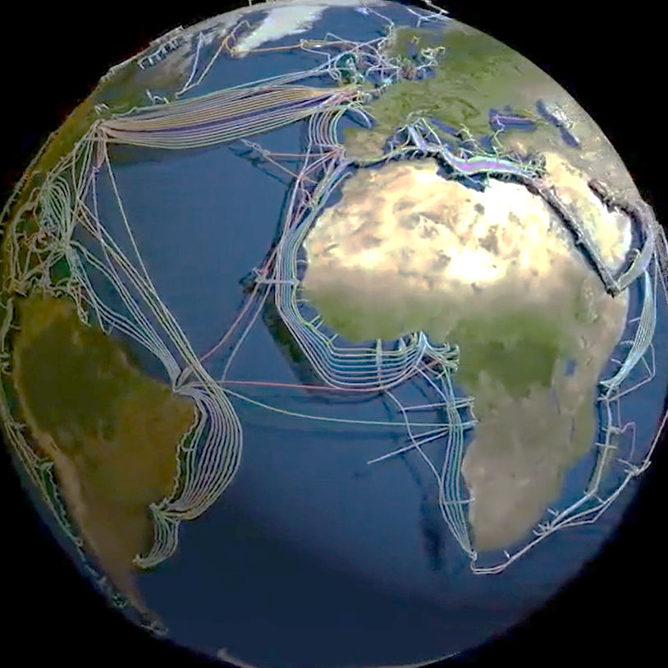
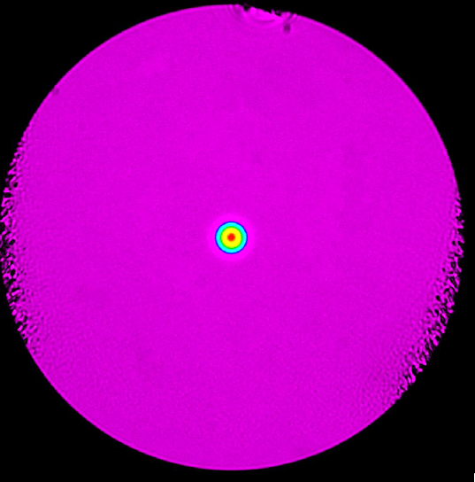

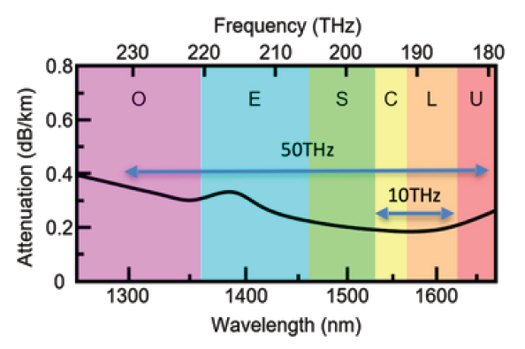

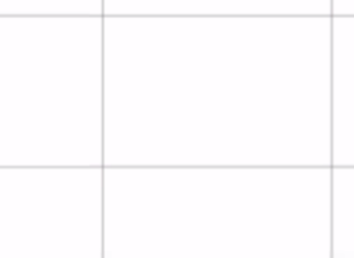
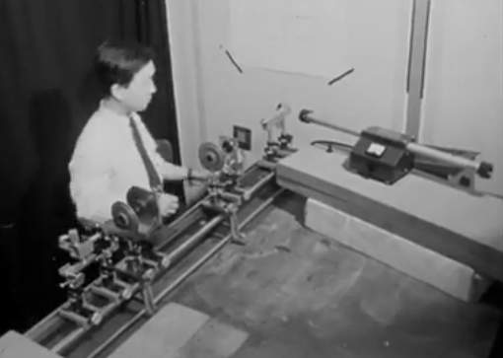
50 years of single mode optical fiber deployment
6 billion kilometres of telecom-grade single mode fiber installed worldwide
Fundamental limitations of solid glass fiber now reached: loss, nonlinearity, latency, capacity…
6 billion kilometres of SMF
125μm
Charles Kuen Kao
1966
Notes:
In 50 years we’ve seen around 6 Billions KM of SMF installed worldwide & demand still exceeds supply!
But as you can see from the graph since the mid 1980s there has been very little improvements in the performance of optical fiber. A measly 0.015 dB/Km in 38 years!

Slide 5
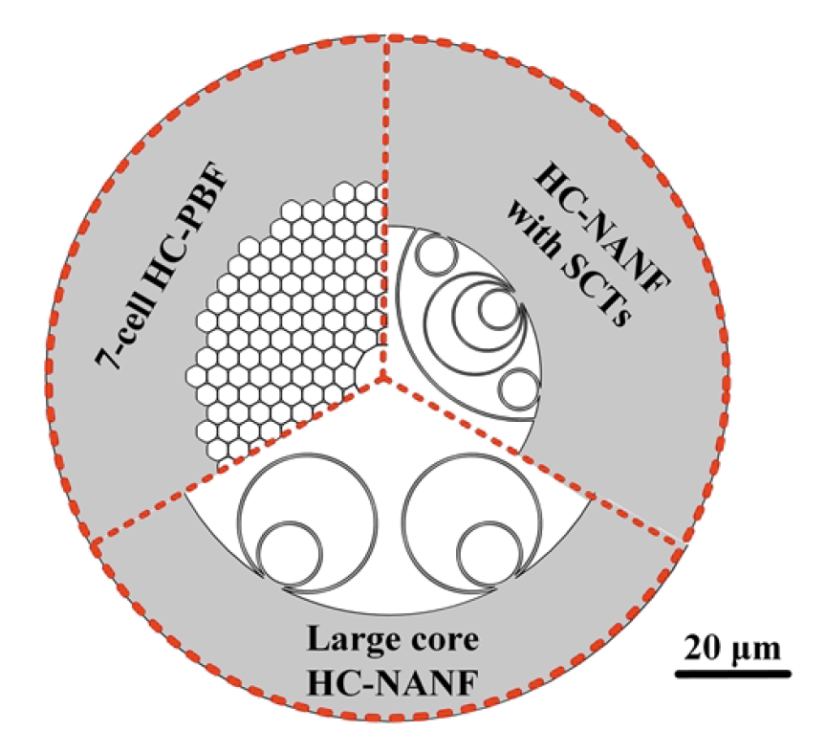
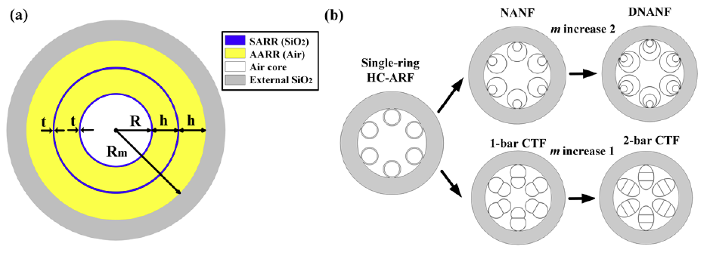
Hollow Core Fiber History
HC-PBFs: Hollow-Core photonic-bandgap fibers
  Medium Loss, Narrow Bandwidth
HC-ARF: Hollow-Core Antiresonant Fibers
  Medium Loss, Wide Bandwidth
HC-NANF: Hollow-Core Nested Antiresonant Nodeless Fiber
Low Loss, Very Wide Bandwidth
    With Semi-Circular Tubes
DNANF: Double Nested Antiresonant Nodeless Fibre
Yunhao et al., “Small-core hollow-core nested antiresonant nodeless fiber with semi-circular tubes“, in Optics Express, vol. 30 no. 12, June 2022
March 2026 | Hollow-core Fiber Connectivity Solutions | Steve Jones
Notes:
The Idea = replace the core with air rather than glass silcia. But not that easy!
HCF traces its history to research at Bell Labs on optical waveguides in the 1960s, metallic pipe products in 1970s, but very impractical to deploy and maintain…)
HC-NANF – Hollow Core - Nested Antoresonant Fibre, patented by Francesco Poletti at Southampton University (published 2014), with a core of air surrounded by a meticulously engineered glass microstructure. thin glass membranes act as low‑finesse reflectors that confine light by antiresonant interference rather than total internal reflection.
& now - HC-DNANF = Double Nested Antiresonant Nodeless Fiber and even triple nested antiresonant nodeless Fiber.

Slide 6
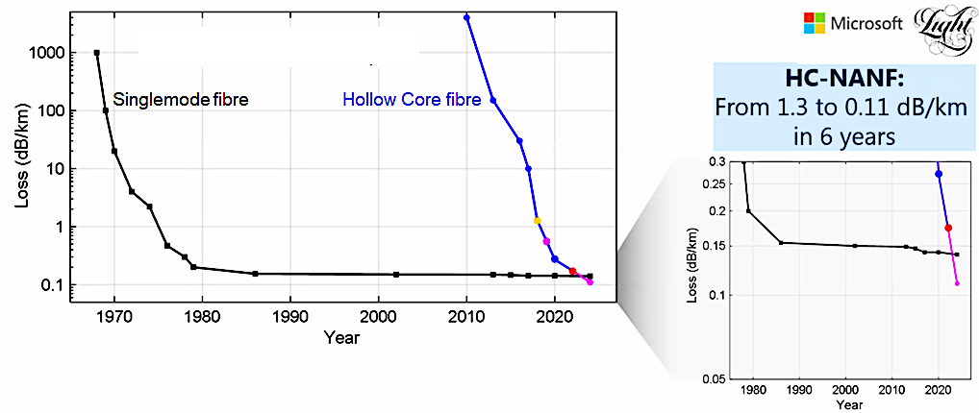

Rapid advances in hollow-core fiber development
Micro-structured glass fibers confine light to a hollow air core
Loss below silica glass in optical fiber first achieved by Microsoft and Southampton University in 2023. HC-NANF
45 years
Notes:
Rapid advances in HCF development in recent years – HC=NANF 1.3 to 0.11db in 6 years
Various HCF structures on right shows an example of C-DNANF = Double Nested Antiresonant Nodeless hollow core Fiber

Slide 7
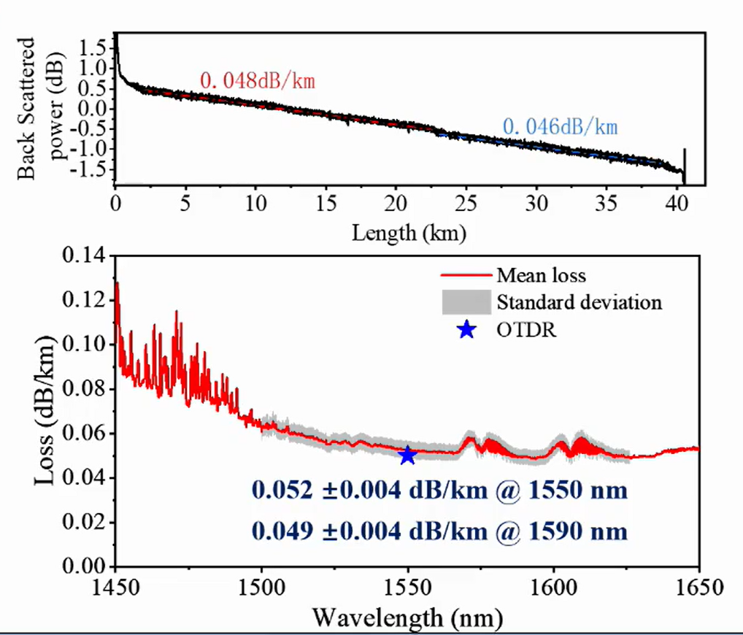



Rapid advances in hollow-core fiber development
Micro-structured glass fibers confine light to a hollow air core
Lowest ever loss in any waveguide recently reported by Linfiber at ECOC 2025: 0.05dB/km over 40km of HCF.
45 years
DNANF
0.11 dB/km @ 1550 nm
0.13 dB/km @ 1020 nm
Notes:
Rapid advances in HCF, including Chinese manufacturer Linfiber, shown at ECOC in 2025 0.005db/km
Microsoft - Hybrid‑Window‑Guidance DNANF: A single hollow‑core fibre can deliver ultralow‑loss guidance in two antiresonant windows simultaneously.
Microsoft Azure recently reported throughput of over 400Tb/s over 400nm optical bandwidth over 60km in the O band.
Healthy to have multiple companies continually improve the technology

Slide 8
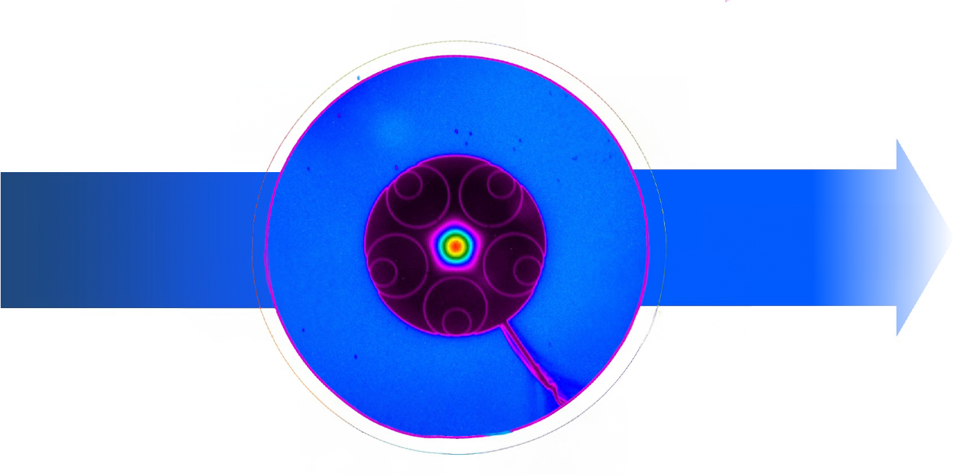
Performance benefits of hollow-core fiber
32% less delay
Low
latency
50% lower attenuation
10,000x more linearity
Ultimate
low loss
Low
nonlinearity
Light is guided
>99.99% in air
Nothing is better
than glass!!!
Wide
bandwidth
Low
thermal
sensitivity
Geometry-defined transmission
25x better delay stability
High damage
threshold
Radiation
hardness
1000x higher power handling
10⁴x more rad-hard
Notes:
Significantly ie 1/3rd reduction in latency.
Low nonlinearity => more power, fewer amplifiers because 99.99% of light is in air. Nonlineir increases bit rates and distance. No backscaterring in air => use coherent fiber bidi
Low thermal sensitivity (no glass) => better delay stability
Radiation-hardness: Opens up whole new applications CERN – no particle collisions. Space, A&D
High damage threshold (kilowatts of optical power has been done) => no amplifiers, can use whole bandwidth
Wide Bandwidth - (change of ref index with wavelength: less modal dispersion): not zero, but much lower (at least order of magnitude, 2 ps/km vs 20 ps/km)
50% lower attenuation

Slide 9
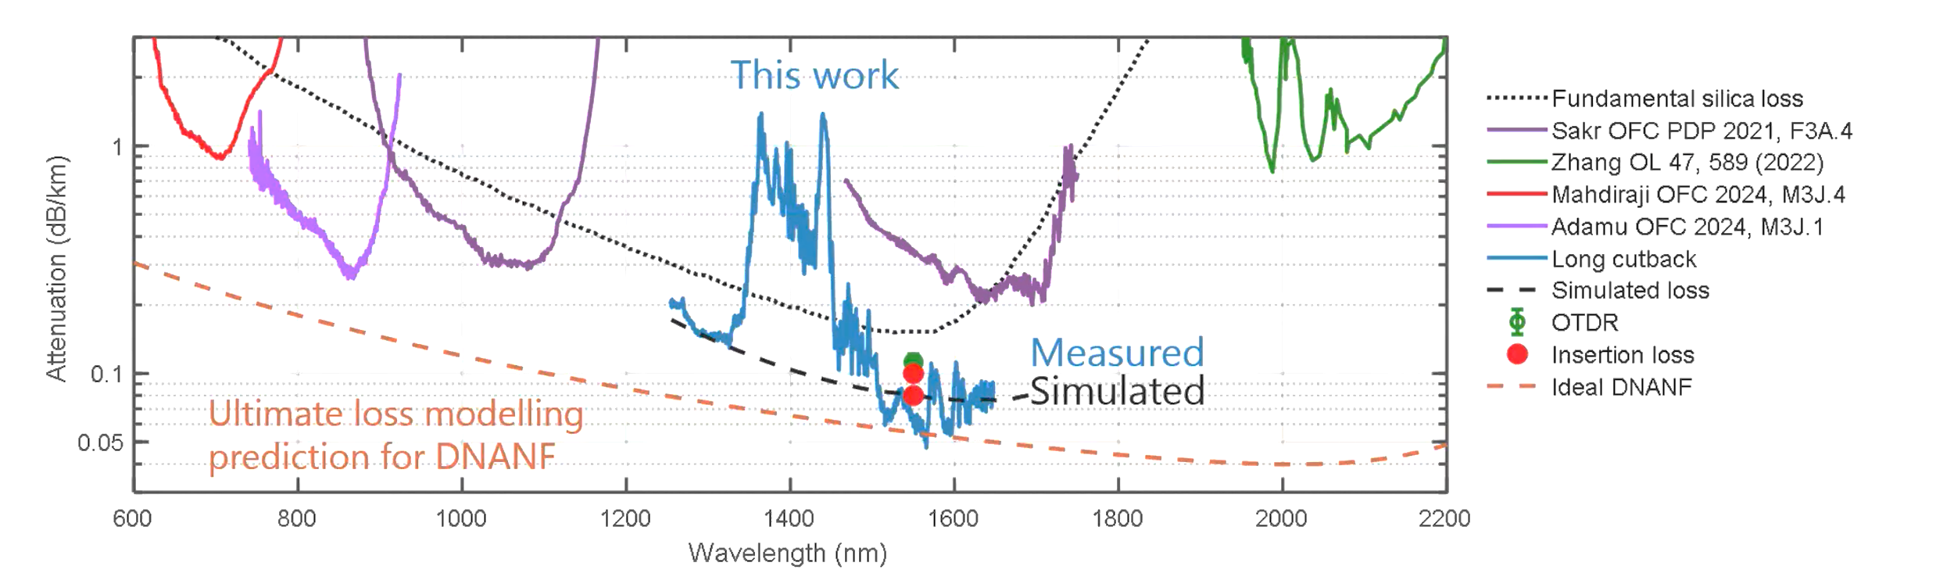
Hollow-core fibers can work at any wavelength
HCF transmission windows defined by microstructure geometry, not material properties
DNANF fibres fabricated with loss below silica across the visible and mid-infrared bands
Even lower attenuation possible at longer telecom wavelengths
Visible
Near-infrared
Telecom bands
Mid-infrared
Silica glass
Geometry-defined transmission
Notes:
Other colours lines are different geometries that have been developed for certain wavelength.
Can use new wavebands, can use lowest loss at 2000nm (if sources are available) for a wide range of application we haven’t even thought of yet
For short-haul, looking for lowest (transceiver) cost

Slide 10
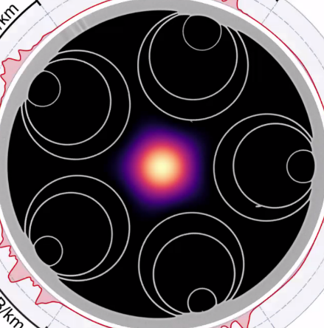
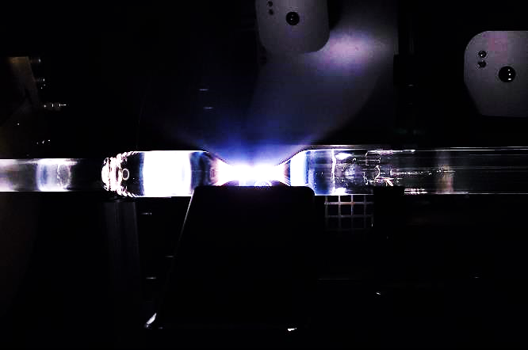
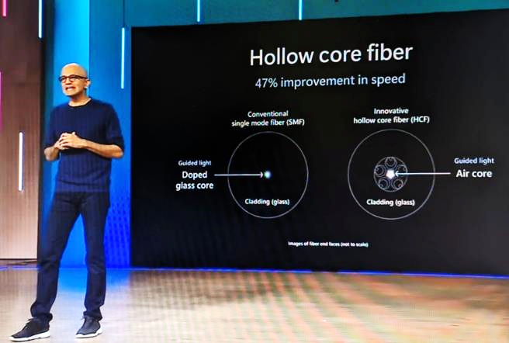
Hyperscalers accelerating investments in hollow-core fiber
Microsoft acquired Lumenisity in 2022 and is now scaling HCF fab capacity with vendors Corning and Heraeus
Hollow-core fiber can provide long-term sustainable differentiation for datacenter networks
Brings servers, data centers and - ultimately - continents closer together for latency-critical services
H+S seen as trusted partner for HCF datacenter interconnect cables, Incl Microsoft
Further opportunities for HCF patch cords to reduce latency in high performance AI compute clusters
Satya Nadella keynote at Microsoft Ignite 2023
Notes:
Heraeus creates preforms that are used to draw these glass fiber structures, also produce HCF themselves, looking to be primary European source.
HS has been providing HCF CABLES for many years

Slide 11
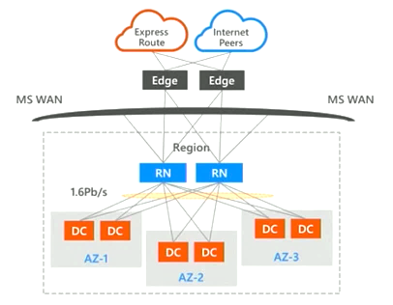
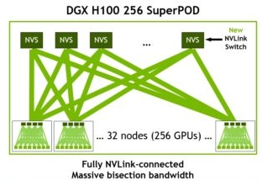
Drivers for HCF deployment in datacenter networks
32% faster transmission
50% lower attenuation
1000x higher power
10,000x more linearity
Metro/regional data center interconnect
      Low latency improves service response speeds
      Wideband links with 200km reach and no amplifiers
      Linear transmission properties allow high launch power
Clear value-add for HCF connectivity solutions
High speed connectivity in AI compute clusters
      Low latency interconnect between GPU arrays
      Allows faster completion of LLM algorithms
      Doubles compute capacity within max latency radius
High volume patchcords at commodity prices
200km
200m
LLM: large language model
Notes:
The two main drivers today for HCF deployment are metro or regional datacenter interconnects, and AI clusters.
For data center interconnects, the low latency of HCF improves service response speed, and also extends the reach of distant datacenters for constant optical power and latency budgets, from around 100km to around 200km. It also means that the radius of the potential area to place a redundant datacenter increases by 50%: this makes it easier to locate datacenters close to available power sources and to industrial and economic hubs. Several service provides are trialling DC to DC for financial-services customers needing ultra-low latency.
For AI clusters, latency between GPUs is a hard limit on completion speed for LLM algorithms, which typically involve very large linear algebra computations distributed between GPUs, and also on the compute capacity that can be concentrated within a radius of a couple of hundred meters. Again the lower latency of HCF allows both faster completion and increases the compute capacity within the maximum latency radius by 70% (1,3²)– that’s in 2D, if you spread compute horizontally. But if you stack up GPUs vertically, the compute capacity doubles.
Microsoft reports that HCF is now operational and carrying live customer traffic in multiple Azure datacenter regions.

Slide 12
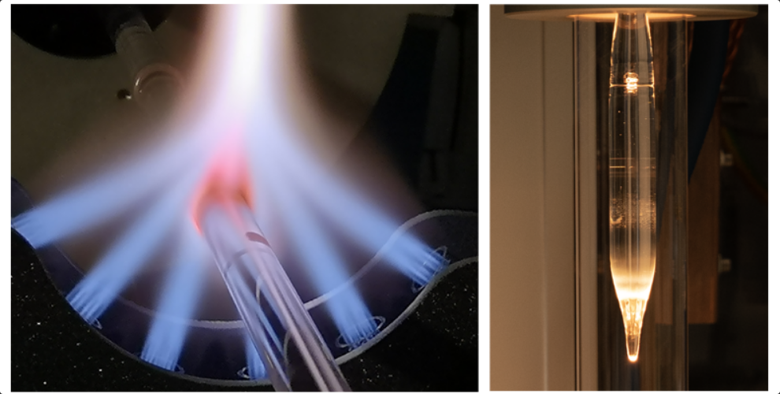
HCF Deployment Challenges
Production capacity / cost
Operational Practices
  Bending radius
  Splicing
  Measurements
Ecosystem Readiness
  No HCF standard
  Information on HCF durability
  Existing SMF installed base
Examples of HCF during the manufacturing process (Microsoft)
Notes:
The first challenge is production capacity and price. Currently HCF price >10x times SMF price . We expect this will reduce significantly in years to come, as new manufacturing plants come online and the manufacturing process is optimized. We’ve talked about Corning and Hereaus, Prysmian, OFC/Furuka, LINfiber and others are active in this space. But I would expect the price of HCF to remain significantly more expensive than SMF for many years. So HCF makes sense for business cases where you can justify the additional expense, and for which you can actually buy the stuff.
The second challenge we have is that our SMF operational practices need to be adapted. HCF has a larger bending radius than SMF, so this needs to be carefully looked at. Splicing needs to align the microtubes together, but also needs to be done in less than 30 seconds to avoid water vapour contamination, so it requires either new splicing machines, or existing splicing machines with specific programs. It also requires careful training of human operators. The OTDR measurements need to be interpreted differently for HCF, as splices and connectors have very different measurement profiles.
And finally ecosystem readiness is also a challenge. There is no widely accepted HCF standard yet. HCF durability also needs to be looked at over the long term. Both these factors are likely to prevent massive long-haul operator deployments for a while. In addition, HFC deployments need to interface with existing SMF plant and equipment, including optical transceivers, amplifiers, cable management systems, etc. The good news is that most of this can be reused: you can use perfectly standard, existing SMF optical transceivers and DWDM systems to light up HCF – they just go further and faster. But at some point HCF and SMF have to interface together. And this is where we play a very specific role that I’m going to reveal to you for the first time.

Slide 13
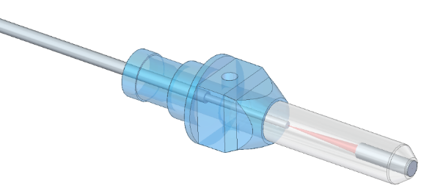
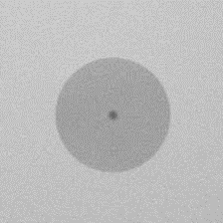
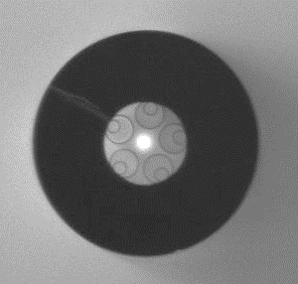
Hollow-core fiber connectivity challenges
Open fragile core structure
      Not possible to polish – only cleaving of endface
      Open end needs sealing against environment
      Microstructure geometry can vary along fibre length
    Mode field diameter is >2x the size of standard SMF
      Mode size conversion is necessary
      Back reflections at interface to SMF need to be suppressed
      Large cladding diameter limits min bend radius to ~75mm
    Need for an element to connect to the world of SMF!
      CUBO HCF-Lens-Connector
SMF-28e
Ø_{Cladding} = 125µm
MFD = 9.2µm
NANF-HCF
Ø_{Cladding} = 235µm
MFD = 24µm
Notes:
nanoscale structures => can't polish
Little crystals (from water vapour) start to form on edges after a few hours => needs to be sealed against normal environment
Cladding diameter slowly reducing => better bend radius
Need to get as much power from SMF into HCF as possible – need alignment & low backscattering
Answer
Patent is ours, granted => public
Light is sealed inside ferrule

Slide 14
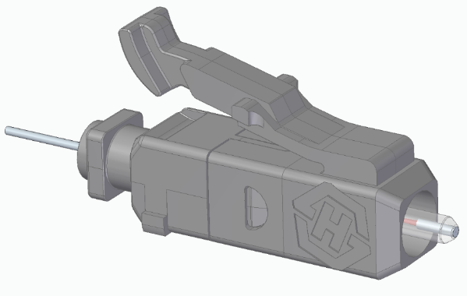
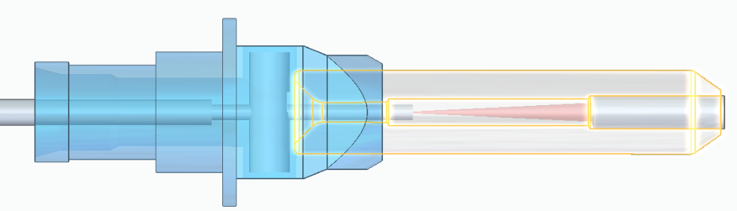
Patented Mode Converting HCF-LC-Connector
LC Connector
Quasi-hermetic sealing at fiber and lens fixing
HCF actively aligned (MFD = 24µm)
HCF cleaved to air – no back reflection
Anti-reflection coated lens
Interface to standard SMF28 fiber (MFD = 10,4µm)
Notes:
Match refractive index of glass => very few reflection , with APC >55dB back refl, typ 70dB
Enables quantum coexistence with classical comms

Slide 15
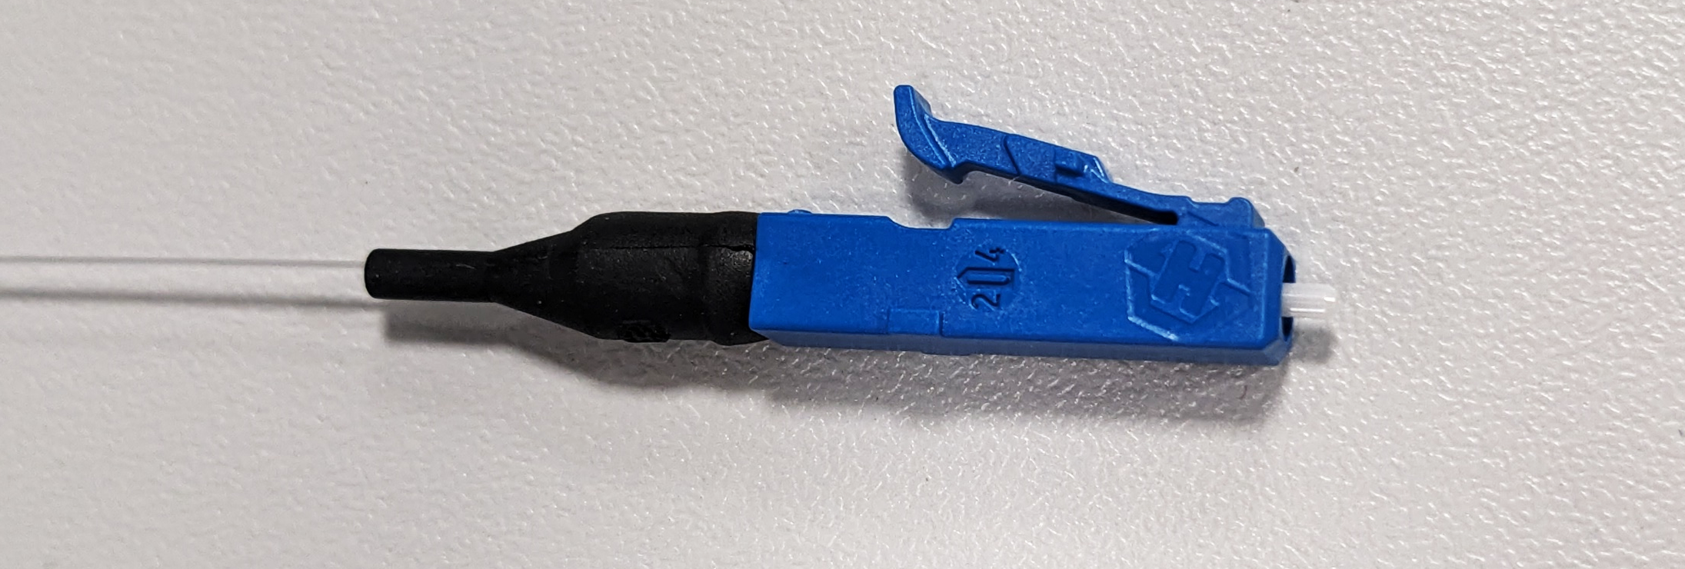
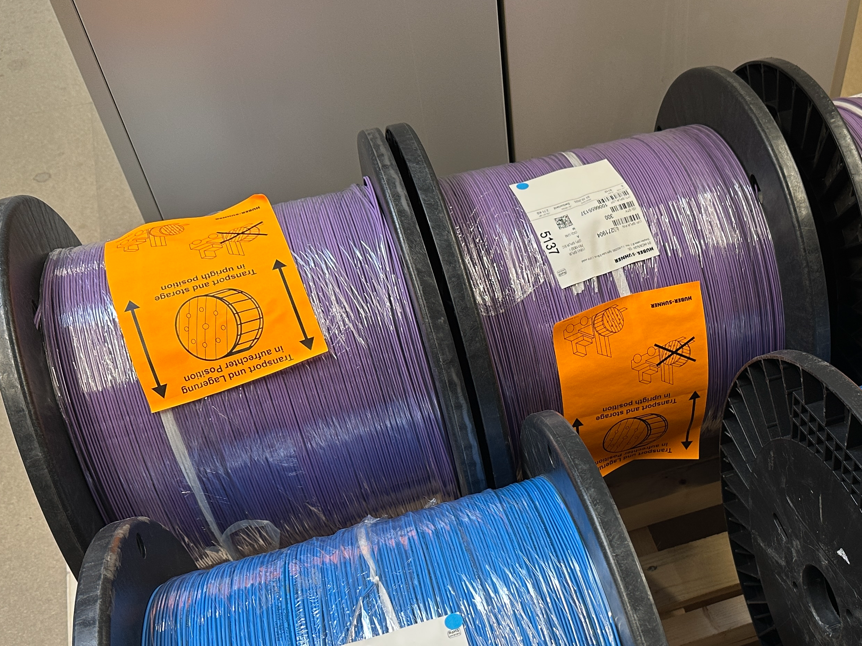
Cabled HCF patchcords with LC/UPC Termination
Cable-Side | Ferrule | IL Assembly | IL QC | Return Loss
H1284-1 | F006357 | -0,36 dB | -0,28 dB | -49,4 dB
H1284-2 | F006358 | -0,29 dB | -0,30 dB | -51,0 dB
H1285-1 | F006359 | -0,54 dB | -0,76 dB | -50,1 dB
H1285-2 | F006360 | -0,24 dB | -0,53 dB | -49,9 dB
Connectors qualified for high optical power handling up to +34dBm at 1550nm
Notes:
This is what we make, pigtails termination for metro cables (typ 32 fibers)​
0.5W, even beyond that now​
​
Can HCF be spliced? Yes, with a specific splice program, IL will be higher than SMF, maybe 0.3dB splice loss​
We supply the tails, customer splice the tails to the cable​
Partial vacuum: HCF filled at temp of molten glass, air contracts as it cools. Cleave end face => low pressure slowly equalizes (because 20µm straw)​
Tubes need to be geometrically aligned during splice, cladding must fuse, minimal damage to internal surfaces​
No specific splicing eqpt for HCF, the program is key

Slide 16
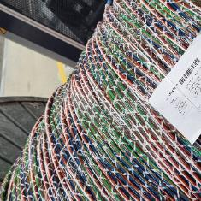

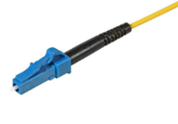
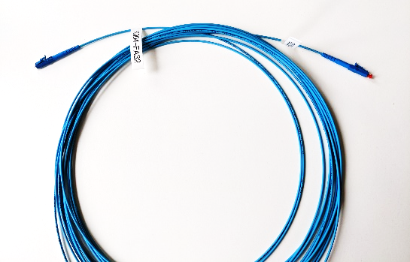

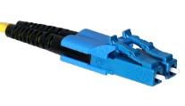
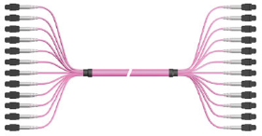
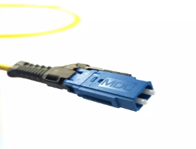
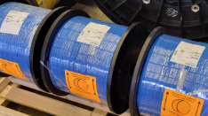


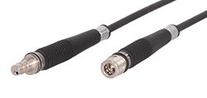
H+S HCF connectivity roadmap
Cable
Ferrule
Connector
Assembly
Management
LC
Patch cords
32/64f MLT
LC/UPC
Fiber Mgmt Systems
LC Duplex
Breakouts
VSFF
Zip Duplex
LC/APC
Connectivity automation
Q-ODC Mini
Outdoor terminations
Notes:
LC/APC still in low-rate production
Larger ferrules possible for much higher launch power, but not right now
Looking at adapting fiber mgmt systems for higher bend radius (both hw and sw)

Slide 17
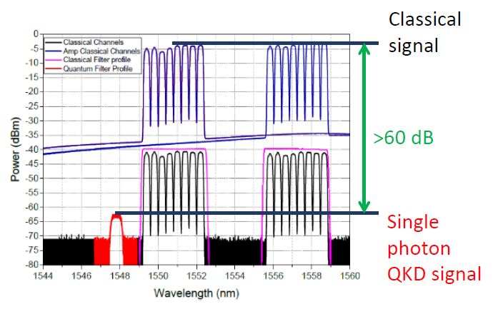
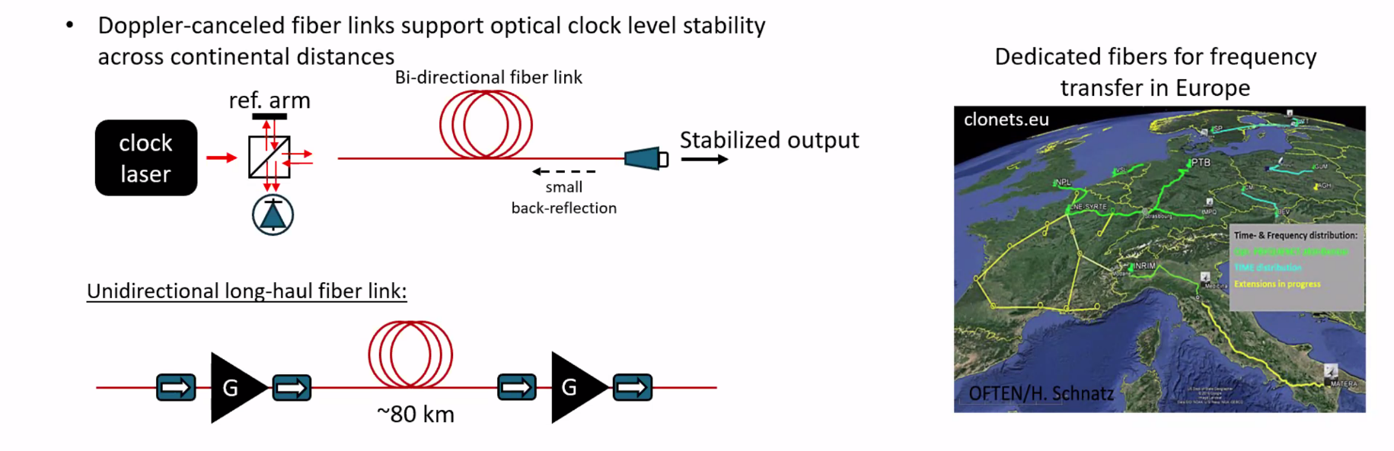
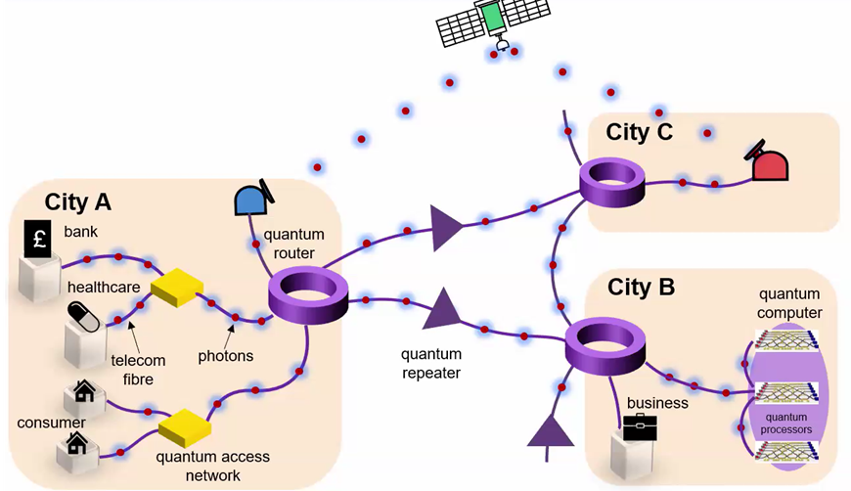
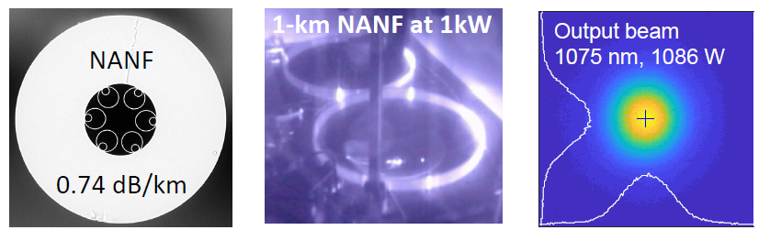

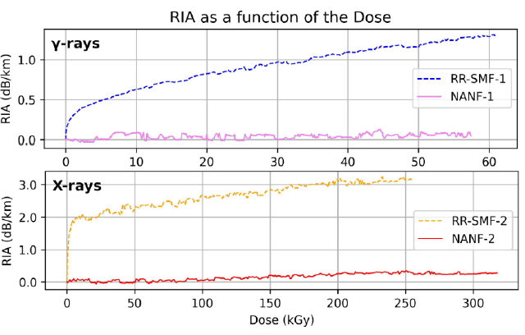
Beyond datacenters: broad applications for hollow core fiber
Quantum networks
Time synchronisation
10,000x more linearity
25x delay stability
Power delivery
Space photonics
20x power-distance
10⁴x rad-hardness
Notes:
Quantum: light travels closer to its vacuum speed (≈30% faster than standard fibre), preserving quantum state timing. Minimizes photon–photon interactions → critical for fragile quantum states (e.g. entanglement).
Time Sync: minimal latency – low jitter. Improved phase stability. Supports sub‑nanosecond synchronisation
Power; 2.5Kw of power – not milli watts
Space: Radiation resilience, temperature robustness, supports precision timing

Slide 18
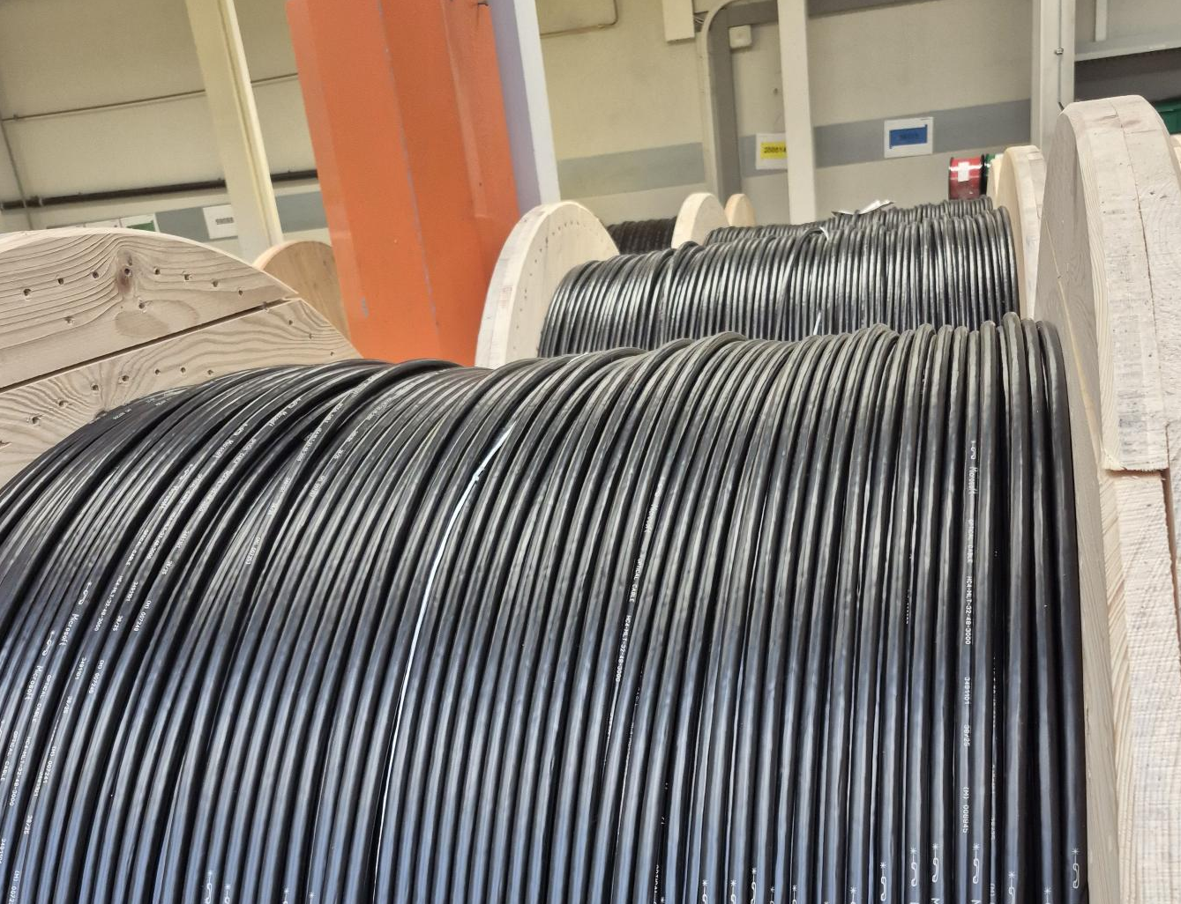
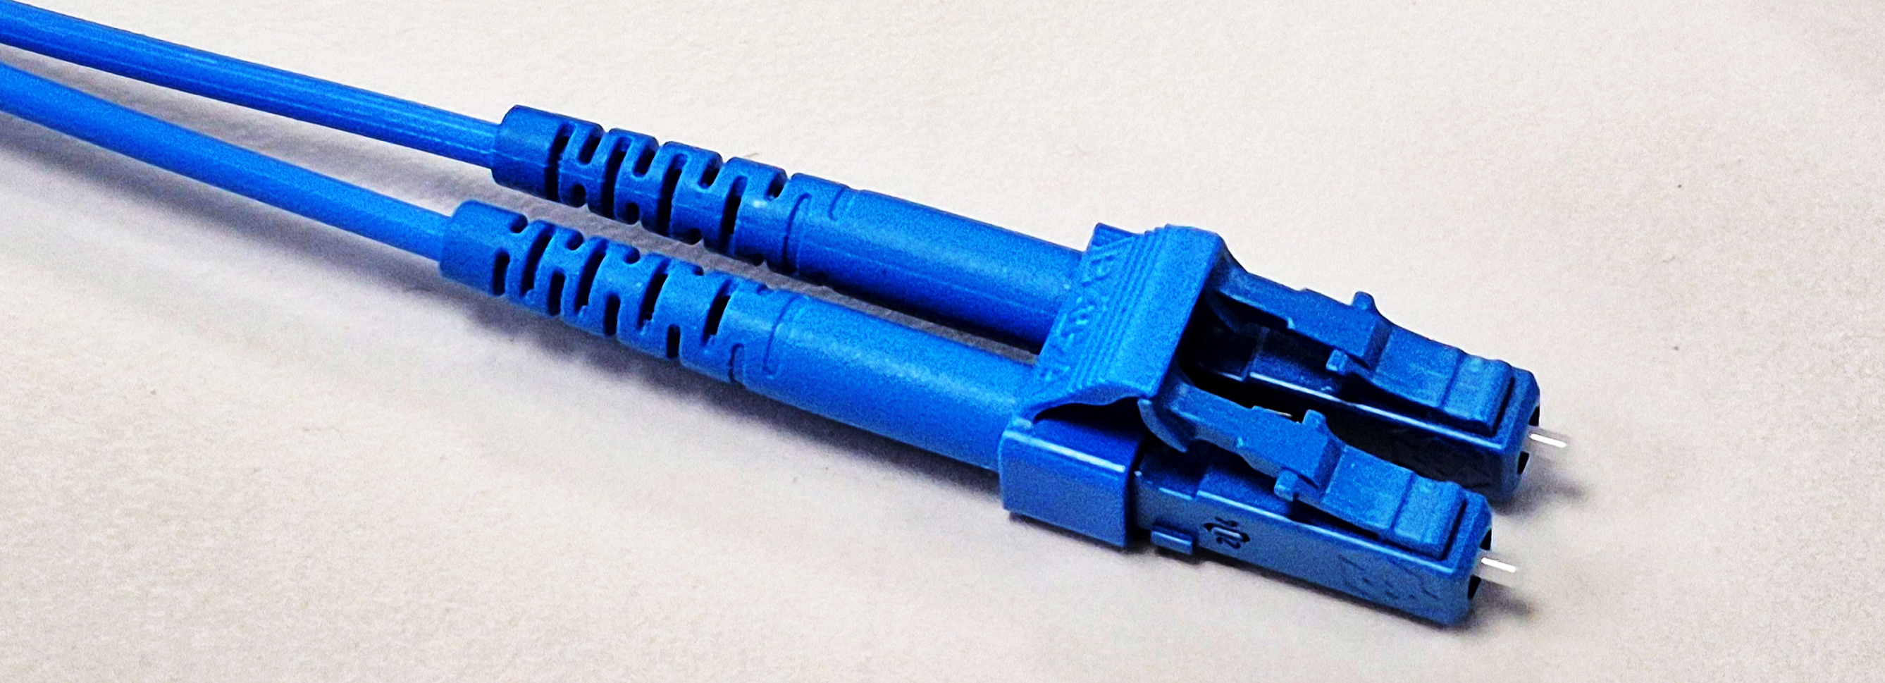
Summary: Hollow Core Fiber Connectivity Solutions
Technology Description
Low-loss, low-latency fiber for ultrafast transmission
Focus on AI-data center, metro and future 6G networks
Record low loss HCF extends transmission lengths
Multiple vendors exploring novel HCF designs
Patented H+S HCF-SMF connector enables robust connectivity solutions portfolio
Illustration
Use case / Customer
Creating end-to-end low-latency data center networks enables sustainable differentiation
Enables amplifier-free metro links
First applications deployed in DC interconnect networks
Potential for efficiency benefits in AI supercomputing
Exploitation beyond DC in timing, sensors, A&D…
Free-space transmission speed with the flexibility of fiber
Standards-compatible HCF connector allows simple integration with existing singlemode fiber systems
Removes glass nonlinearities to create high power links
Highly stable delay for precision time distribution
Enables quantum coexistence with classical comms
USPs
Notes:
Enables quantum coexistence with classical comms

Slide 19
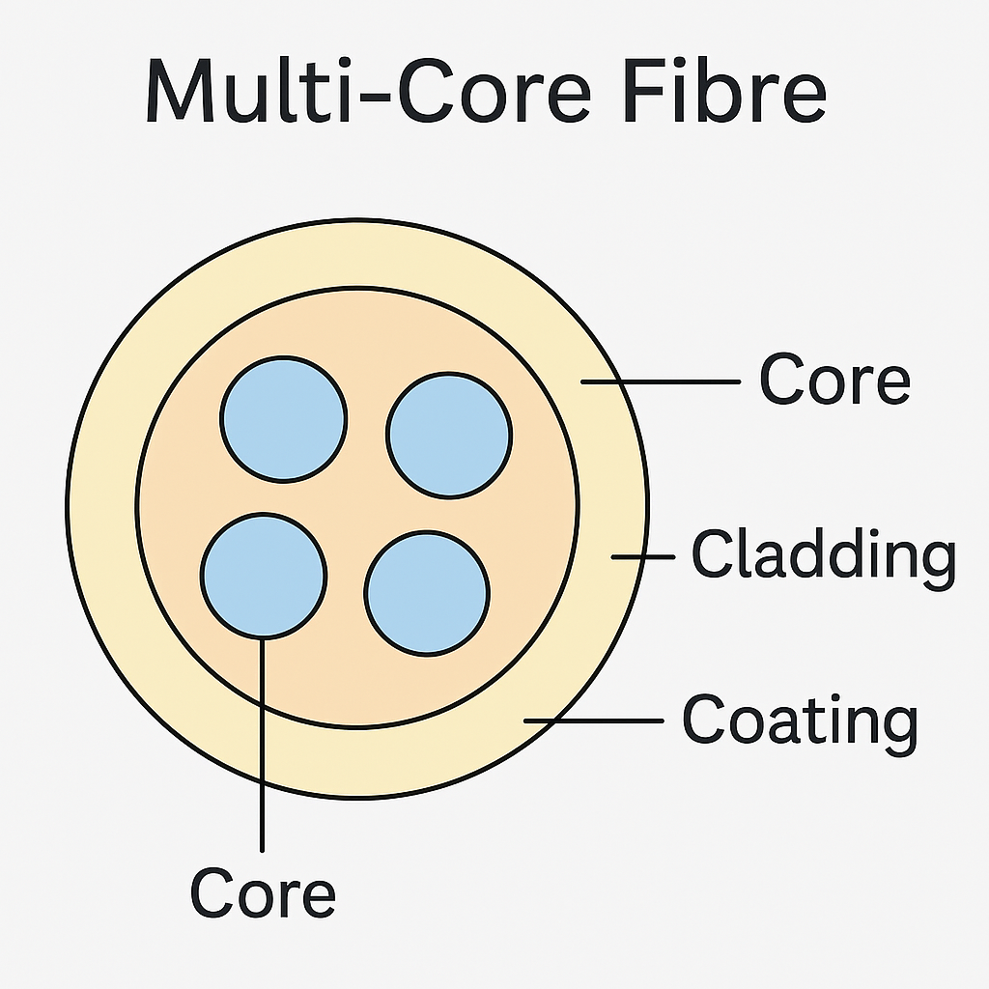
What about Multi-Core Fiber?
Why Multi‑Core Fiber is useful
Massive capacity increase
Instead of pulling separate fibres, one Multi-core fibre can deliver similar capacity.
Better space efficiency
Ideal where ducts, conduits, or subsea cables are space‑limited.
Lower cost per bit (long term)
Shared cladding and installation reduce physical infrastructure overhead.
Energy efficiency
Fewer fibres → smaller cables → reduced amplification and cooling needs.
Key technical challenges
Inter‑core crosstalk
Light leaking between cores must be minimised using core spacing and trench designs.
Fan‑in / Fan‑out devices
Special components are needed to connect MCF to standard single‑core equipment.
Ecosystem maturity
Transceivers, splicing, and monitoring tools are still evolving.
Still need ‘adaptor’ to connect to high speed 400G, 800G, Terabit transceivers

Slide 20

March 2026 | Hollow-core Fiber Connectivity Solutions | Steve Jones
steve.jones@hubersuhner.com
+44 7900 881729
Steve Jones | LinkedIn
Or look for Unicorn Farmer
Follow our #Brainsnack videos:
HUBER+SUHNER Cube Optics AG: Overview | LinkedIn

