Slide 1
Notes:
Good Afternoon everyone.
Welcome to NetUK 1, the inaugural event. Thanks to everyone for coming, I’m glad we’re all here and honestly I’m just as surprised as everyone that we managed to pull this off.
Anyway, for those that don’t know me I’m Dave Pumford, the NetUK Management Committee Chair.
I’ve got a few introductory slides to go through before I hand you over for the conference content, don’t worry I’ll be quick so you don’t have to listen to my accent for too long.

Slide 2

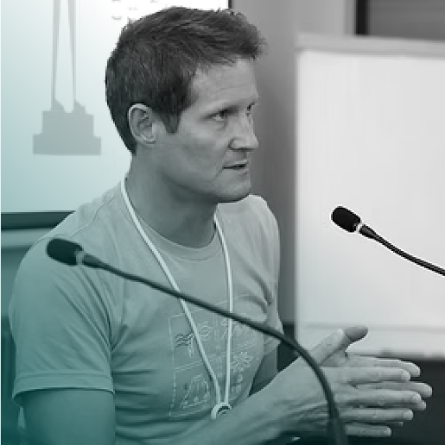
Management Committee Update
Community Update
Financial Breakdown
What’s next?
Q&A
Nick Wenban-Smith
Nominet

Slide 3
NetUK Community Update
NetUK has successfully grown year after year with attendance and funding.
All 3 committees (MC, OC and PC) are now established and running well together.
The MC guardianship model with the 3 non-profits and PTX seems to be working very well to ensure the event continues to grow and remain financially viable.
NetUK supported RIPE in Edinburgh this year with a £11,300 sponsorship to promote the new UK network infrastructure community.

Slide 4
 | #NetUK3* | #NetUK2 | #NetUK1
Event & Social | £121,935 | £123,862 | £75,169
Marketing | £22,445 | £3,995 | £4,272
Merchandise | £2,883 | £2,972 | £3,392
Total Expenditure | £147,263 | £116,096 | £82,833
Sponsorship | £151,750 | £149,379 | £112,059
Tickets | £11,011 | £9,905 | £4,379
Total Income | £162,761 | £159,238 | £116,439
Balance | £92,291 | £76,792 | £33,605
*TBC after the event.

Slide 5
NetUK, what’s next?
NetUK is now looking to support more regional meet-ups across the UK with funding to get them off the ground – we hope this will feed into content for the main NetUK event in July. If you’re interested, please contact the MC.
NetUK will be hiring a contractor for #NetUK4 to support the event’s marketing efforts. This is a massive effort that needs a strong, dedicated focus to support the OC and community development. More information to follow in the next few months.
NetUK has committed to The Brewery for the next 2 events; the feedback has been extremely positive, and we expect attendance numbers to continue to grow.
We believe we have found the right balance between commercial and technical for the event and will continue to push this ethos over the long term.

Slide 6

Management Committee
Ask us anything?

Slide 7
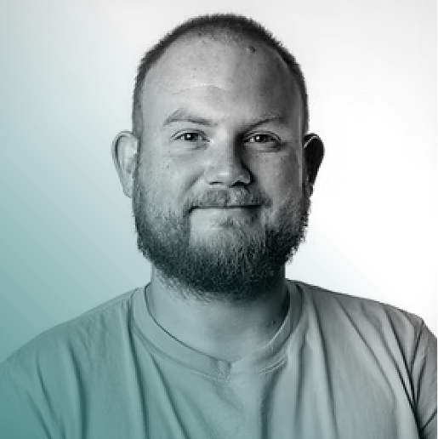
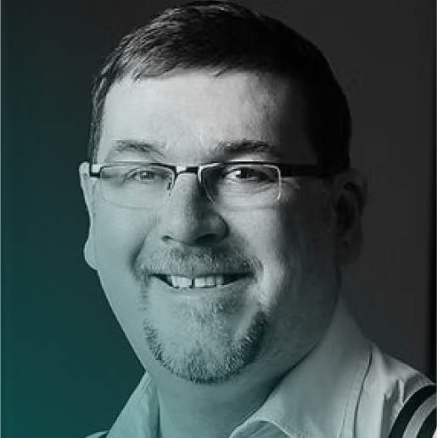
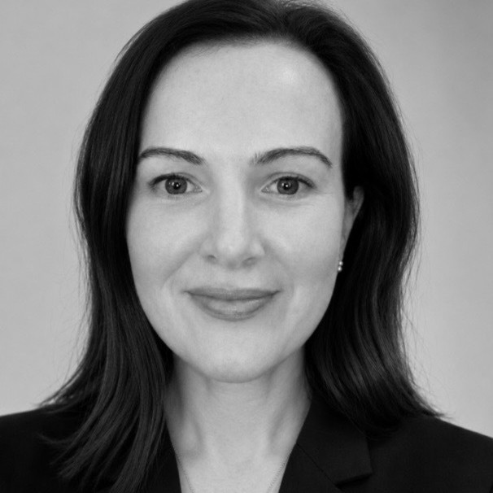
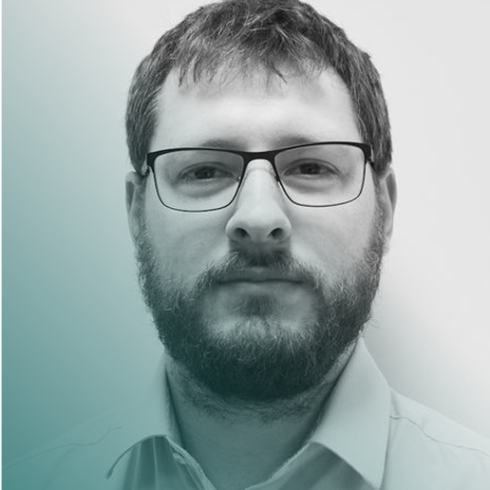
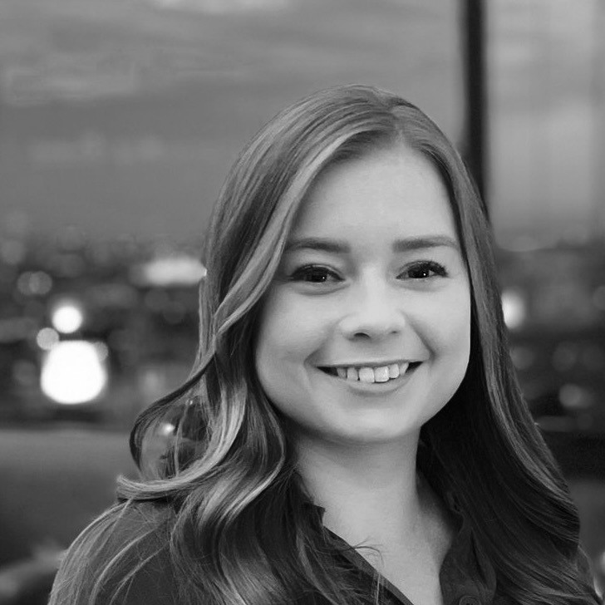
Management Committee
Dave Pumford
PTX Technologies
[ MC Chair ]
Richard Irving
LONAP
Megan Atkins
LINX
Nick Wenban-Smith
Nominet
Matt Jepp
SG.GS
[ PC Chair ]
Holly Ruff
LINX
[ OC Chair ]

Slide 8














Thank you
Enjoy NetUK3!

