Slide 1
Notes:
Good Afternoon everyone.
Welcome to NetUK 1, the inaugural event. Thanks to everyone for coming, I’m glad we’re all here and honestly I’m just as surprised as everyone that we managed to pull this off.
Anyway, for those that don’t know me I’m Dave Pumford, the NetUK Management Committee Chair.
I’ve got a few introductory slides to go through before I hand you over for the conference content, don’t worry I’ll be quick so you don’t have to listen to my accent for too long.

Slide 2

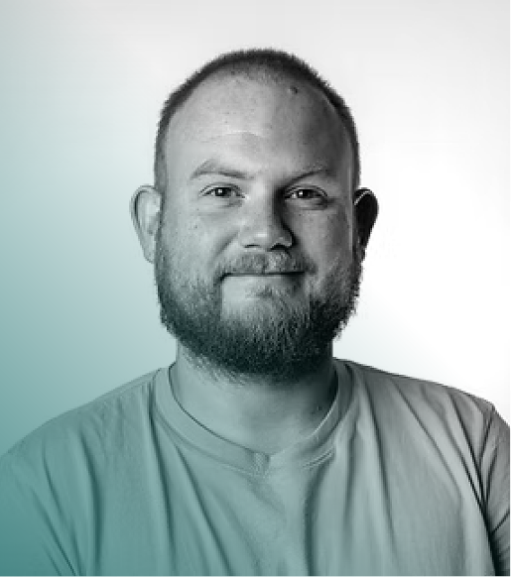
Welcome to #NetUK3!
On behalf of the Management, Programme and Organising Committees, I would like to welcome you all to #NetUK3.
Two packed days ahead, from data centre networks to data centres in space, with the courtyard social this evening.
Welcome back to The Brewery. If you need any assistance reach out to anyone wearing a NetUK polo.
Dave Pumford
Chair, Management Committee at NetUK

Slide 3
Housekeeping
[ WIFI ]
Brewery_WiFi
[ LOCATIONS ]
King George III
Breaks + Lunch
The Porter Tun
All presentations
Brewery Courtyard
Event Social
[ EMERGENCY EXITS ]
Follow the green exit signage
[ ACCESS ]
Any needs? Ask at Registration

Slide 4



#NetUK3 Conference Statistics
219
In-person Attendees
36
Virtual
Attendees
12
Student / Concession Attendees
267* Attendees
125+ Companies
Notes:
d next year for tickets / agenda now the heavy lifting is complete.

Slide 5














#NetUK3 Official Sponsors
[ HOSTS ]
[ GOLD ]
[ SILVER ]
[ SOCIAL ]
[ LUNCH ]
[ LANYARD ]
[ ASSOCIATE ]
[ ASSOCIATE ]

Slide 6
#NetUK3 Ticket Cost
Running a conference in Central London, in July, is still expensive. This year it cost even more than we planned for.
More financial detail in tomorrow’s NetUK Update (15:45).
Visit the sponsor tables in King George III during the breaks. The gap between £120 and £529 is covered by them.
£120
Ticket Price inc VAT
£446
Planned Cost PP
£529
Actual
Cost PP

Slide 7
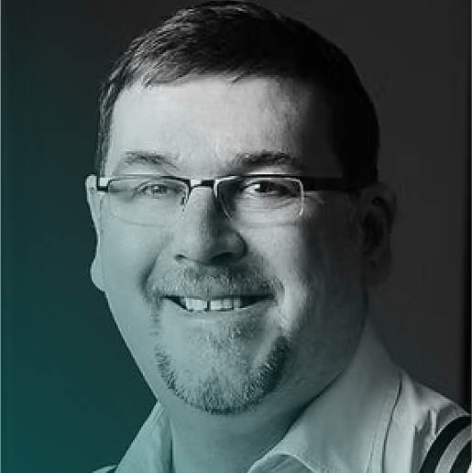
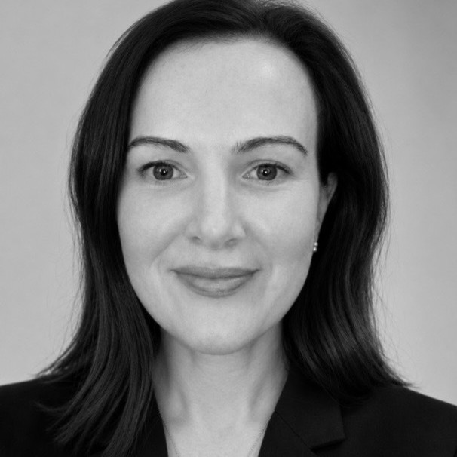
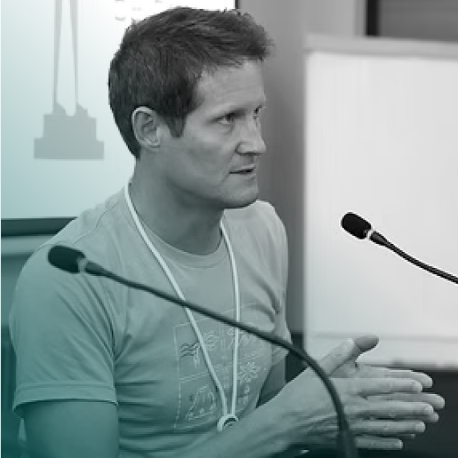
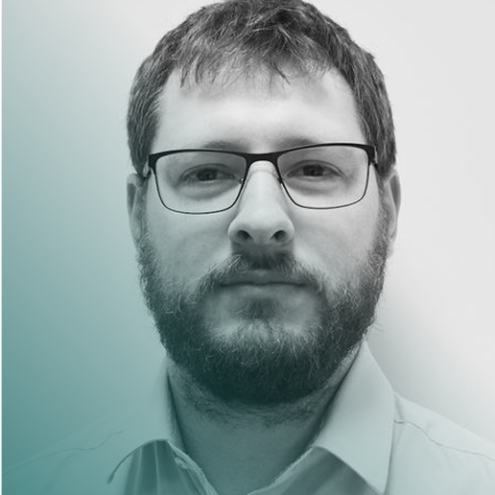
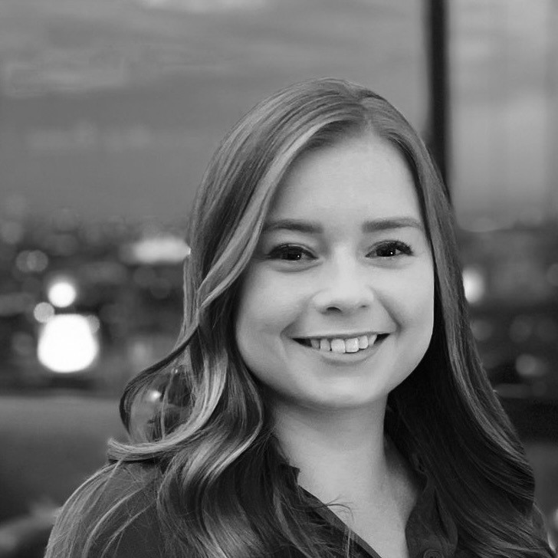
Management Committee
Dave Pumford
PTX Technologies
[ MC Chair ]
Richard Irving
LONAP
Megan Atkins
LINX
Nick Wenban-Smith
Nominet
Matt Jepp
SG.GS
[ PC Chair ]
Holly Ruff
LINX
[ OC Chair ]

Slide 8
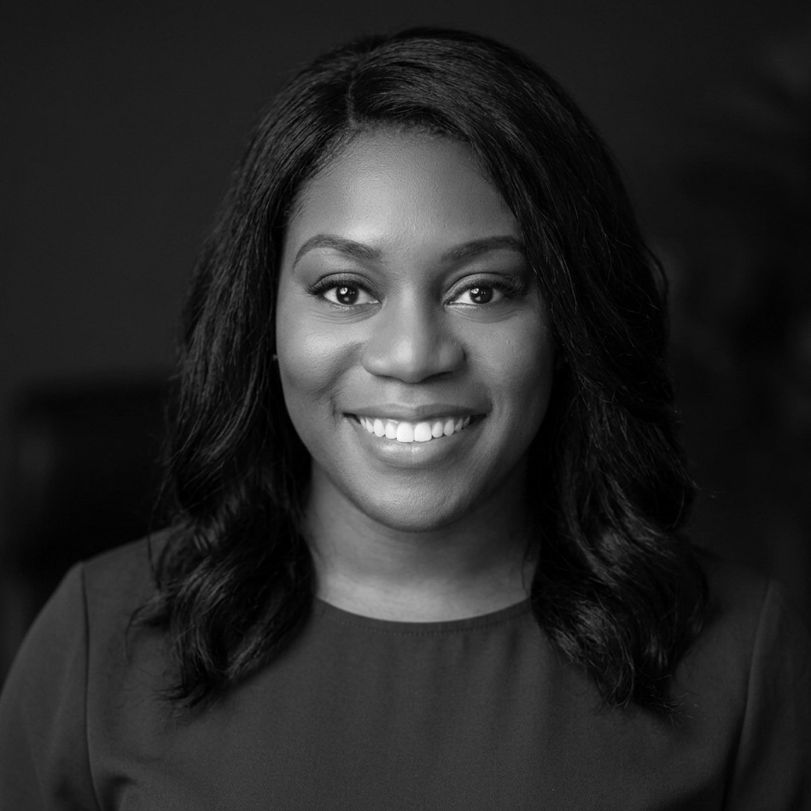
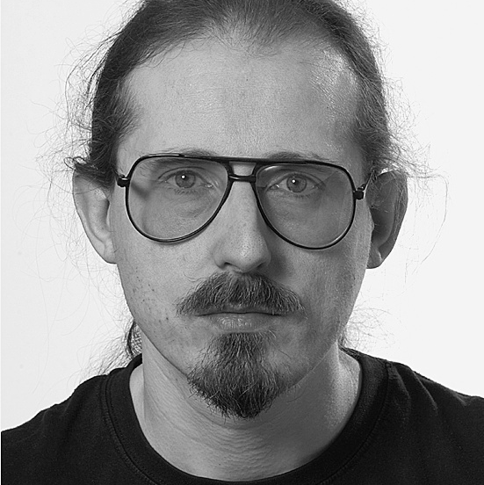
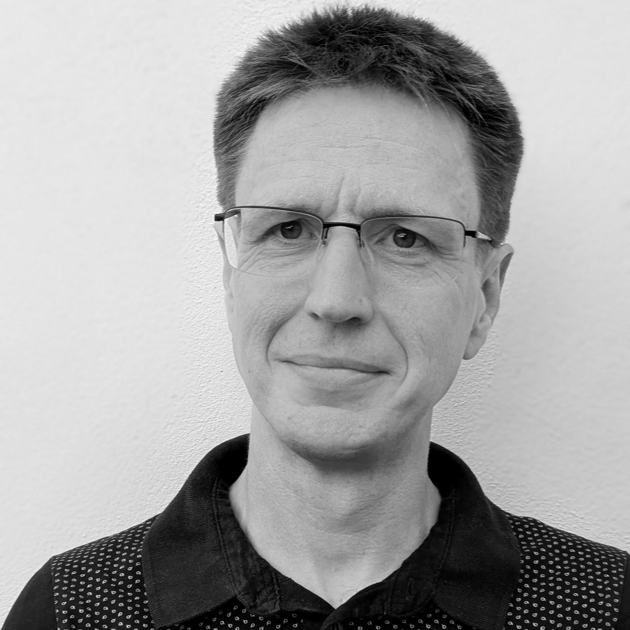
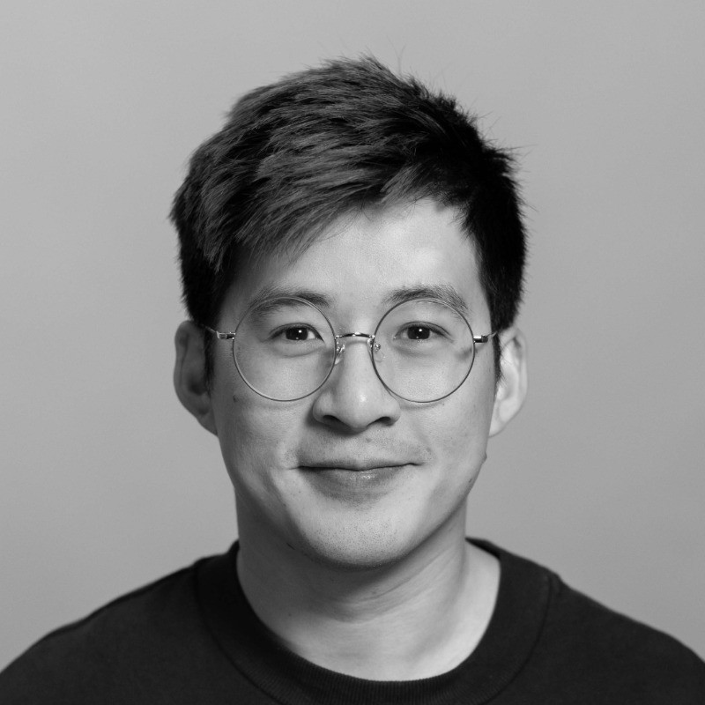
Organising Committee
[ PHOTO ]
Holly Ruff
[ OC Chair ]
Rebecca Class-Peter
Brandon Butterworth
Robert Lister
Kenson Tyler-Lai
Natalie Wood

Slide 9
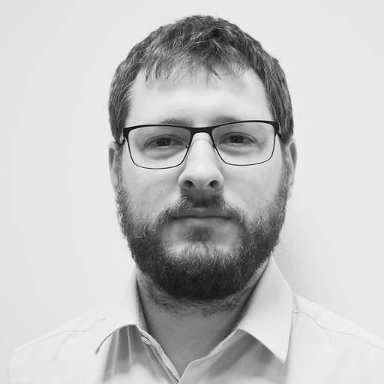
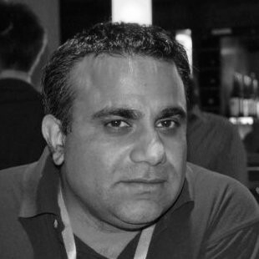
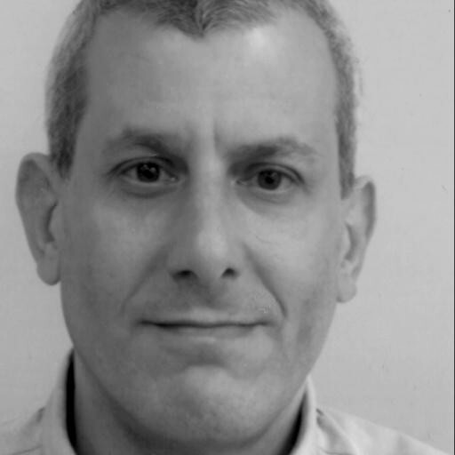
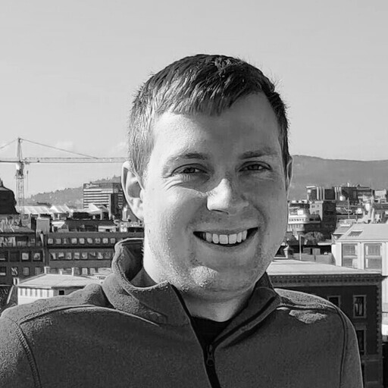
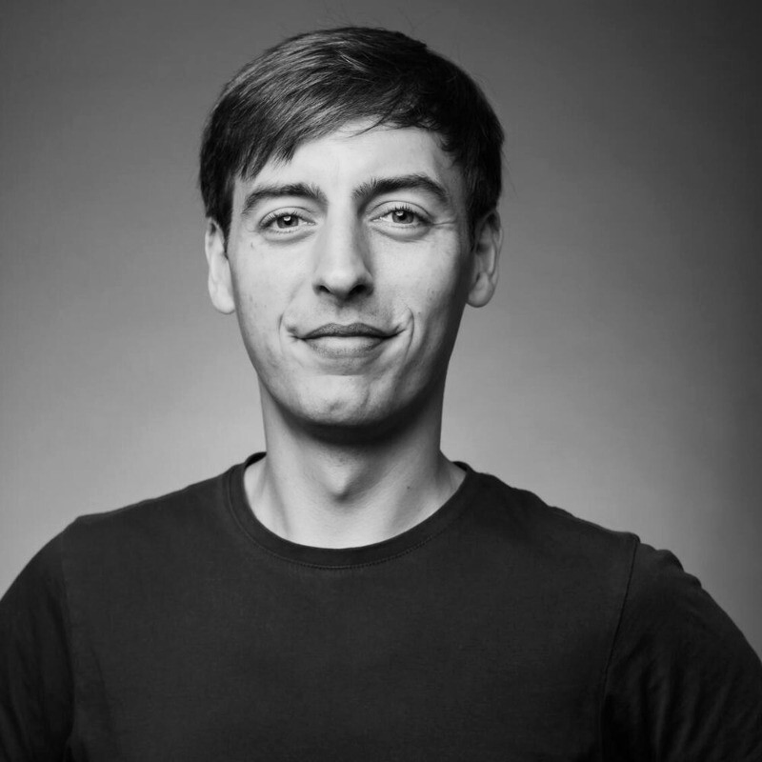
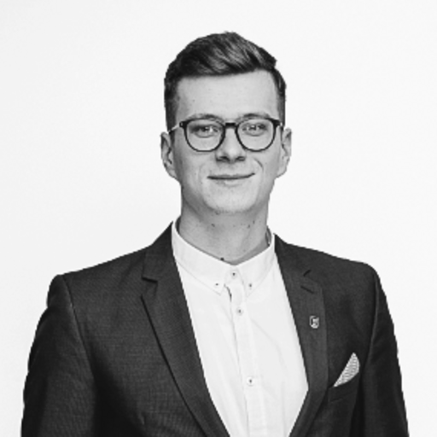
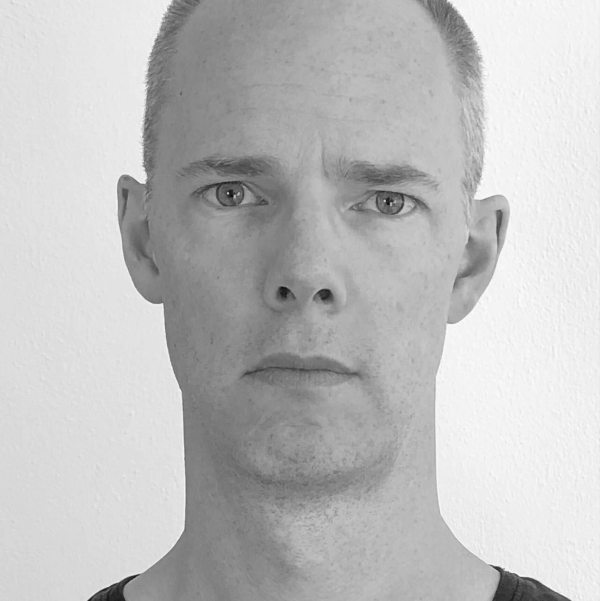
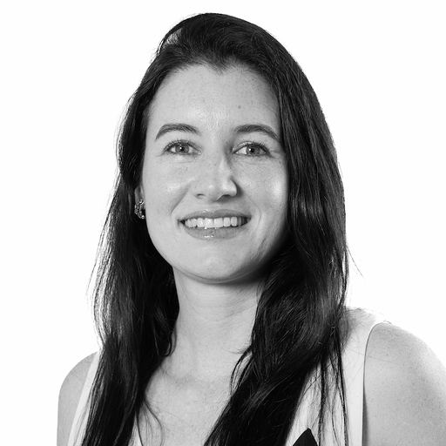
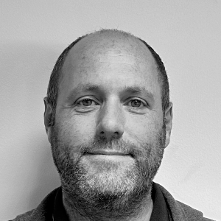
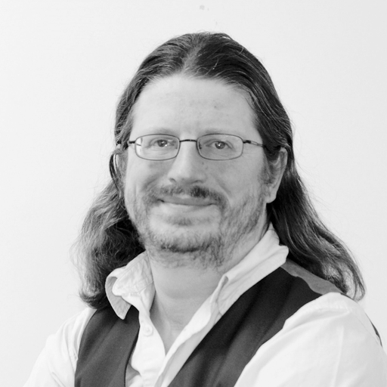
Programme Committee
Matt Jepp
[ PC Chair ]
Mo Shivji
Brandon Butterworth
Steve Karmeinsky
Rebecca Class-Peter
Josh Levett
James Bensley
[ COULD BE YOU? ]
Paulius Judickas
Paul Dunbar
Elisa Peirano
Nick Ryce
Dave Wilson
Speak to Us
to join the PC

Slide 10
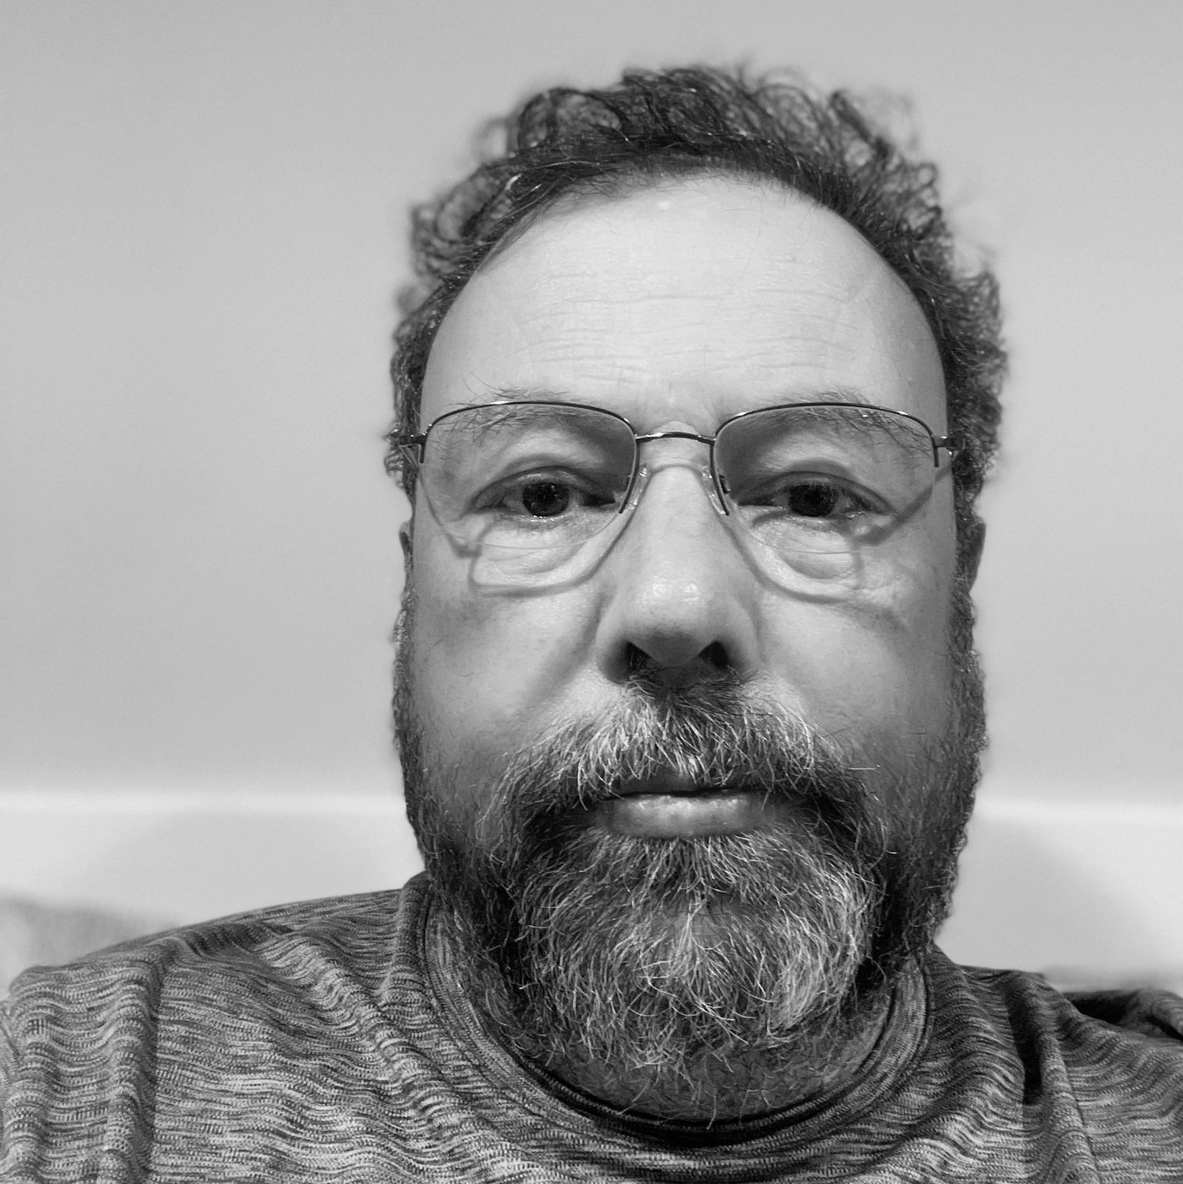
[ IN MEMORIAM ]
Fearghas McKay
A FRIEND OF NETUK FROM THE VERY BEGINNING

Slide 11

Our Mission
NetUK aims to foster a vibrant community of individuals and organisations that are passionate about the United Kingdom’s network infrastructure industry.

Slide 12



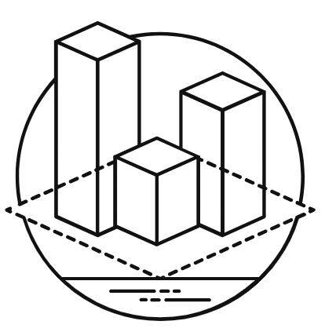
Our Objectives
We aim to promote:
Knowledge Sharing
Facilitate the exchange
of ideas and insights through conferences
and workshops.
Professional Exposure
Provide valuable opportunities
for both individuals and sponsors
to collaborate and advance
within the industry.
Community Development
Foster a collaborative spirit that thrives on a shared passion for technological achievements.
Inclusivity & Diversity
Promote participation from all corners of the community, regardless of background or experience.
Notes:
We believe we can build this community up by focusing on the following core objectives.
Knowledge Sharing - Facilitate the exchange of ideas, insights and experience through events and conferences,
ensuring members stay at the forefront of the evolving internet infrastructure landscape.
Community Development - Foster a collaborative spirit that thrives on a shared passion for regional achievements
within grassroots communities such as NetLdn, NetMcr and NetDiff, while supporting the establishment of new regional
communities.
Professional Exposure - Provide valuable opportunities for individuals and sponsors to build industry connections, find
collaborators, and advance their careers within the internet industry.
Inclusivity & Diversity - Promote participation from all corners of the community, regardless of background or
experience, believing everyone deserves a voice in shaping the future of the internet.
Collectively, the MC and PC both believe remaining focused on these objectives will help us achieve our overall mission.

Slide 13
Day One | This Afternoon
13:00 NetUK3 Welcome — Dave Pumford, NetUK
13:15 When UK Traffic Takes an Unplanned Detour — Ritesh Mukherjee, Nokia
13:45 Optimising Transceiver Efficiency — Gerhard Stein, Flexoptix
14:15 Distributed Fibre Optic Sensing — Jasmine Parkes, Comtek / Bangor University
14:30 Agentic AI Network Automation — Gary Taylor, Megaport • Sponsor
14:50 Hollow Core Fibre — Steve Jones, Huber+Suhner
15:20 Break, King George III (30 min)
15:50 Data Centers in Space — Geoff Bennett, Nokia
16:20 Telecoms Inventory for GPON — Craig Gallen, Entimoss / Solent Uni & Corey Maltby, Solent Uni
16:35 Edge Network Evolution — Ben Ryall, Meta
17:05 Which in My Switch? LPO, CPO & XPO — Robert Friskney, Arista
17:35 Social, Brewery Courtyard — Sponsored by PTX Technologies

Slide 14
Day Two | Tuesday 7 July
09:00 Doors Open & Registration
10:00 LON2 Network Refresh — Jan Kayser, LINX
10:15 Everything is fine and our automation works perfectly — Stefan Funke, inter.link
10:30 SCION: Secure Path-Aware Routing — Kevin Meynell, SCION Association
11:00 PeeringDB Product Committee — Leo Vegoda, PeeringDB
11:15 Break, King George III (30 min)
11:45 Rethinking Network Monitoring — David Flores
12:15 Autonomous System Provider Authorisation — Ralph Smit, RIPE NCC
12:45 The Network Automation Forum Framework — Pete Crocker, OpsMill
13:15 Lunch, provided by Smartoptics (60 min)
14:15 The Great Escape from On-Prem — Nico Cartron & Ed Daniel, Infoblox • Sponsor
14:35 Building a National NOG Community — Keith Mitchell
15:05 Operators’ Checklist: DNSSEC KSK Rollover — David Groves, Nominet
15:45 NetUK Update
16:00 Evaluating BGP Roles (RFC 9234) with AI — Julian Lucek, HPE

Slide 15
[ SOCIAL EVENT ]
Brewery Courtyard, tonight from 17:35. Stay for a drink, catch up with colleagues and meet someone new.
SPONSORED BY PTX TECHNOLOGIES

Slide 16
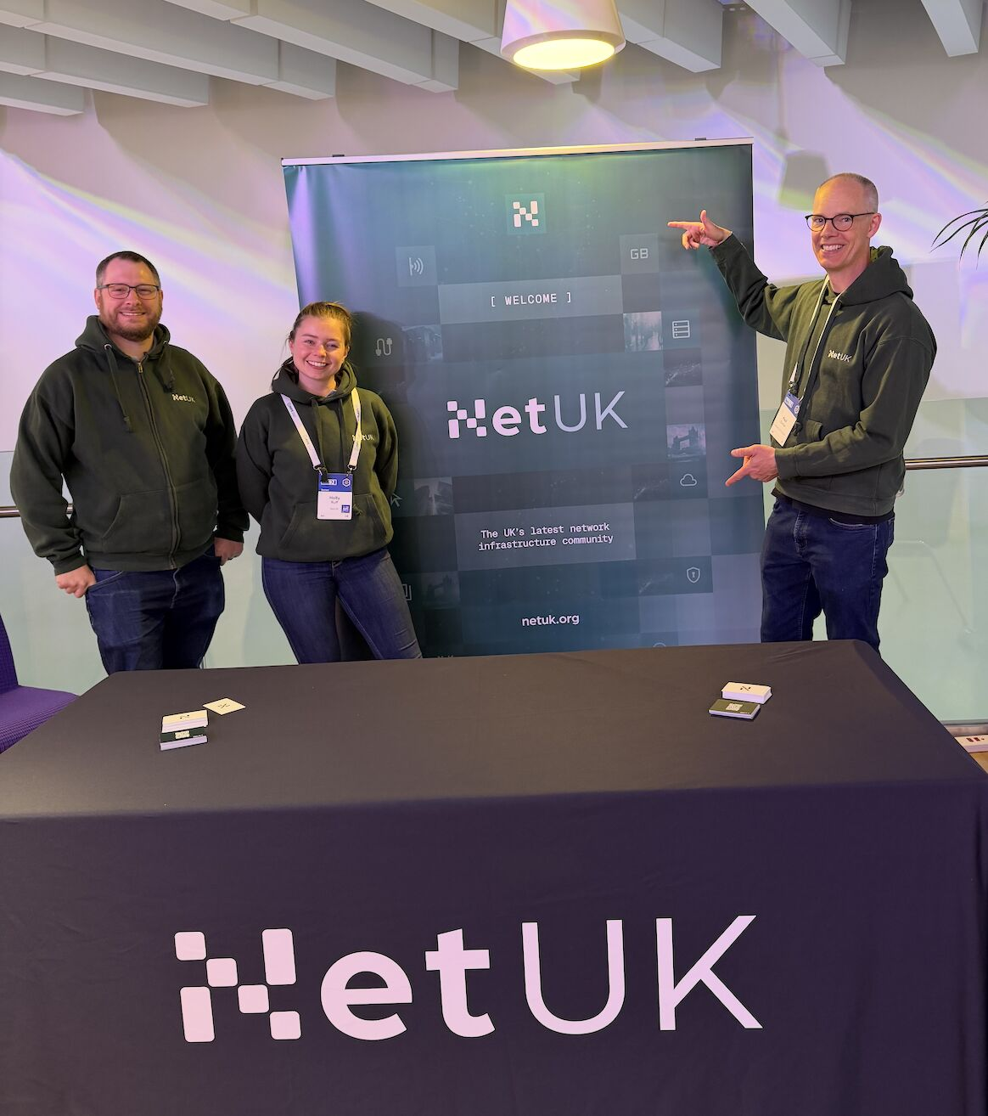
#NetUK3 Event Hoodie
[ HOODIE PHOTO ]
[ FREE MERCH ]
Please ensure you collect
your free #NetUK3 Hoodie!
+ It’s 30° outside — you’ll be needing it.

Slide 17
Hybrid Event & Questions
NetUK 3 webcast is live on YouTube.
Please join our Slack and the channel #NetUK3 to engage with all conference attendees.
If you have any questions for our speakers at the end of their talk:
  In Person: Please line up to the microphone stand, identify yourself and ask your question when the session chair confirms.
  Virtual: Please ask in the Slack channel #NetUK3 with #question added to the end, it will then be asked by one of our session chairs.

Slide 18



Social Links
members-subscribe@lists.netuk.org
members-unsubscribe@lists.netuk.org
LINKEDIN
NetUK
YOUTUBE
NetUKorg
SLACK
netukorg

Slide 19
Respect + Code of Conduct
Everyone agreed to NetUK/LONAP’s Code of Conduct when purchasing a ticket.
Our Code of Conduct can be found here: [ www.lonap.net/code-of-conduct ]
Please follow this during the event both in person and virtually.
If you wish to raise an issue please find a MC or PC member.

Slide 20
Thank you
Enjoy NetUK3!

