Slide 1


Slide 2


Slide 3

An introduction to data centre networks
Foeh Mannay & Utkarsh Shah
(On behalf of Xantaro Group)

Slide 4
Hello World!
00

Slide 5

FM
Foeh Mannay
Solutions Architect
Experience
Focus
  5 years+ with Xantaro
  Solutions Architect (Pre-Sales)
  24 years+ with
  Service Providers
  Vendors
  Contracting
  Service Provider – IP/MPLS
  Data Centre – EVPN/VxLAN
  Fixed Networks – Passive Optical Networks (PON)

Slide 6

US
Utkarsh shah
Solutions Architect
Experience
Focus
  9 years+ with Xantaro
  Solutions Architect (Pre-Sales)
  Consultant (Professional Services)
  Systems Engineer (Professional Services)
  14 years+ with
  System Integrators
  Service Provider – IP/MPLS
  Data Centre – EVPN/VxLAN

Slide 7
FM
01
Introduction
Agenda
02
Legacy Data Centre Networks
03
Data Centre & Campus Fabric Architectures
04
Data Centre & Campus Fabric Interconnect Options
05
Real World Use Cases
06
Conclusion

Slide 8
FM
01
Thank you to NetUK Program Committee for the opportunity, to all attendees for your time and participation & Nick Wiecha for his technical review of this presentation ☺
General Disclaimers
02
This session provides a high-level, vendor-neutral introduction to data centre and campus fabric architectures based on IP Clos fabrics
03
Vendor-specific features, implementation details, AI fabrics, and deep technical dives are outside the scope of this session
04
The focus is on data centre networking and IP fabric architectures
05
Common industry approaches are covered for simplicity; alternative designs and technologies exist but are not discussed
06
As an introductory session, some concepts have been intentionally simplified. For detailed technical information, please refer to relevant RFCs and vendor documentation

Slide 9
Introduction
01

Slide 10
What is a Datacentre?
FM
~300+
DATA CENTRES - LONDON
50000 m²/ 90MW
VIRTUS SLOUGH
LARGEST DC - UK
~11800+
Network
> 500 MW
DATA CENTRES IN THE WORLD
~ 97
DEDICATED AI COMPUTE
META AI – COLUMBUS SITE
TRILLION GB OF DATA IN DC – WORLDWIDE (EST. 2025)
GOOGLE OMAHA & COLUMBUS CLUSTER
Storage
Compute
~994K m²
LARGEST DC – WORLD
CHINA TELECOM – INNER MONGOLIA INFORMATION PARK
Figure: Interesting Facts – Data Centres
Support Systems
Figure: Data Centre Components
Notes:
Purpose Built facility
Compute – Servers, memory, GPU
Storage – SAN, NAS
Network – Routers, switches, firewalls
Support systems – cooling, power (inc. generators), security
Physical facility that stores & manages and organisations critical IT systems & data
Main components:
Compute –
Servers
Memory
GPU
Storage
SAN
NAS
Network
Routers
Switches,
Firewalls and other support systems
Support systems
Cooling
Power (incl. backup generators)
Security (physical and network)
Cool Facts about Data Centres:
The world has ~ 11,800 data centres
London has over 300+ Data Centres – largest concentration of DC’s in any given city across the globe
VIRTUS Slough – Largest UK DC by footprint and power (50000 m2 / 90 MW)
Largest DC in the world (floor space) is by China Telecom - Inner Mongolia Information Park ~ 994K m2
~ 97 trillion gigabytes of data stored collectively across data centres globally (Est. 2025)
Meta AI (Columbus Site), Google Omaha Cluster and Colombus cluster offer over 500 MW of dedicated AI compute

Slide 11
data centre Tiers
FM
Tier 1
Tier 2
Tier 3
Tier 4
Single Path
Multiple Paths
Completely Fault Tolerant
Power and Cooling
Redundant Components
Few / None
Every Component
Expected Uptime / Downtime per Year
99.671%
28.8h
99. 741%
22.7h
99.982%
1.6h
99.995%
0.4h
Figure: Data Centre Tiers
Source:
https://www.hpe.com/uk/en/what-is/data-center-tiers.html
https://www.cisco.com/c/en_uk/solutions/data-center-virtualization/what-is-a-data-center.html
Notes:
https://www.hpe.com/uk/en/what-is/data-center-tiers.html
https://www.cisco.com/c/en_uk/solutions/data-center-virtualization/what-is-a-data-center.html
Tier 1
Single path for power and cooling
Few (if any) redundant components
Expected uptime of 99.671% (28.8 hours of downtime annually)
Tier 2
Single path for power and cooling
Some redundant components
Expected uptime of 99.741% (22 hours of downtime annually)
Tier 3
Multiple paths for power and cooling
Additional redundant components
Expected uptime of 99.982% (1.6 hours of downtime annually)
Tier 4
Completely fault tolerant
Every component has redundancy
Expected uptime of 99.995% (26.3 hours of downtime annually)

Slide 12
Physical data centre types
FM
Type | Exclusivity | Facilities Management | Systems Management
Enterprise​ | Dedicated | In-house | In-house
Colocation | Shared | Outsourced | In-house
Manage Services | Shared | Outsourced | Outsourced
Notes:
Colocation Data Centres
Shared facility, privately managed infrastrucutre
Power, cooling and HVAC provided by a third party
Scalable model supporting diverse customer needs
Reduces costs versus building a dedicated data centre
Enterprise Data Centres
Owned & operated by a single organization
Supports predictable workloads & limited scalability needs
Used for internal data & IT operations
Best for organizations with resources to manage their own facility
Managed Service Provider Data Centres
Operated & maintained by a MSP
Typically dedicated to a single organization
Designed for predictable workloads with limited scalability
Ideal for organizations in-house data centre expertise
Public Cloud Data Centres
Delivers on-demand cloud services (SaaS, PaaS, IaaS)
Fully managed by the cloud provider
Highly scalable & flexible
Pay as you go model with reduced infrastructure costs
https://www.splunk.com/en_us/blog/learn/data-centers.html

Slide 13
Cloud datacentre types
FM
Type | Purpose
Public Cloud​ | Pay-as-you-Grow Hosting of IaaS, PaaS, SaaS
Hyperscaler | Very High Scale SaaS
Edge | Low Latency, Real-time & IoT
Notes:
All of these are highly scalable, automated and managed by the provider.

Slide 14

Common use cases for datacentres
FM
01
Productivity Applications
02
Storage Applications & Databases
03
Disaster Recovery & Backup
04
Computing, streaming, content delivery & hosting
05
Artificial intelligence (AI) &/OR Machine Learning (ML), Big Data

Slide 15
Evolution of Datacentres
FM
  04
  AI/ML
  Ultra high bandwidth
  Latency sensitive
  Congestion management
  Scalable
  Energy efficient
  03
  TRANSITION TO CLOUD INFRASTRUCTURES
  Cloud Native Architectures
  Microservices
  Public or Private
  02
  VIRTUALISATION
  Shared resources
  Optimal resource utilisation
  Workload mobility
  01
  MAINFRAME SYSTEMS TO X86-BASED SERVERS
  On Premises
  Managed locally
Notes:
1 – Typically on-premises, managed locally
2 –
3 – Public and private, hybrid architectures

Slide 16
FM
Common types of traffic flow
  North South
        Traffic between internal & external networks
        Typically, resources outside the local network/data centre
        Endpoints <> External Endpoints
  East West
        Traffic between servers within a data centre
        Typically, local DC
        Endpoints <> Endpoints
  Inter-DC
        Traffic between two or more DC’s or to the public cloud
        Endpoints <> Endpoints (across DC’s)
        Endpoints <> External Endpoints (via DCI)

Slide 17
Legacy Datacentres
FM
02

Slide 18
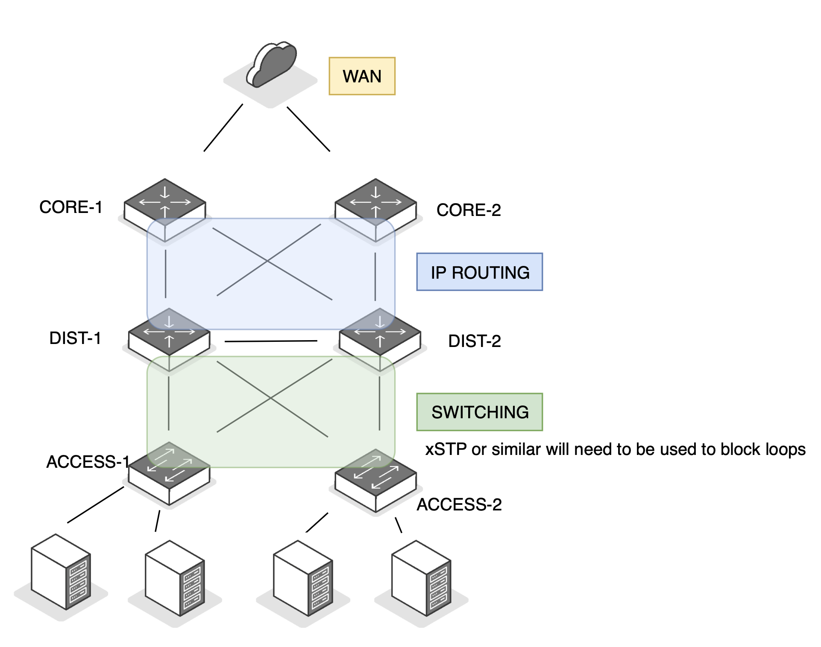

Legacy DATACENTRES - Architecture
FM
N
Multiple hops
Careful forecast planning
High CAPEX & OPEX costs
Blocked / unused ports
Uneven link utilisation
Slow convergence
S
Figure: Legacy Data Centres
DANGER!
SPANNING TREE
Contagion
Notes:
Core, Distribution & Access - Multiple hops
Multiple hops – Core, distribution/aggregation & access
xSTP for loop prevention and blocked ports/architecture
Careful forecast planning
High CAPEX & OPEX costs
Non-optimal link utilization and traffic forwarding
Predominantly North-South traffic

Slide 19
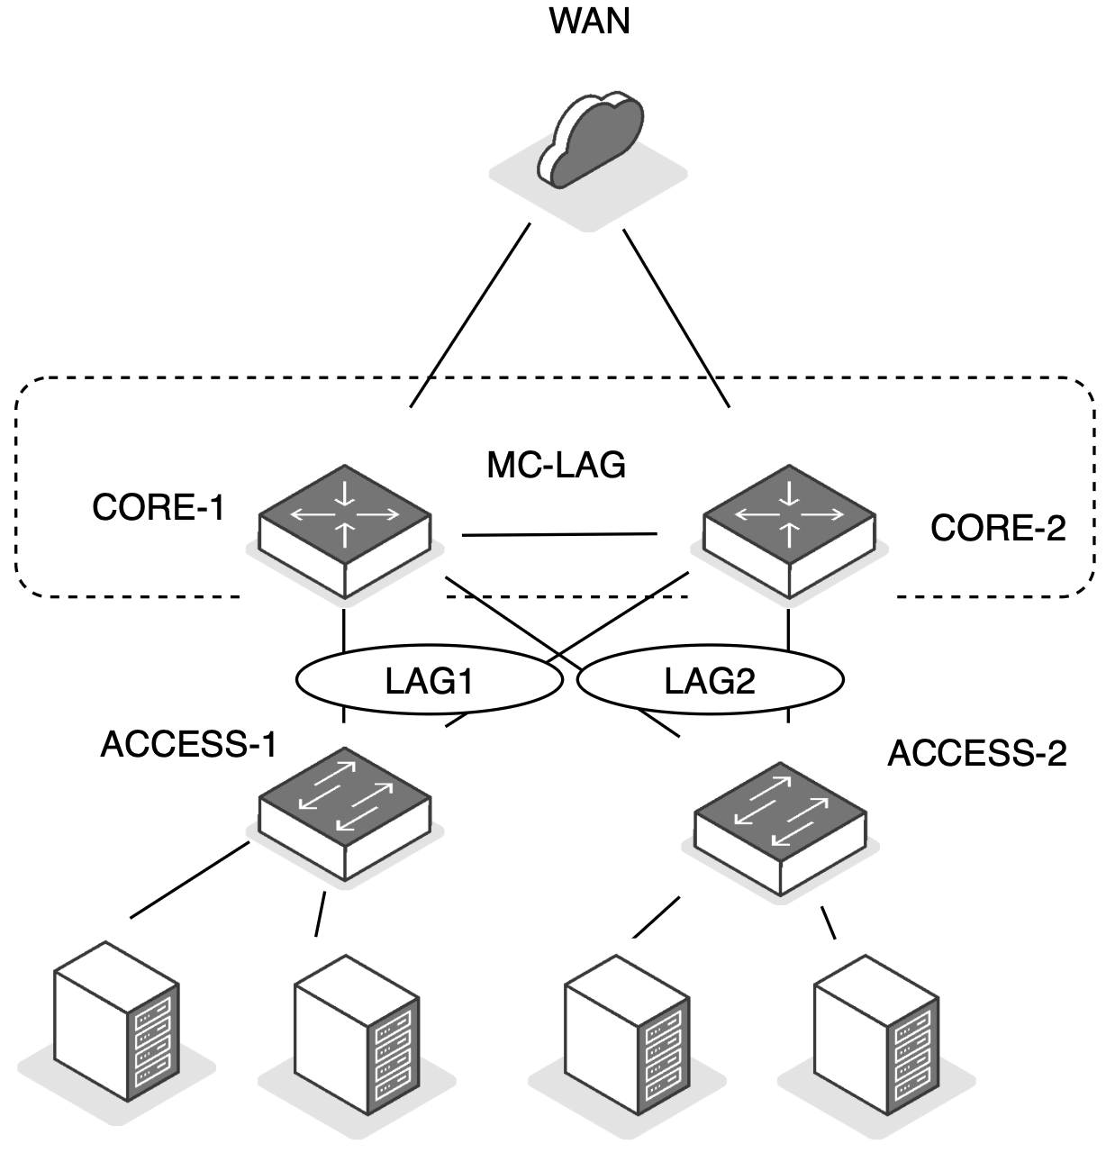
Legacy DATACENTRES - Architecture
FM
    Vendor Lock-in
    Sync issues, orphaned ports, etc.
    Two device limit
!
CAUTION!
MC-LAG
LAG10
Figure: Legacy Data Centres – MC-LAG
Notes:
Core/Distribution Layer bottlenecks
-
Inter
-
VLAN routing
-
MAC, ARP table scale
-
HSRP, STP state
-
Services attachment (FW, SLB)
-
“2
-
way” ONLY
-
Large fault domains

Slide 20
Legacy Data centre Networks - SUMMARY
FM
  Multiple touch points for service orchestration
High CAPEX & OPEX
Bottlenecks at distribution layer:
MAC & ARP Table Scale issues
Centralised services attachment (Load Balancer, Firewalls etc.)
Larger fault domains
Inter-VLAN
~80%
Higher levels of oversubscription
  North – South Traffic
Typically blocking architectures
Dedicated L2 access layers and stretching VLAN

Slide 21
MODERN Datacentre and Campus Fabric Architecture
03

Slide 22
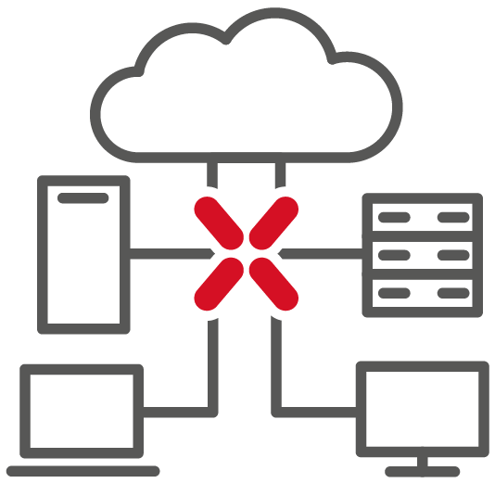


Requirements that led to a change in architecture
FM
  Changes in Traffic Patterns
Distributed microservices
Any-to-any flows
    ~80% East/west traffic
  Scale, Speed, Network Insights
Automation & orchestration
    Deeper insights
    Real-time visibility
  Resiliency & Latency Changes
Predictable latency
Non-blocking architectures
Fast convergence
  Cost optimization
Effective link utilisation
CAPEX & OPEX reduction
Modularity
new technology Adoption
Notes:
Mobility & scale requirements lead to network automation

Slide 23
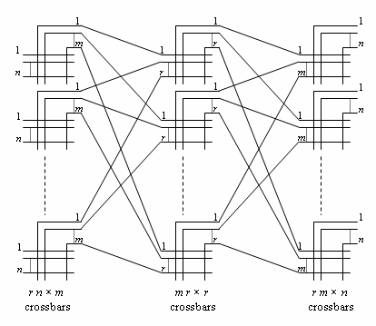
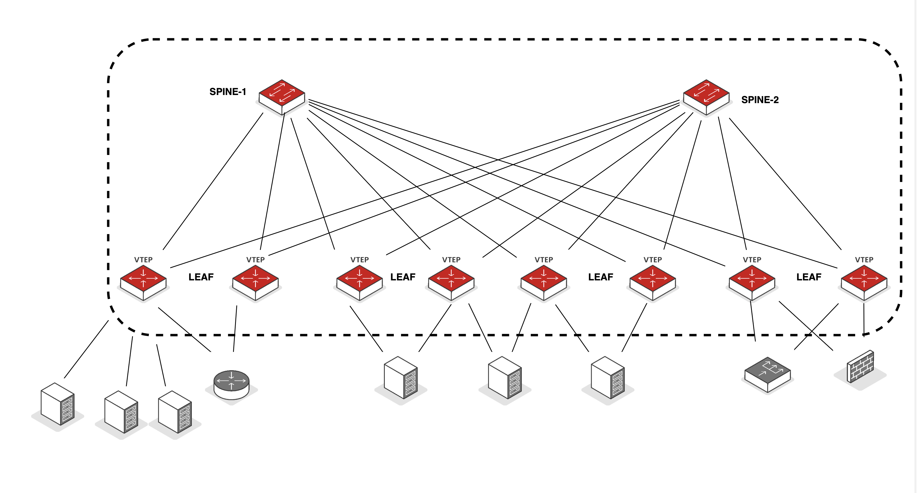
Foundational requirements
FM
  STABLE
  &
  SCALABLE
  VENDOR AGNOSTIC
  (HARDWARE & PROTOCOL SUPPORT)
  PERFORMANCE
  (THROUGHPUT & LATENCY)
  EASE OF MANAGEMENT
  PROVEN EXPERIENCE - HYPERSCALE DEPLOYMENTS
  NETWORK INSIGHTS & FASTER DEPLOYMENT
Borrowed concepts from Clos Architecture:
  Edson Erwin
  Charles Clos
Source: Wikipedia contributors, "Clos network topology" [Online image], Wikimedia Commons. Available: https://commons.wikimedia.org/wiki/File:Clos\_network\_topology.svg
[Accessed: Jun. 10, 2026]. License: CC BY-SA 4.0.
Figure: Crossbars
Figure: Folded Fabrics
Notes:
https://cloudswit.ch/blogs/deep-dive-into-clos-architecture-leaf-spine/

Slide 24
Architecture improvements & Advantages - overview
FM
Introduced layer 3 – routed links between spine and leaf nodes
Predictable hops/latency
Easier to scale out – changes are more confined to a single layer
Improved link utilisation due to Equal Cost Multipath (ECMP)
Multi-tenancy ~ 16 Million Tenants
Control plane learning via EVPN
Figure: IP Clos Fabrics
Notes:
Routing brings stability

Slide 25
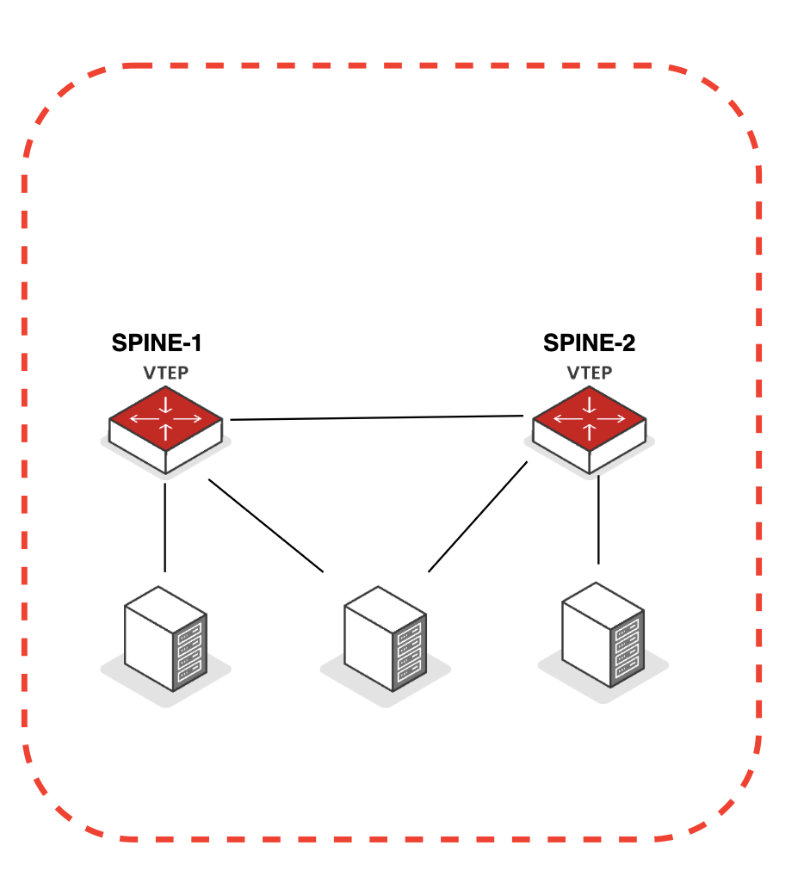
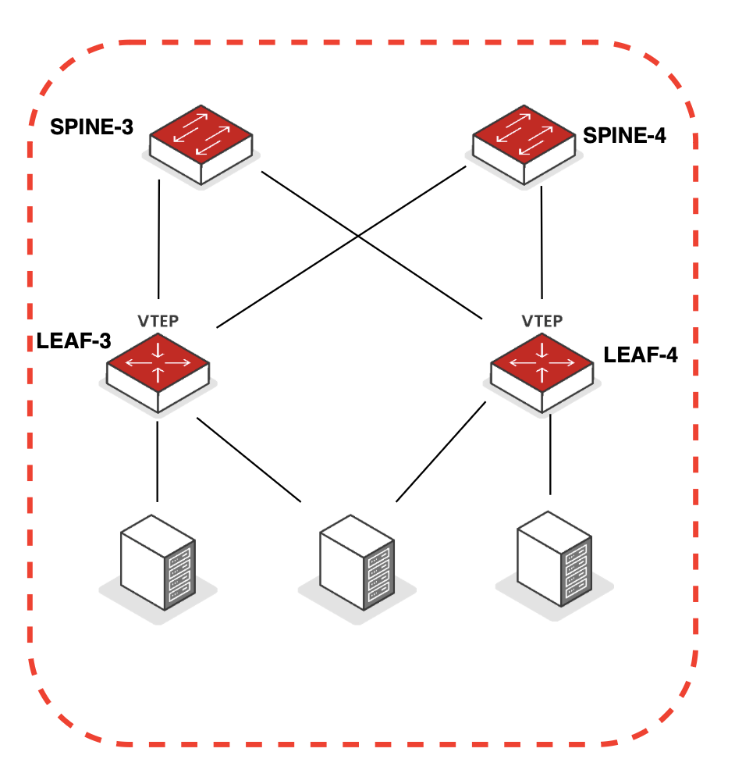
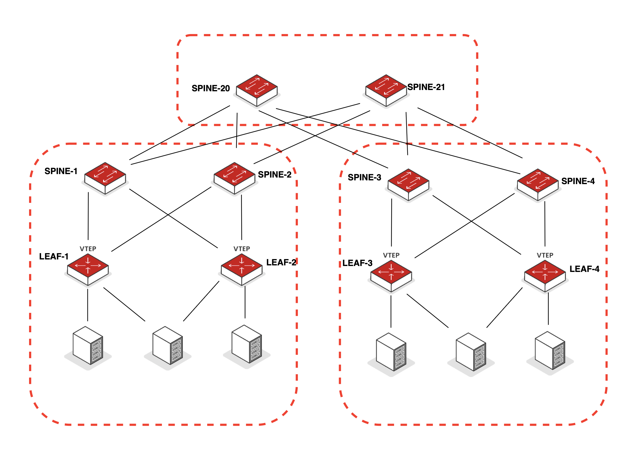
Common architectures - Overview
US
Collapsed Spines
3-Stage Clos Fabric
5-Stage Clos Fabric

Slide 26
UNDERLAY Architecture

Slide 27

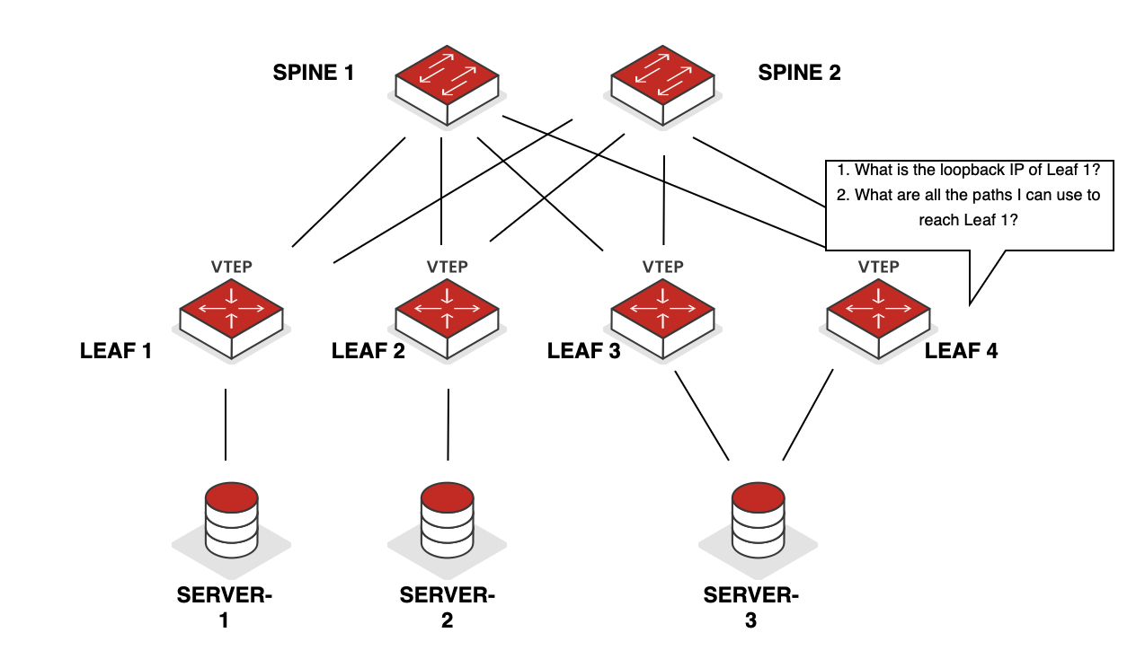
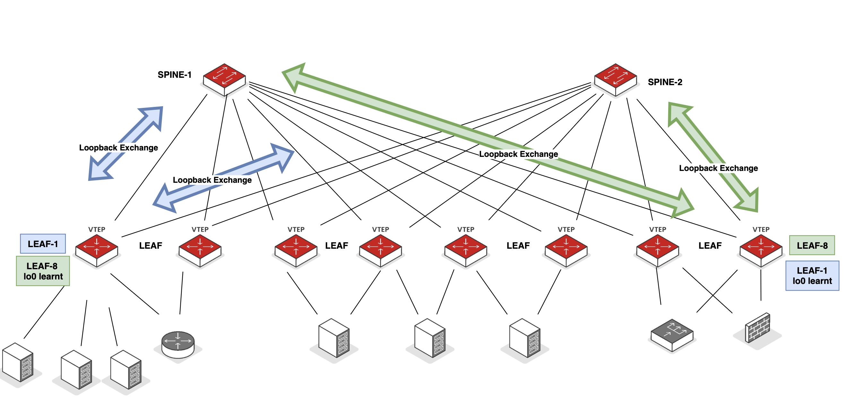
Underlay architecture
US
Underlay goals:
    Switch to Switch Reachability
    Provide Load Balancing across Links
    Forward Traffic between Leafs
Most Common Routing Options:
    OSPF
    IS-IS
    iBGP
    eBGP (RFC 7938 )*
    * Considered for this presentation
Figures: Underlay Overview
Notes:
POST OFFICE METAPHOR

Slide 28
Underlay architecture
US
Points to consider:
Review validated designs from your vendor
Keep it simple - vast community online and check with your friendly SE!
BGP – RFC 7938 “Use of BGP for Routing in Large Scale Data Centres” became more-or-less the most common approach
Multiple options:
    iBGP in underlay + eBGP in overlay – Earlier implementations
    eBGP in underlay + eBGP in overlay – Most common in implementations today
Hang on - What if I want to use OSPF or IS-IS? Some good points shared below:
https://blog.ipspace.net/2018/05/is-ospf-or-is-is-good-enough-for-my/
https://blog.ipspace.net/2018/06/is-ebgp-really-better-than-ospf-in-leaf/

Slide 29
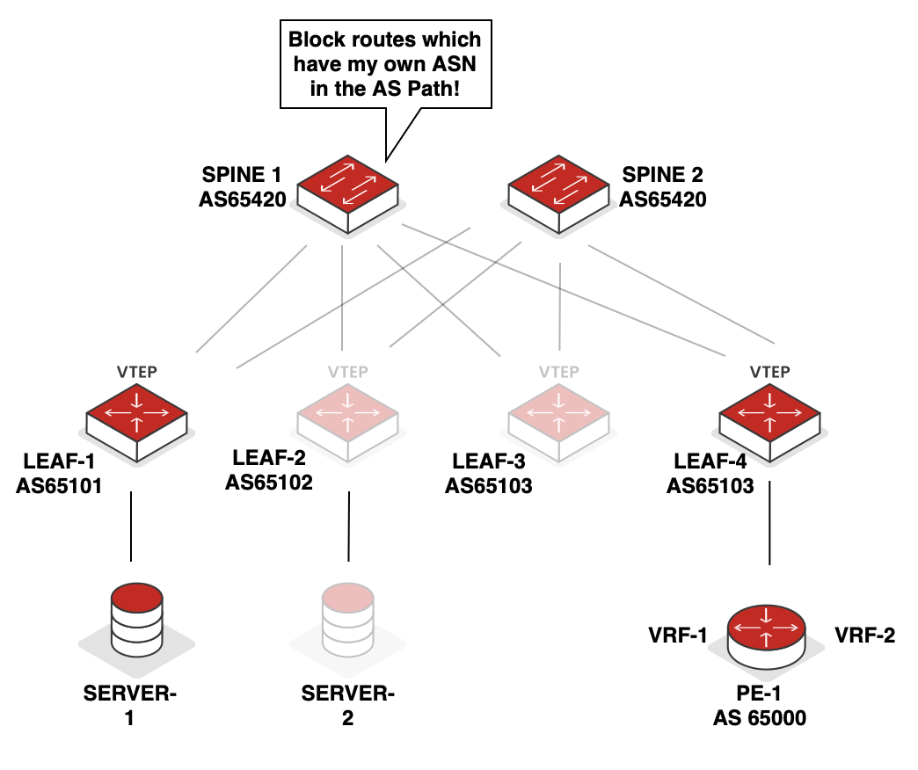



Underlay architecture
US
3 Stage Clos Reference Scenario:
eBGP & load balancing
Private ASN’s – can be 16 bit or 32 bit
BGP Path Hunting
    Same ASN on Spines – Resolved by default
    Different ASN on Spines – Use Policies
Leafs can have different (or same) ASN’s
  IPv6
    Auto-Discovered BGP Neighbours/ BGP unnumbered
2
PREFIX-A
AS 65420 65101
PREFIX-A
AS65101
1
6
PREFIX-A
AS 65104 65000 65103 65420 65101
PREFIX-A
AS 65104 65420 65101
5
PREFIX-A
AS 65000 65104 65420 65101
3
4
Figure: Spines with the same AS
Notes:
Understand NOS’s default BGP route advertisement process
For IPv6 fans – Consider Auto-Discovered BGP Neighbours/ BGP unnumbered
IPv6 RA on P2P links
IPv6 Neighbour Discovery
BGP Extended Next-Hop

Slide 30
overlay ARchitecture

Slide 31
Overlay Architecture - Introduction
US
New requirements:
    Mobility
    Virtualization
    Multi-tenancy
The need to support layer 2 applications over a layer 3 infrastructure still exists!
    Newer applications can also run completely over layer 3
VPLS had limitations in the DC world:
    Relied on MPLS
    Flood and learn mechanism
    Typically used only for layer 2 requirements
    Multi-homing was also challenging
  VxLAN was born!! (Amongst other technologies)

Slide 32
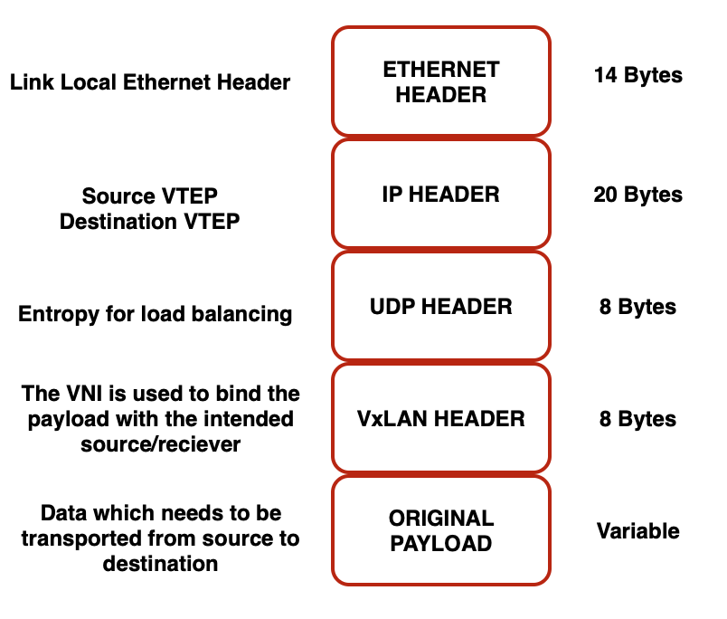
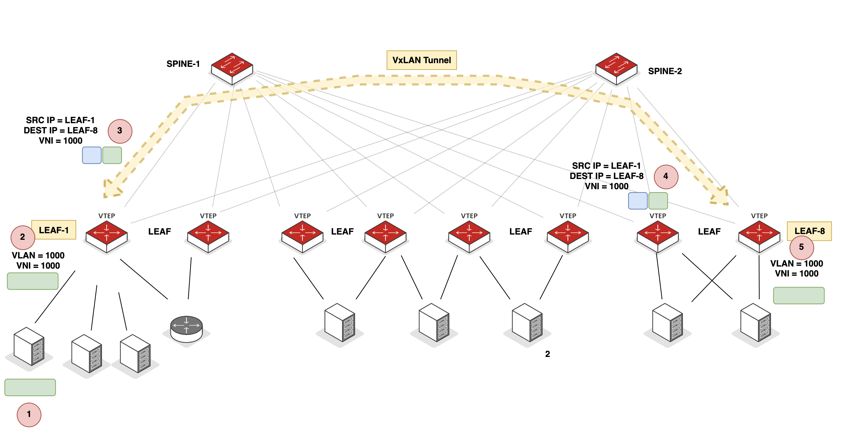
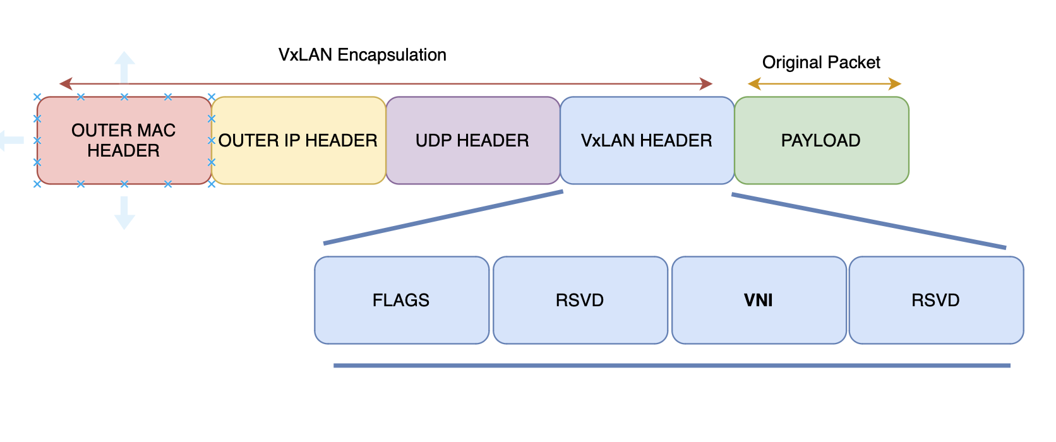
Overlay Architecture - VxLAN
US
Virtual Extensible LAN (VxLAN) – RFC 7348
    Data plane encapsulation technology
    Control Plane
      Flood & learn
      EVPN
    Multi-tenancy functionality ~ 16 Million segments
      Virtual Network Identifier (VNI) – 24 bit
    Meets L2 & L3 transport requirements
    Encapsulation & decapsulation endpoints are called Virtual Tunnel Endpoints (VTEP’s)
    Can operate in:
      Host to Host overlay
      Host to Network Overlay
      Network to Network Overlay
Figures: VxLAN Encapsulation
Figures: VxLAN Overview
Notes:
EVPN (for MPLS) was then extended in the DC world and EVPN now works with VxLAN to assist (VxLAN) with control plane

Slide 33
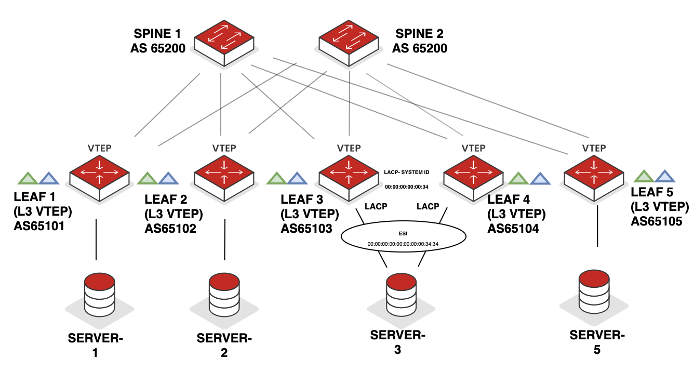
What is A VTEP?
FM
  VXLAN Tunnel Endpoint
    Encapsulates user traffic into VXLAN as it enters the network
    Decapsulates VXLAN back to Ethernet as it leaves the network
  EVPN Signalling
    Normal MAC learning user side
    BGP used to share forwarding info
VXLAN
Figure: VTEP Conceptual Diagram

Slide 34
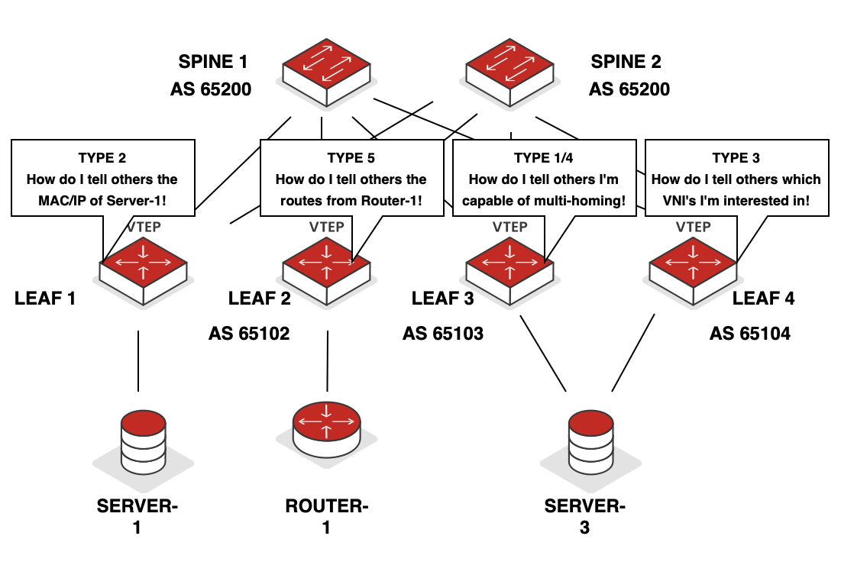
OVERLAY ARCHITECTURE - EVPN
US
Ethernet VPN (using MP-BGP)
    MPLS (RFC 7432)
    VxLAN (RFC 8365)
    Overlay support – L2 & L3
    Control plane learning
    Improves multi-homing shortfalls of VPLS
    Faster convergence (EVPN Type-1 NLRI)
    Reduction in flooding
    Can use BFD in underlay to improve convergence times
Figure: EVPN – Conceptional Overview - Simplified

Slide 35
EVPN Route TYPE Overview

Slide 36

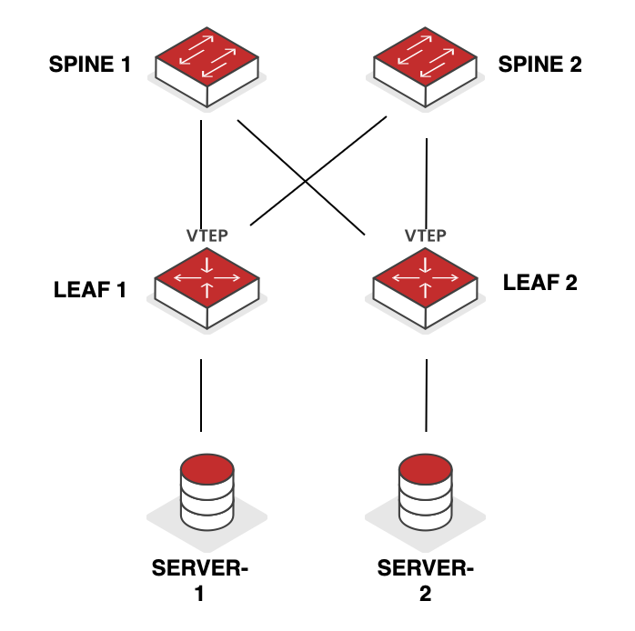
EVPN Route Types
Remote VTEP’s learn MAC & IP addresses from Source VTEP (MAC + MAC/IP)
Populates MAC + ARP tables
Proxy ARP & ARP Suppression (Optional)
T2
MAC/IP Advertisement Routes
VNI 100
VNI 100
Manages Broadcast, Unknown Unicast and Multicast (BUM) traffic
Allows discovery of remote VNI’s and their interest in BUM traffic for specific VNI
Builds ingress replication list
T3
Inclusive Multicast Ethernet Tag (IMET)
VLAN 100
VLAN 100

Slide 37
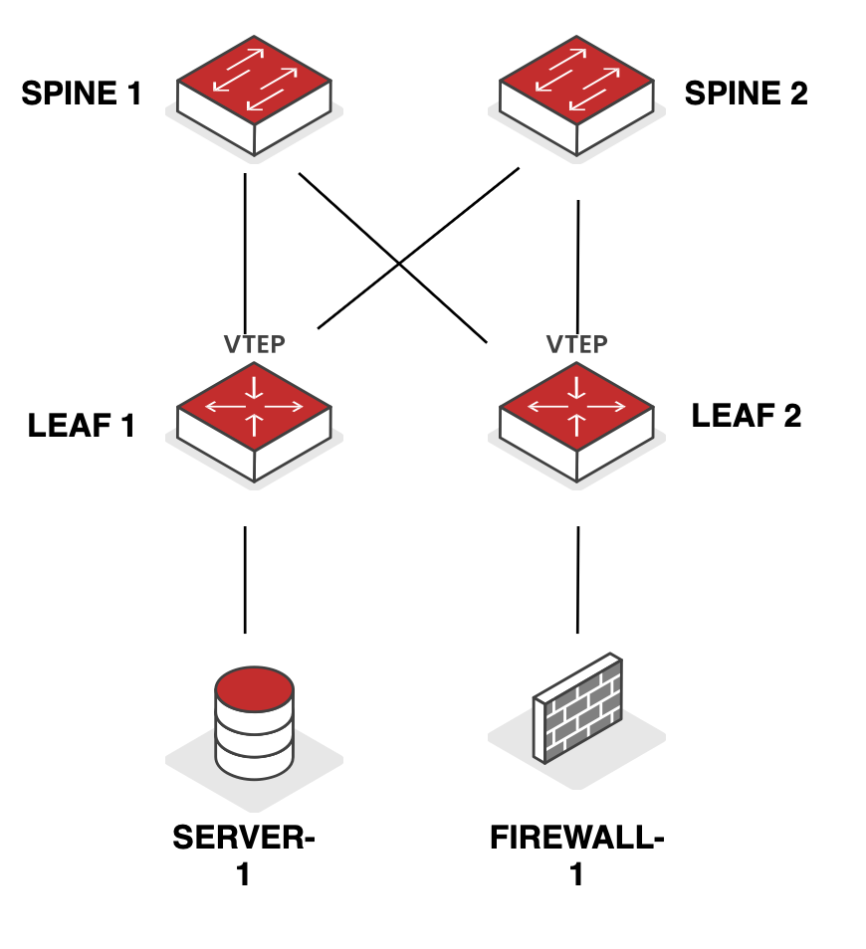
EVPN Route Types
Advertises IP Prefix only
Common use cases:
  Symmetric routing within DC
  Layer 3 DCI
0.0.0.0/0
advt. via EVPN T5
T5
IP Prefix Routes
0.0.0.0/0
VLAN 333

Slide 38
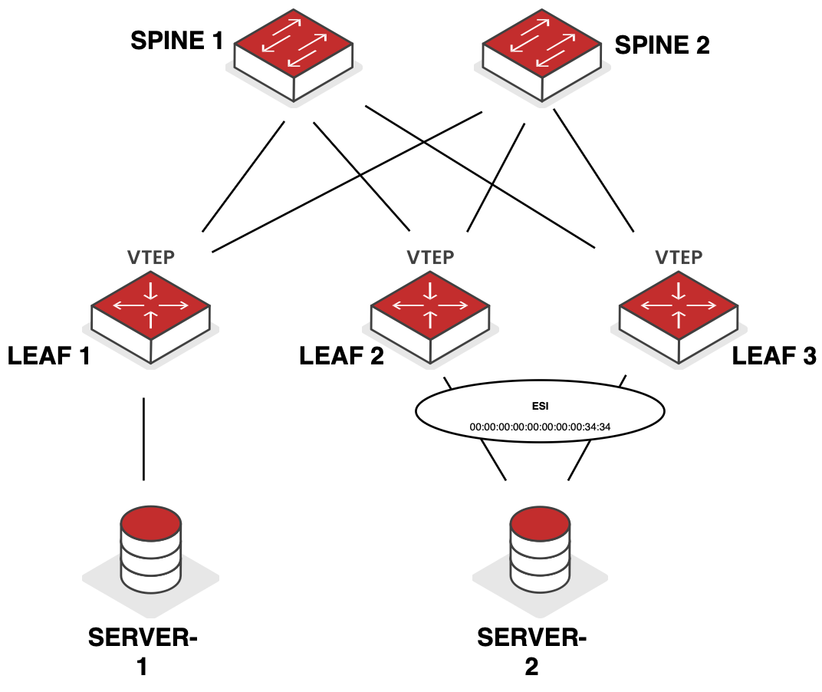
EVPN Route Types
Two Types
  EAD per Ethernet Segment (ES)
  EAD per EVPN Instance (EVI)
  Used for:
    Split Horizon
    Aliasing
    Mass withdrawal
T1
Ethernet Auto-Discovery
(EAD)
Designated Forwarder
non-Designated Forwarder
T4
Used for multi-homed peers
Ethernet Segment Identifier (attached to T2 routes)
Designated Forward & Non-Designated Forwarder
Ethernet Segment Route
Notes:
Split Horizon – Leaf 2 doesn’t forward BUM traffic from Leaf-3
Aliasing is where Leaf 1 uses both L2 and L3 to Server-2
Mass withdrawal – Leaf 2 tells other leafs where it’s all segments have gone down

Slide 39
Multi-tenancy
FM

Slide 40
MAC-VRF – VLAN Based
FM
MAC-VRF-V20
Common on older platforms
Limited scalability - unique instance per VLAN requiring a separate MAC-VRF
Single MAC/Bridge table per MAC-VRF
Single broadcast domain per MAC-VRF
1:1 mapping:
    VLAN/BD >> MAC-VRF >> EVI
EVPN INSTANCE 20
VLAN 20 / VNI 10020
MAC Table
VLAN | MAC | Egress Interface
20 | AA | interface-5
20 | BB | interface-10
MAC-VRF-V40
EVPN INSTANCE 40
VLAN 40 / VNI 10040
MAC Table
VLAN | MAC | Egress Interface
40 | CC | interface-8
40 | DD | interface-16
Figure: VLAN Based Services

Slide 41
MAC-VRF – VLAN AWARE
FM
Much more common today
Better scale (than VLAN based) due to a common instance for multiple VLANs requiring a single MAC-VRF
Multiple MAC/Bridge table per MAC-VRF
Multiple broadcast domains per MAC-VRF and per VLAN
Many(n):1 mapping between > VLAN/BD >> MAC-VRF >> EVI
MAC-VRF-V20-V40
EVPN INSTANCE 2040
VLAN 20 / VNI 10020
MAC Table
VLAN | MAC | Egress Interface
20 | AA | interface-5
20 | BB | interface-10
VLAN 40 / VNI 10040
MAC Table
VLAN | MAC | Egress Interface
40 | CC | interface-8
40 | DD | interface-16
Figure: VLAN Aware Services

Slide 42
ROUTING Approaches
FM

Slide 43


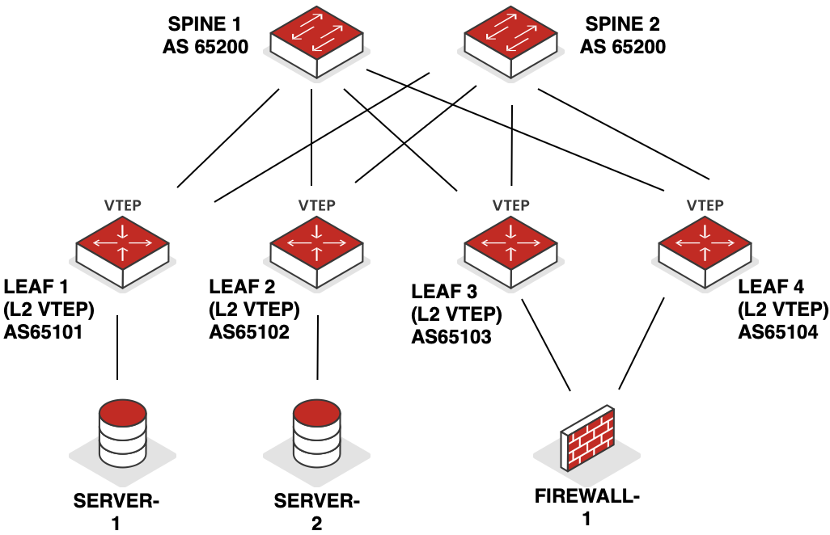
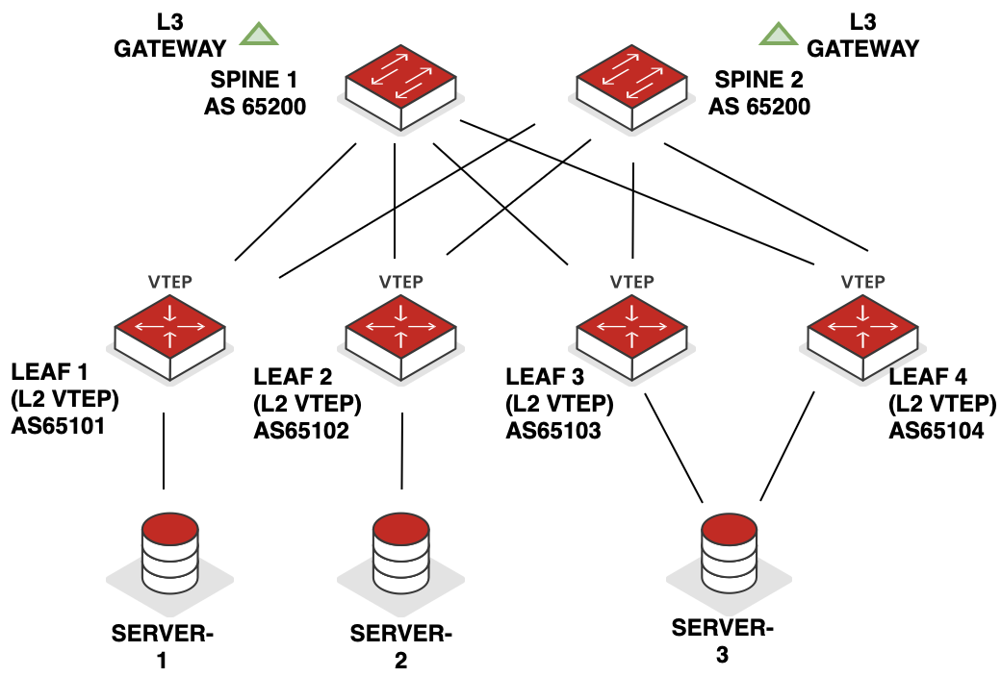
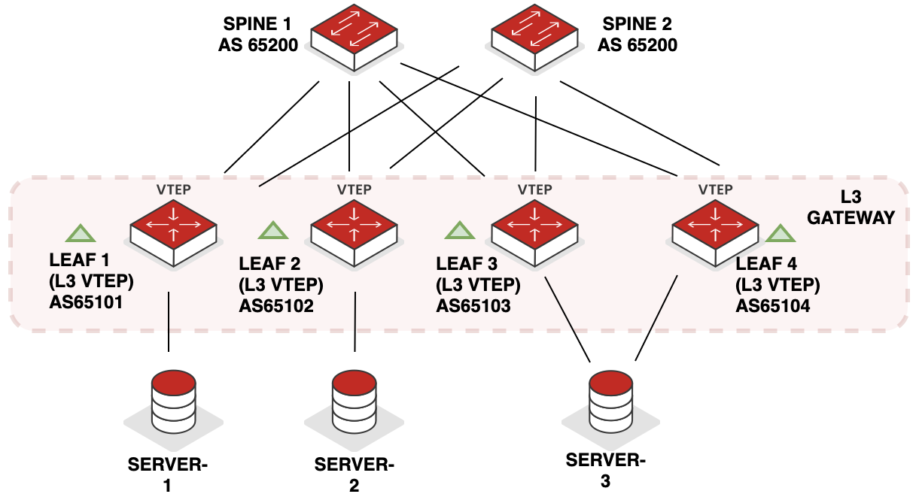
Common Gateway Placement options
FM
Figure: Bridge Overlay with External Routing
Figure: Centrally Routed & Bridged
Figure: Edge Routed & Bridged

Slide 44
Introducing Routing approaches
FM
Asymmetric
L3
L2
L2
L2
MAC Routes
Exchanged
L2 + L3
L2 Only
Symmetric
L3
IP Routes
Exchanged
L3
L2
L2
L2 + L3
L2 + L3
Figure: Symmetric vs. Asymmetric Routing
Notes:
Note – in the asymmetric case you need to have all VNIs that you ever want to route between on each gateway switch
Switch-route-switch, switch & switch, switch-route-switch vs. switch-route, route-switch

Slide 45
ASYMMETRIC ROuting
US
Please check the appendix section for a step by step walkthrough

Slide 46
SYMMETRIC ROuting
US
Please check the appendix section for a step by step walkthrough

Slide 47
PACKET Walkthrough
US

Slide 48
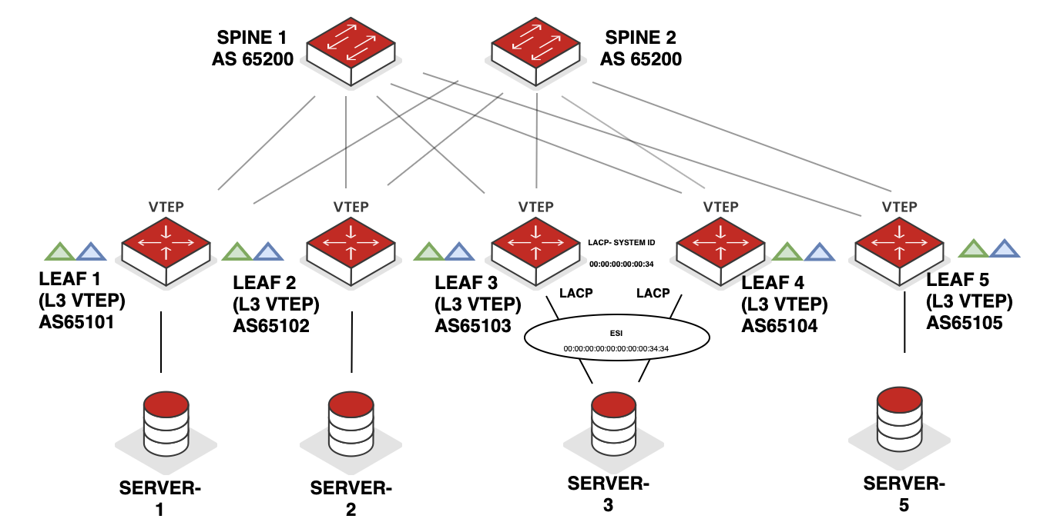

VxlAN Packet Walkthrough (using ASYMETRICAL ROUTING)
SRC = G/W v40
DST = Server-5
US
SRC: CA
DST: CB
SRC: BA
DST: BC
SRC: 192.168.255.1
DST: 192.168.255.5
SRC: 192.168.255.1
DST: 192.168.255.5
SRC 54698
DST 4789
SRC 54698
DST 4789
VNI 10040
VNI 10040
SRC: 4B
DST: DC
SRC: 4B
DST: DC
CA
SRC: 192.168.20.10
DST: 192.168.40.50
SRC: 192.168.20.10
DST: 192.168.40.50
BC
Payload
2
3
Payload
BA
CB
SRC: AA
DST: 2A
4
SRC: 4B
DST: DC
1
SRC: 192.168.20.10
DST: 192.168.40.50
SRC: 192.168.20.10
DST: 192.168.40.50
Payload
Payload
VLAN 20 / VNI 10020 192.168.20.10/24
VLAN 40 / VNI 10040 192.168.40.50/24
 | Additional Information
 | VLAN | MAC | IP Address
 | 20 | 2A | 192.168.1.20.1/24
 | 40 | 4B | 192.168.1.40.1/24
LEAF 1 LOOPBACK |  |  | 192.168.255.1
LEAF 5 LOOPBACK |  |  | 192.168.255.5
MAC: AA
MAC: DC
Assumptions:
eBGP in underlay & overlay is configured & necessary EVPN routes have been exchanged (T1, T2, T3 & T4)
MAC/IP learning has taken place on the VTEP
ARP resolution is completed on Server-1 & Server-5 for their gateways
Figure: Packet Walkthrough

Slide 49
Which option would you typically use?
FM
Asymmetric Routing
Bridge-Route-Bridge
Typically seen when hosts are connected to almost every leaf and VLAN’s are on almost every single VTEP
IP VRF is optional (NO L3VNI)
Reduced scale
Small/Medium scale deployments
Easy to operate & troubleshoot
Bridge-Route-Route-Bridge
Typically used when VLAN’s are not present on all leafs and hosts are connected to only specific leafs
L3VNI is mandatory and G/W’s must map to an IP VRF
Better scale
High scale deployments
Slightly more complex to operate & troubleshoot
Symmetric Routing

Slide 50





popular ASIC Manufacturers & Designers
FM
Merchant Silicon
Proprietary Silicon
Notes:
https://elegantnetwork.github.io/posts/A-Summary-of-Network-ASICs/
Cisco – Leaba
Intel - Barefoot

Slide 51



Common Broadcom ASIC FAMILIES
FM
102.4 Tb/s
TOMAHAWK
High bandwidth
Hyperscale Fabrics
TRIDENT
Feature Rich
Enterprise & Cloud Edge
Programmable
BANDWIDTH
JERICHO
Programmable
Scale-Out
Carrier Grade Infrastructure
Deep buffers
Concept borrowed from TechFieldDay Presentation on YouTube – “Broadcom Tomahawk4: Industry's Highest Bandwidth Chip” - https://www.youtube.com/watch?v=B-COGMbaUg4
FEATURES

Slide 52
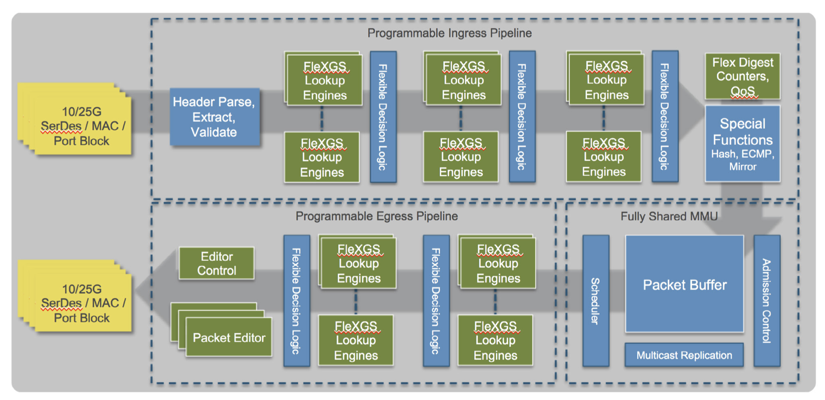
Arista 7050X3 with Trident 3 ASIC
FM
Figure: Arista 7050X3 with Trident 3 ASIC
Source: https://www.arista.com/assets/data/pdf/Whitepapers/7050X3_Architecture_WP.pdf

Slide 53


POPular Network VENDORS & NOS
(NON-AI Data Centres)
FM
Arista Extensible Operating System (EOS)
Linux based
Cisco Nexus OS (NX-OS) (amongst others)
Dedicated data centre OS (ACI and Standalone)
JUNOS & JUNOS EVO
JUNOS is built on a FreeBSD Kernel & JUNOS EVO is built on a Linux kernel
Nokia Service Router Operating System (SROS) & Nokia Service Router Linux (SR-Linux)
SR-Linux is built on an unmodified Linux kernel
Software for Open Networking in the Cloud (SONIC)
Linux based
Developed by Microsoft for Azure Hyperscale DC’s

Slide 54
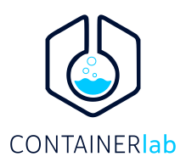



Common tools to build your home lab
US
Arista, Juniper Networks & Nokia offer free images to study & learn in your home lab!
Arista & Nokia offer lightweight containerised images too!
Containerlabs - https://containerlab.dev
EVE-NG - https://www.eve-ng.net
GNS3 - https://www.gns3.com
Netlabs - https://netlab.tools
Netlab by IPSPACE

Slide 55
FABRIC Tools – automation/provisioning/monitoring tools
US
Cloud Vision
Supports Arista devices (Intent based support can be added in conjunction with Arista Validated Design)
Strong change control and time series history
Application Centric Infrastructure (ACI) and Nexus Dashboard
Supports Cisco Nexus platforms
Policy driven
Juniper Apstra
Supports Arista, Juniper Networks, Cisco, Sonic etc.
Intent based framework
Event Driven Automation
Nokia, multi-vendor support in roadmap
Kubernetes & intent based framework

Slide 56
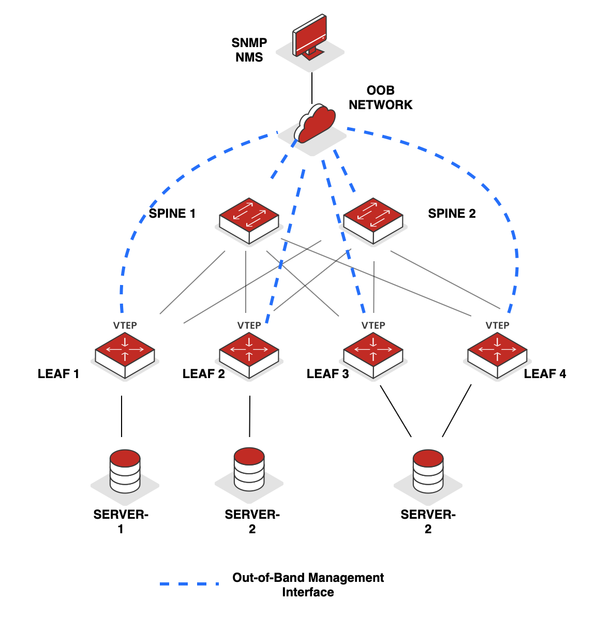
Simple Network management protocol (SNMP)
FM
SNMPv1 & v2 (limited security)
SNMPv3 (stronger authentication)
SNMP Trap (Sent on trigger event)
Typical components:
    Network Management System (NMS)
    Agent
    Management Information Base (MIB)
AGENT
AGENT
AGENT
AGENT
MIB
MIB
MIB
MIB
NMS
Get Requests
SNMP AGENT
GetNext Requests
GetBulk Requests
Set Requests
Get Response
Traps, Notification, Inform
Figure: Legacy SNMP

Slide 57
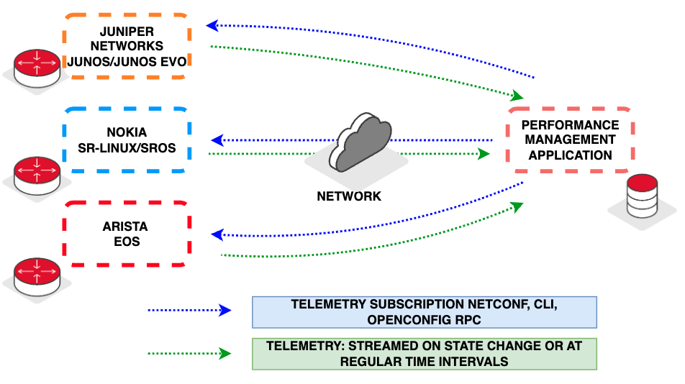
FM
modern data centre management & Visibility
Subscription-based (Push Model)
Sent upon update
    Immediate
    No wasted bandwidth / processing
Figure: Streaming Telemetry
Notes:
e.g. NETCONF & gNMI
Legacy SNMP polling uses a "pull" model where monitoring platforms need to periodically request updated information such as counter values. This has several drawbacks:
Network resources are consumed even when there is no updated information to report
Time-sensitive events may not be seen for some time after they occur due to polling intervals
Modern telemetry is subscription based and uses a "push" model. The monitoring platform subscribes to the data in which it is interested and, for continuously changing data, may specify how frequently it wishes to be updated with new values.
The network elements then push only the values that have changed within the subscribed categories towards the monitoring platform.
This allows monitoring platforms to display completely live data, accurate up to the current moment.

Slide 58
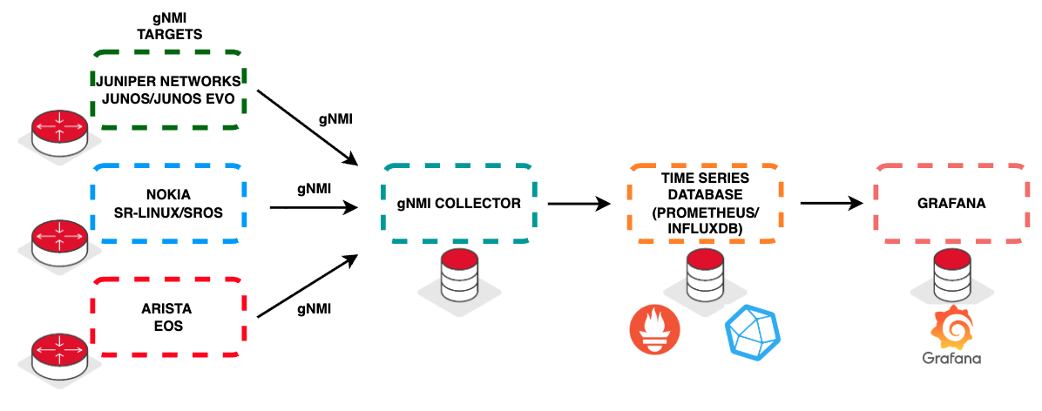
FM
modern data centre management & Visibility
Figure: Collectors and Time Series Databases
Collectors allow easy aggregation and replication to multiple systems
Time Series Databases allow querying / reporting / trend analysis

Slide 59
Data Centre interconnect (DCI)
US
04
Includes roles of Data Centre Interconnect Operators

Slide 60
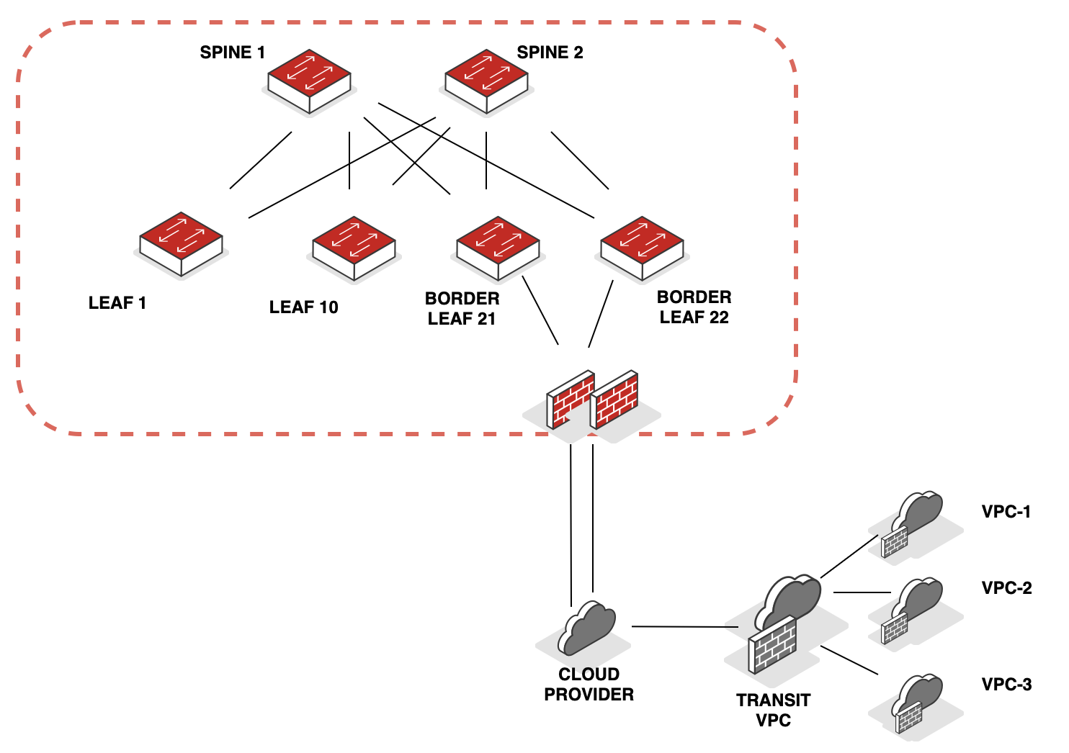
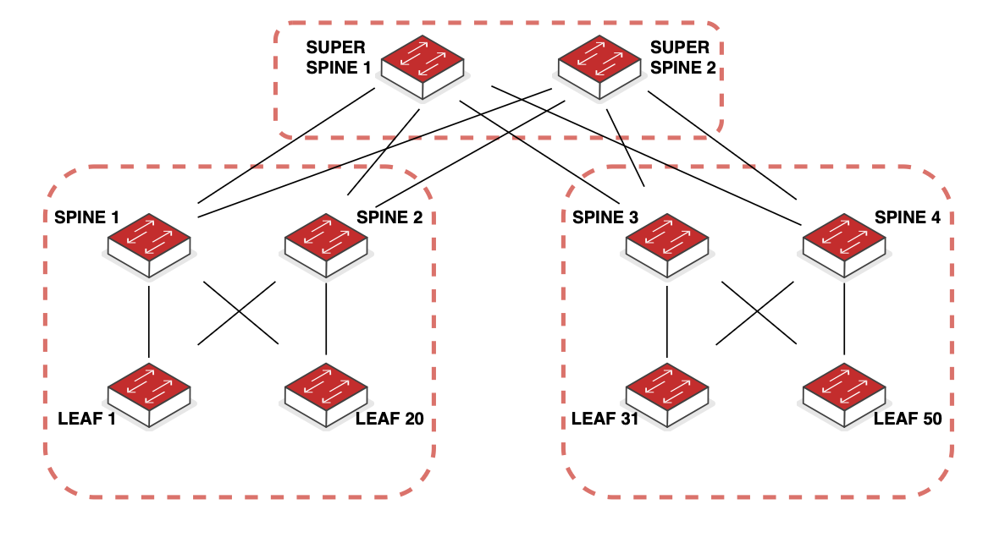
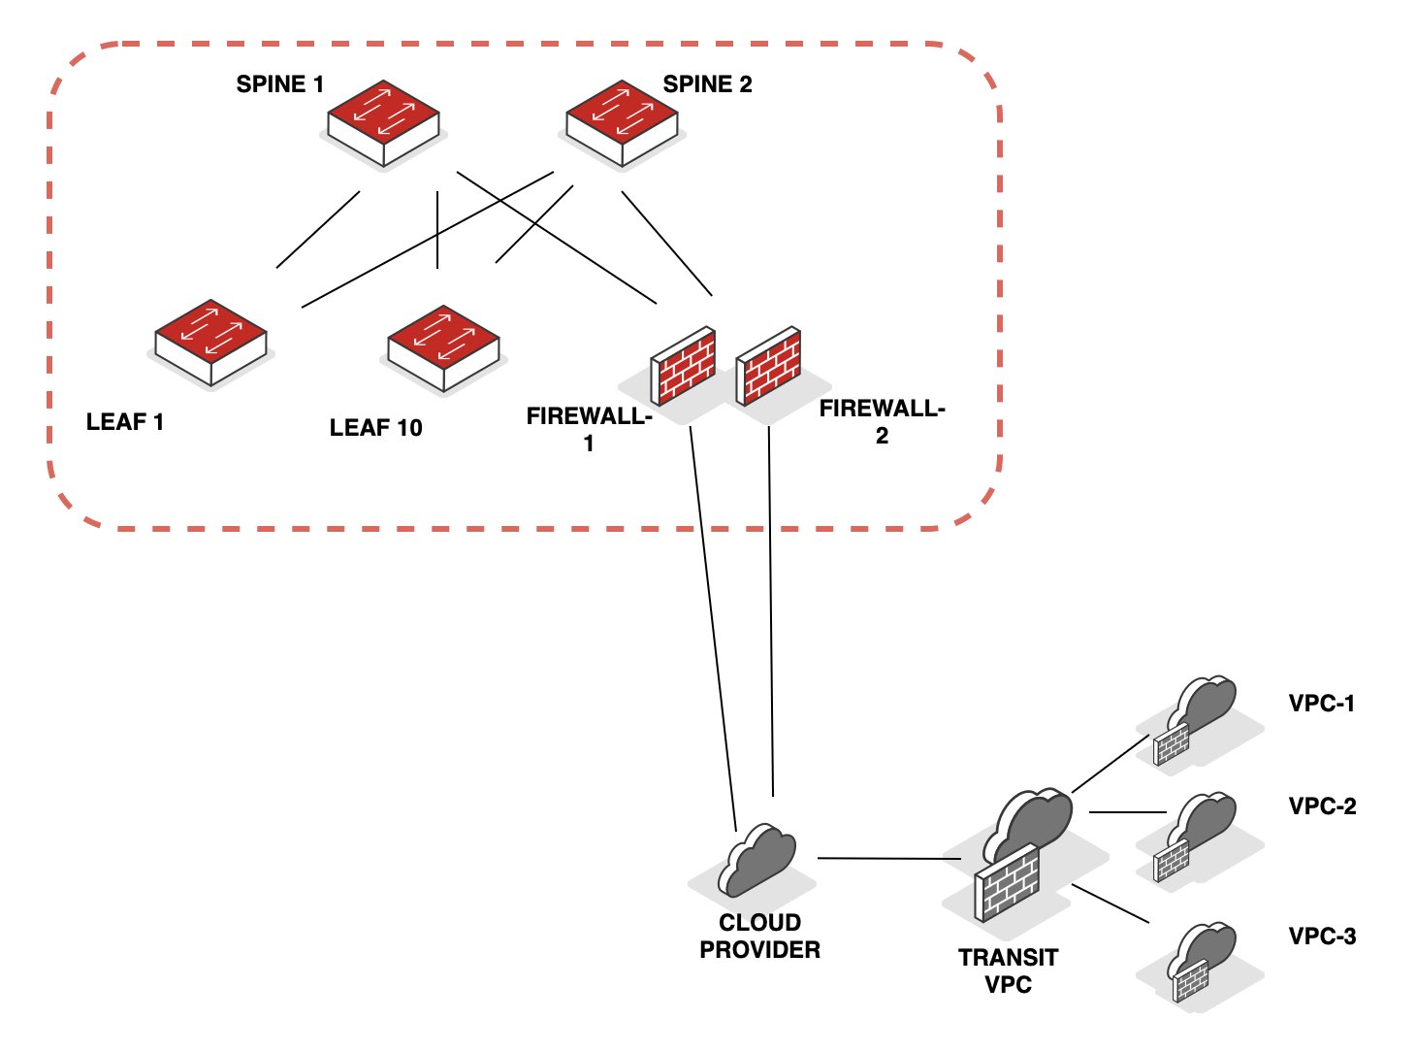
Data Centre interconnect - overview
US
Several points to consider:
Application requirements
    Mobility
    Layer 2 vs layer 3 interconnect
Scale limitations
Handling BUM traffic
Platform support & scale
Underlaying infrastructure
Redundancy requirements
(Many more points of consideration & several design options)
Figure: Hybrid DCI – Option 1
POD 1
POD 2
Figure: Interconnecting multiple pods
Figure: Hybrid DCI – Option 2 (EVPN T5)

Slide 61
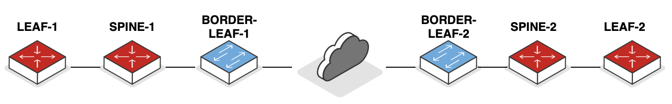
layer 2 DCI
US
DOMAIN-C
Ethernet or L2 MPLS TRANSIT
01
Easy to deploy
Flood & learn MAC
  L2 HANDOFF
DOMAIN-A (EVPN/VxLAN)
DOMAIN-B (EVPN/VxLAN)
L2 HANDOFF
L2 HANDOFF
IP or L3 MPLS TRANSIT
02
  Over The Top (OTT)
Stretches EVPN/VxLAN domain across sites
Intermediate scale and control
DOMAIN-A (EVPN/VxLAN)

Slide 62
layer 2 DCI
US
03
Higher scale – DC/Pods
Tighter control on scaling
Unified EVPN Layer 2 Interconnect solution
VxLAN VNI Gateway Switch from Border Leaf
  EVPN VxLAN to EVPN VxLAN
  Seamless Stitch
DOMAIN-A (EVPN/VxLAN)
DOMAIN-C
DOMAIN-B (EVPN/VxLAN)
EVPN/VxLAN
TRANSIT
04
  EVPN VxLAN to EVPN MPLS
Higher scale – DC/Pods
Tighter control on scaling
Unified EVPN Layer 2 Interconnect solution
MPLS from Border Leaf
  Seamless Stitch
DOMAIN-A (EVPN/VxLAN)
DOMAIN-C
DOMAIN-B (EVPN/VxLAN)
EVPN-MPLS
TRANSIT

Slide 63
layer 3 DCI
US
05
Higher scale – DC/Pods
Tighter control on scaling
Unified EVPN Layer 3 Interconnect solution
  EVPN VxLAN to EVPN VxLAN
  Seamless Stitch
  L3 DCI – EVPN T5
DOMAIN-A (EVPN/VxLAN)
DOMAIN-C
DOMAIN-B (EVPN/VxLAN)
EVPN/VxLAN
TRANSIT
(via T5)
06
  EVPN VxLAN to EVPN MPLS
Higher scale – DC/Pods
Tighter control on scaling
Unified EVPN Layer 3 Interconnect solution
  Seamless Stitch
  L3 DCI – EVPN T5
DOMAIN-A (EVPN/VxLAN)
DOMAIN-C
DOMAIN-B (EVPN/VxLAN)
IP VPN-MPLS
TRANSIT

Slide 64
REAL WORLD USE CASes
05

Slide 65
Changes observed in campus networks over time
FM
LEGACY NETWORKS
PRESENT CAMPUS NETWORKS
Manual provisioning
Data & Voice
100 Mbps-1 Gbps End Devices
Security – Edge
PoE requirements
Legacy monitoring protocols - SNMP
Automated provisioning
Data, Voice, Video, IoT + BYOD
100 Mbps, 1 Gbps, 2.5 Gbps, 10 Gbps, 25 Gbps, 40 Gbps
Security - Zero Trust
PoE, PoE+ & PoE++ requirements
Streaming real time telemetry updates

Slide 66
CRITICAL National INFRASTRUCTURE (CNI)
FM
Transport
Chemicals
Energy (Electricity, Gas & Oil)
Defence
Civil Nuclear
CNI
Finance
Emergency Services
Food
  CRITICAL NATIONAL INFRASTUCUTRE
Health
Government
Space
Water
Communication
TelecommunicatIons
Data infrastructure (data centre & cloud infrastructure)
Broadcast
Postal Service

Slide 67
CRITICAL National INFRASTRUCTURE (CNI)
FM
DC’s are essential services and classified as CNI
DC’s need to have appropriate & propriate measure in place as required by Ofcom (regulator)
Regulatory exemptions apply to services provided by Security Service, SIS & GCHQ
DC’s with a rated IT load (RITL) >= 1 MW & Enterprise DC’s >= 10 MW are in scope
Manage cyber security risks through appropriate technical & organisational controls
Maintain service resilience by preventing, minimising & recovering from cyber incidents
Report significant incidents to regulators when essential services are impacted

Slide 68
Case reference – campus fabric
US
05_{A}

Slide 69
Customer overview
US
US
CUSTOMER PROFILE
CHALLENGES
One of the United Kingdom’s largest & most connected colocation providers/data centres
Global presence
SME’s, Government, Hyperscalers & large-scale enterprises have presence here
Internet exchanges, peering points etc. are heavily present here
Massive growth – legacy infrastructure started to crumble
Falls under Critical Network Infrastructure
Flat network needed to be segregated
Lacks automation & visibility
Scale along with resiliency, redundancy and availability requirements required a new thought process
Legacy network – Lacked value added services
Note: Additional details such as additional information on customer profile, scale, requirements etc. will be shared in the workshop

Slide 70
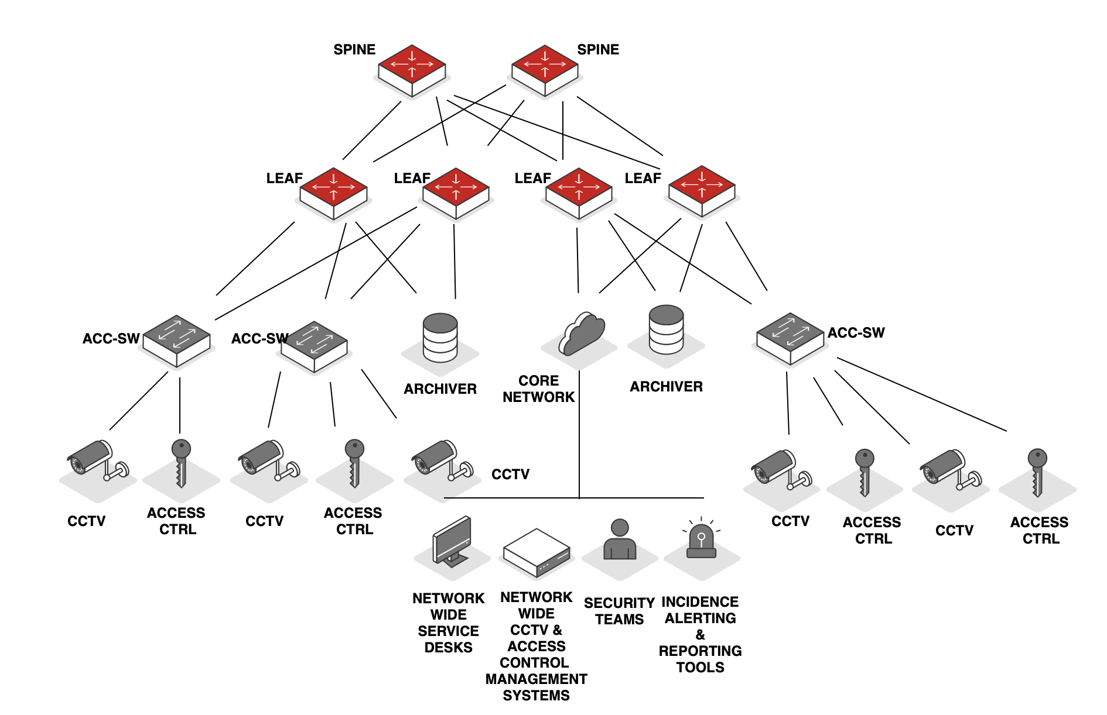
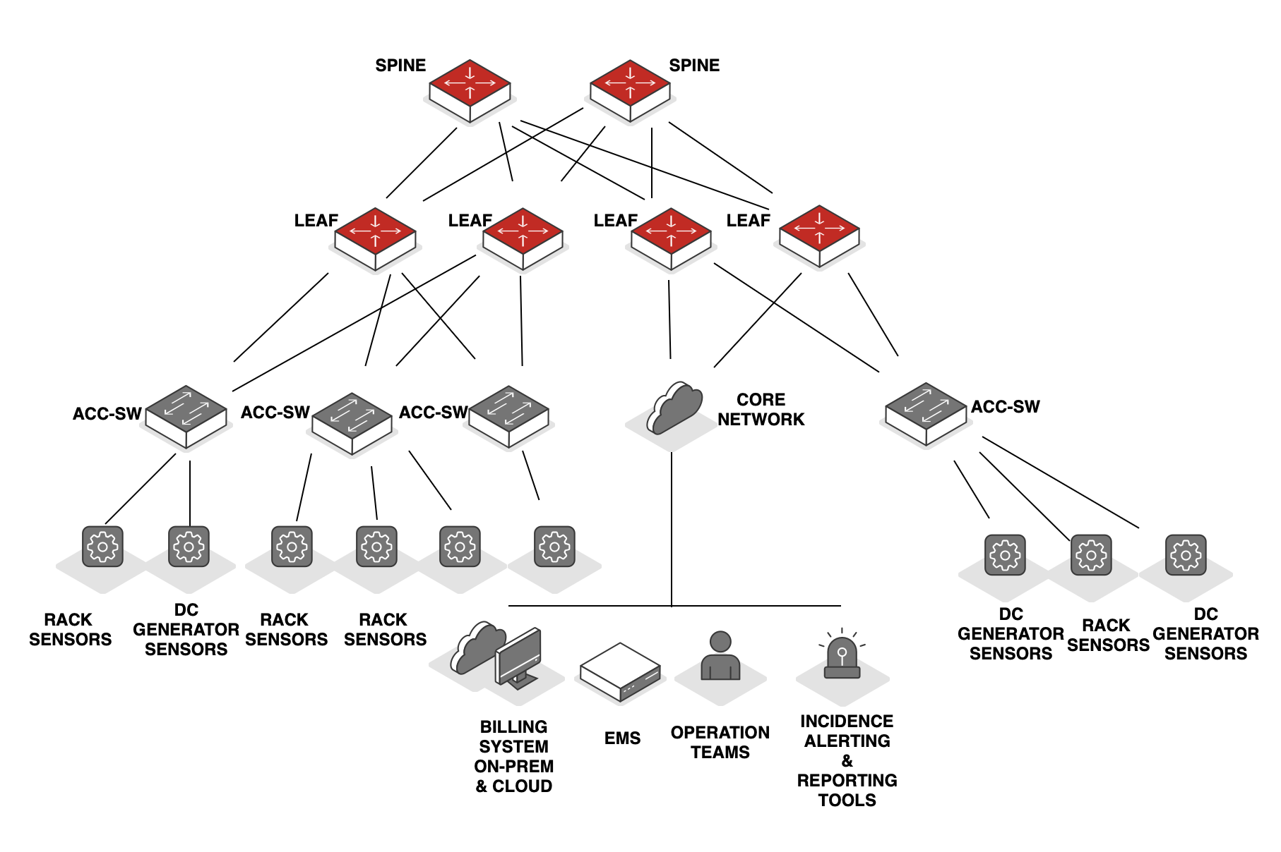
Campus Fabric – Security & ENERGY MANAGEMENT SYSTEM
US
BLDG - 1
BLDG - 5
Intent based networking
    Day 0 – Day 2
Increased visibility and proactive anomalies detection
Highly available network
Ease of deployment & operations (Single Pane of Management)
Scalable
BLDG - 10
BLDG - 1
BLDG - 8
Figure: Campus Fabric

Slide 71
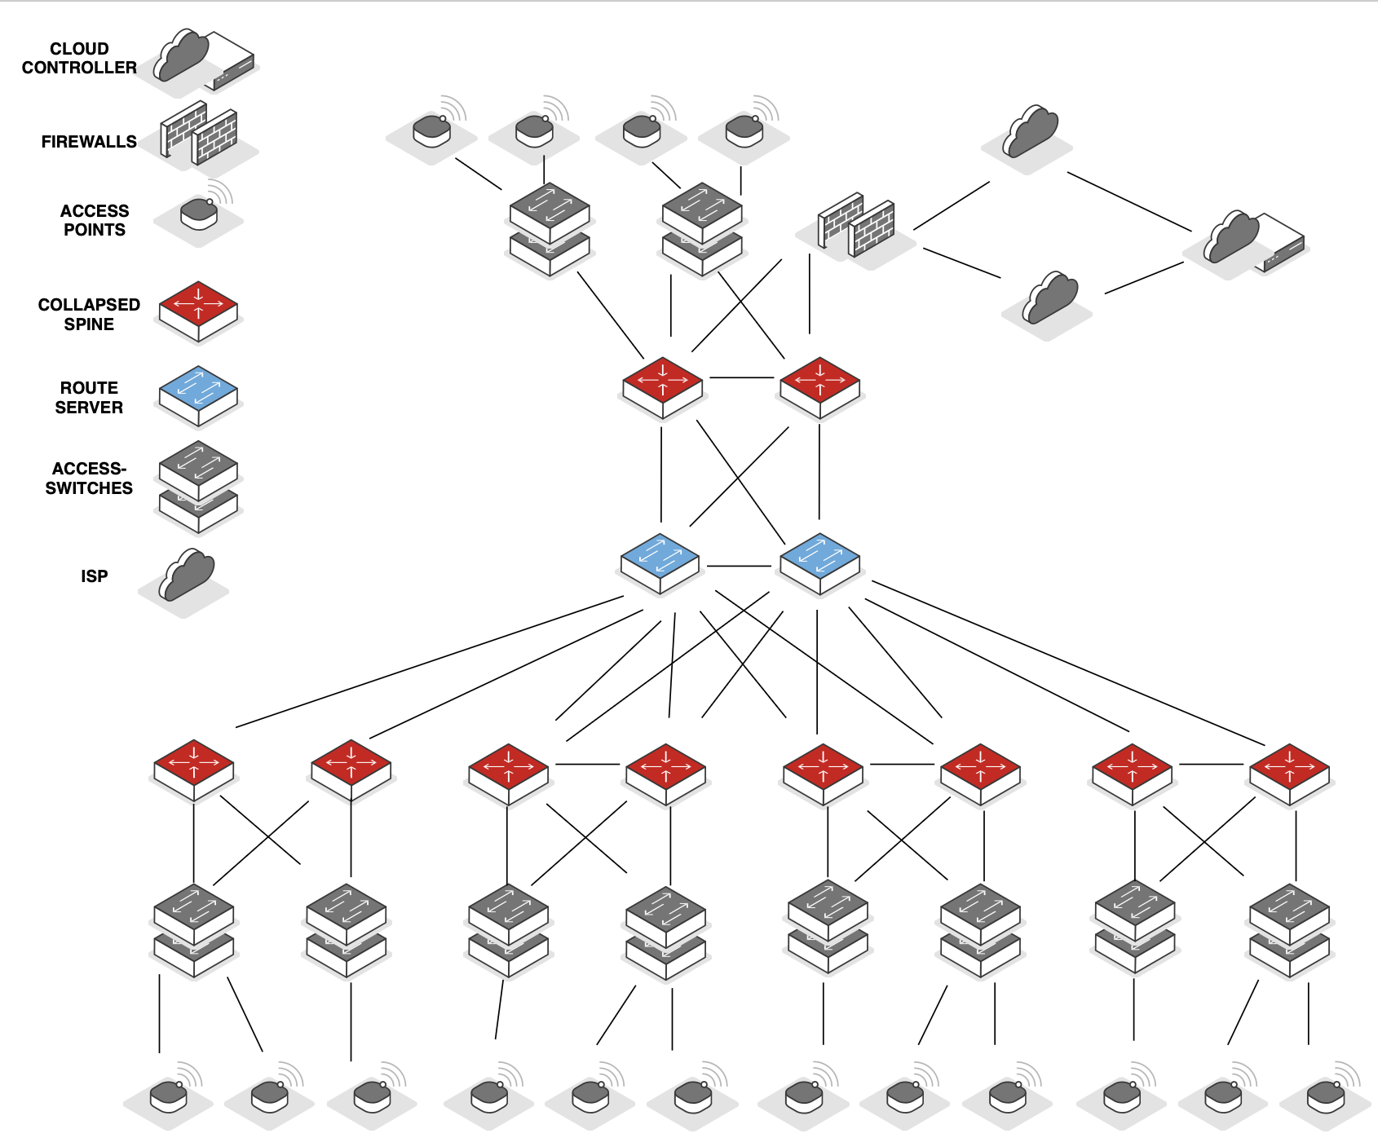
CAMPUS FABRIC – WiFI
US
Seamlessly mobility across campus
    Corporate
    Guest
  Cloud based wireless controller
  Location tracking
  High availability & scalable
  Single Pane of Management
  Improved visibility
  Inter-op with legacy wireless network
BLDG - 1
BLDG - 2
BLDG - 6
BLDG - 8
BLDG - 9
Figure: Campus Fabric WiFi

Slide 72
Case reference – mid Scale enterprise customer
05_{B}

Slide 73
Customer overview
US
CUSTOMER PROFILE
CHALLENGES
One of Europe’s largest SIP voice trunk providers
Voice & business internet services
Looking for a cost-effective solution
Easier management and automation
Lacked single pane of management
Long lead times for service provisioning
Need for scalable, resilient and highly available services
Hybrid data centre architecture
Note: Additional details such as additional information on customer profile, scale, requirements etc. will be shared in the workshop

Slide 74
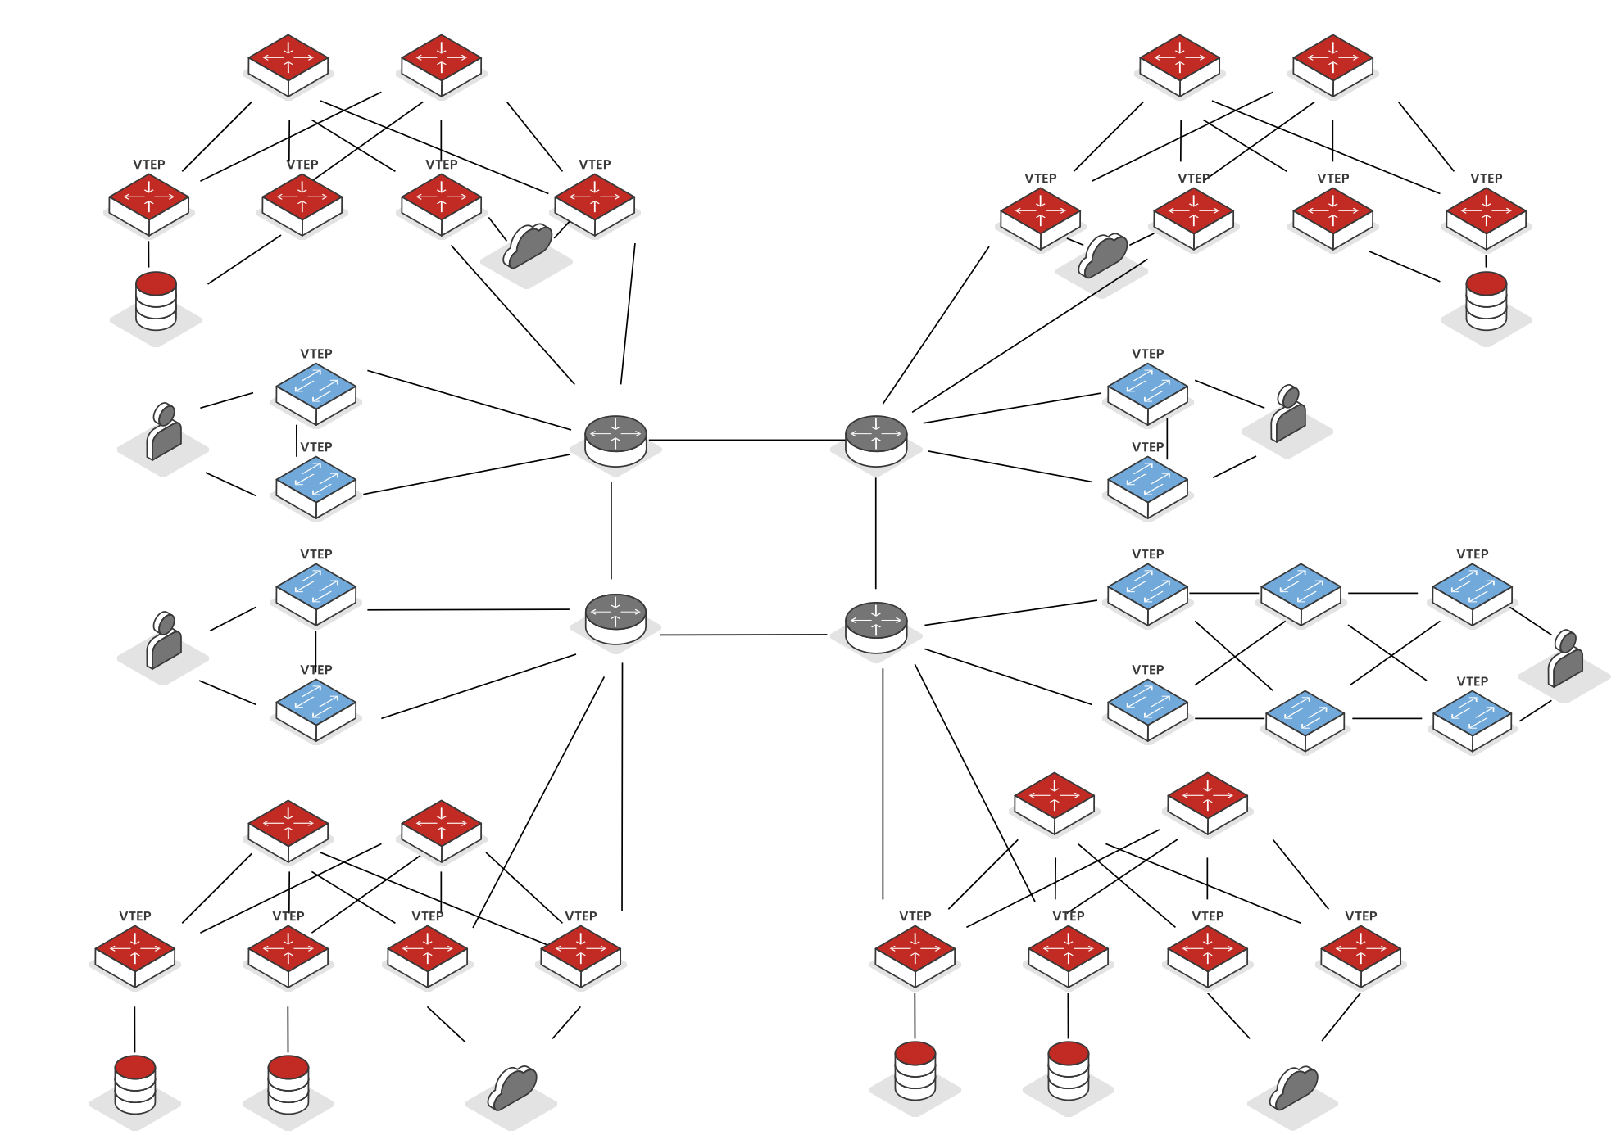

US
DC-1 VNI99111
DC-1
DC-2
DC-2 VNI99222
BORDER LEAF
BORDER LEAF
LEAF
LEAF
GENERIC SYSTEM
CORE NW
METRO WAN VNI99123
CORE NW
GENERIC SYSTEM
POP-1
POP-2
METRO WAN VNI99123
METRO WAN VNI99123
POP-4
POP-3
IP TRANSIT METRO BACKBONE
DC-4
DC-3
Figure: Stitched
Multi-DC
LEAF
BORDER LEAF
BORDER LEAF
LEAF
GENERIC SYSTEM
CORE NW
GENERIC SYSTEM
CORE NW

Slide 75
Case reference – large Scale enterprise customer
US
05_{C}

Slide 76
Customer overview
US
CUSTOMER PROFILE
CHALLENGES
Global, large-scale manufacturer
Research and production - automobile components
Headquartered in Germany
Legacy layer 2 switched network
Required high performance network interconnect to connect various data centres around the world
No automation
Required resilient and highly available network for production and research traffic
Legacy infrastructure was causing several network issues
Note: Additional details such as additional information on customer profile, scale, requirements etc. will be shared in the workshop

Slide 77
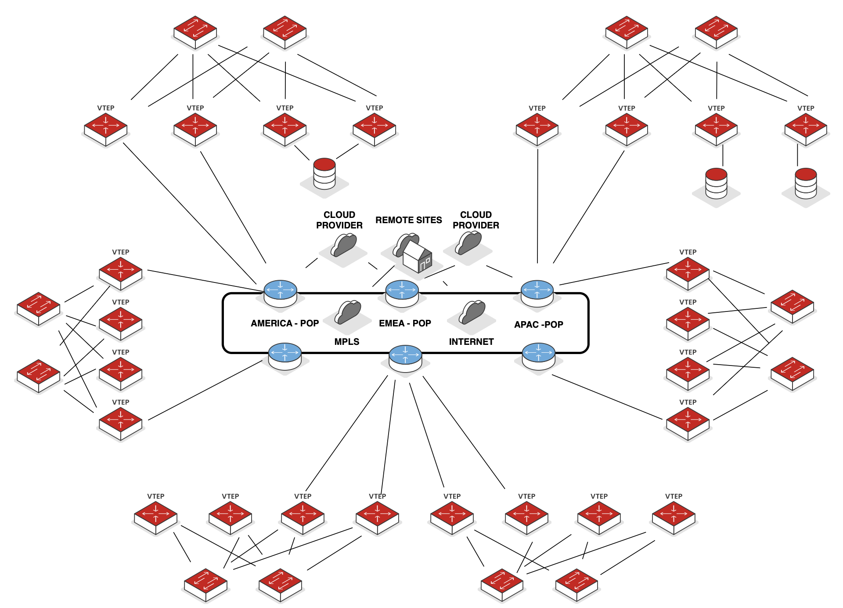
US
DC-30
DC-20
DC-40
HIGH PERFORMANCE BACKBONE
DC-50
BGP ROUTE ADVERTISEMENTS
DC-60
DC-10
Figure: Multi-national Datacentres

Slide 78
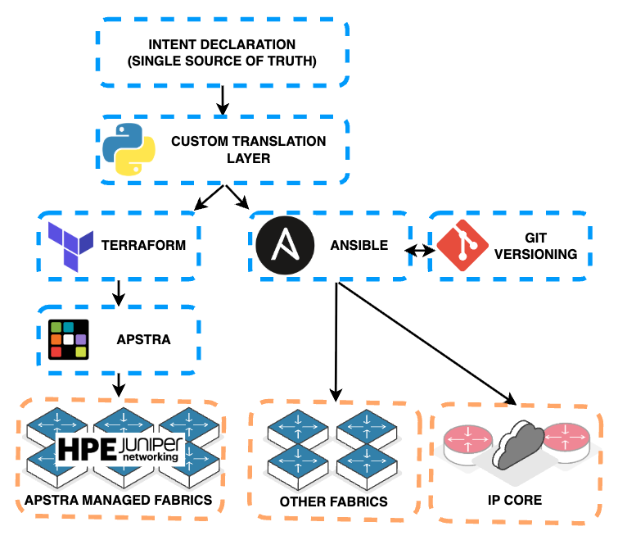
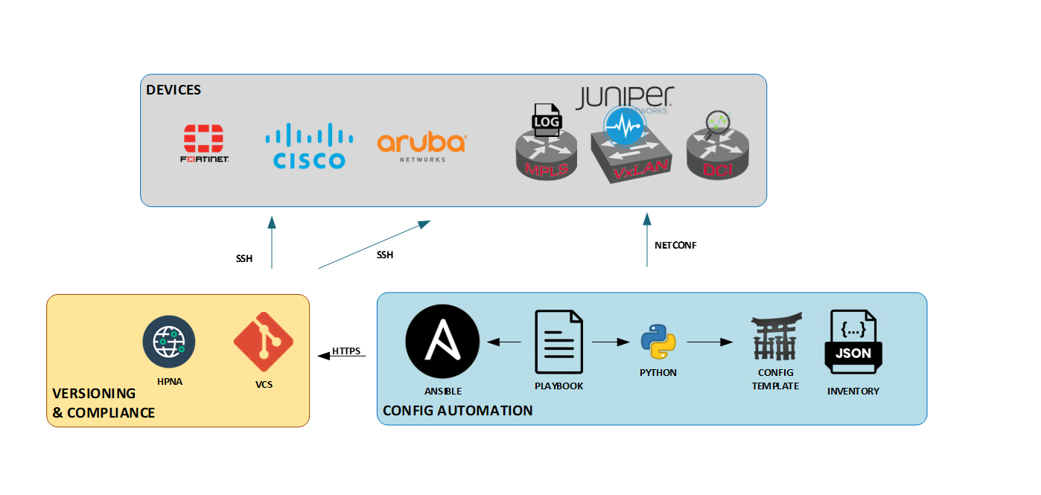
AUTOMATION Story
US
Figure: Automation Transformation

Slide 79
Conclusion
06
AI For Networks

Slide 80
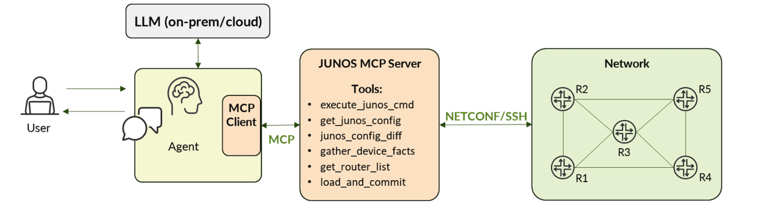
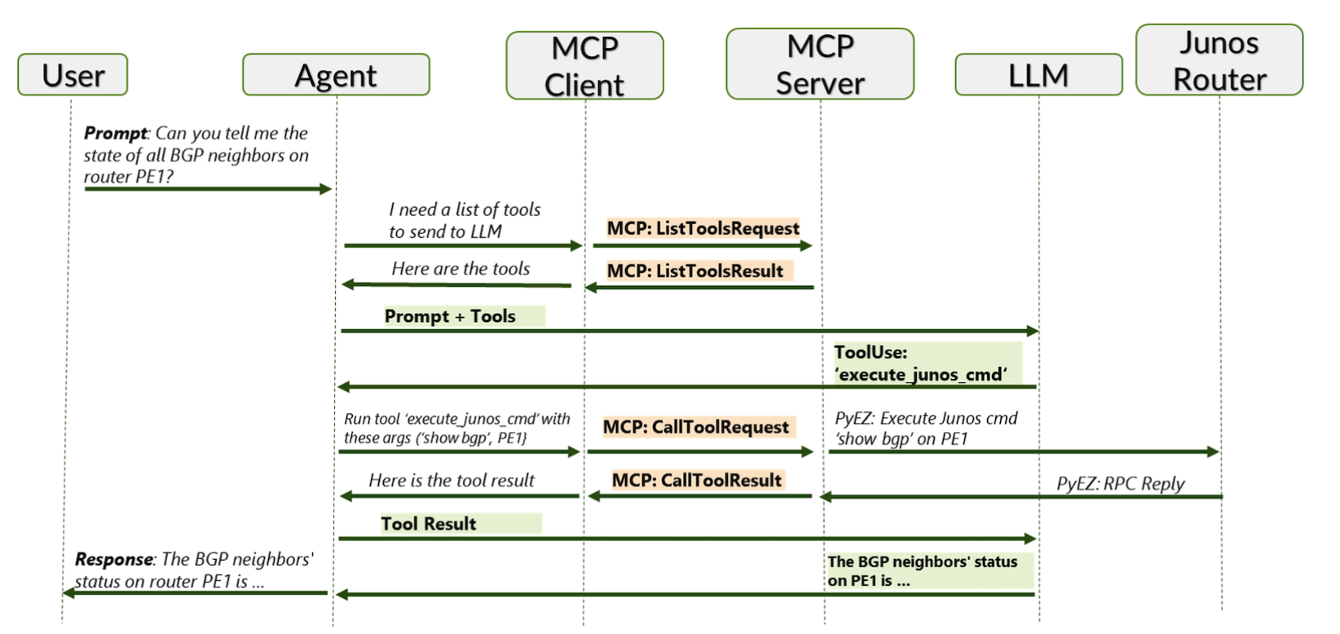
USING AI For Networks
FM
Source: https://community.juniper.net/blogs/victor-ganjian/2025/11/01/network-automation-with-ai-and-junos-mcp-server
Figure: MCP Servers – Simplified Overview

Slide 81
FM
01
Spawning lab setups
Where do you think you could use AI in networks?
02
Correlating logs/events - troubleshooting
03
Vibe scripting in lab networks
04
Interacting with IPAM & Telemetry tools
05
Forecasting
06
What else can you think of?

Slide 82
Taking things forward
FM
Interesting video series:
YouTube - Jeff Tantsura and Jeff Doyle - Between 0x2 Nerds Series
Interesting articles & views:
Blog by Ivan Pepelnjak - https://www.ipspace.net/Main_Page
Must read book:
Aninda Chatterjee - Deploying Juniper Data Centers with EVPN VxLAN
Lab:
Containerlab - https://containerlab.dev
Arista/Juniper Networks / Nokia SR-Linux images are easily available

Slide 83
Taking things forward
FM
Cisco ACI Brief Introduction https://www.ciscolive.com/c/dam/r/ciscolive/emea/docs/2019/pdf/BRKACI-3101.pdf
Arista AVD:
https://avd.arista.com/6.2/index.html
Nokia Validated Designs
https://documentation.nokia.com/networks-design-hub/data-center-networks.html
Juniper Validated Designs
https://techlibrary.juniper.net/documentation/validated-designs/us/en/data-center/
PFE Introduction:
https://www.denog.de/media/DENOG12/Day0_workshop_ASIC.pdf

Slide 84
THANK YOU!

Slide 85
Appendix
07
Walkthroughs

Slide 86
EVPN Route TYPE Overview

Slide 87
EVPN ROUTE TYPE 1 & Type 4 Overview
FM
Type 1: Ethernet Auto-discovery
Reachability to a Segment
Multi-homing
Mass Withdrawal
I Can Reach
A Segment!
Type 4: Ethernet Segment Route
DF Election
Let's Elect a
Designated Forwarder
Figure: Route Types 1 & 4

Slide 88
EVPN Route Type 1 - Overview
US
Ethernet Auto-Discovery (EAD) route
Used in conjunction with EVPN Type 4
Generated for two types:
    EAD per Ethernet Segment (ES) –
      Builds a list of VTEP’s capable of load-balancing (single active vs all-active)
    EAD per EVPN instance (EVI) –
      Builds a list of VTEP’s who share a common ESI
  Used for (Depending on vendor implementation the above types are used):
    Split horizon
      Preventing the Designated Forwarder from forwarding BUM traffic back to the hosts by tracking the VTEP source IP for BUM traffic
    Aliasing
      Used by multi-homed peers inform other VTEPs they are part of the ES if they did not originate an EVPN T2 route
    Mass withdrawal/fast convergence
      Used to inform remote VTEP’s to withdraw association of routes from the ES during failure so remote VTEPs can converge faster
Note: Please review EVPN Type 4 slides prior to EVPN Type 1 sides for a better understanding.
Notes:
Both routes below carry ESI
EAD per Ethernet Segment (ES)
EAD per EVPN instance (EVI)

Slide 89
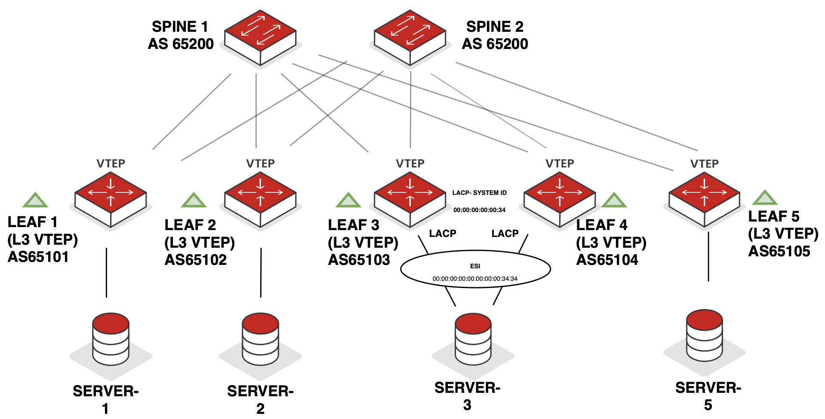
EVPN TYPE 1 – Split Horizon - Overview
US
1
eBGP established for underlay & overlay with required address families
3
2
Server-3 is dual-homed to Leaf-3 & Leaf-4
3
Leaf-3 & Leaf-4 advertise EVPN Type-1 (EAD per EVI, EAD per ES) & Type-4 routes for multihoming
Designated Forwarder
non-Designated Forwarder
4
4
Server-3's ARP request is hashed to Leaf-4, the non-designated forwarder on the Ethernet segment
2
VLAN 100 / VNI 10100 192.168.100.10/24
VLAN 100 / VNI 10100 192.168.100.20/24
VLAN 100 / VNI 10100 192.168.100.30/24
VLAN 100 / VNI 10100 192.168.100.50/24
Figure: Split Horizon Behaviour

Slide 90
EVPN TYPE 1 – Split Horizon - Overview
US
5
Leaf-4 lacks Server-2's ARP entry and floods the ARP request via ingress replication to all VTEP's in the VNI
5
Designated Forwarder
non-Designated Forwarder
VLAN 100 / VNI 10100 192.168.100.10/24
VLAN 100 / VNI 10100 192.168.100.20/24
VLAN 100 / VNI 10100 192.168.100.30/24
VLAN 100 / VNI 10100 192.168.100.50/24
Figure: Split Horizon Behaviour

Slide 91
EVPN TYPE 1 – Split Horizon - Overview
US
6
Leaf-3 receives the BUM traffic and, as the designated forwarder, may forward the ARP request to Server-2
6
7
Leaf-3 identifies the source VTEP as its ESI-LAG peer via Type-1 routes and drops the traffic
Designated Forwarder
non-Designated Forwarder
7
VLAN 100 / VNI 10100 192.168.100.10/24
VLAN 100 / VNI 10100 192.168.100.20/24
VLAN 100 / VNI 10100 192.168.100.30/24
VLAN 100 / VNI 10100 192.168.100.50/24
Figure: Split Horizon Behaviour

Slide 92
EVPN TYPE 1 – ALIASING - Overview
US
1
eBGP established for underlay & overlay with required address families
2
Server-3 is dual-homed to Leaf-3 & Leaf-4
3
Relevant EVPN multi-homing configuration is given on Leaf 3 & Leaf 4.
4
5
Leaf-3 & Leaf-4 advertise EVPN Type-1 (EAD per EVI, EAD per ES) & Type-4 routes for multihoming & advertise them to remote VTEP’s
3
3
4
Designated Forwarder
non-Designated Forwarder
5
To reach Server 3 (post ARP resolution etc.), Leaf 1 uses next-hop pointing to the shared ESI between Leaf 3 & Leaf 4
2
VLAN 100 / VNI 10100 192.168.100.10/24
VLAN 100 / VNI 10100 192.168.100.20/24
VLAN 100 / VNI 10100 192.168.100.30/24
VLAN 100 / VNI 10100 192.168.100.50/24
Figure: Aliasing

Slide 93
EVPN TYPE 1 – Mass withdrawal/fast convergence - Overview
US
1
eBGP established for underlay & overlay with required address families
2
Server-3 is dual-homed to Leaf-3 & Leaf-4
3
Relevant EVPN multi-homing configuration is given on Leaf 3 & Leaf 4. Leaf-3 & Leaf-4 advertise EVPN Type-1 (EAD per EVI, EAD per ES) & Type-4 routes for multihoming & advertise them to remote VTEP’s
3
3
4
ARP learning has taken place, and traffic is moving between Server-1 and Server-3 over the fabric
4
Designated Forwarder
non-Designated Forwarder
2
VLAN 100 / VNI 10100 192.168.100.10/24
VLAN 100 / VNI 10100 192.168.100.20/24
VLAN 100 / VNI 10100 192.168.100.30/24
VLAN 100 / VNI 10100 192.168.100.50/24
Figure: Mass Withdrawal

Slide 94
EVPN TYPE 1 – Mass withdrawal/fast convergence - Overview
US
5
Leaf 3’s Ethernet Segment link towards Server-3 goes down.
6
6
Leaf 3’s generates an EVPN-T1 route towards all leafs mentioning its segment has gone down.
Upon receiving this notification remote VTEP’s withdraw all addresses mapped to Leaf 3’s ethernet segment for that VNI followed by individual route updates
Designated Forwarder
5
non-Designated Forwarder
VLAN 100 / VNI 10100 192.168.100.10/24
VLAN 100 / VNI 10100 192.168.100.20/24
VLAN 100 / VNI 10100 192.168.100.30/24
VLAN 100 / VNI 10100 192.168.100.50/24
Figure: Mass Withdrawal

Slide 95
EVPN TYPE 1 – Mass withdrawal/fast convergence - Overview
US
7
Leaf-1 can switch to remaining VTEPs sharing Server-3 ES, enabling faster convergence without waiting for individual updates (even if Leaf-3 advertised multiple host routes for the VNI)
7
Designated Forwarder
non-Designated Forwarder
VLAN 100 / VNI 10100 192.168.100.10/24
VLAN 100 / VNI 10100 192.168.100.20/24
VLAN 100 / VNI 10100 192.168.100.30/24
VLAN 100 / VNI 10100 192.168.100.50/24
Figure: Mass Withdrawal

Slide 96
EVPN Route TYPE 2 - Overview
FM
I learned a MAC!
MAC/IP Advertisement Route
    MAC only
    MAC & IP
Remote leafs learn destination VTEP & VNI
Populates MAC forwarding table
Populates ARP cache (MAC & IP only)
    Allows proxy ARP & ARP suppression
Figure: Route Type 2
Notes:
MAC/IP advertisement route
Can contain MAC only or MAC/IP (based on routing model deployed)
Binds originating (source) VTEP & installs MAC under the relevant VLAN/VNI
Facilitates remote leaf to build ARP cache using MAC/IP
Introduces functionality such as proxy ARP & ARP suppression

Slide 97
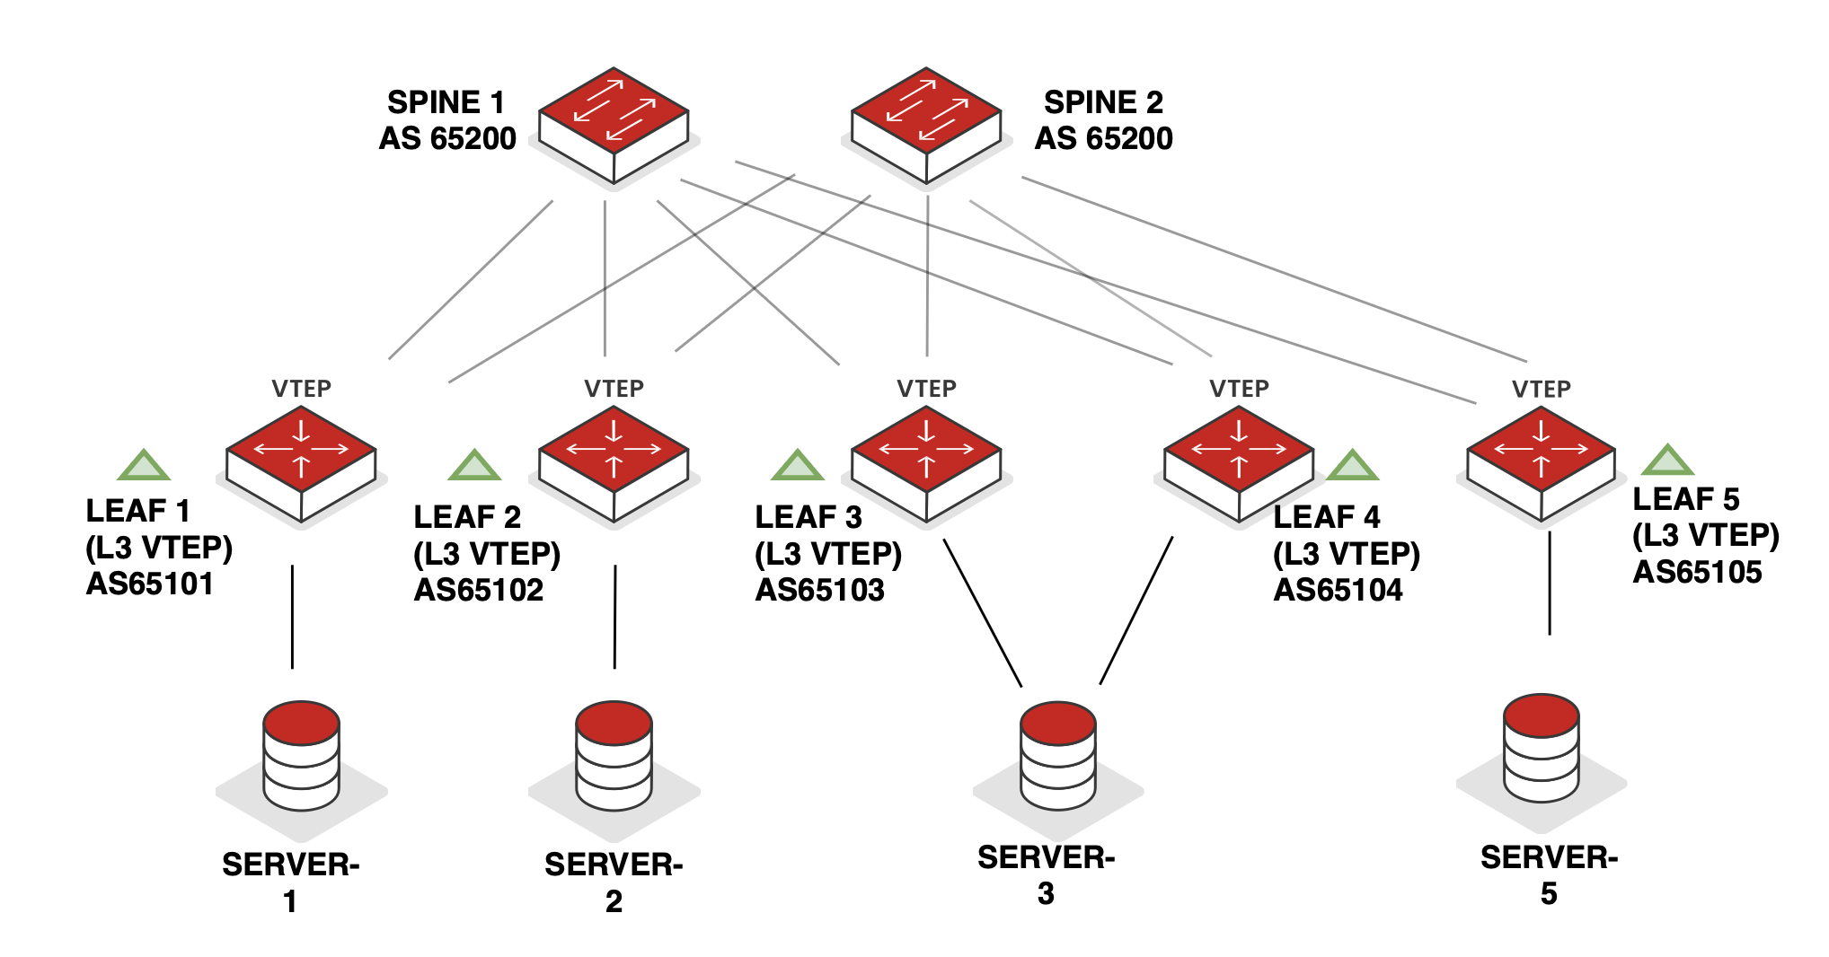
EVPN TYPE 2 - Overview
US
1
eBGP has been established in the underlay and overlay with the relevant address families
2
Server-1 attempts L2 traffic to Server-5, but ARP entry for Server-5 is unknown.
4
3
ARP from Server-1 for Server-5 is received on Leaf -1
Leaf-1 is configured as GW for VLAN 100 & ARP snooping; it learns MAC & IP, populating relevant tables & databases.
3
4
2
VLAN 100 / VNI 10100 192.168.100.10/24
VLAN 100 / VNI 10100 192.168.100.20/24
VLAN 100 / VNI 10100 192.168.100.30/24
VLAN 100 / VNI 10100 192.168.100.50/24
Figure: Type 2 Overview

Slide 98
EVPN TYPE 2 - Overview
US
5
Leaf-1 broadcasts ARP as unicast inside VXLAN tunnels to all VTEPs interested in VNI 100 via ingress replication
5
VLAN 100 / VNI 10100 192.168.100.10/24
VLAN 100 / VNI 10100 192.168.100.20/24
VLAN 100 / VNI 10100 192.168.100.30/24
VLAN 100 / VNI 10100 192.168.100.50/24
Figure: Type 2 Overview

Slide 99
EVPN TYPE 2 - Overview
US
6
Leaf-1 also generates EVPN Type-2 MAC+IP route, advertising Server-1 MAC & IP to all VTEPs for VNI 10100 via BGP updates to spines.
6
6
6
6
7
Leaf-5 uses the Type-2 update to learn MAC & IP, populates tables & databases, & sends ARP request to local VLAN 100 hosts
7
7
VLAN 100 / VNI 10100 192.168.100.10/24
VLAN 100 / VNI 10100 192.168.100.20/24
VLAN 100 / VNI 10100 192.168.100.30/24
VLAN 100 / VNI 10100 192.168.100.50/24
Figure: Type 2 Overview

Slide 100
EVPN TYPE 2 - Overview
US
8
ARP response from Server-5 for Server-1 is received on Leaf 5
9
9
Leaf-5 configured as G/W for VLAN 100 & ARP snooping enabled – it learns Server-5 MAC & IP, updates tables & databases, & advertises T2 MAC/IP route (of Server-5) to VTEPs interested in VNI10100.
9
9
8
VLAN 100 / VNI 10100 192.168.100.10/24
VLAN 100 / VNI 10100 192.168.100.20/24
VLAN 100 / VNI 10100 192.168.100.30/24
VLAN 100 / VNI 10100 192.168.100.50/24
Figure: Type 2 Overview

Slide 101
EVPN TYPE 2 - Overview
US
10
10
Leaf-5 encapsulates ARP response & sends via VXLAN to Leaf-1 only
11
11
Leaf-1 uses T2 update from Leaf-5 to learn MAC & IP, updates tables & databases, & forwards ARP response to Server-1 locally in VLAN 100
VLAN 100 / VNI 10100 192.168.100.10/24
VLAN 100 / VNI 10100 192.168.100.20/24
VLAN 100 / VNI 10100 192.168.100.30/24
VLAN 100 / VNI 10100 192.168.100.50/24
Figure: Type 2 Overview

Slide 102
EVPN TYPE 2 - Overview
US
12
Server-1 & Server-2 can now communicate at Layer 2
12
12
VLAN 100 / VNI 10100 192.168.100.10/24
VLAN 100 / VNI 10100 192.168.100.20/24
VLAN 100 / VNI 10100 192.168.100.30/24
VLAN 100 / VNI 10100 192.168.100.50/24

Slide 103


EVPN TYPE 2 - Overview
US
13
Assuming Server-2 wants to communicate at Layer 2 with Server-5 and lacks its ARP entry it sends an ARP request to Leaf 2
14
Leaf-2 uses previously learned MAC/IP info in tables/databases (from T2 route advertised by Leaf-5) & replies to Server-2 ARP request via proxy ARP, while suppressing ARP flooding into the fabric via ARP suppression
13
VLAN 100 / VNI 10100 192.168.100.10/24
VLAN 100 / VNI 10100 192.168.100.20/24
VLAN 100 / VNI 10100 192.168.100.30/24
VLAN 100 / VNI 10100 192.168.100.50/24
Figure: Type 2 Overview

Slide 104
EVPN ROUTE TYPE 3 - Overview
FM
Please send me BUM Traffic for VNI X
Inclusive Multicast Ethernet Tag (IMET)
Manages Broadcast, Unknown Unicast and Multicast (BUM) traffic
  Identifies remote VTEP's interested in receiving BUM traffic for their VNI’s
  Allows discovery of remote VTEP's
    Learn which VTEP's are in the same VNIs as the local device
    Build ingress replication lists
Figure: Route Type 3
Notes:
Not used when multicast is replicated in the underlay or when static lists are used
Informs other VTEPs of ingress replication mode using PMSI tunnel attribute
Inclusive Multicast Ethernet Tag (IMET)
Used to manage Broadcast, Unknown Unicast and Multicast (BUM) traffic
Using multicast in the underlay for BUM traffic distribution (does NOT use EVPN or EVPN-T3)
Ingress/headend replication (uses EVPN Route Type 3)
Informs other VTEP’s of ingress replication mode (using PMSI tunnel attribute)
Can create a static list or learn dynamically (thru configuration knobs) to identify remote VTEPS interested in receiving BUM traffic for their VNI’s
Serves two main purposes
Allows the local VTEP to discover remote VTEPs
Allows the local VTEP to add remote VTEP’s who are configured with the same VNI’s to a list of interested BUM traffic receivers

Slide 105
EVPN Type 3 - Overview
US
1
eBGP has been established in the underlay and overlay with the relevant address families
2
Leaf-1 is configured with dynamic VNI learning, enabling EVPN Type-3 (T3) route generation (vendor-dependent); (Other leafs configured similarly)
2
VLAN 100 / VNI 10100 192.168.100.10/24
VLAN 100 / VNI 10100 192.168.100.20/24
VLAN 100 / VNI 10100 192.168.100.30/24
VLAN 100 / VNI 10100 192.168.100.50/24
Silent Host
Figure: Type 3 Overview

Slide 106
EVPN Type 3 - Overview
US
Leaf-1 advertises EVPN Type-3 (T3) route to remote VTEPs; other leafs follow same process (not shown for brevity).
Leaf-1 receives EVPN T3 routes from remote VTEPs, identifies VNI interest overlap, & establishes VXLAN ingress-replication tunnels.
3
3
3
3
3
VLAN 100 / VNI 10100 192.168.100.10/24
VLAN 100 / VNI 10100 192.168.100.20/24
VLAN 100 / VNI 10100 192.168.100.30/24
VLAN 100 / VNI 10100 192.168.100.50/24
Silent Host
Figure: Type 3 Overview

Slide 107
EVPN Type 3 - Overview
US
4
Server-1 sends ARP request for Server-5 to Leaf-1; Leaf-1 has no corresponding ARP entry in local tables/databases
5
Leaf-1 uses ingress replication to interested VTEPs (identified via EVPN Type-3 routes) & replicates ARP request individually to each remote VTEP
5
4
VLAN 100 / VNI 10100 192.168.100.10/24
VLAN 100 / VNI 10100 192.168.100.20/24
VLAN 100 / VNI 10100 192.168.100.30/24
VLAN 100 / VNI 10100 192.168.100.50/24
Silent Host
Figure: Type 3 Overview

Slide 108
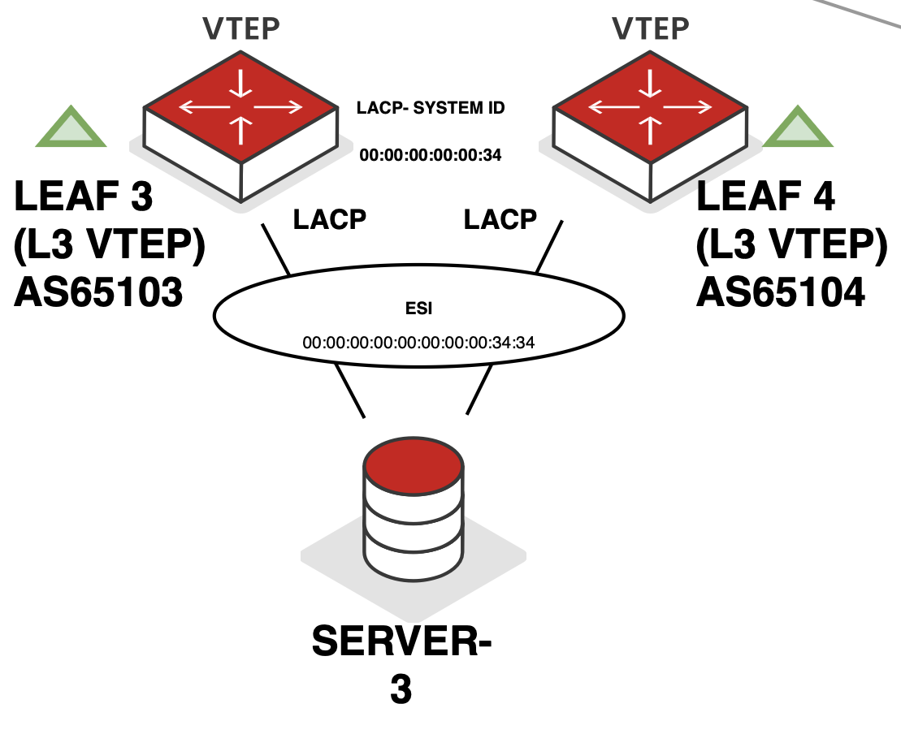
EVPN Type 4 - Overview
FM
Ethernet Segment route
Used for multi-homed peers
Two common forms of multi-homing (based on vendor support)
    M-LAG (Out of Scope for Presentation)
    EVPN Multi-homing
  Used for Designated Forwarder (DF) election between ESI LAG peers (modulo operation – RFC7432/other options to change behaviour available – check documentation!)
  Ethernet Segment Identifier (ESI) – used to jointly identify common ethernet segments between EVPN multihomed peers
    Also attached to EVPN T2 routes
  DF
    Permitted to forward BUM traffic from fabric to hosts on the ethernet segment
  Non-DF
    Prohibited to forward BUM traffic from fabric to hosts on the ethernet segment
EVPN Multi-homing
Figure: Type 4 Overview

Slide 109
EVPN TYPE 4 - Overview
US
1
eBGP has been established in the underlay and overlay with the relevant address families
5
2
Server-3 is dual-homed with Leaf-3 & Leaf-4
3
3
3
Relevant EVPN multi-homing configuration is given on Leaf 3 & Leaf 4
Designated Forwarder
non-Designated Forwarder
4
Server-3 sends an ARP request to Server-2 which is received on Leaf-3
4
2
5
Leaf-3 learns MAC/IP via ARP & advertises EVPN Type-2 (T2) route with Server-3 MAC+IP to all leafs, including ESI signalling to remote VTEPs for multi-homed reachability
VLAN 100 / VNI 10100 192.168.100.10/24
VLAN 100 / VNI 10100 192.168.100.20/24
VLAN 100 / VNI 10100 192.168.100.30/24
VLAN 100 / VNI 10100 192.168.100.50/24
Figure: Type 4 Overview

Slide 110
EVPN TYPE 4 - Overview
US
6
6
6
Leaf-4 also receives T2 route & uses local logic to learn MAC/IP bindings potentially learned via remote EVPN LAG peer due to hashing
7
Designated Forwarder
non-Designated Forwarder
7
Leaf-2 learns MAC/IP information, updates tables, & forwards ARP request to Server-2 (refer to EVPN T2 slides for remaining process).
VLAN 100 / VNI 10100 192.168.100.10/24
VLAN 100 / VNI 10100 192.168.100.20/24
VLAN 100 / VNI 10100 192.168.100.30/24
VLAN 100 / VNI 10100 192.168.100.50/24
Figure: Type 4 Overview

Slide 111
EVPN TYPE 4 - Overview
US
8
Assume Server-5 sends ARP request to Server-3; ingress replication from Leaf-5 delivers BUM traffic to Leaf-3 & Leaf-4.
8
9
8
9
Leaf-4 will discard BUM traffic from the fabric towards the ES as it’s the non-DF. Server-3 receives the ARP-request only from Leaf-3
9
8
Designated Forwarder
non-Designated Forwarder
9
VLAN 100 / VNI 10100 192.168.100.10/24
VLAN 100 / VNI 10100 192.168.100.20/24
VLAN 100 / VNI 10100 192.168.100.30/24
VLAN 100 / VNI 10100 192.168.100.50/24
Figure: Type 4 Overview

Slide 112
EVPN ROUTE TYPE 5 - Overview
FM
I have an
IP Prefix!
IP Prefix Route
Provides Layer 3 Connectivity
    Similar to MPLS VRF
Common Uses:
    Symmetric Routing within DC
    Layer 3 DCI
    CDN Anycast
Figure: Route Type 5

Slide 113
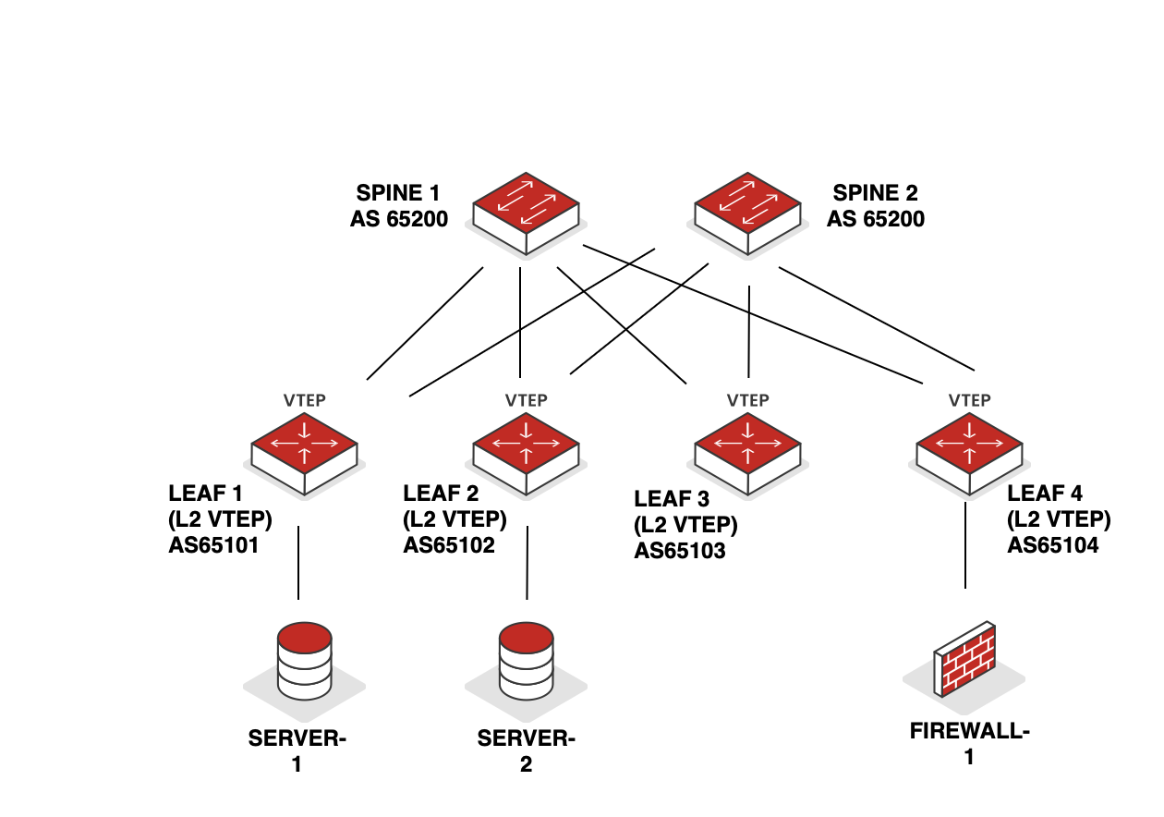
EVPN TYPE 5 - OVERVIEW
US
0.0.0.0/0 advertised as EVPN T5
0.0.0.0/0 received as EVPN T5
Installed in relevant tables/database
2
3
4
BGP (IPv4 Unicast)
0.0.0.0/0 n/h Firewall-1
Redistribute & advertised EVPN T5 0.0.0.0/0 route >> BGP IPv4 Unicast 0.0.0.0/0 to Server-1
1
Figure: Type 5 Overview

Slide 114
ASYMMETRIC ROuting
US

Slide 115
Asymmetric Routing - overview
US
Assumptions:
instance-type > MAC-VRF
Service-type vlan-aware
1
eBGP has been established in the underlay and overlay with the relevant address families
2
Anycast gateways configured with identical VLAN/VNI & L3 gateways across all leaf switches
2
2
2
2
2
3
Server-1 sends traffic to Server-5 on a different network & resolves ARP for its local gateway on Leaf 1.
Server-5’s MAC/IP is already learned on Leaf 1 via prior EVPN Type-2 route from Leaf 5
 | Additional Information
 | VLAN | VNI | MAC | IP Address
 | 20 | 10020 | 2A | 192.168.1.20.1/24
 | 40 | 10040 | 4B | 192.168.1.40.1/24
LEAF 1 LOOPBACK |  |  |  | 192.168.255.1
LEAF 5 LOOPBACK |  |  |  | 192.168.255.5
VLAN 20 / VNI 10020 192.168.20.10/24
VLAN 40 / VNI 10040 192.168.40.50/24
Figure: Asymmetric Routing Overview

Slide 116
Asymmetric Routing - overview
US
4
Server-1 sends traffic destined for Server-5. The destination MAC is VLAN 20’s G/W MAC on Leaf 1
SRC: AA
DST: 2A
6
SRC: 192.168.20.10
DST: 192.168.40.50
Payload
5
5
Leaf 1 processes traffic matching its local MAC & identifies the destination as locally connected via VLAN 40 gateway
4
Packet is locally routed & a subsequent lookup determines reachability to Server-5 within VLAN 40 bridge domain in the L2VPN instance
Traffic is then sent with the VNI tag associated with VLAN 40 (VNI 10040)
6
VLAN 20 / VNI 10020 192.168.20.10/24
VLAN 40 / VNI 10040 192.168.40.50/24
Figure: Asymmetric Routing Overview

Slide 117
Asymmetric Routing - overview
US
VLAN 20 / VNI 10020 192.168.20.1/24
VLAN 40 / VNI 10040 192.168.40.1/24
7
Traffic arrives on Leaf 5 where the VxLAN header is decapsulated
8
Traffic is bridged to Server-5 via L2VNI 10040. Return traffic from Server-5 to Server-1 follows the same process, with the source VTEP routing locally & forwarding via the egress VTEP within the L2VN
7
8
VLAN 20 / VNI 10020 192.168.20.10/24
VLAN 40 / VNI 10040 192.168.40.50/24
instance-type > MAC-VRF
Service-type vlan-aware
Figure: Asymmetric Routing Overview

Slide 118
SYMMETRIC ROuting
US

Slide 119
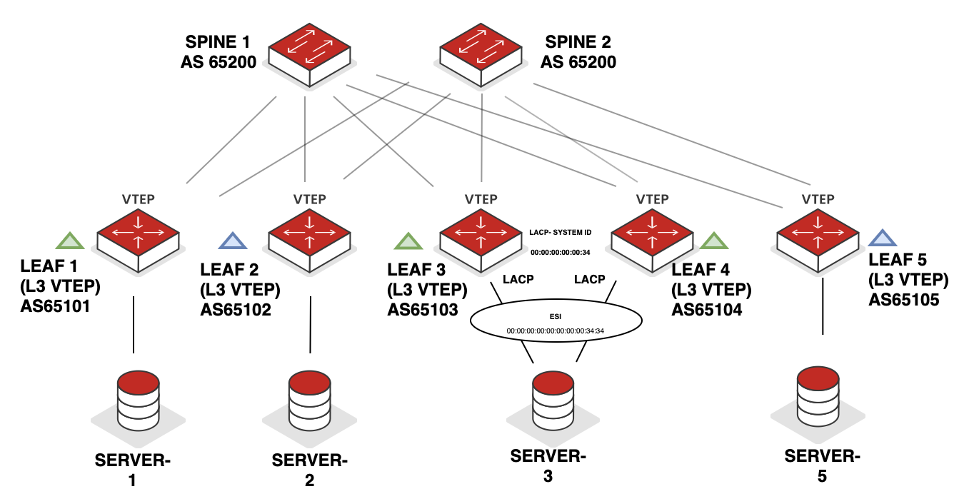
symmetric ROUTING - overview
US
VLAN 20 / VNI 10020 192.168.20.1/24
VLAN 40 / VNI 10040 192.168.40.1/24
1
eBGP has been established in the underlay and overlay with the relevant address families
2
Appropriate anycast gateways have been configured on leafs where end hosts reside requiring layer 3 reachability
LEAF 1
LEAF 5
VRF_CE2040
IRB/SVI - VLAN 20
RT 100:2040
VRF_CE2040
IRB/SVI - VLAN 40
RT 100:2040
2
2
L3VNI 2040 (RT 1:2040)
MAC-VRF CE20
LEAF 2
MAC-VRF CE40
VRF_CE2040
IRB/SVI - VLAN 40
RT 100:2040
MAC-VRF CE40
L2VNI 40 (RT 1:40)
Figure: Symmetric Routing Overview

Slide 120
symmetric ROUTING - overview
US
VLAN 20 / VNI 10020 192.168.20.1/24
L3VNI 2040
vrf-instance -> VRF_CE2040
VLAN 40 / VNI 10040 192.168.40.1/24
3
All leafs then create an L3VPN instance & enable symmetric routing. Within this instance, the L3VNI is defined. For this example, L3VNI = 2040.
4
Server-1 communicates with Server-5 & sends an ARP to its gateway configured on Leaf 1
3
3
3
3
3
4
VLAN 20 / VNI 10020 192.168.20.10/24
VLAN 40 / VNI 10040 192.168.40.50/24
Figure: Symmetric Routing Overview

Slide 121
symmetric ROUTING - overview
US
VLAN 20 / VNI 10020 192.168.20.1/24
L3VNI 2040
vrf-instance -> VRF_CE2040
VLAN 40 / VNI 10040 192.168.40.1/24
5
6
5
Leaf 1 learns MAC/IP binding & populates ARP & EVPN tables. Host route (/32) is also installed in the IP VPN table.
Leaf 1 advertises the following routes:
T2 > MAC of Server-1
T2 > MAC + IP of Server-1
T5 > IRB/SVI Subnet (VLAN 20 G/W)
6
VLAN 20 / VNI 10020 192.168.20.10/24
VLAN 40 / VNI 10040 192.168.40.50/24
Figure: Symmetric Routing Overview

Slide 122
symmetric ROUTING - overview
US
VLAN 20 / VNI 10020 192.168.20.1/24
L3VNI 2040
vrf-instance -> VRF_CE2040
VLAN 40 / VNI 10040 192.168.40.1/24
7
Leaf 5 performs the following:
imports the MAC route into the MACVRF if the VLAN/Bridge Domain exists. Since the VLAN/BD does not exist in this example, no entries are added
The /32 host IP of Server-1 is imported into the relevant VRF table
The IRB/SVI Subnet (VLAN 20 G/W) is imported into the relevant VRF table
8
7
8
The same process applies to Server-5’s MAC/IP and Leaf 5’s G/W route to be installed on Leaf 1
VLAN 20 / VNI 10020 192.168.20.10/24
VLAN 40 / VNI 10040 192.168.40.50/24
Figure: Symmetric Routing Overview

Slide 123
symmetric ROUTING - overview
US
VLAN 20 / VNI 10020 192.168.20.1/24
L3VNI 2040
vrf-instance -> VRF_CE2040
VLAN 40 / VNI 10040 192.168.40.1/24
9
Leaf 1 receives traffic from Server-1 destined for Server-5.
A route lookup is performed as IRB/SVI 20 is bound to routing instance VRF_CE2040. A matching route exists for Server-5.
9
Ethernet header is rewritten:
SRC MAC = Leaf 1 IRB MAC
DST MAC = Leaf 5 IRB MAC.
Packet is encapsulated into L3VNI (VNI 2040) & routed to Leaf 5.
VLAN 20 / VNI 10020 192.168.20.10/24
VLAN 40 / VNI 10040 192.168.40.50/24
Figure: Symmetric Routing Overview

Slide 124


symmetric ROUTING - overview
US
VLAN 20 / VNI 10020 192.168.20.1/24
L3VNI 2040
vrf-instance -> VRF_CE2040
VLAN 40 / VNI 10040 192.168.40.1/24
10
Traffic is received on Leaf 5.
Since the destination MAC matches its own IRB, a route lookup is triggered. L3VNI maps to the VRF containing VLAN 40, so traffic is locally forwarded to VLAN 40, transitioning from L3VNI to L2VNI.
11
Traffic from L2VNI is then switched & bridged to Server-5
VLAN 20 / VNI 10020 192.168.20.10/24
VLAN 40 / VNI 10040 192.168.40.50/24
Figure: Symmetric Routing Overview

Slide 125
OTT WALKTHROUGH
US

Slide 126
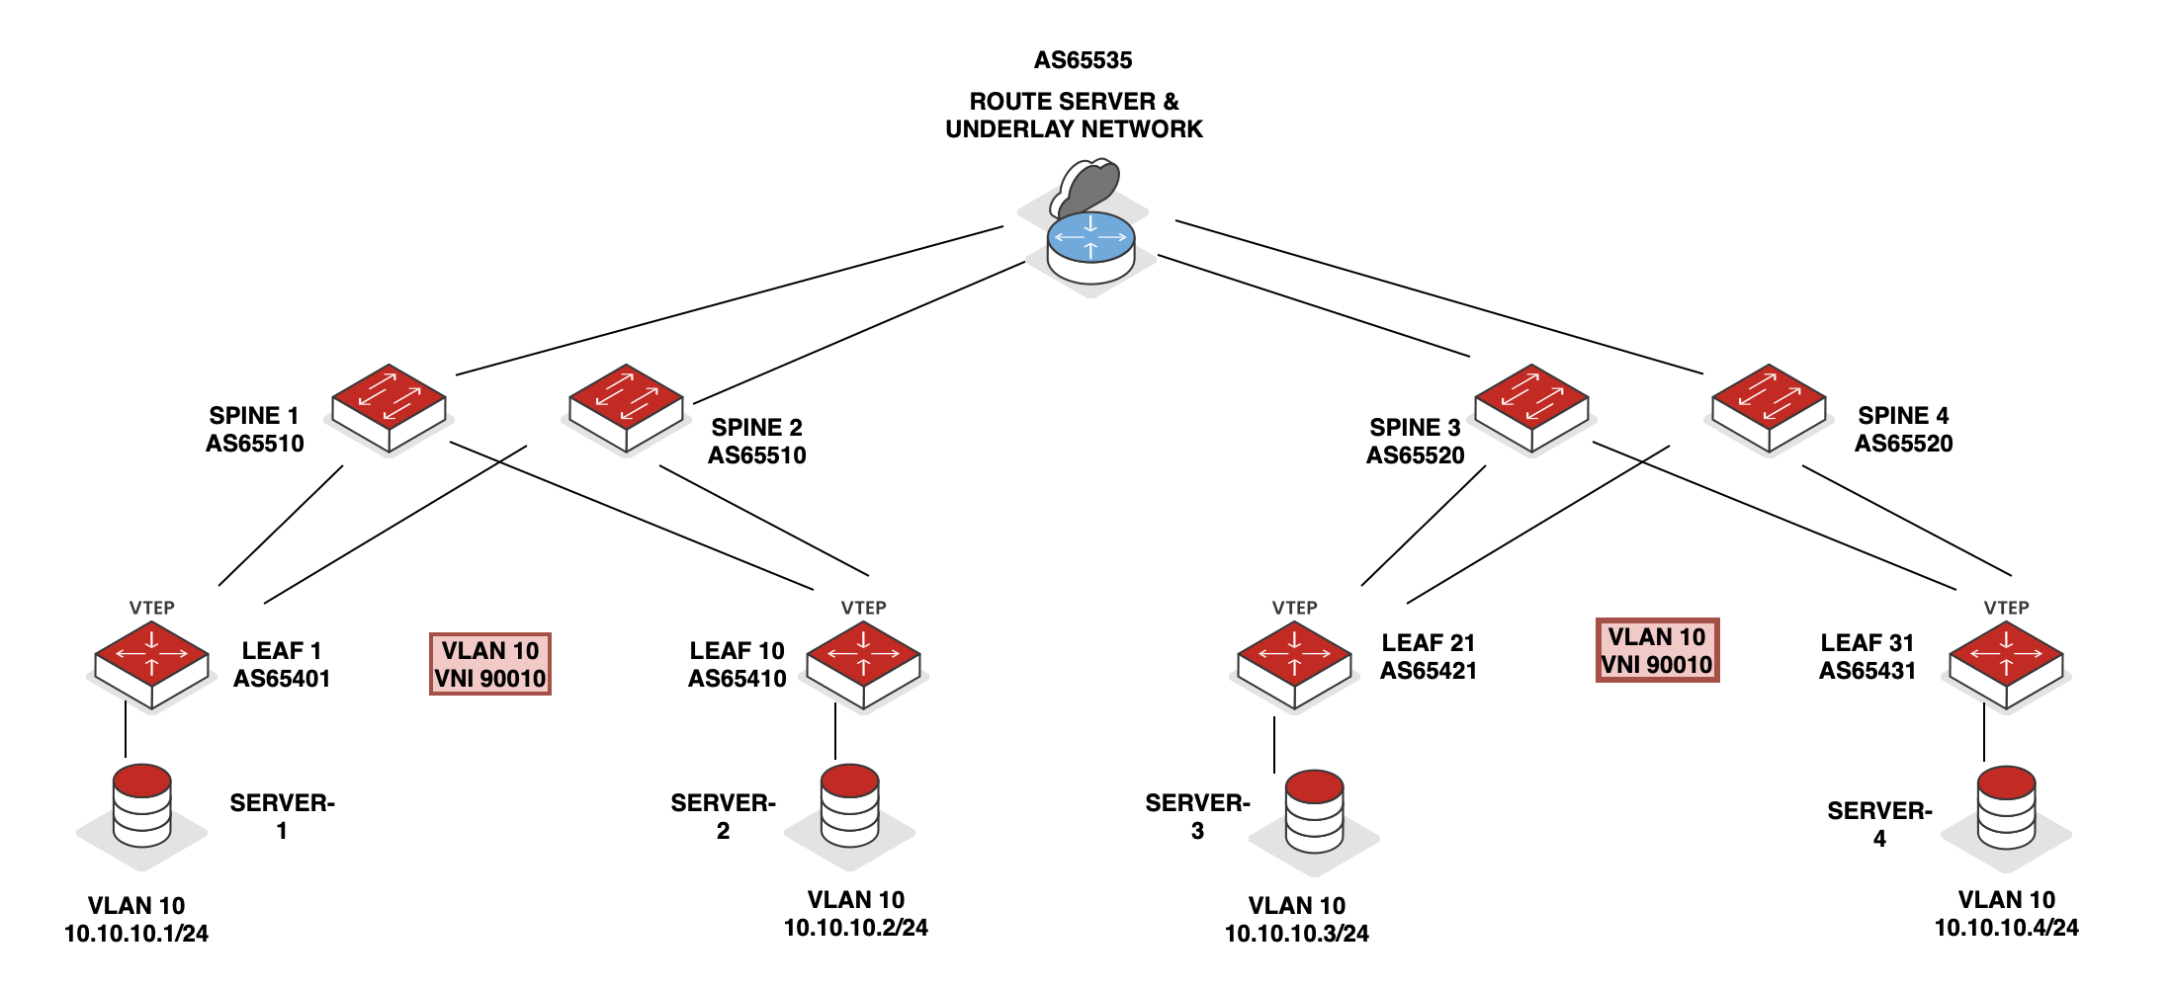
OTT Walkthrough
US
1
eBGP has been established in the underlay and overlay with the relevant address families between spines and leafs local to it’s only data centre, only
2
The route server peers with spines to exchange loopback routes in the underlay via eBGP
2
2
DC-1
DC-2
1
1
Figure: OTT Walkthrough

Slide 127
OTT Walkthrough
US
3
DC-1’s spines advertise their local DC’s loopbacks to the route server
4
DC-2’s spines advertise their local DC’s loopbacks to the route server
3
4
DC-1
DC-2
Figure: OTT Walkthrough

Slide 128
OTT Walkthrough
US
5
The route server advertises DC1’s loopback routes to DC2
6
The route server advertises DC2’s loopback routes to DC1
5
6
DC-1
DC-2
Figure: OTT Walkthrough

Slide 129
OTT Walkthrough
US
7
The spines in each DC further advertise the remote DC’s underlay loopback routes to their local leafs.
8
Underlay loopback reachability is now complete & each leaf should know how to reach leafs in remote DC’s
DC-1
DC-2
7
7
8
8
8
8
Figure: OTT Walkthrough

Slide 130
OTT Walkthrough
US
The spines from DC 1 & DC 2 peer with the route servers using eBGP* and signal their interest to receive EVPN routes
* without changing the next-hop of EVPN advertisements thru additional configuration
9
9
DC-1
DC-2
Figure: OTT Walkthrough

Slide 131
OTT Walkthrough
US
Relevant EVPN routes are now exchanged between leaf’s in the EVPN overlay.
Leaf-1 & Leaf-31 have learnt their local hosts MAC address via ARP snooping & advertise this to all remote VTEPs (in this example)
10
DC-1
DC-2
10
10
Figure: OTT Walkthrough

Slide 132
OTT Walkthrough
US
Server-1 sends its traffic to Server-4. Traffic is encapsulated by Leaf-1 and the VxLAN packet gets a VNI of 90010
The Route Server(s) becomes a transit node in the underlay facilitating communication between DC-1 & DC-2
11
12
12
11
DC-1
DC-2
11
Figure: OTT Walkthrough

Slide 133
OTT Walkthrough
US
13
Leaf-31 receives the VxLAN traffic with a VNI of 90010
14
Leaf-31 forwards the payload after removing the necessary headers
DC-1
DC-2
13
14
Figure: OTT Walkthrough

Slide 134
EVPN Route Types
Provides layer 3 connectivity
Common use cases:
  Symmetric routing within DC
  Layer 3 DCI
  CDN Anycast
T5
IP Prefix Routes
Gateway 333
VNI 333
Gateway 666
VNI 666
VLAN 333
VLAN 666

Slide 135
THANK YOU!

