Slide 1
Infoblox unites networking, security and cloud with a protective DDI platform that delivers enterprise resilience and agility.
Notes:
These modern networking and security challenges aren’t independent—they are interconnected. Which is why we are uniting networking and security with tools to help them work better together.

Slide 3




FORGED THROUGH CONSTANT
GROWTH AND INNOVATION
Launch of
Universal
DDI
Hyperscaler Partnerships
SOC
Insights
Decoy Dog Threat Intel
New CEO
Scott Harrell
Investment
Acquired
Launch of
Threat Defense
security solution
Secure DNS
as a Service
Vista acquired
Infoblox
Virtual DDI
in the Public & Hybrid Cloud
Acquired
DNS
Firewall
Acquired
IPO
NYSE
Delivered
DNS
Appliance
Distributed
DDI
Management
2000
2005
2010
2012
2013
2014
2016
2017
2019
2020
2023
2024
2025
Notes:
Innovation, as well as major advances in DHCP and IPAM, has been the result of over 2 decades of investment in technology, business partnerships and exceptional leadership

Slide 4




OUR PROTECTIVE DDI PLATFORM DELIVERS ENTERPRISE
RESILIENCE AND AGILITY
We seamlessly integrate, secure and automate critical network services, so organizations can move fast without compromise.
Notes:
Infoblox unites networking and security to deliver unmatched performance and protection.
Trusted by Fortune 100 companies and emerging innovators, we provide real-time visibility and control over who and what connects to your network, so your organization runs faster and stops threats earlier.

Slide 5
WE UNITE NETWORKING, SECURITY AND CLOUD
Infoblox is a pioneer in DNS and is the leading provider of DNS, DHCP, IPAM and security solutions
NETWORKING
SECURITY
CLOUD
Universal DDI across on-prem and clouds
Unified internal and external DNS management
First and only DDI as-a-service
Industry-leading resiliency architecture
End-to-end on-prem and cloud visibility
Built-in DNS security protection
Preemptive protection against AI-driven and sophisticated attacks
Algorithmic protections to block data exfiltration, DGAs and Zero Day DNS
Brand protection by identifying and taking down
lookalike domains
Security ecosystem integrations (open API)
SOC Insights to speed up incident response
Threat exposure management
Unified DNS management across clouds, on-prem, and external providers
Consistent policies everywhere—cloud, on-prem, and external DNS
Universal IP address management across on-prem and public clouds
Cross-cloud automation with a single API
Flexible delivery options: as a service or virtual appliances
Unified asset visibility across your entire digital estate
Notes:
We unite networking and security through a comprehensive set of solutions across the technology landscape in order to deliver visibility, control, automation and security across the enterprise.

Slide 6

The great escape from on-prem
From on-prem to Protocol-as-a-Service: an Enterprise Journey
Ed Daniel, STAFF TECHNICAL MARKETING ENGINEER
NETUK3, London, july 2026

Slide 7
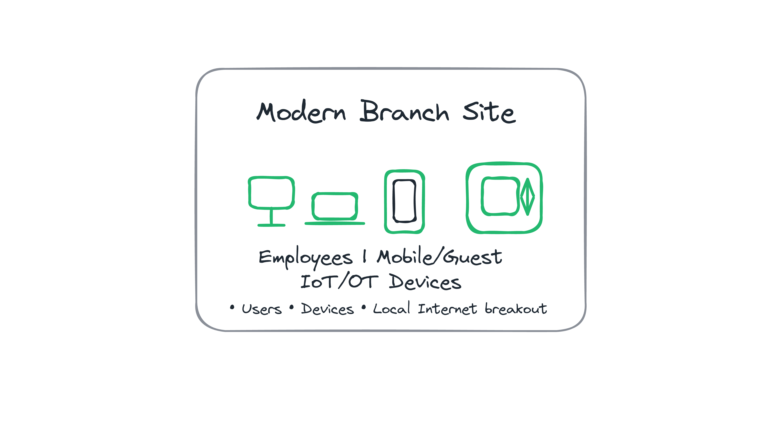
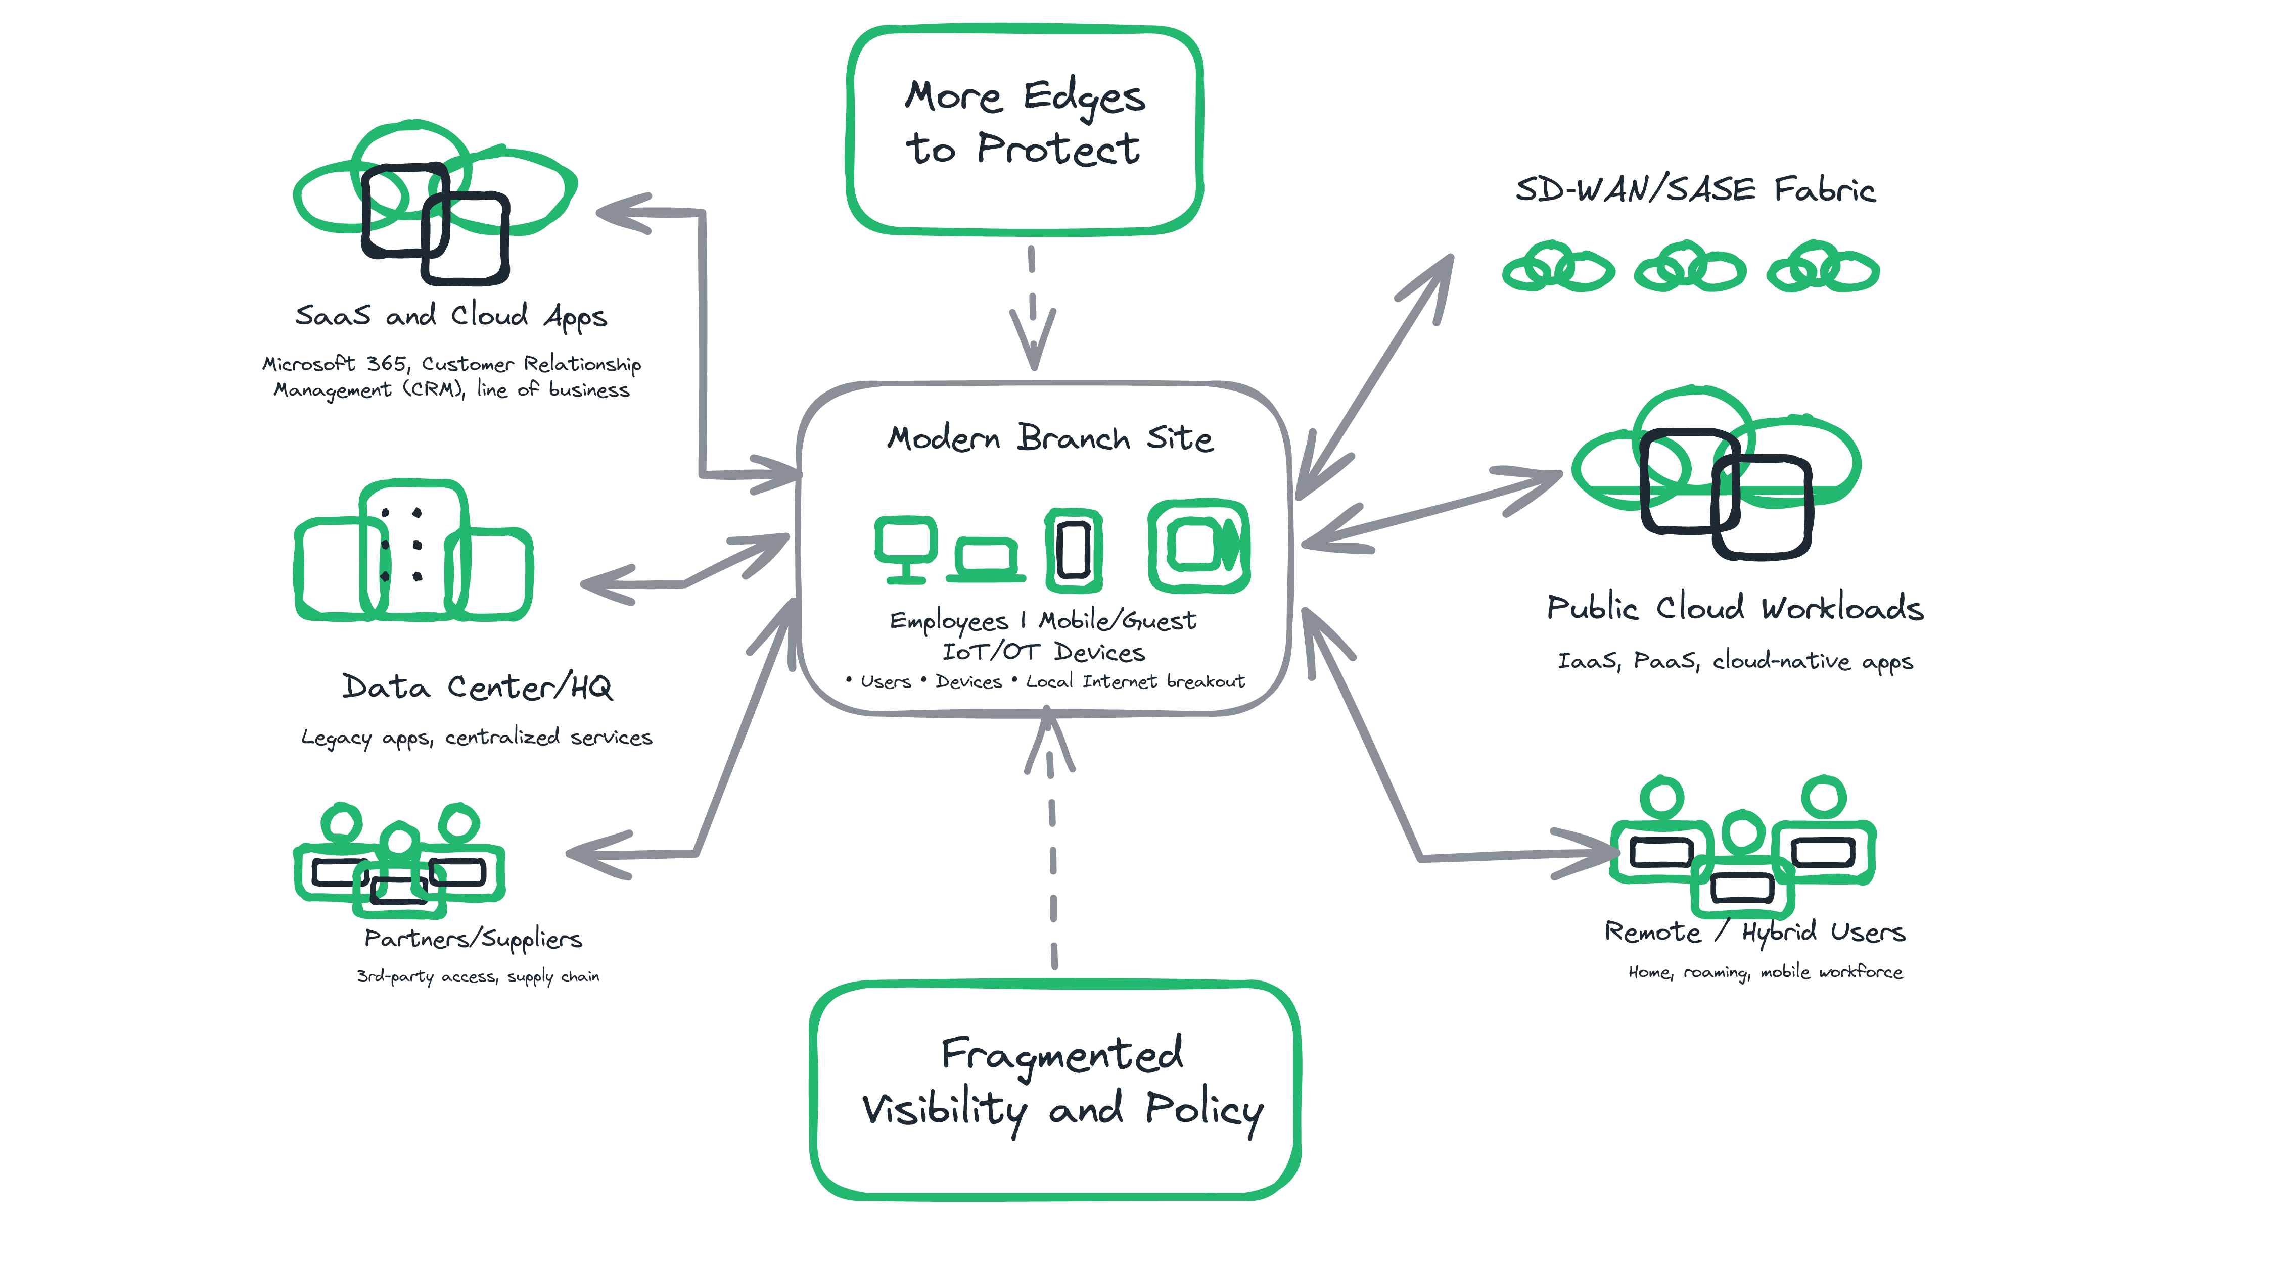
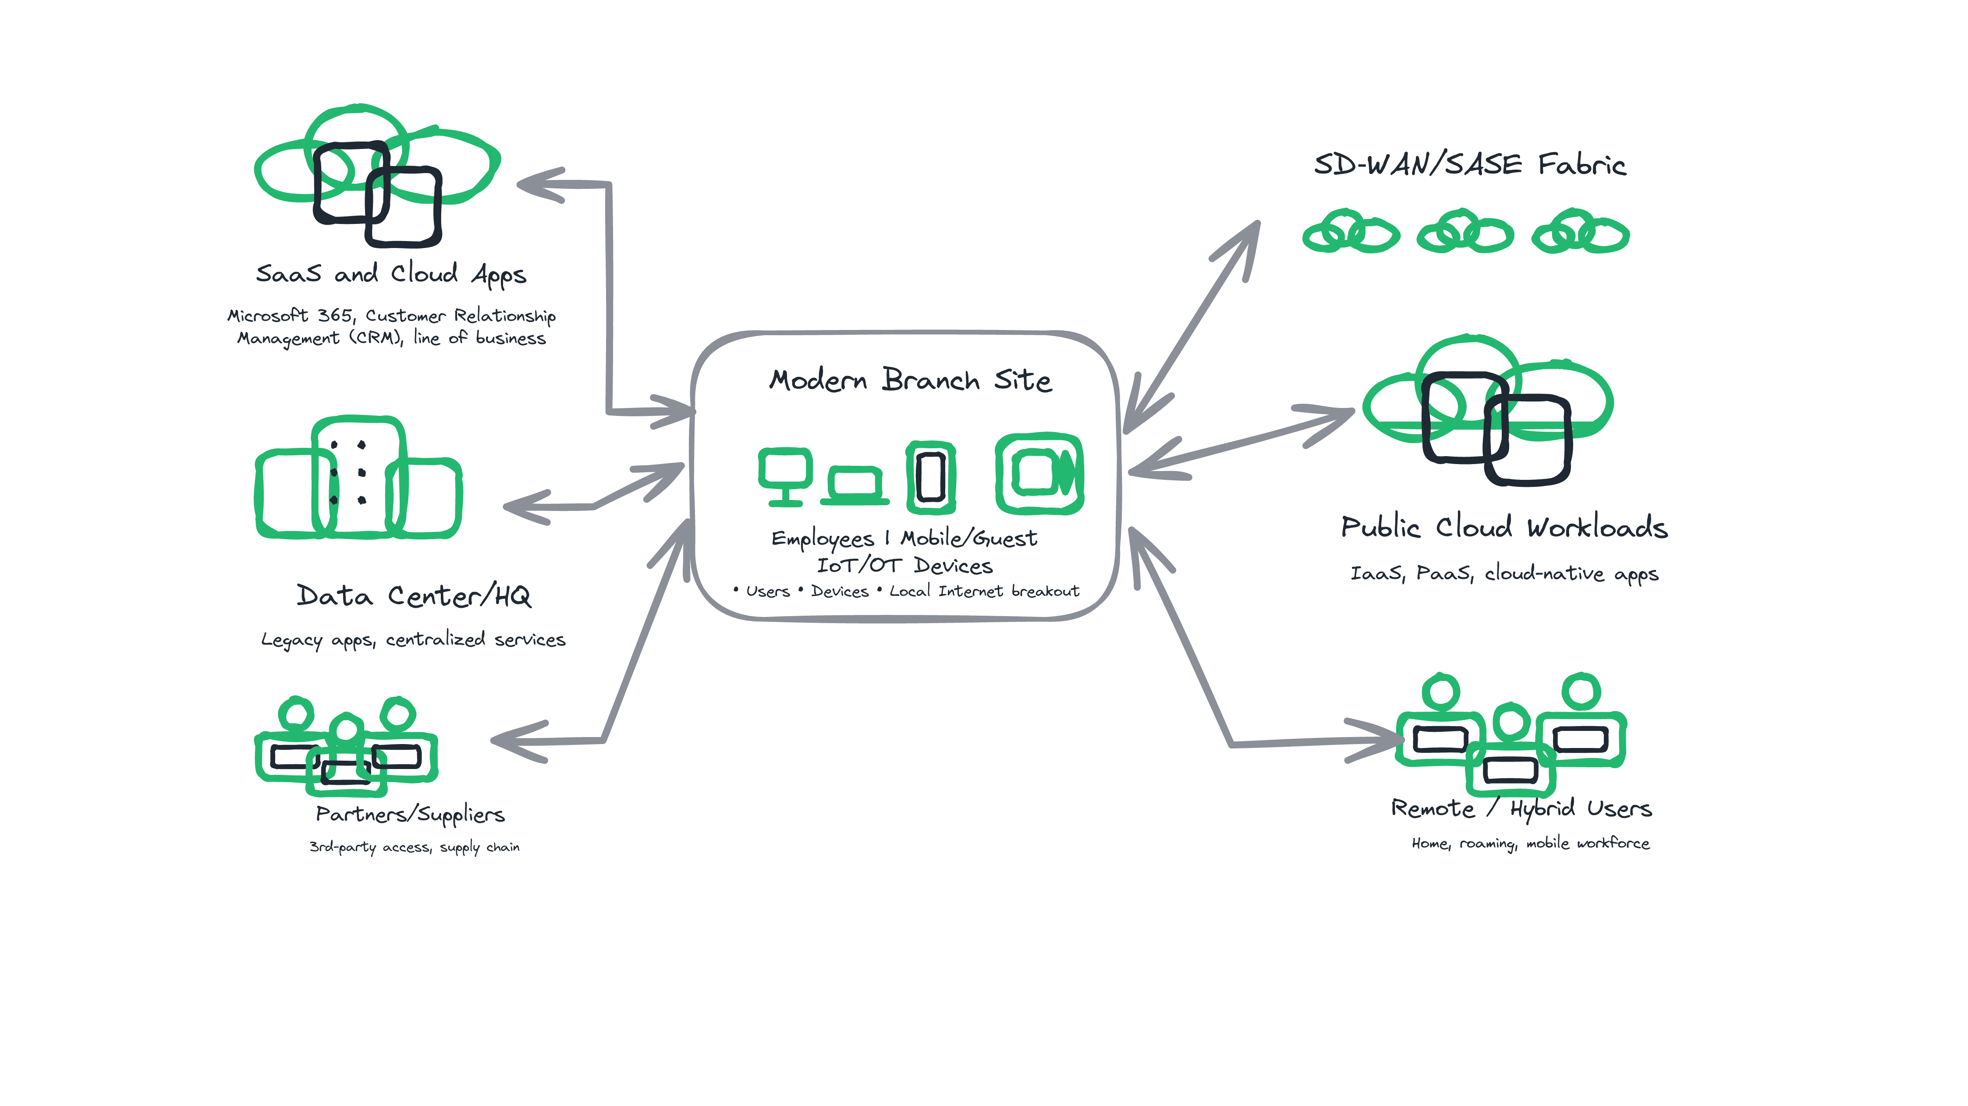
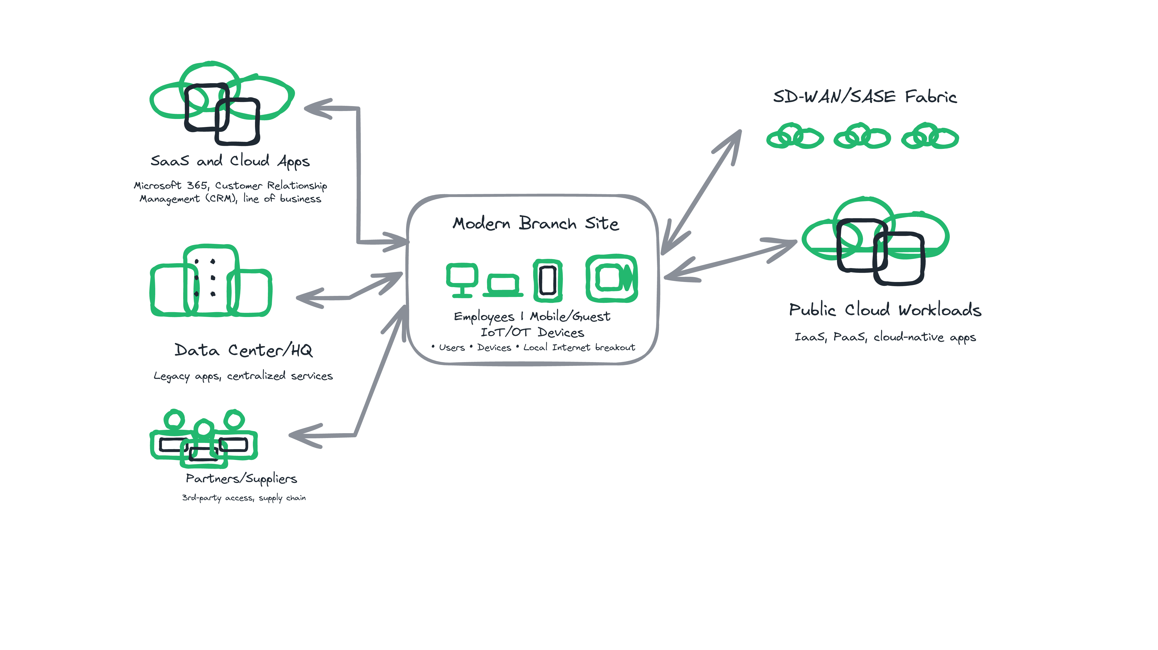
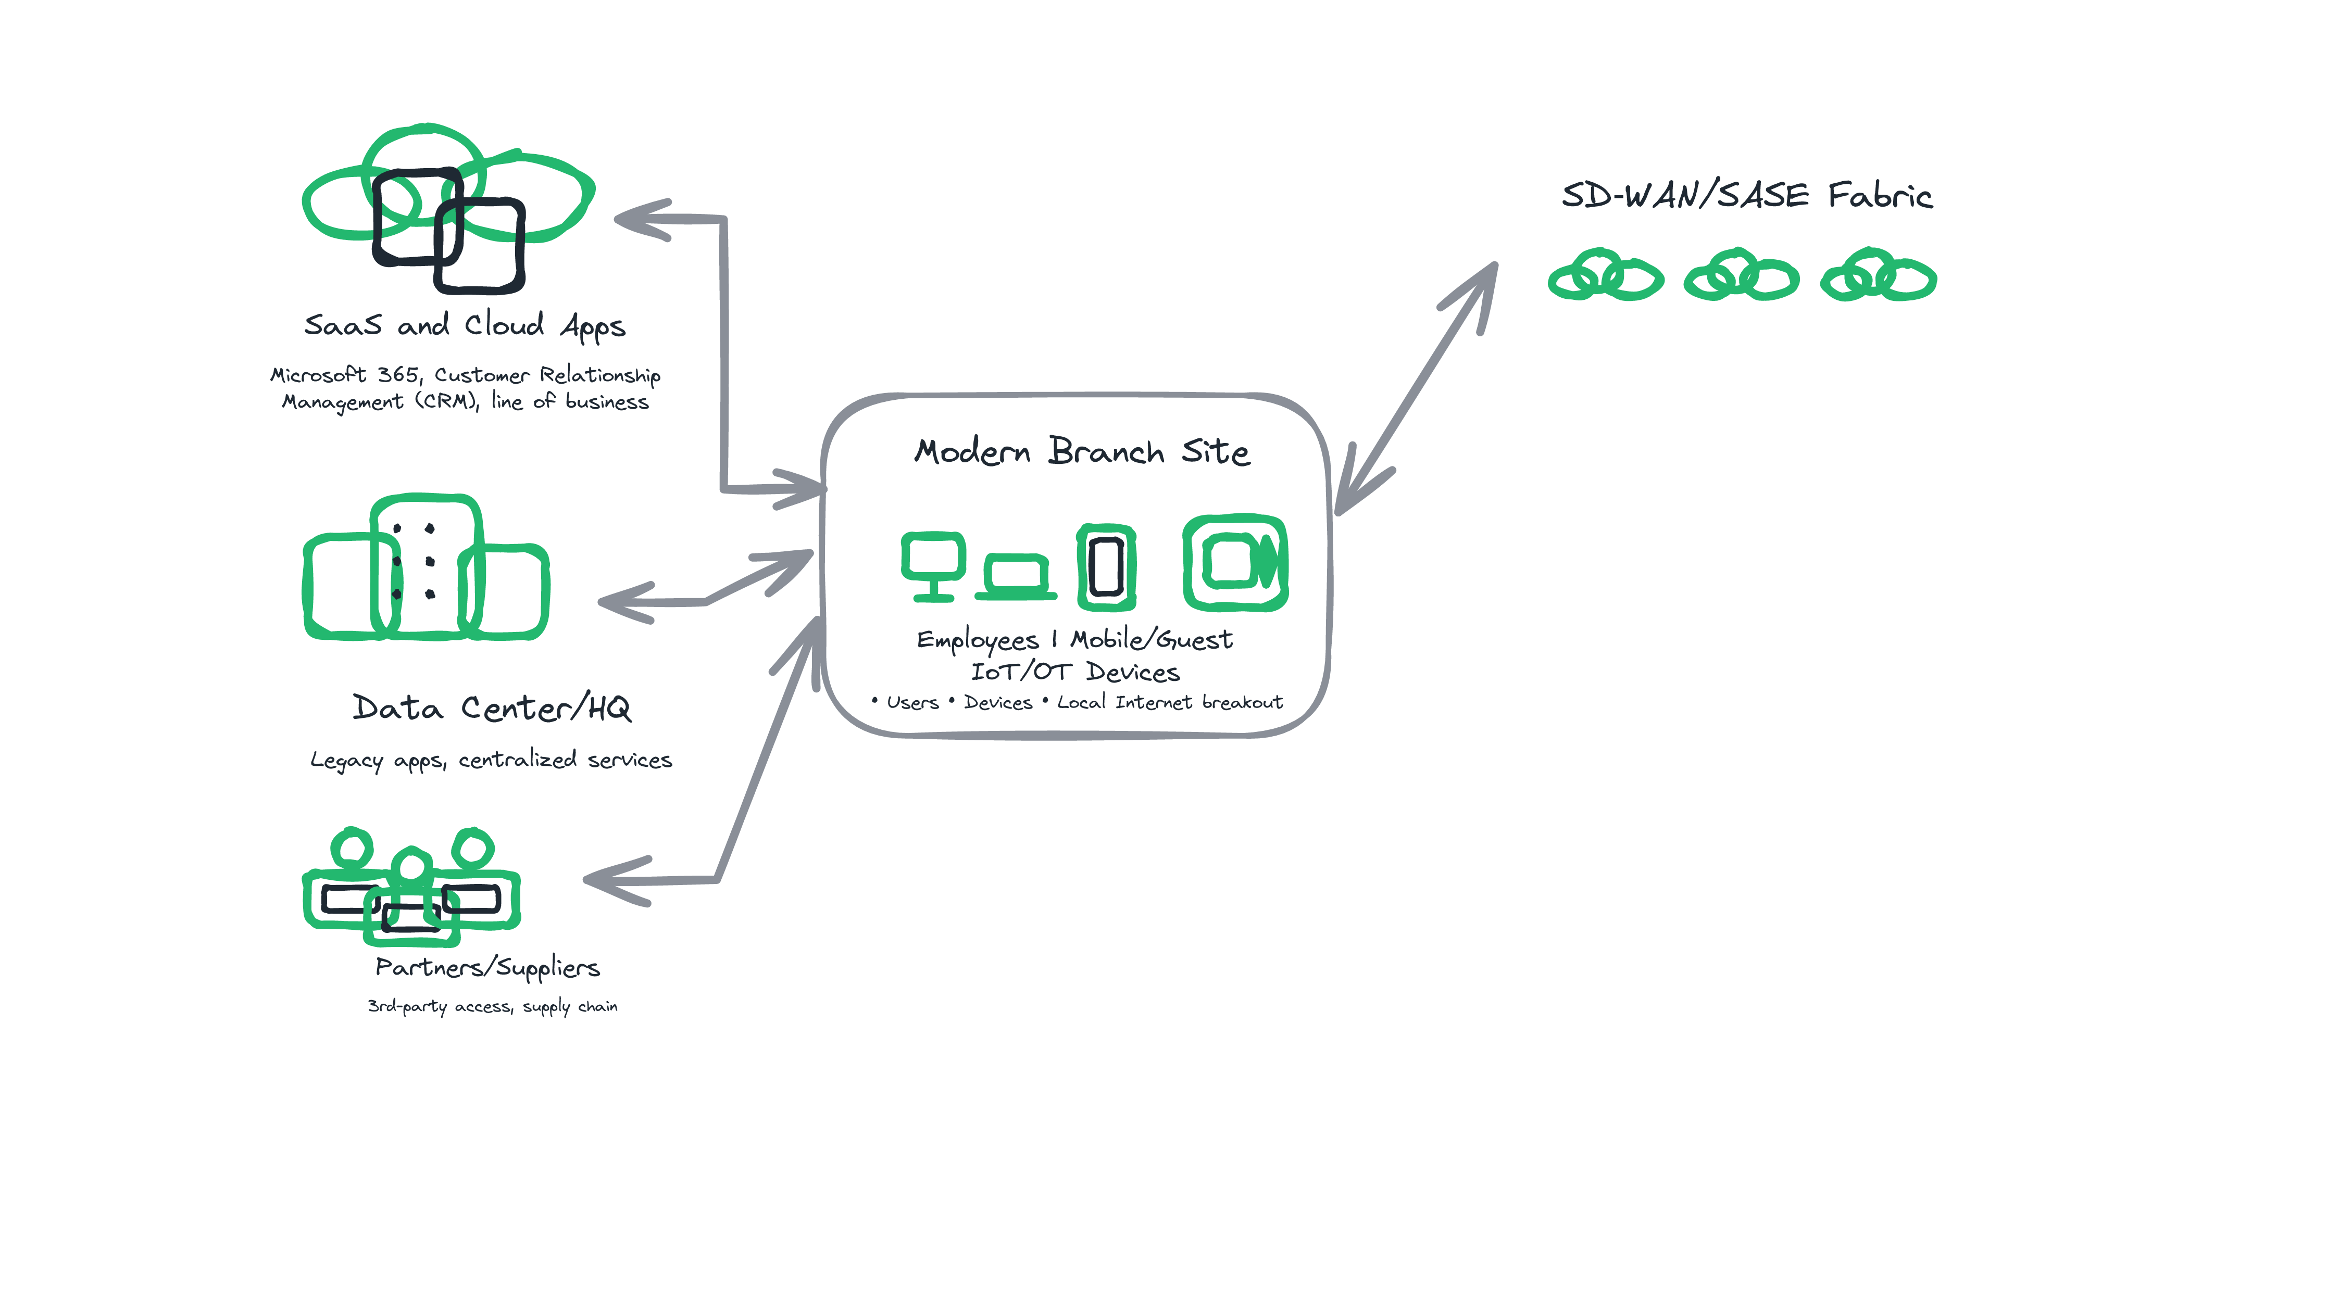
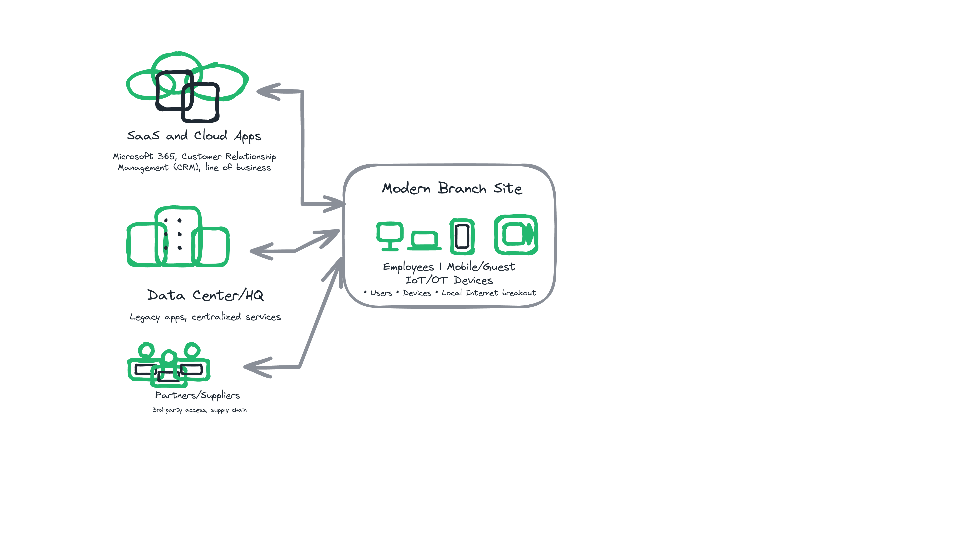
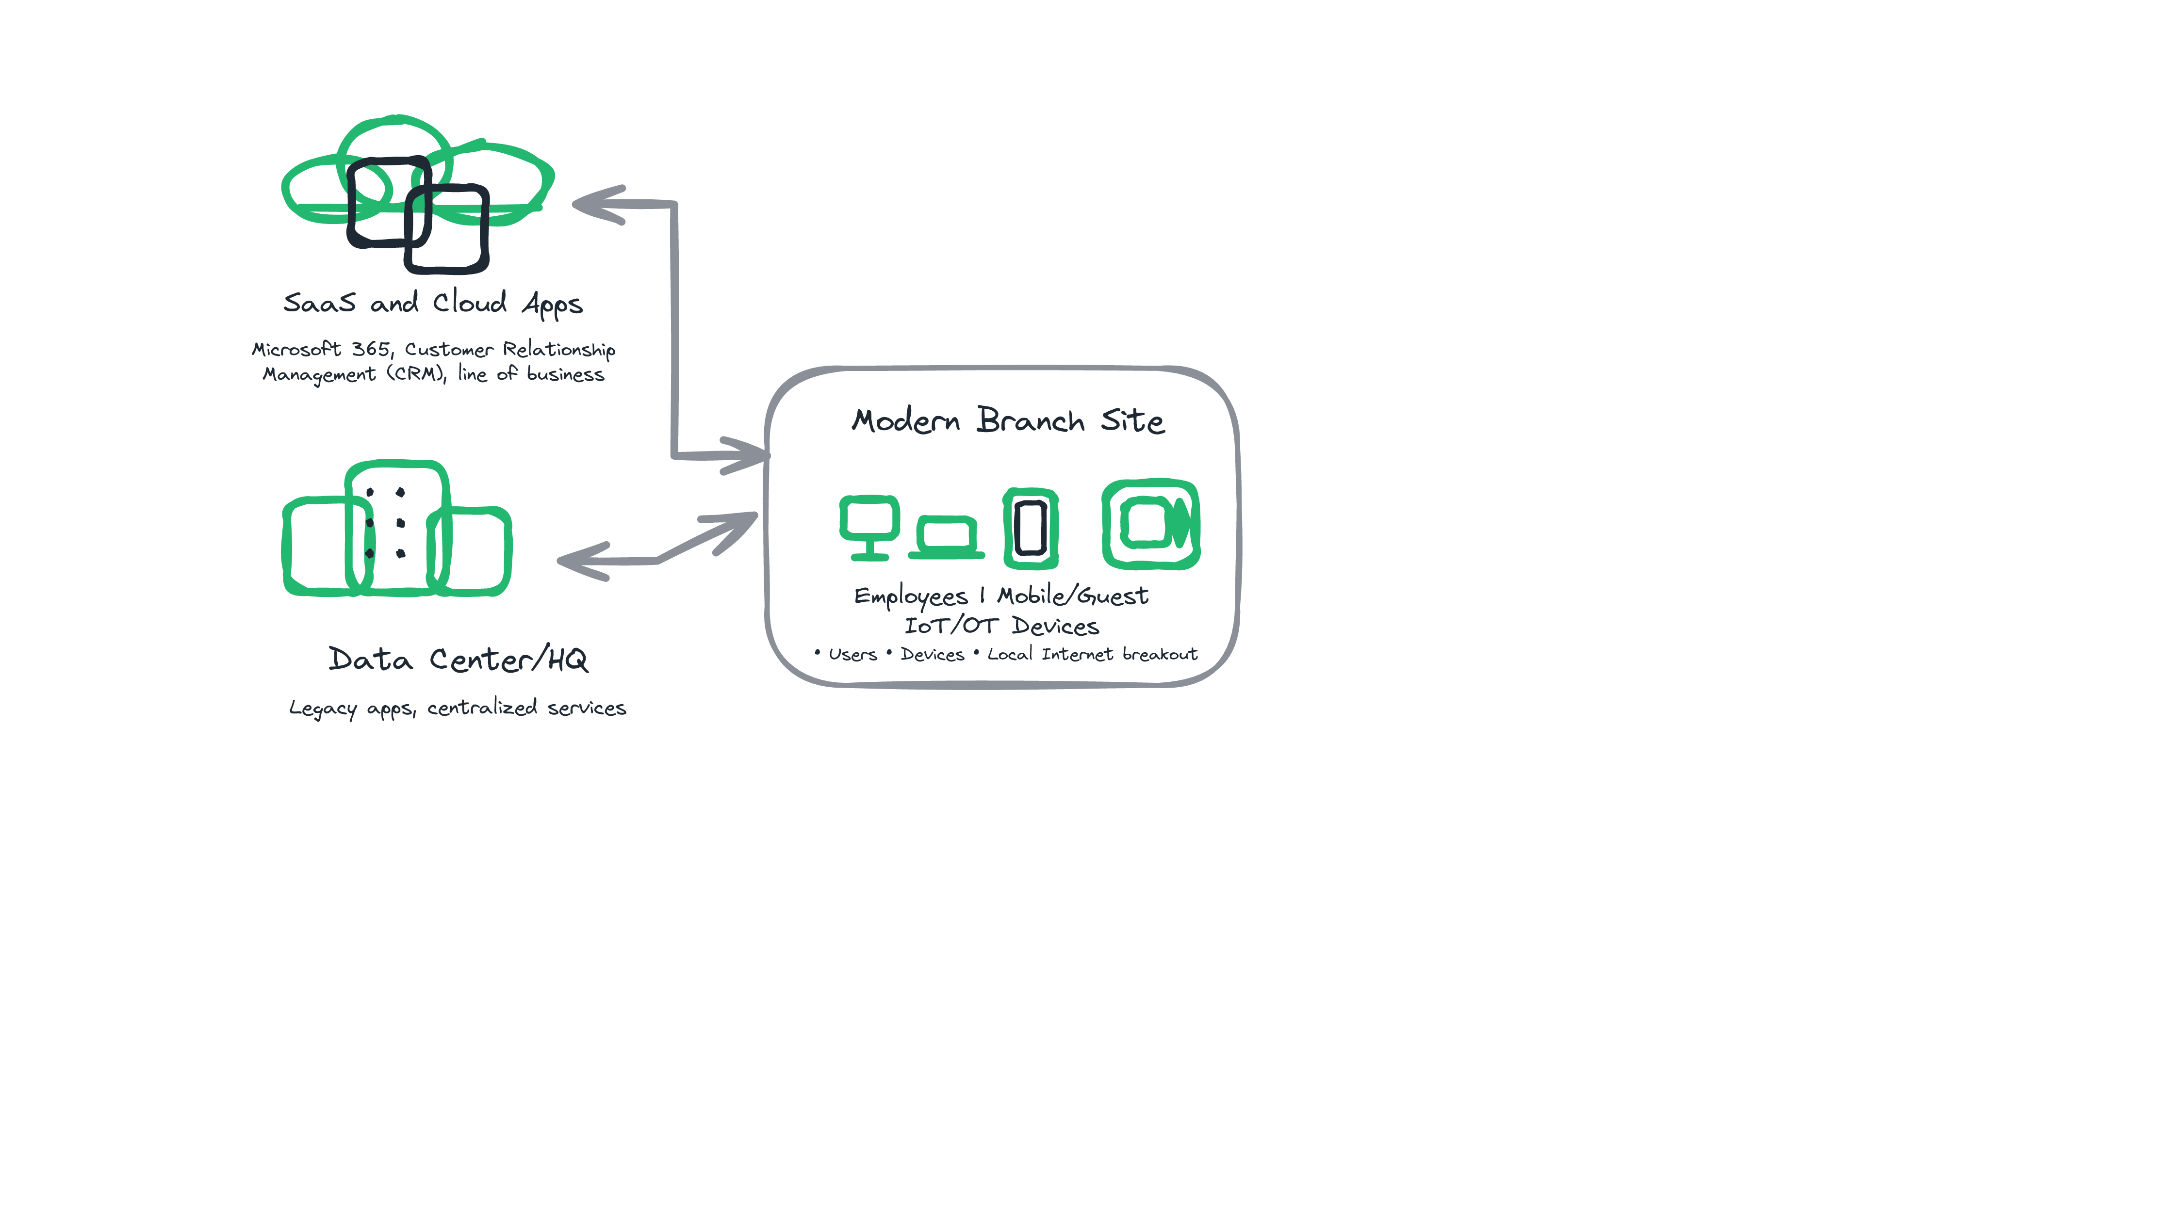
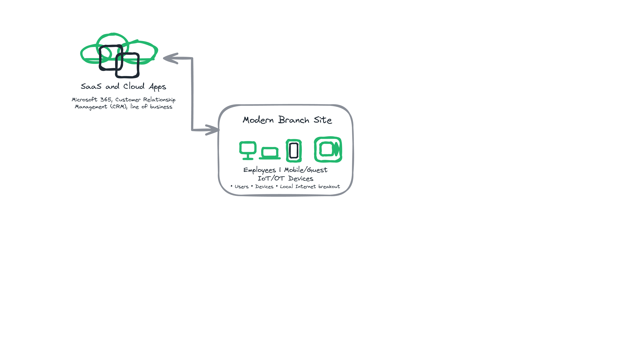
Today / Before

Slide 8
What if you could deliver protocols as a service, like NTP, DNS and/or DHCP?

Slide 9
After
Infoblox Portal
Other Cloud Providers and SD-WAN/SASE Vendors
AWS
SD-WAN/SASE
Vendor A
SD-WAN/SASE
Vendor B
SD-WAN/SASE
Vendor X
Azure
Infoblox
Security
NIOS-X
as a Service
Google's
Cloud WAN
Google
Cloud
Users
Branches and Campus
Data Center
Notes:
Animation idea:

Slide 10
Walnut-sourced NETUK3 version demo
Click to play…

Slide 11
Q&A

